Slide 1

National Law and practice
Chapter 10 – Leasing and Property Management

Slide 2
Leasing and Property Management – Basic Concepts
Property management is a specialty within the real estate profession.
Most states require property managers to hold an active real estate license.
Property managers generally fall into one of three categories:
- Individual Property Manager – manages properties for one or more owners.
- Individual Building Manager – manages a single large property.
- Resident manager (residential properties only) – lives on the property and may
be employed by a real estate broker to be an on-site manager of the property.
Pg. 275

Slide 3
Leasing and Property Management – Basic Concepts
Property managers have a fiduciary relationship with their principal.
Charged with producing the greatest possible net return on the owner’s investment while they safeguard the value of the investment for the owner/investor.
Property managers are usually general agents as they bind lease agreements in the name of their principal ( a limited agent could not do that.)
Pg. 275

Slide 4

Leasing and Property Management – Basic Concepts
Property management services fall into three primary categories:
Financial
Physical
Administrative
Specific function, duties and responsibilities are determined by the management agreement.
Pg. 276

Slide 5
Leasing and Property Management – Basic Concepts
Property management agreements will usually include the following items:
Reporting – Financial reporting to the principal is a fundamental responsibility of the property manager.
Reports may be required monthly, quarterly, and annually.
Annual operating budget, monthly cash flow reports, expenses, net operating income, net cash flow, profit and loss statements are a sample of some of the reports that may be required.
Pg. 276

Slide 6
Leasing and Property Management – Basic Concepts
Budgeting – An operating budget based on expected expenses and revenues is a necessity for management.
The budget determines rental rates, amounts available for capital expenditures, funds needed for reserves, salaries and wages, etc.
Budgets should indicate expected returns based on the previous year’s performance.
Operating statements itemizing income and expenses should be presented to the owner on a regular basis so that the owner can evaluate the manager’s performance against the budget.
Pg. 276

Slide 7
Leasing and Property Management – Basic Concepts
Items that would be reported to the owner might be:
Income – the total of scheduled rents plus revenues from other
sources (vending machines, laundry, etc.)
Expenses – may be fixed (remain constant) or variable
(change from month to month).
Capital Expenditures - expenditures for major items (renovations, major repairs) should be included as a budgeting item.
Cash Reserve – a cash reserve is a fund set aside from operating revenues for variable expenses such as supplies,
Pg. 276

Slide 8
Leasing and Property Management – Basic Concepts
Renting – The property manager’s responsibilities include seeing that the property is properly rented. They will need to perform the following tasks:
Controlling vacancies
Marketing and Advertising the property
Establish and set rents
Select and screen tenants
Collect rents
Maintain tenant relations
Maintain the real property
Handle security deposits (placed in a separate trust account)
Verify adequate insurance coverage
Pg. 277

Slide 9
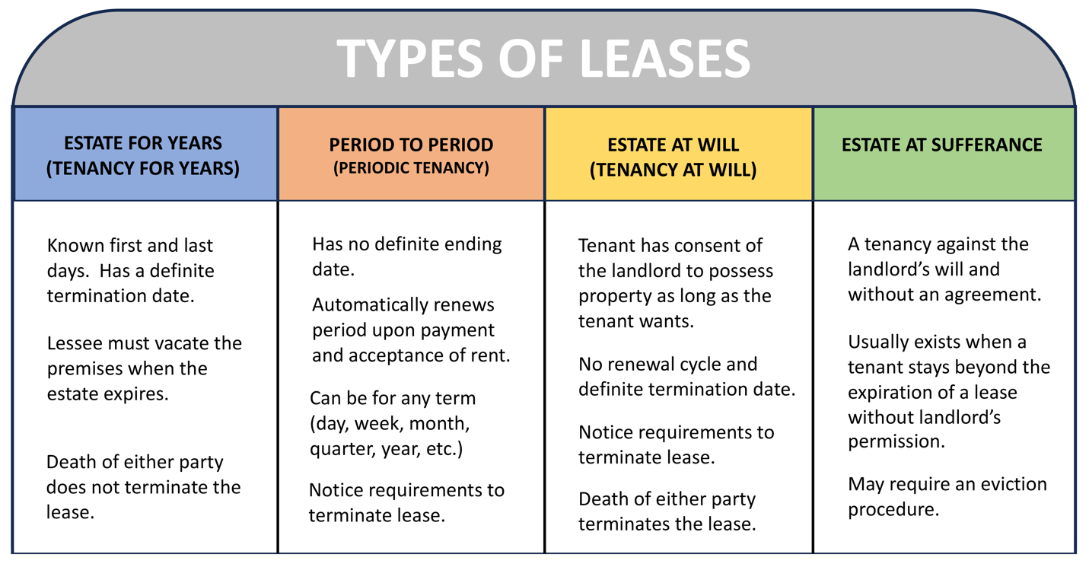
Leasing and Property Management – Understanding leases
Pg. 279

Slide 10
Leasing and Property Management – Understanding leases
Types of Leases:
Estate for Years –
- For definite period (years, months, weeks, days.)
- When the estate expires, the lessee must return the premises to the
lessor and vacate the premises.
- Most commercial leases are an estate for years.
- Death of either party (lessor or lessee) does not terminate the lease.
Pg. 279

Slide 11
Leasing and Property Management – Understanding leases
Types of Leases:
Periodic Tenancy (Estate from period-to-period) –
- An estate from period-to period does not have any definite period.
- Begins as a lease for a definite period but continues after the
expiration of the lease.
- As long as the lessee continues to pay rent at a regular interval, the
lessor accepts it, and no one gives notice to terminate the lease, the
lease from period-to-period continues. (Death does not terminate.)
- Very common with residential properties.
Pg. 279

Slide 12
Leasing and Property Management – Understanding leases
Types of Leases:
Tenancy at Will (Estate at Will)–
- A tenancy at will is similar to the periodic tenancy, except that it does
not begin with a definite period.
- Continues with the consent of the lessor, as long as the tenant pays
rent at regular intervals.
- Terminated by the death of either party.
- Rarely, if ever, used in a written lease.
Pg. 279

Slide 13
Leasing and Property Management – Understanding leases
Types of Leases:
Tenancy at Sufferance (Estate at Sufferance)–
- A tenancy or estate at sufferance comes into existence when a tenant stays beyond the expiration of another type of lease without the lessor’s permission.
Pg. 280

Slide 14
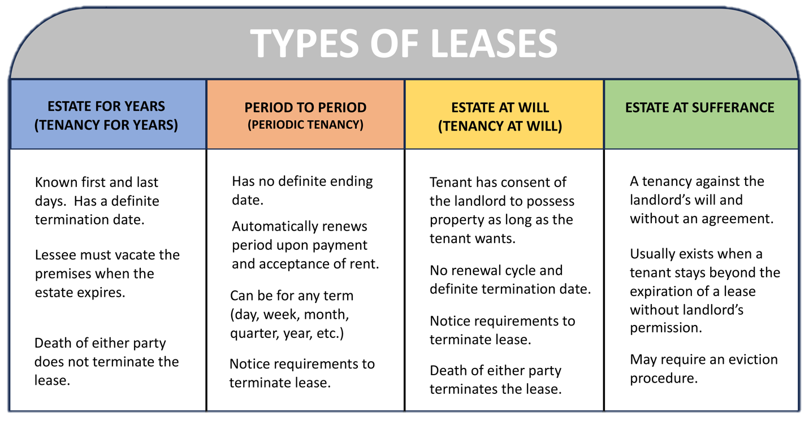
Pg. 279

Slide 15
Leasing and Property Management – Understanding leases
Types of Leases:
Gross Lease–
- Tenant pays an established, fixed rent, and the landlord pays all
property operating expenses, such as taxes, insurance, utilities,
and other services.
- Usually found in residential leases.
Pg. 280

Slide 16
Leasing and Property Management – Understanding leases
Types of Leases:
Net Lease–
- Tenant pays rent plus some or all of the operating expenses
attributable to the rented space.
- Usually found in office and industrial leases.
Pg. 280

Slide 17
Leasing and Property Management – Understanding leases
Types of Leases:
Percentage Lease–
- A percentage lease may be a gross lease or a net lease, but the
rent is not fixed.
- Rent depends on the income generated by the tenant in the
leased property.
- Usually found in retail leases.
Pg. 280

Slide 18
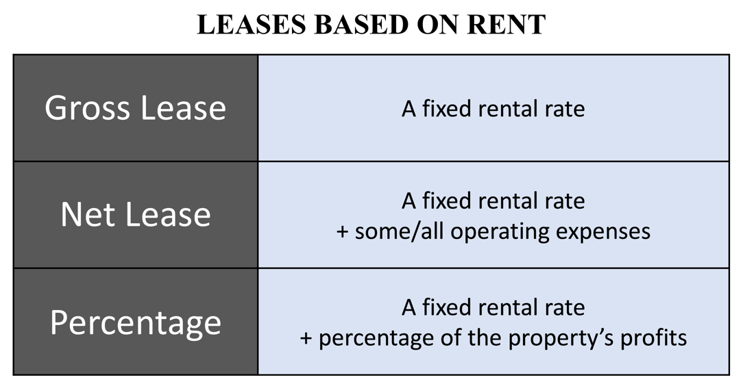
Leasing and Property Management – Understanding leases
Types of Leases:
Pg. 281

Slide 19
Leasing and Property Management – Understanding leases
Types of Leases:
Ground Lease–
- An owner grants a tenant a leasehold interest in land only, in
exchange for rent.
- Utilized for agricultural or mining operations.
- Usually very long-term leases ranging from 30 to 50 years.
Pg. 281

Slide 20
Leasing and Property Management – Understanding leases
Key elements and provisions of lease agreements:
Rent – defines the lease rent amount.
Security Deposit – defines the amount of security deposit, where it will be held and how it can be returned. Cannot be withheld for normal wear and tear.
Lease Term – the start and end date of the lease.
Pg. 281

Slide 21
Leasing and Property Management – Understanding leases
Key elements and provisions of lease agreements:
Repairs and Maintenance – defines the landlord’s and tenant’s respective responsibilities for property repairs and maintenance.
Subletting and Assignment– defines whether the tenant can sublet or assign their lease interest to another individual with or without the landlord’s approval.
Rules and Regulations– the tenant will be obligated to abide by all usage restrictions imposed by the lease’s rules and regulations for the property.
Pg. 282

Slide 22
Leasing and Property Management – Understanding leases
Key elements and provisions of lease agreements:
Improvements and Alterations– defines what, if any, alterations the tenant is allowed to do. Also, will define who owns any improvements made to the property by the tenant.
- Improvements usually belong to the landlord, even if installed by
the tenant.
Pg. 282

Slide 23
Leasing and Property Management – Understanding leases
Key elements and provisions of lease agreements:
Options– defines and clarifies if the tenant has any opportunity to choose a course of action at some time in the future under certain terms.
Damage and Destruction – defines the rights and obligations of the parties in the event, if the leased premises are damaged or destroyed.
Signatures – Indicating acceptance. Remember a lease for less than one year does not need to be in writing to be enforceable under the Statute of Frauds.
Pg. 282

Slide 24
Leasing and Property Management –
Landlord (Lessor) Rights and Responsibilities
Rights:
Retains a right of entry into the premises in order to perform needed repairs and maintenance on a property.
Pg. 283

Slide 25
Leasing and Property Management –
Landlord (Lessor) Rights and Responsibilities
Rights:
The lease and/or the law may specify that a landlord may enter the tenant’s property only under one or more of the following conditions:
- An emergency requires the landlord to enter.
- The tenant gives consent to enter.
- The landlord enters during normal business hours and only after giving notice
to either make repairs or to show the property to prospective tenants,
purchasers or contractors.
- The tenant has abandoned or surrendered the property.
- The landlord has a court order allowing the entry.
Pg. 283

Slide 26
Leasing and Property Management –
Landlord (Lessor) Rights and Responsibilities
Rights:
Landlord has the right to receive prompt payment of rent.
Landlord has the right to expect the tenant to adhere to building rules.
At the end of the term the landlord has the right to retake possession of the premises.
In the case of a tenant breach the landlord has the right to pursue eviction to retake possession.
Pg. 283

Slide 27
Leasing and Property Management –
Landlord (Lessor) Rights and Responsibilities
Responsibilities:
Landlord is expected to deliver a property that is habitable. The landlord should at the very least:
- Keep the heating, cooling, electrical, and plumbing systems in good
working condition.
- Keep floors, stairways and railing safe and in good repair.
- Provide pest control as needed.
- Repair roof leaks and broken windows promptly.
Pg. 283

Slide 28
Leasing and Property Management –
Tenant (Lessee) Rights and Responsibilities
Rights:
Tenant has the right to quiet enjoyment.
Tenant has the right to a habitable residence/building.
Tenant may have other rights if landlord doesn’t perform under the terms of the lease such as:
- moving out without liability for back rent or the unexpired portion of
the lease (constructive eviction).
- referring the problem to mediation, arbitration or small claims court.
Pg. 283

Slide 29
Leasing and Property Management –
Tenant (Lessee) Rights and Responsibilities
Responsibilities:
Pay rent on time.
Follow the rules and regulations set by the landlord.
Give a 30-day notice when terminating a month-to-month lease.
Return all door and mailbox keys when leaving the property.
Leave the unit in as clean a condition as it was at the start of the lease.
Keep the unit clean and sanitary.
Dispose of all trash and other waste in a sanitary manner.
Use and operate all fixtures correctly and safely.
Refrain from damaging or destroying property.
Prevent others from destroying the property.
Use the property only for its intended purposes.
Pg. 284

Slide 30
Leasing and Property Management – Leasing and the Law
Americans with Disabilities Act (ADA)
ADA Title 1 provides that any employer of 15 or more employees must adopt nondiscriminatory employment procedures.
Employers must make reasonable accommodations to enable an individual with a disability to perform essential job functions.
Pg. 284

Slide 31
Leasing and Property Management – Leasing and the Law
Americans with Disabilities Act (ADA)
Property managers must be familiar with ADA Title III
Prohibits discrimination in commercial properties and public accommodations.
Requires that people with disabilities have full and equal access to facilities and services.
Pg. 284

Slide 32
Leasing and Property Management – Leasing and the Law
Americans with Disabilities Act (ADA)
Owners of existing structures are protected from the expense of extensive remodeling.
- The ADA still requires reasonably achievable accommodations to
provide access to the facilities or services.
New construction and remodeling MUST meet higher standards of accessibility and usability.
- It costs less to incorporate accessible features in the design than to
retrofit.
Pg. 285

Slide 33
Leasing and Property Management – Leasing and the Law
Americans with Disabilities Act (ADA)
A property manager is responsible for determining whether a building meets ADA accessibility requirements.
Property managers may need to prepare a plan for retrofitting a building that is not in compliance when removal of existing barriers is achievable and can be performed without much difficulty or expense.
Pg. 285

Slide 34
Leasing and Property Management – Leasing and the Law
Americans with Disabilities Act (ADA)
The following are typical examples of readily achievable modifications:
- Ramping or removing an obstacle from an otherwise accessible
entrance.
- Lowering wall-mounted public telephones.
- Adding raised letters and Braille markings on elevator buttons.
- Installing auditory signals in elevators.
- Reversing the direction in which doors open.
Pg. 285

Slide 35
Leasing and Property Management – Leasing and the Law
Equal Credit Opportunity Act (ECOA)
Prohibits lenders from denying a loan based on a person’s race, color, religion, national origin, sex, marital status, age, or receipt of public assistance.
Pg. 285

Slide 36
Leasing and Property Management – Leasing and the Law
Equal Credit Opportunity Act (ECOA)
ECOA also affects property managers.
- Managers should use the same lease application for every applicant.
- If a manager requests a credit report from one applicant, they should
require a credit report from all applicants.
- The manager should be consistent in evaluating the income and debt of
applicants, and in determining whether to rent to an applicant.
Pg. 285

Slide 37
There is a definite termination date with a periodic tenancy.
1) True
2) False

Slide 38
There is a definite termination date with a periodic tenancy.
1) True
2) False

Slide 39
Which of the following situations describes constructive eviction?
1) A court order expels a tenant because of tenant default.
2) A tenant is forced out of the premises because the landlord
has declared bankruptcy.
3) A tenant vacates the premises and declares the lease canceled
because the landlord has made the premises uninhabitable.
4) A tenant changes the locks overnight and does not allow the
landlord access to the premises.

Slide 40
Which of the following situations describes constructive eviction?
1) A court order expels a tenant because of tenant default.
2) A tenant is forced out of the premises because the landlord
has declared bankruptcy.
3) A tenant vacates the premises and declares the lease canceled
because the landlord has made the premises uninhabitable.
4) A tenant changes the locks overnight and does not allow the
landlord access to the premises.

Slide 41
Which of the following happens when a leased property is sold?
1) The buyer acquires title to subject to the lease.
2) The lease is cancelled.
3) The lease expires within days unless renewed.
4) A new lease is automatically executed.

Slide 42
Which of the following happens when a leased property is sold?
1) The buyer acquires title to subject to the lease.
2) The lease is cancelled.
3) The lease expires within days unless renewed.
4) A new lease is automatically executed.

Slide 43
In accordance with the Statute of Frauds,
1) Leases in excess of one year must be recorded to be
enforceable.
2) Oral leases are not enforceable.
3) A five-year lease must be in writing to be enforceable.
4) An unwritten lease is fraudulent.

Slide 44
In accordance with the Statute of Frauds,
1) Leases in excess of one year must be recorded to be
enforceable.
2) Oral leases are not enforceable.
3) A five-year lease must be in writing to be enforceable.
4) An unwritten lease is fraudulent.

Slide 45
Which of the following is NOT true of periodic tenancies?
1) They have no definite termination date.
2) They continue for successive periods.
3) They require notice of termination.
4) They cannot exceed one year.

Slide 46
Which of the following is NOT true of periodic tenancies?
1) They have no definite termination date.
2) They continue for successive periods.
3) They require notice of termination.
4) They cannot exceed one year.

Slide 47
An assignment of a leasehold interest transfers the interest of the:
1) Tenant.
2) Landlord.
3) Lessor.
4) Assignee.

Slide 48
An assignment of a leasehold interest transfers the interest of the:
1) Tenant.
2) Landlord.
3) Lessor.
4) Assignee.

Slide 49
The parties have a one-year written lease. The expiration date of the lease is May 1. How much notice must the man give the woman to recover possession when the lease expires?
1) 30 days
2) 60 days
3) One week
4) No notice required

Slide 50
The parties have a one-year written lease. The expiration date of the lease is May 1. How much notice must the man give the woman to recover possession when the lease expires?
1) 30 days
2) 60 days
3) One week
4) No notice required

Slide 51
An estate at sufferance is when the lessee has not vacated the property per the lease agreement and continues to have possession of the property beyond the termination/expiration date.
1) True
2) False

Slide 52
An estate at sufferance is when the lessee has not vacated the property per the lease agreement and continues to have possession of the property beyond the termination/expiration date.
1) True
2) False

Slide 53
A man signed a lease for six months. This is an example of a(n)
1) Estate for years.
2) Periodic estate.
3) Tenancy at will.
4) Tenancy at sufferance.

Slide 54
A man signed a lease for six months. This is an example of a(n)
1) Estate for years.
2) Periodic estate.
3) Tenancy at will.
4) Tenancy at sufferance.

Slide 55
If a property’s vacancy rate is significantly lower than market rates, it may be a sign that the manager needs to
1) Lower rental rates.
2) Raise rental rates.
3) Find better tenants.
4) Improve management quality.

Slide 56
If a property’s vacancy rate is significantly lower than market rates, it may be a sign that the manager needs to
1) Lower rental rates.
2) Raise rental rates.
3) Find better tenants.
4) Improve management quality.

Slide 57
What kind of agency is commonly created by a management agreement?
1) Universal
2) Specific
3) General
4) Vicarious

Slide 58
What kind of agency is commonly created by a management agreement?
1) Universal
2) Specific
3) General
4) Vicarious

Slide 59
Which of the following describes a gross lease?
1) The tenant pays a base rent plus some or all of the operating
expenses.
2) The tenant pays a fixed rent, and the landlord pays all
operating expenses.
3) The tenant pays a base rent plus an amount based on income
generated in the leased space.
4) The tenant pays a rent that increases at specified times over
the lease term.

Slide 60
Which of the following describes a gross lease?
1) The tenant pays a base rent plus some or all of the operating
expenses.
2) The tenant pays a fixed rent, and the landlord pays all
operating expenses.
3) The tenant pays a base rent plus an amount based on income
generated in the leased space.
4) The tenant pays a rent that increases at specified times over
the lease term.

