Slide 1


National Law and practice
Chapter 5 – Property Ownership

Slide 2
Property Ownership – Real estate vs. Real Property
Real Estate – Land plus man made improvements.
Real Property – Land, improvements, attachments, and legal rights.
Pg. 101

Slide 3
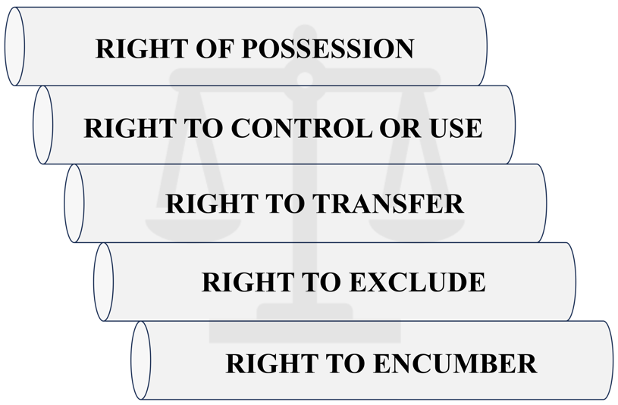
Property Ownership – Real estate vs. Real Property
Bundle of Legal Rights
Right of Possession – the right to occupy.
Right to Control – doing with the property those activities allowed by law.
Right to Transfer – the right to sell, will, or transfer the property.
Pg. 102

Slide 4
Property Ownership – Real estate vs. Real Property
Bundle of Legal Rights
Right to Exclude – the right to keep others from entering or using the property.
Right to Encumber – the right to place liens or provide non- possessory interest in the property to someone else.
Pg. 102

Slide 5
Property Ownership – Deeds
Ownership in real property is evidenced by a Conveyance Deed which documents:
Owners of the property
Type of ownership
Legal description of the property
Other items pertinent to the transfer of title
Pg. 102

Slide 6
Property Ownership – Deeds
An owner must use some form of written deed to transfer title to a new owner.
Grantor (seller) – Owner conveying title.
Grantee (buyer) – Buyer receiving title.
Title passes from the grantor when the signed (only by the Grantor) Deed is delivered and accepted by the Grantee (buyer).
Pg. 102

Slide 7
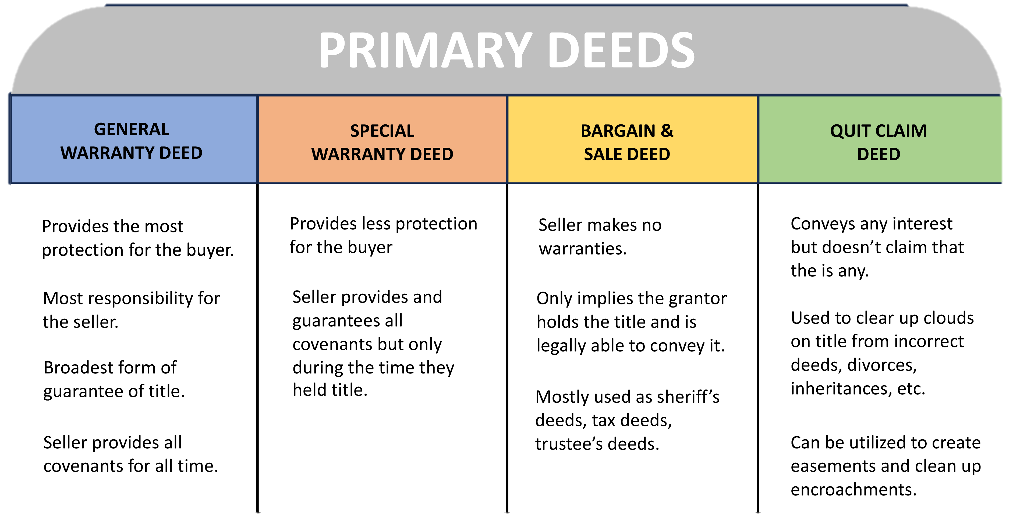
Pg. 103

Slide 8
Property Ownership – Deeds
General Warranty Deed – Grantor provides the greatest protection for the Grantee.
Covenant of Seisin – the grantor owns the property and has the right to convey it.
Covenant Against Encumbrances – the grantor warrants that the property is free from any liens or encumbrances except those specifically stated in the deed.
Pg. 103

Slide 9
Property Ownership – Deeds
General Warranty Deed – Grantor provides the greatest protection for the Grantee.
Covenant of Quiet Enjoyment – the grantor guarantees that the grantee won’t be disturbed by a third-party claiming ownership.
Covenant of Further Assurance – the grantor promises to obtain and deliver any instrument required to make the title good against third party claims in the future.
Pg. 104

Slide 10
Property Ownership – Deeds
General Warranty Deed – Grantor provides the greatest protection for the Grantee.
Covenant of Warranty Forever – the grantor promises to obtain and deliver any instrument required to make the title good against third-party claims, even if those claims originated during a time when the grantor didn’t own the property.
Pg. 104

Slide 11
Property Ownership – Deeds
Special Warranty Deed – Grantor warrants that the property was not encumbered during the time that the grantor held title.
The Covenant of Warranty Forever is removed.
Pg. 104

Slide 12
Property Ownership – Deeds
Bargain and Sale Deed – the grantor warrants that the title is valid.
The grantor may or may not warrant against encumbrances.
The grantor does not promise to defend against any claims
by other parties.
Pg. 104

Slide 13
Property Ownership – Deeds
Quitclaim Deed – contains no warranties or promises.
Used to cure a defect in title (cloud on title).
Pg. 104

Slide 14
Pg. 103

Slide 15
Property Ownership – Deeds
A deed must contain the following essential elements to be valid:
Grantor and Grantee
Consideration
Granting Clause
Description of Real Estate
Signature of grantor (grantee doesn’t need to sign)
Delivery and Acceptance
Pg. 104

Slide 16
Property Ownership – Deeds
Acknowledgement (notarization) provides evidence that the grantor’s signature is valid.
Title is transferred when the executed Deed is delivered and
accepted by the grantee.
A Deed does not need to be recorded to be valid.
Pg. 105

Slide 17
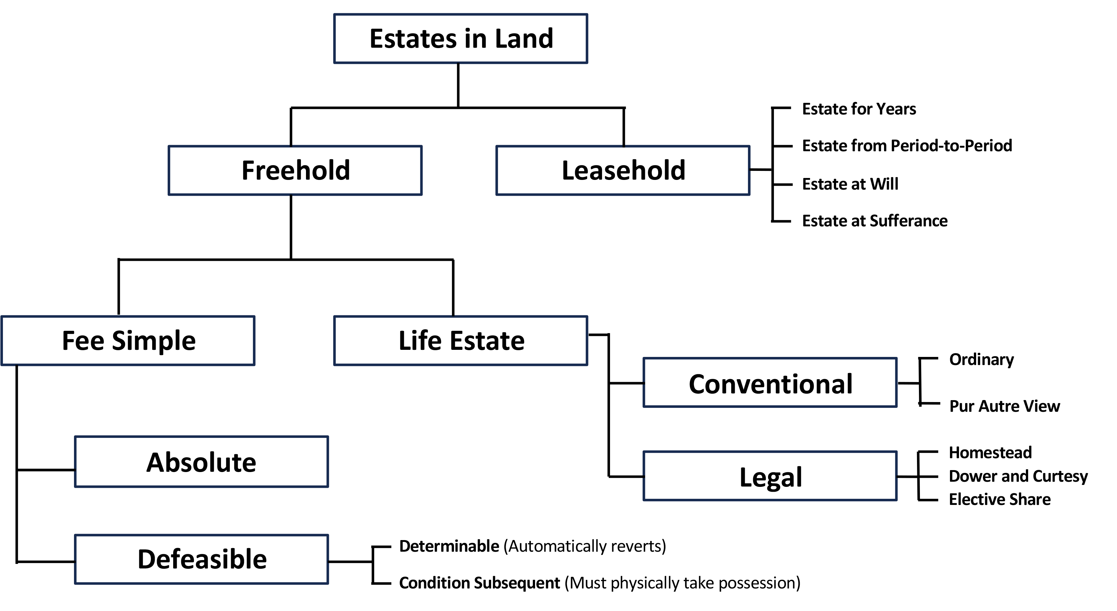
Property Ownership – Ownership Rights
Ownership of any combination of the Bundle of Rights has an interest in the property.
Possessory Interest – right to possess. (Lease, ownership, etc.)
Referred to as an Estate in Land.
Non-Possessory Interest – no right to possess. (Lien, etc.)
Pg. 106

Slide 18
Property Ownership – Ownership Rights
Freehold Estate – ownership for an indeterminable length of time
Fee Simple – Includes all the Bundle of Rights.
Absolute – highest interest in real estate recognized by law.
Entitled to all the rights of the property.
Legal rights can pass to heirs through a will or laws of
descent.
Pg. 107

Slide 20
Property Ownership – Ownership Rights
Freehold Estate – ownership for an indeterminable length of time
Defeasible – owner’s interest is subject to the occurrence or
non-occurrence of an event.
Determinable – rights automatically revert to the grantor or grantor’s
heirs upon an event occurring. The grantor does not need to
physically take possession of the property.
Pg. 107

Slide 21
Property Ownership – Ownership Rights
Freehold Estate – ownership for an indeterminable length of time
Defeasible – owner’s interest is subject to the occurrence or
non-occurrence of an event.
Condition Subsequent – the owner might have the right to reclaim the property if a non-allowed event occurred.
Requires a court action, and the Grantor would have to physically re-possess the property.
Pg. 107

Slide 23
Property Ownership – Ownership Rights
Life Estate
Conventional Life Estate – ownership that is not inheritable.
Life tenant owns the property for the duration of the measuring life.
Remainderman – person to whom the property will pass when the life
estate ends.
Reversionary interest – ownership returns to the original owner or heirs
at the end of the life estate.
Pur Autre Vie (For the Life of Another) – a life estate based on the
lifetime of a person other than the Life Tenant.
Pg. 107

Slide 25
Property Ownership – Ownership Rights
Life Estate
Legal Life Estate – designed to protect family survivors.
Dower – the right a widow has in property owned by her husband.
Curtsey – the right a widower has in property owned by his wife.
Elective Share – allows a surviving spouse to make a claim upon their
deceased spouse’s real and personal property, even if not named in
the will.
Homestead – protects the “family home” from general creditors
attempting to collect on debts.
Pg. 108

Slide 27
Property Ownership – TYPES OF OWNERSHIP
Individual Ownership
Tenancy in Severalty (Estate in Severalty) – Owned by a single person or a single entity.
Pg. 109

Slide 28
Property Ownership – TYPES OF OWNERSHIP
Individual Ownership
Trust – Transferring ownership of property to another to hold and/or manage for the benefit of a third party.
Trustor – creates the Trust
Trustee – manages the Trust on behalf of the Trustor
Beneficiary – those that benefit from the Trust.
Pg. 109

Slide 29
Property Ownership – TYPES OF OWNERSHIP
Individual Ownership
Living Trust – created during the lifetime of the Trustor.
Testamentary Trust – created by will upon the death of a Trustor.
Pg. 109

Slide 30
Property Ownership – TYPES OF OWNERSHIP
Individual Ownership
General Partnership – two or more people carry on a business venture as co-owners.
General partners are entitled to participate in the
management of the business.
General Partnership dissolves if a General Partner dies,
withdraws or partnership goes bankrupt.
Pg. 109

Slide 31
Property Ownership – TYPES OF OWNERSHIP
Individual Ownership
Limited Partnership
2 types of partners:
General Partners – responsible for the partnership’s
operation.
Limited Partners – responsible for expenses and
debts, and have no voice in the partnership.
Pg. 109

Slide 32
Property Ownership – TYPES OF OWNERSHIP
Individual Ownership
Corporations –
Considered an artificial person.
Made up of people who own stock in the company.
Run by a board of directors.
A corporation exists until it is formally dissolved.
Would require corporate authorization for someone to
contract in the name of the corporation.
Pg. 110

Slide 33
Property Ownership – TYPES OF OWNERSHIP
Individual Ownership
Limited Liability Company (LLC) –
Combines attributes of both corporations and
partnerships.
Tax advantages of a partnership.
Limited liability like a corporation.
Would require a duly authorized individual to contract
on behalf of the LLC.
Pg. 110

Slide 34
Property Ownership – TYPES OF OWNERSHIP
Concurrent Ownership – When more than one person concurrently owns a property.
Tenants in Common
Undivided interests
Unequal ownership shares possible
No right of survivorship. Ownership passes by will or laws
of decent.
Interest can be conveyed to an outside party without
permission of other Tenants in Common.
Pg. 110

Slide 35
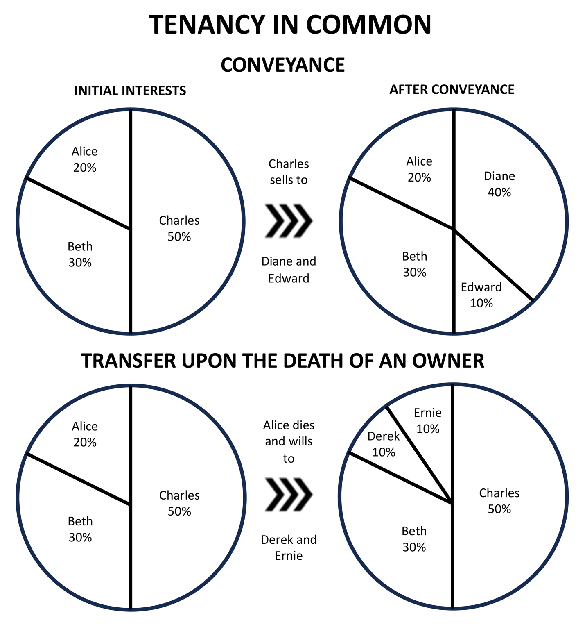
Pg. 111

Slide 36
Property Ownership – TYPES OF OWNERSHIP
Concurrent Ownership – When more than one person concurrently owns a property.
Joint Tenancy
Equal Undivided interests
Equal ownership shares
Right of Survivorship
Can sell interests to a non-co-owner as a Tenant in Common
Pg. 112

Slide 37
Property Ownership – TYPES OF OWNERSHIP
Concurrent Ownership – When more than one person concurrently owns a property.
Joint Tenancy
Four unities required: (P.I.T.T.)
Possession – equal possessory rights.
Interest – equal ownership share.
Title – created on the same document (Deed)
Time – created at the same time.
Pg. 112

Slide 38
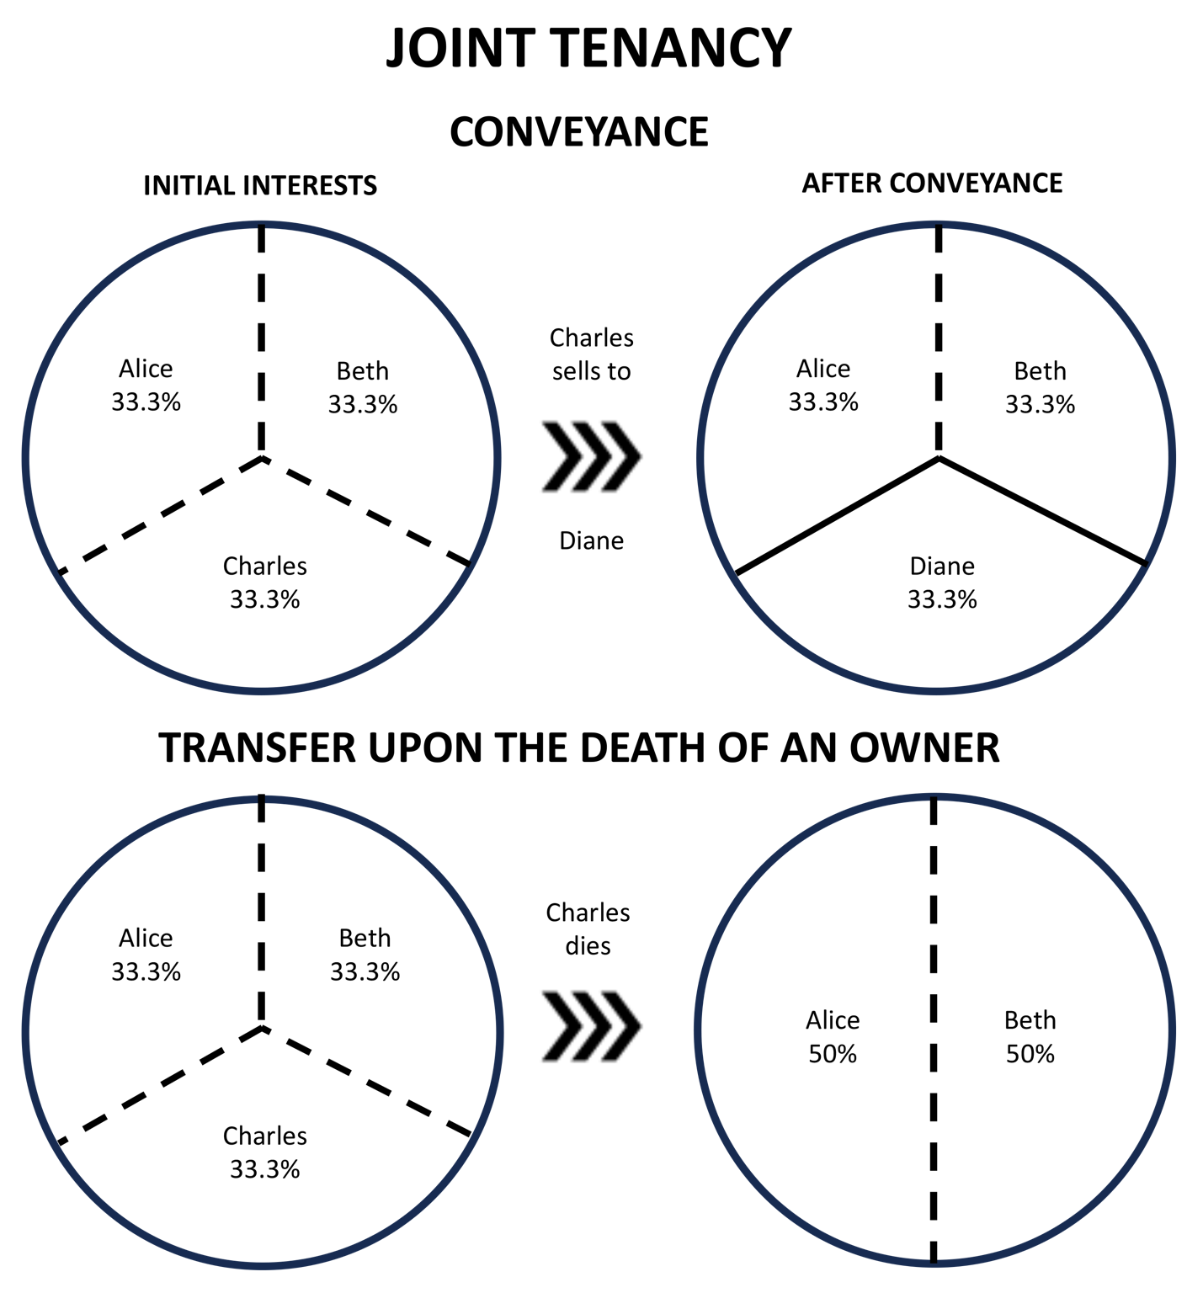
Pg. 113

Slide 39
Property Ownership – TYPES OF OWNERSHIP
Concurrent Ownership – When more than one person concurrently owns a property.
Tenancy by the Entireties
Same condition as Joint Tenancy but includes requirement of
marriage.
Spouses cannot act alone to sell the property.
Pg. 113

Slide 40
Property Ownership – TYPES OF OWNERSHIP
Concurrent Ownership – When more than one person concurrently owns a property.
Community Property
Separate Property – real and personal property acquired before a marriage
or by gift or inheritance.
Community Property – all other property earned or acquired during the marriage.
Pg. 114

Slide 41
Property Ownership – TYPES OF OWNERSHIP
Concurrent Ownership – When more than one person concurrently owns a property.
Community Property
Upon death of one spouse, the surviving spouse automatically owns one-half of
the community property. The deceased spouse’ share is passed on to their heirs.
There is no automatic right of survivorship.
Pg. 114

Slide 42
Property Ownership – COMMON INTEREST OWNERSHIP PROPERTIES
Condominiums – residential, commercial, or industrial units which allow for multiple owners in a larger building.
Owner owns a fee simple title to air rights in a specific unit and an undivided interest in common areas as a Tenant in Common.
Default by the owner on their loan does not affect the other owners.
Pg. 114

Slide 43
Property Ownership – COMMON INTEREST OWNERSHIP PROPERTIES
Condominiums – residential, commercial, or industrial units which allow for multiple owners in a larger building.
Condominium developer must file a Declaration with the county for the condominium project. This would include by-laws and restrictive covenants, survey and architectural drawings.
HOA (Homeowners Association) carry out administrative functions. Can collect owner’s fees and can levy fines or implement foreclosure for non-payment of fees.
Pg. 114

Slide 44
Property Ownership – COMMON INTEREST OWNERSHIP PROPERTIES
Cooperatives – corporation holds title to the property.
Individuals purchase stock in the corporation.
Receive a proprietary long-term lease to a particular unit.
Shareholder agrees to pay a proportionate share of expenses for
maintenance, taxes, insurance, debt service, etc.
Licensees must have Securities license to broker cooperatives.
Pg. 115

Slide 45
Property Ownership – COMMON INTEREST OWNERSHIP PROPERTIES
Time-Share – multiple owners enjoy the use of a single piece of
property.
For a specified period of time. Known as fractional ownership.
Typical in resort or vacation locations.
Each owner responsible for their share of property expenses.
Pg. 115

Slide 46
Property Ownership – ENCUMBRANCES
Encumbrance – an interest another entity has in a property that does not contain a possessory right.
Liens:
Legal Title – full ownership of property.
Equitable Title – a right to obtain full ownership.
Lien Theory State – lender places a lien on the property.
Title Theory State – lender has legal title until the borrower satisfies
the terms of the loan.
Pg. 115

Slide 47
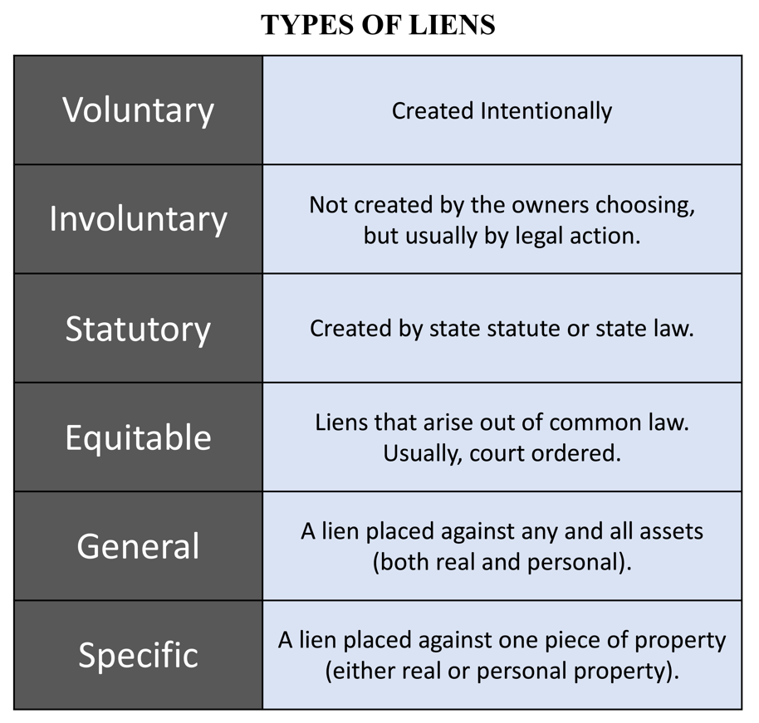
Liens can be described as:
Pg. 116

Slide 48
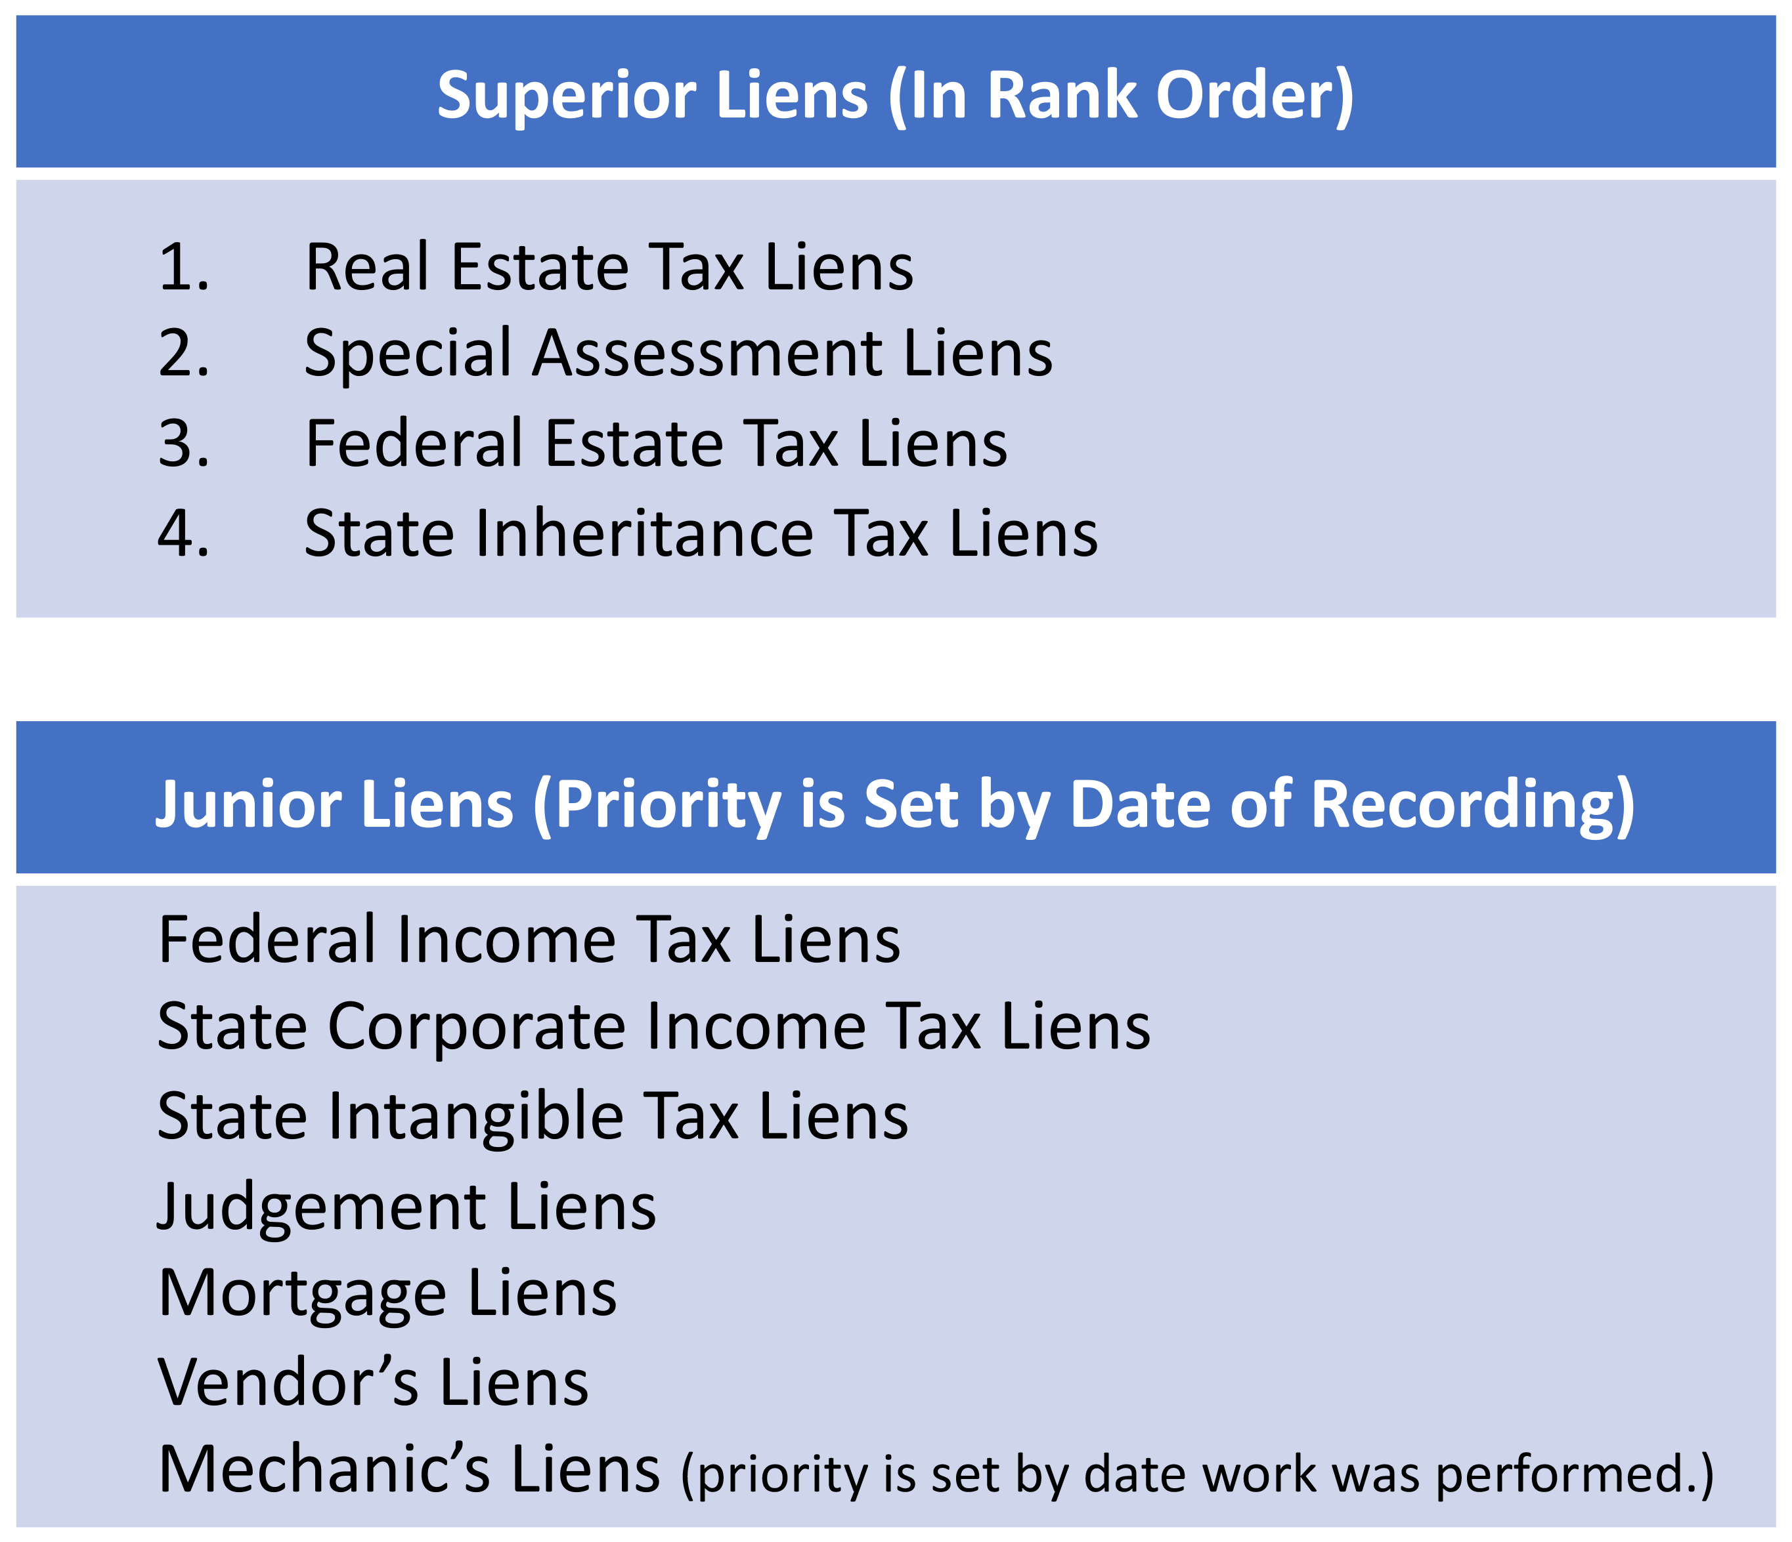
Property Ownership – ENCUMBRANCES
Lien Priority – order with which liens are paid off when the asset is sold or foreclosed upon.
Superior Liens – paid first.
Junior Liens – paid based on the date of recording of the lien.
Mechanic’s Liens – priority established as of either the date the work was started or when materials were first furnished.
Pg. 117

Slide 49
Property Ownership – ENCUMBRANCES
A home is foreclosed on for non-payment of a mortgage lien that was recorded in 2010 for $225,000 with a balance remaining of $160,000. A second mortgage was recorded in 2015 with a balance due of $25,000 and a mechanic’s lien for $11,000 was recorded in 2016. An unpaid real estate tax lien was recorded this year for $2,450. The house sells for $350,000. In what order will the liens be paid?
Tax Lien - $2,450
1st Mortgage - $160,000
2nd Mortgage - $25,000
Mechanics Lien - $11,000
Balance Due to the Homeowner: $151,550
Pg. 118

Slide 50
Property Ownership – ENCUMBRANCES
Easements – providing a right to use land for a particular purpose.
Written agreements that should be recorded.
Easement Appurtenant – allows use of an adjoining parcel owned by another.
Dominant Tenement – has the right to use the other person’s land.
Servient Tenement – provides the easement to the dominant tenement.
Easement runs with the land and transfers with title if the property sells.
Party wall easements – (condominiums, shared walls, etc.) – parties share ½ of a common wall and agree to not damage or destroy the wall they both share.
Easement by Necessity – granted by the court to landlocked owners.
Pg. 118

Slide 51
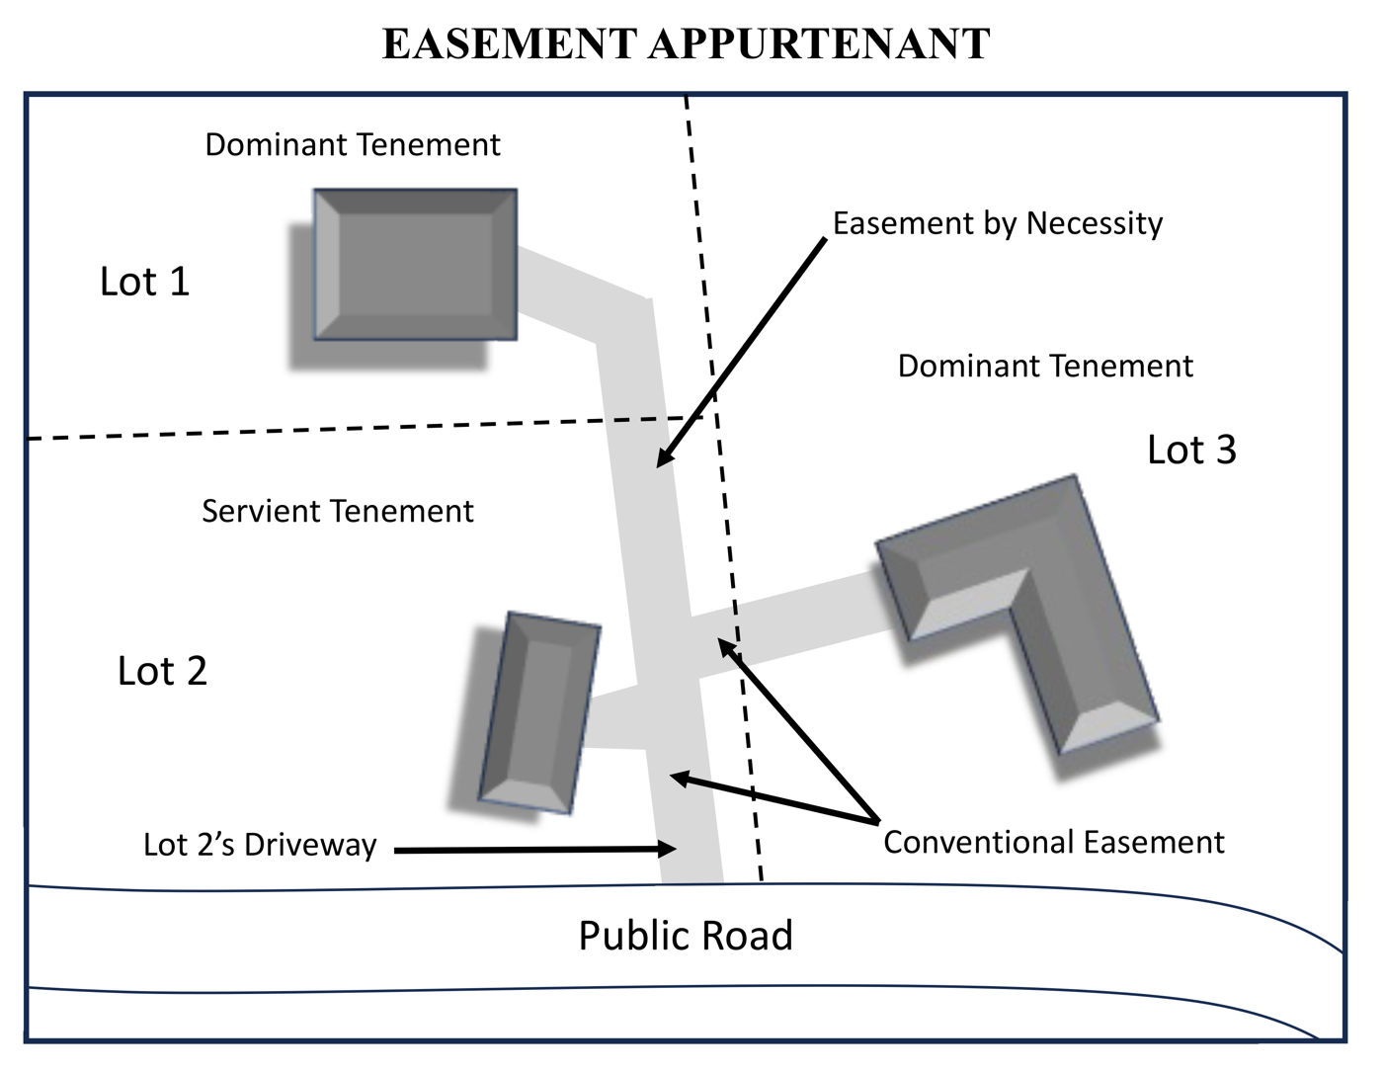
Pg. 119

Slide 52
Property Ownership – ENCUMBRANCES
Easements – providing a right to use land for a particular purpose.
Easement in Gross – only affects one parcel of land.
Commercial – transferrable and does not terminate on the passing of
the grantor or grantee.
Personal – not transferable and ends upon the death of the easement
holder (grantee).
Pg. 120

Slide 53
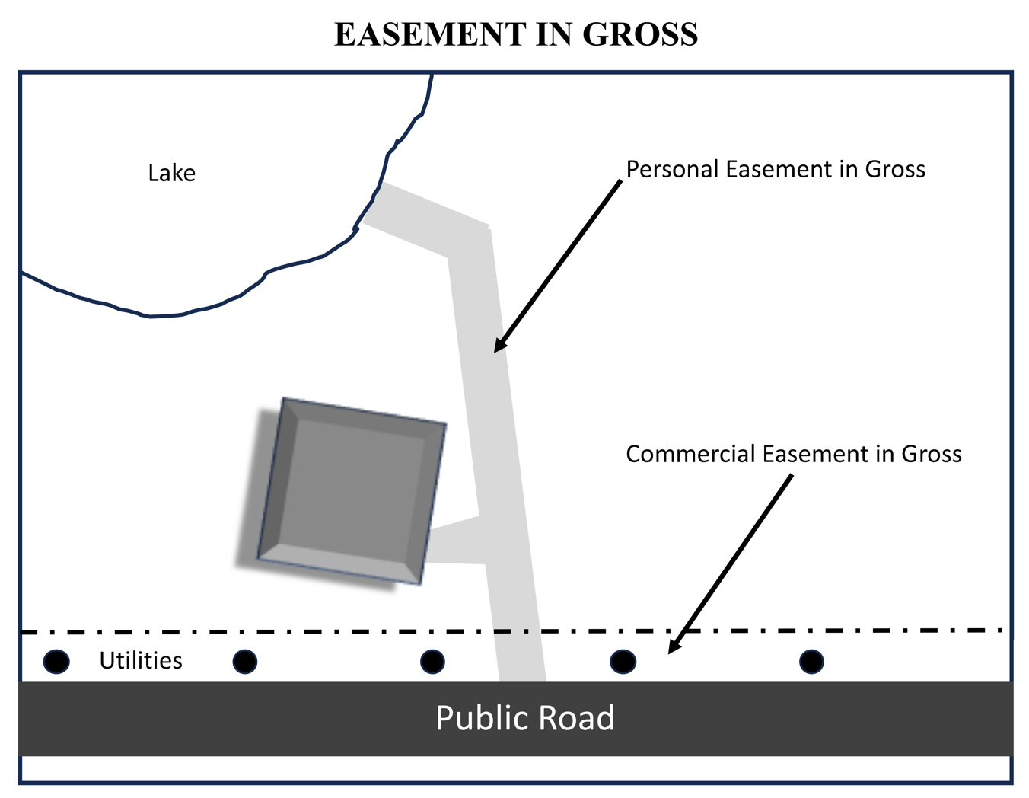
Pg. 120

Slide 54
Property Ownership – ENCUMBRANCES
Easements – providing a right to use land for a particular purpose.
Easement by Prescription – the user of someone else’s land legally obtains an easement right. It would require:
O pen Use (readily visible)
C ontinuous (some states require up to 18 years / can be multiple parties)
E xclusive (the adverse possessor does not share control of the property
with anyone else)
A dverse (it is adverse to the owners ownership rights)
N otorious (the parties using the property know it is not their property)
License – a revokable, non-transferrable right to use a property.
Pg. 120

Slide 55
Property Ownership – ENCUMBRANCES
Encroachments – when a neighboring parcel allows a building, fence, driveway, etc. to cross over the boundary line illegally.
Long term encroachments may qualify for an Easement by Prescription.
Can be corrected by drafting an easement.
Usually identified through a survey or an Improvement Location Certificate
Pg. 121

Slide 56
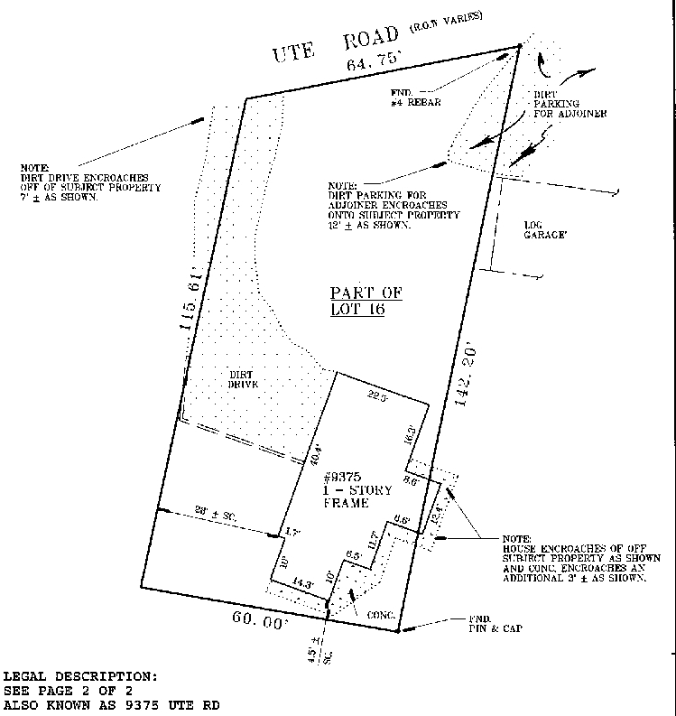
Pg. 121

Slide 57
Property Ownership – ENCUMBRANCES
Alienation – an owner separating from their real estate.
Voluntary – where the owner chooses to sell the property, give it to someone, or will it to someone when they die.
Involuntary – the owner loses their property against their wishes.
Eminent Domain
Adverse Possession
Foreclosure
Pg. 122

Slide 58
Property Ownership – ENCUMBRANCES
Adverse Possession – A legal principle that grants title to someone who resides on or is in possession of another person’s land.
The Adverse Possessor must prove:
Open use
Continuous use
Exclusive use
Adverse use
Notorious use
Pg. 122

Slide 59
A life estate must have a Pur Autre Vie.
1) True
2) False

Slide 60
A life estate must have a Pur Autre Vie.
1) True
2) False

Slide 61
Homestead, dower and curtesy, and elective share are examples of
1) A conventional life estate.
2) A legal life estate.
3) An estate created by an owner’s agreement.
4) A fee simple absolute.

Slide 62
Homestead, dower and curtesy, and elective share are examples of
1) A conventional life estate.
2) A legal life estate.
3) An estate created by an owner’s agreement.
4) A fee simple absolute.

Slide 63
The highest form of ownership interest one can acquire in real estate is the
1) Dower and curtesy.
2) Conventional life estate.
3) Defeasible fee simple estate.
4) Absolute fee simple estate.

Slide 64
The highest form of ownership interest one can acquire in real estate is the
1) Dower and curtesy.
2) Conventional life estate.
3) Defeasible fee simple estate.
4) Absolute fee simple estate.

Slide 65
Which of the following cannot take title as a joint tenant with right of survivorship?
1) Wife and husband.
2) Two female business partners
3) Two brothers in partnership
4) A corporation

Slide 66
Which of the following cannot take title as a joint tenant with right of survivorship?
1) Wife and husband
2) Two female business partners
3) Two brothers in partnership
4) A corporation

Slide 67
In February, a seller conveyed an undivided one-half interest in a parcel of land to a woman. In March, the seller conveyed the remaining one-half interest to a man. The deed to the man included the following statement. “This man is to be a joint tenant with the woman.” Both deeds were recorded. Based on these facts, which of the following is TRUE?
1) The man and woman hold title to the land as joint tenants.
2) The man and the woman own the land by partition.
3) The man and woman are tenants in common.
4) The man owns the land as a joint tenant, the woman owns the land as a tenant in common.

Slide 68
In February, a seller conveyed an undivided one-half interest in a parcel of land to a woman. In March, the seller conveyed the remaining one-half interest to a man. The deed to the man included the following statement. “This man is to be a joint tenant with the woman.” Both deeds were recorded. Based on these facts, which of the following is TRUE?
1) The man and woman hold title to the land as joint tenants.
2) The man and the woman own the land by partition.
3) The man and woman are tenants in common.
4) The man owns the land as a joint tenant, the woman owns the land as a tenant in common.

Slide 69
You purchased the right to live in an apartment in a resort for the 32nd complete week of each calendar year for the next 30 years. The type of interest you have is called a(n)
1) Joint tenancy
2) Time-share estate
3) Tenancy in common
4) Estate for Years.

Slide 70
You purchased the right to live in an apartment in a resort for the 32nd complete week of each calendar year for the next 30 years. The type of interest you have is called a(n)
1) Joint tenancy
2) Time-share estate
3) Tenancy in common
4) Estate for Years.

Slide 71
An easement in gross has a dominant tenement and a servient tenement.
1) True
2) False

Slide 72
An easement in gross has a dominant tenement and a servient tenement.
1) True
2) False

Slide 73
A woman built a fence that extended beyond the boundary of her property onto her neighbor’s property. This is an example of
1) laches
2) An easement by necessity
3) An encroachment
4) An appurtenant easement

Slide 74
A woman built a fence that extended beyond the boundary of her property onto her neighbor’s property. This is an example of
1) laches
2) An easement by necessity
3) An encroachment
4) An appurtenant easement

Slide 75
A homeowner employed a contractor to build a swimming pool on his property. Upon completion of the swimming pool, the contractor filed a lien to receive payment of the contract fee. Such filing could be considered any of the following EXCEPT
1) A specific lien.
2) An encumbrance.
3) A general lien.
4) A mechanic’s lien.

Slide 76
A homeowner employed a contractor to build a swimming pool on his property. Upon completion of the swimming pool, the contractor filed a lien to receive payment of the contract fee. Such filing could be considered any of the following EXCEPT
1) A specific lien.
2) An encumbrance.
3) A general lien.
4) A mechanic’s lien.

Slide 77
Which of the following is defined as a claim, charge or liability that attaches to real estate?
1) Lien
2) Easement
3) Deed restriction
4) Encumbrance

Slide 78
Which of the following is defined as a claim, charge or liability that attaches to real estate?
1) Lien
2) Easement
3) Deed restriction
4) Encumbrance

Slide 79
All of the following liens must be recorded to be effective EXCEPT
1) Money judgment.
2) Mechanic’s lien.
3) Real estate tax lien.
4) Voluntary lien.

Slide 80
All of the following liens must be recorded to be effective EXCEPT
1) Money judgment.
2) Mechanic’s lien.
3) Real estate tax lien.
4) Voluntary lien.

