Slide 1


Slide 2

Colorado Closings and Settlement
Chapter 24
Cash Transaction Closings

Slide 3


Selling Price
$142,000

Slide 4
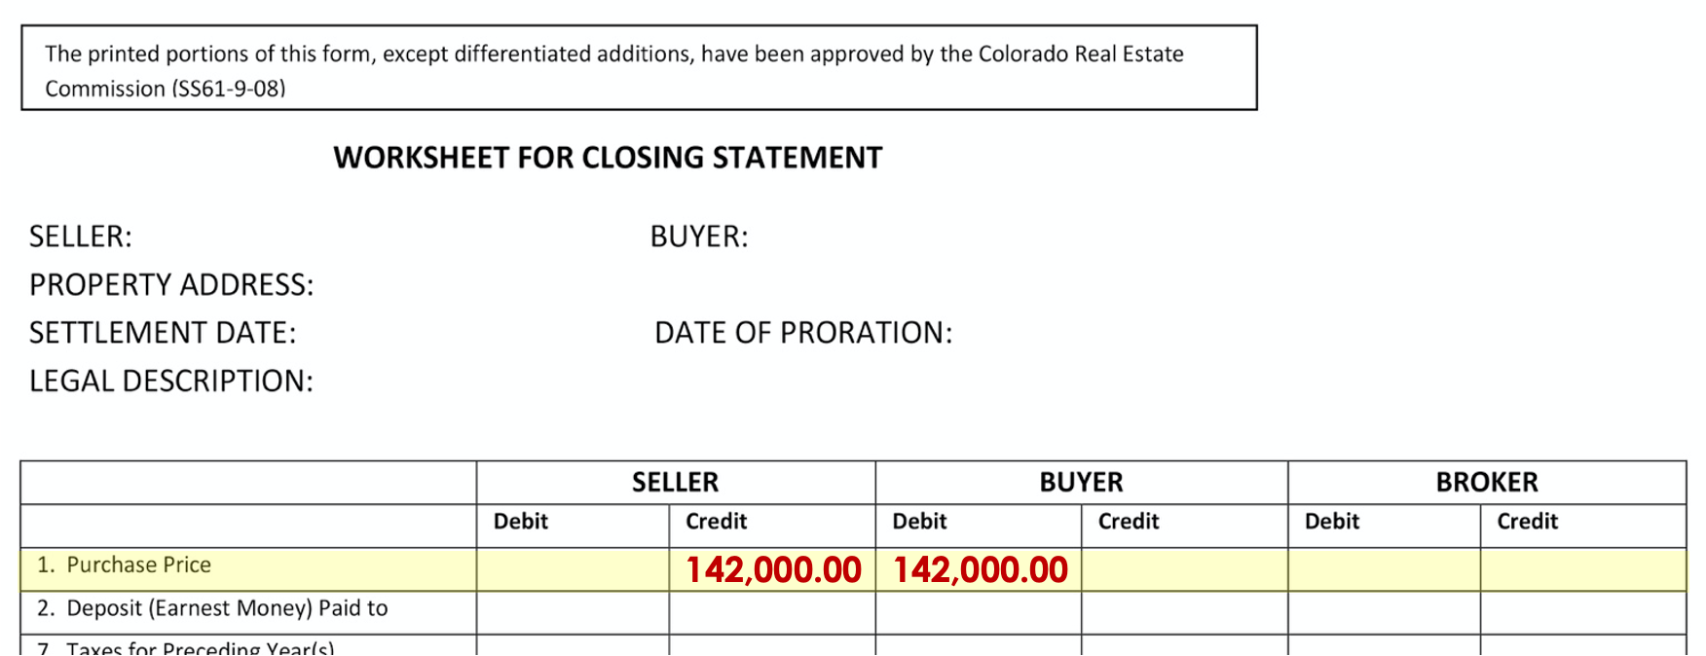
Line 1
Credit Seller / Debit Buyer
$142,000.00

Slide 5
Deposit Paid to Broker
$1,800

Slide 6
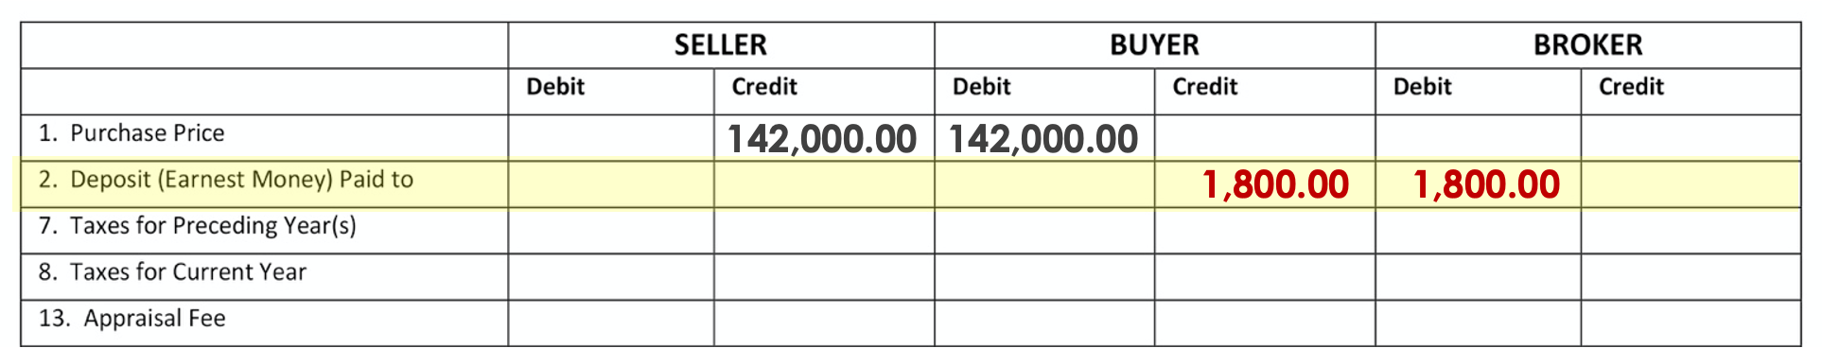
Line 2
Credit Buyer/ Debit Broker
$1,800.00

Slide 7
Title Insurance Premium
$764

Slide 8
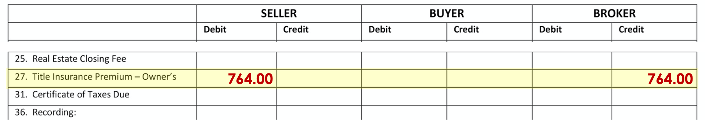
Line 27
Debit Seller/ Credit Broker
$764.00

Slide 9
Title Examination
$160

Slide 10
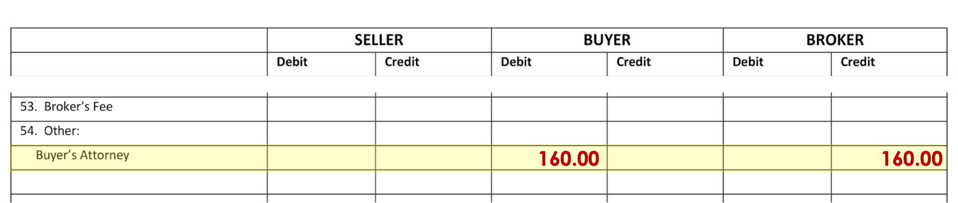
Line 54 - Buyer's Atty
Debit Buyer/ Credit Broker
$160.00

Slide 11
Warranty Deed
$6

Slide 12
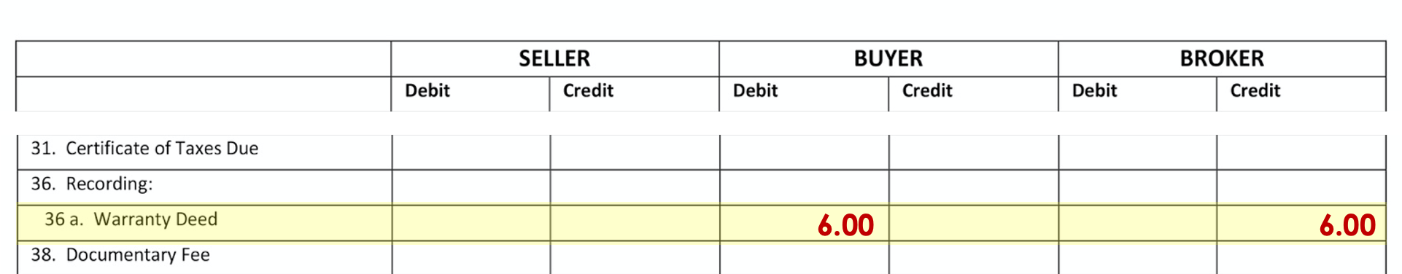
Line 36a
Debit Buyer/ Credit Broker
$6.00

Slide 13
Doc Fee
$ ???

Slide 14

$142,000 x 0.0001 =
$14.20
or
142,000.00 = 14.20

Slide 15
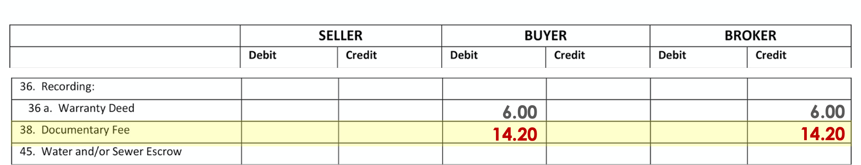
Line 38
Debit Buyer/ Credit Broker
$14.20

Slide 16
Certificate of Taxes Due
$15

Slide 17
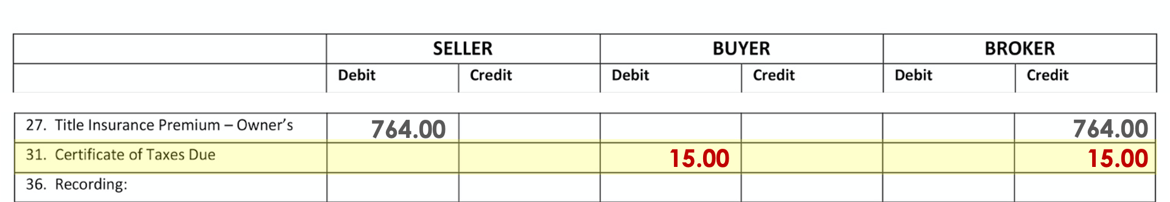
Line 31
Debit Buyer/ Credit Broker
$15.00

Slide 18
Last Year’s Taxes
$1,366
(PAID)

Slide 19
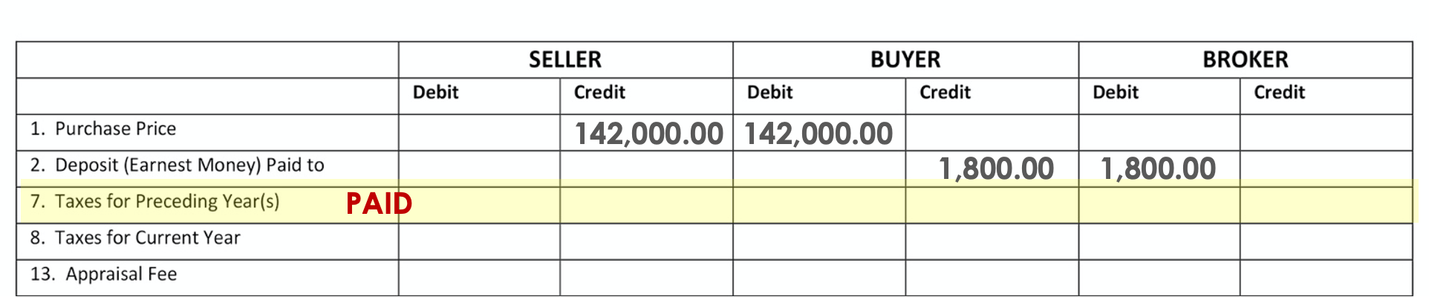
Line 7
PAID

Slide 20
Current Year’s Taxes
$ ???

Slide 21
What’s the Date of Closing?
July 1
Who are we going to Debit?
Seller
How many days has
Seller owned:
Jan – 31
Feb – 29 (Leap year)
Mar – 31
Apr – 30
May – 31
June - 30
182

Slide 22
What’s the Date of Closing?
July 1
Who are we going to Debit?
Seller
How many days has
Seller owned:
182
$1,366 ÷ 366 x 182 =
$679.27

Slide 23
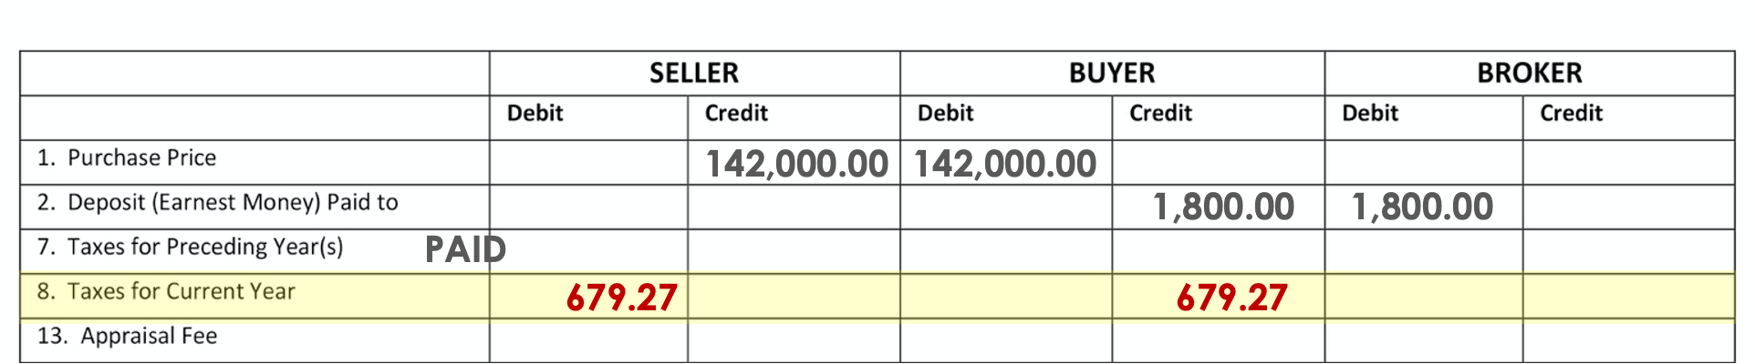
Line 8
Debit Seller/ Credit Buyer
$679.27

Slide 24
Appraisal Fee
$500

Slide 25
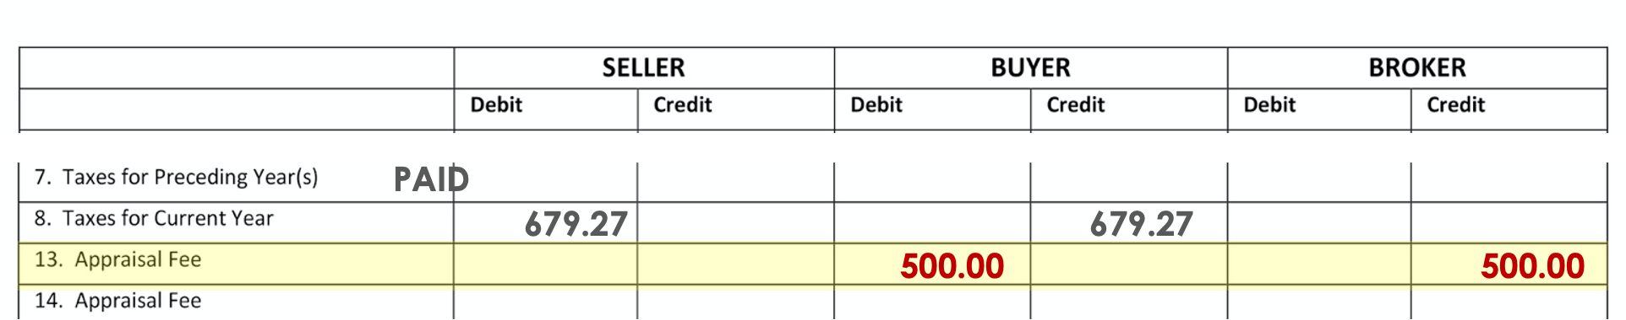
Line 13
Debit Buyer/ Credit Broker
$500.00

Slide 26
Closing Fee
(split 50/50)
$200

Slide 27
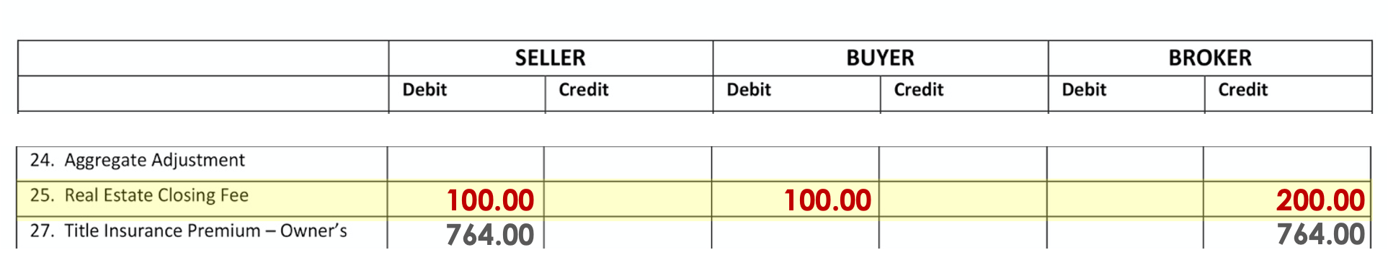
Line 25
Debit Seller/ Debit Buyer/ Credit Broker
$100.00 / $100.00 / $200.00

Slide 28
Water/Sewer Bill
$ ???

Slide 29
What’s the Date of Closing?
July 1
Who are we going to Debit?
Buyer
How many days in the period:
June – 30
July – 31
Aug – 31
92

Slide 30
What’s the Date of Closing?
May 10
Who are we going to Debit?
Buyer – Paid in Advance
How many days in the period:
92
How many days are we collecting for:
July – 31
Aug – 31
62

Slide 31
What’s the Date of Closing?
May 10
Who are we going to Debit?
Buyer – Paid in Advance
How many days in the period:
92
How many days are we collecting for:
62
$23 ÷ 92 x 62 =
$15.50

Slide 32
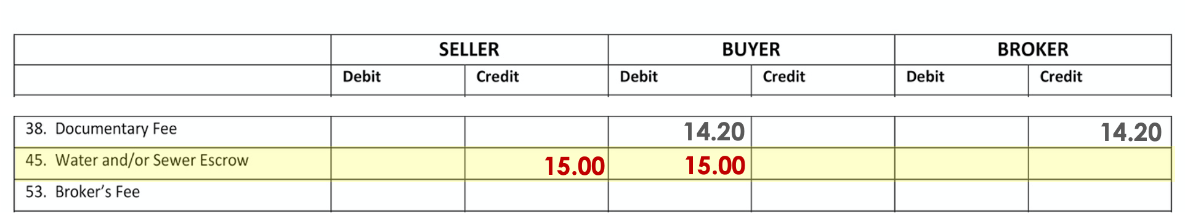
Line 45
Credit Seller/ Debit Buyer
$15.00

Slide 33
Broker’s Fee 6%
$8,520

Slide 34
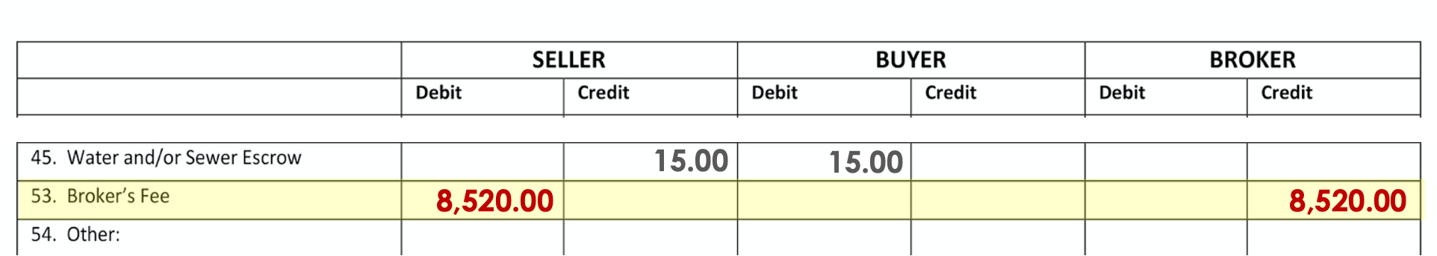
Line 53
Debit Seller/ Credit Broker
$8,520.00

Slide 35
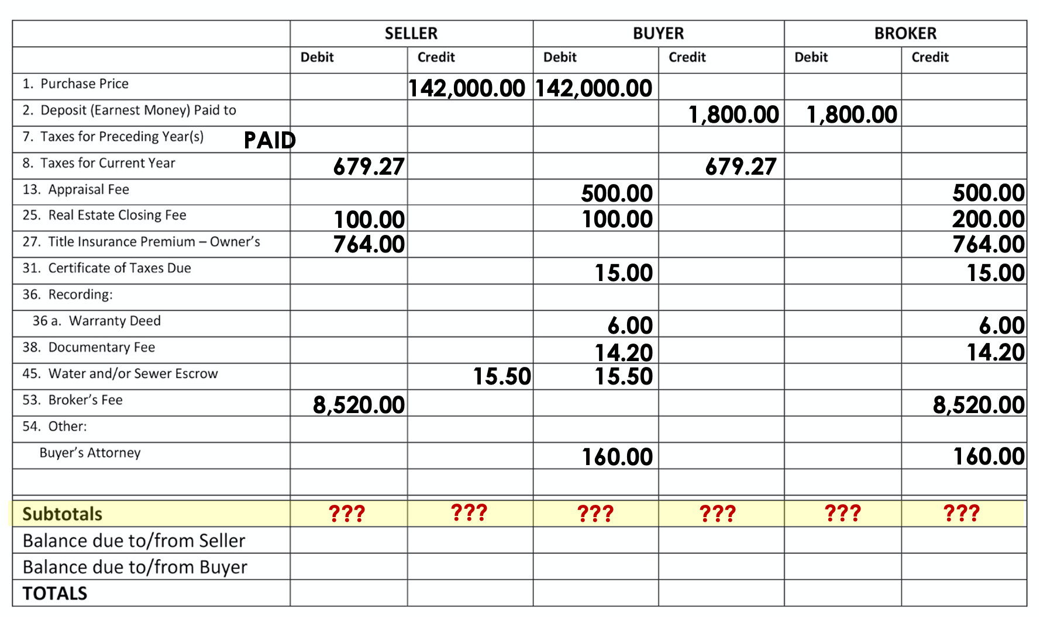

Slide 36
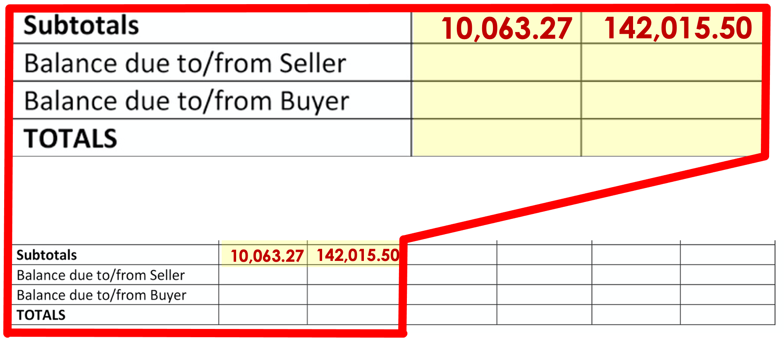

Slide 37
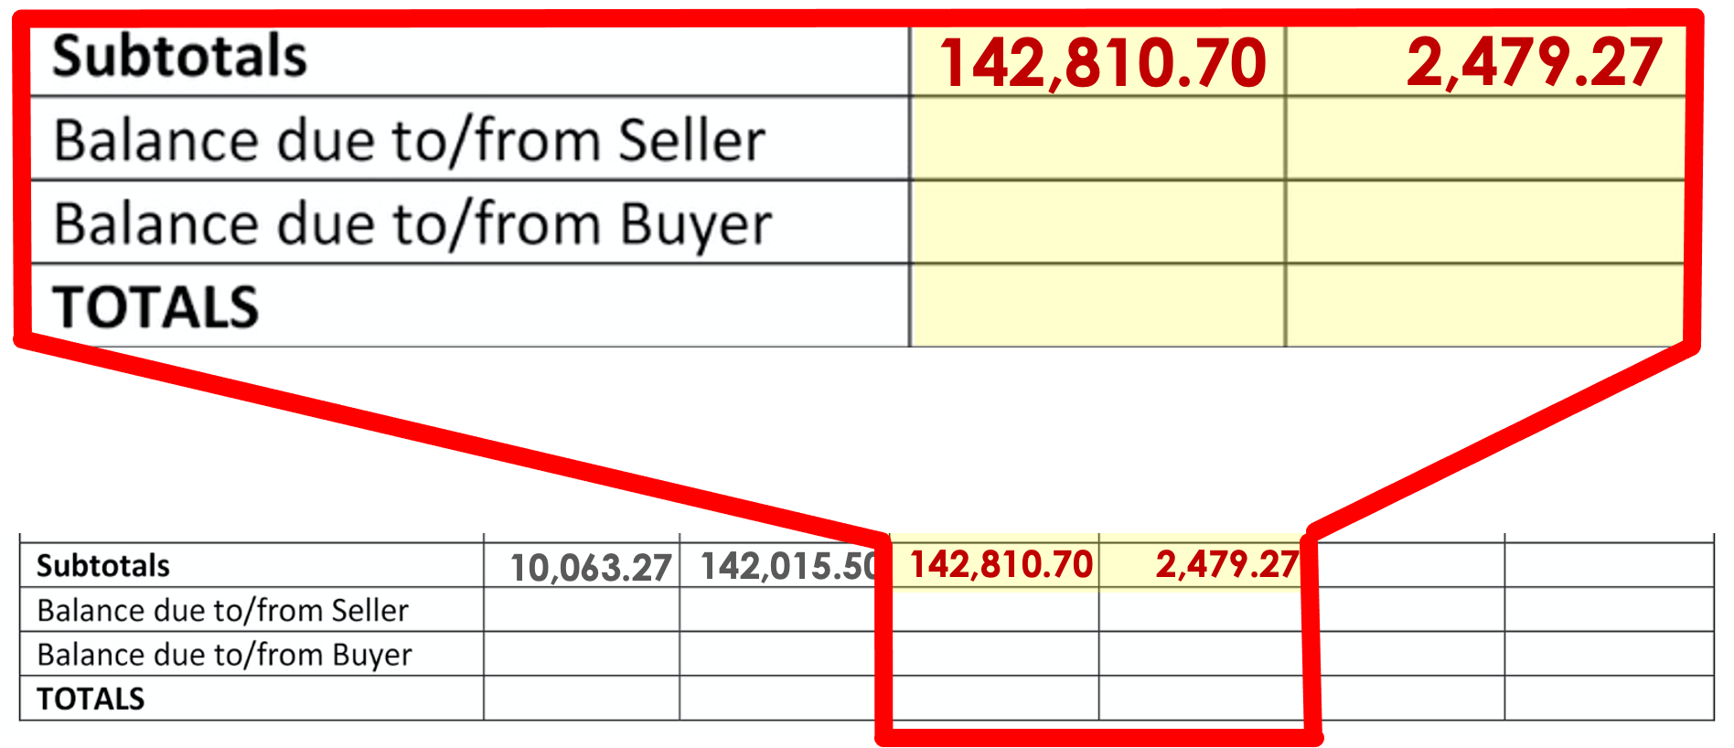

Slide 38
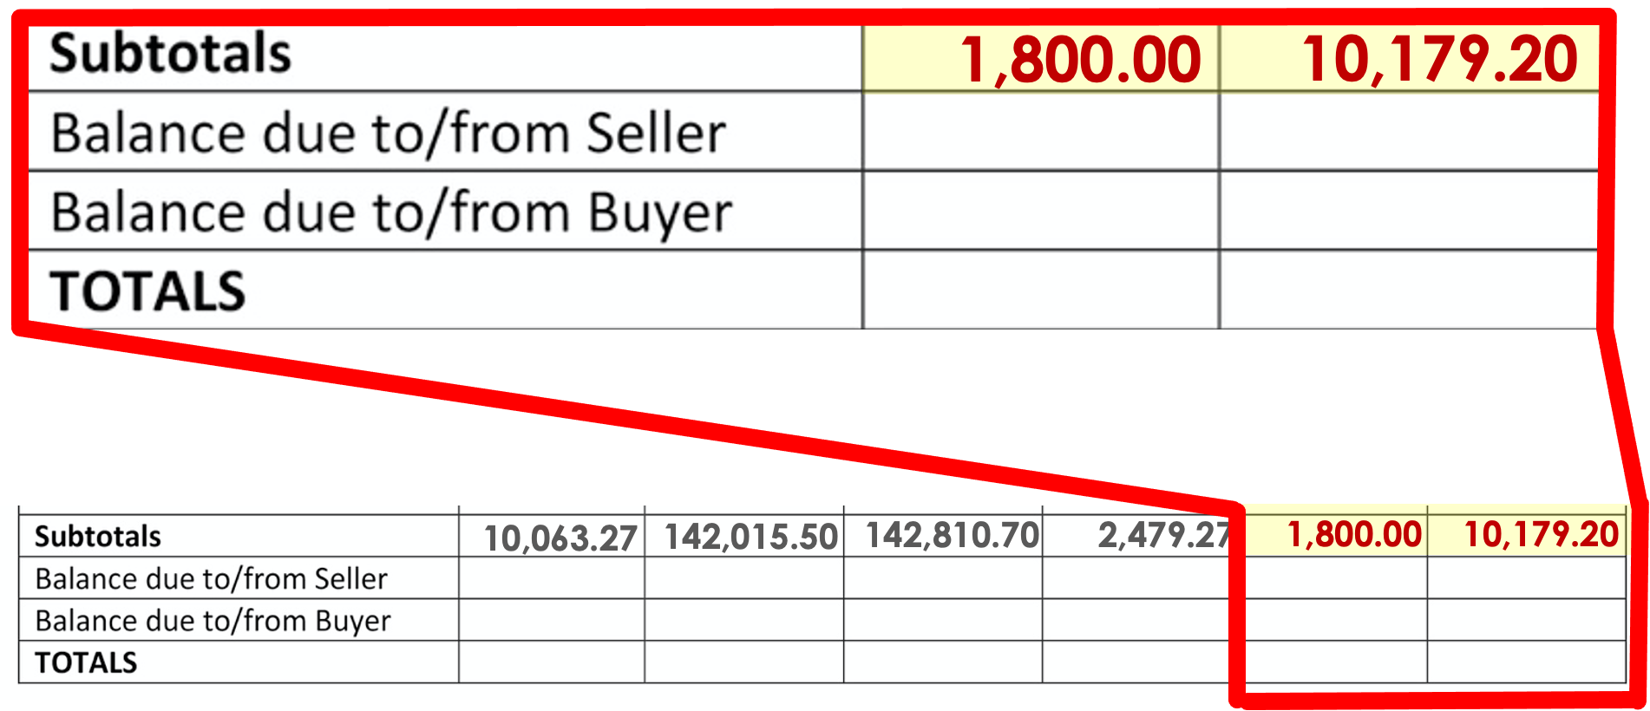

Slide 39
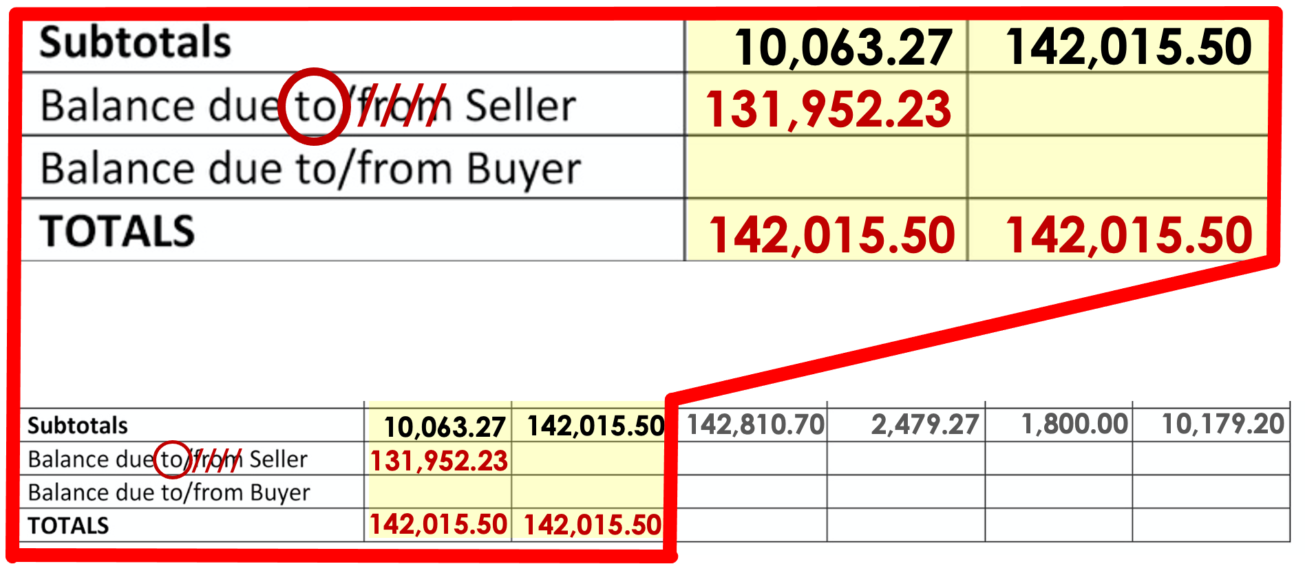

Slide 40
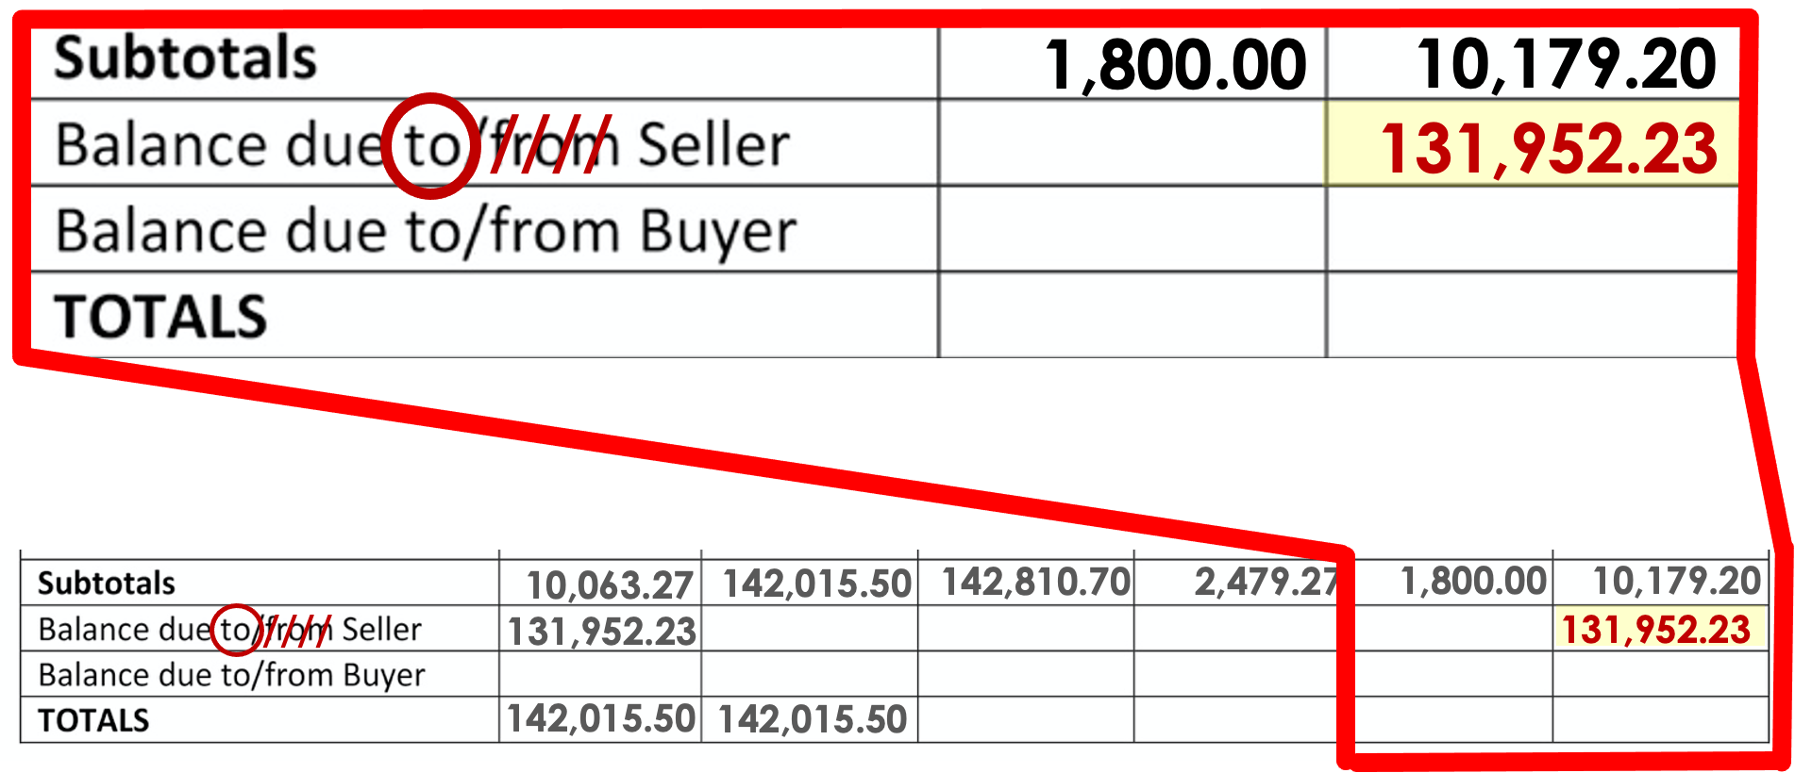

Slide 41
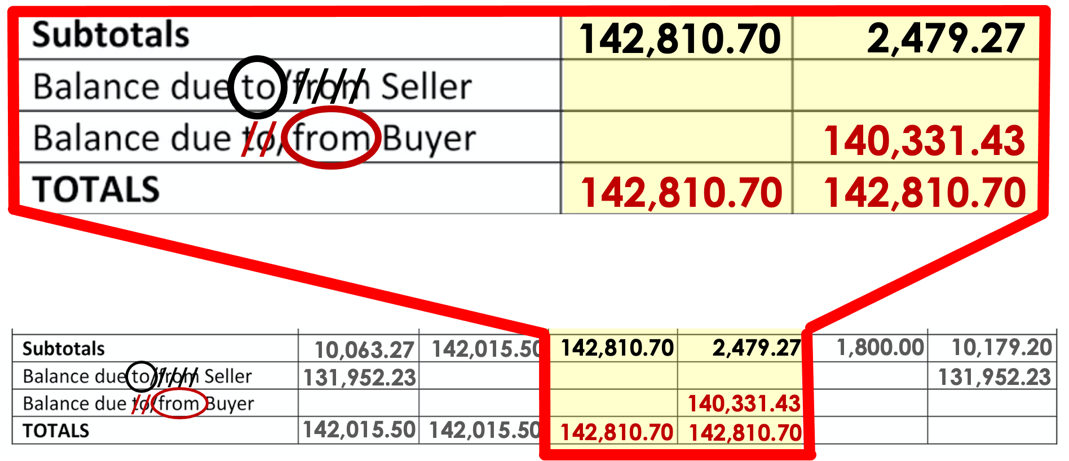

Slide 42
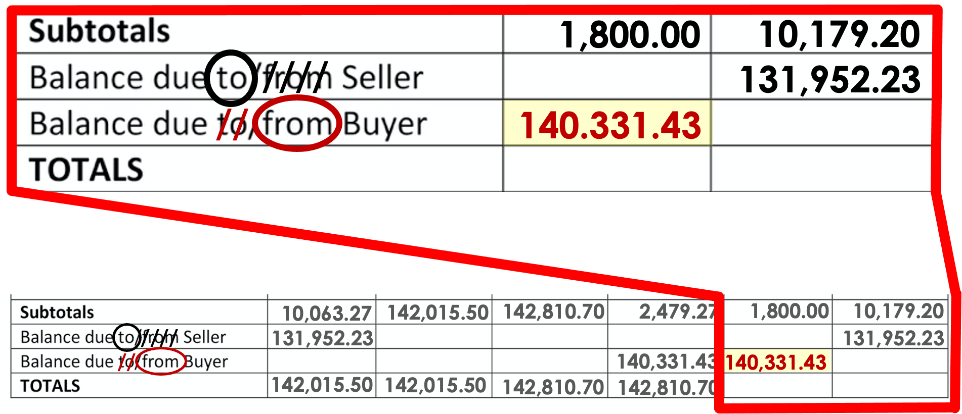

Slide 43
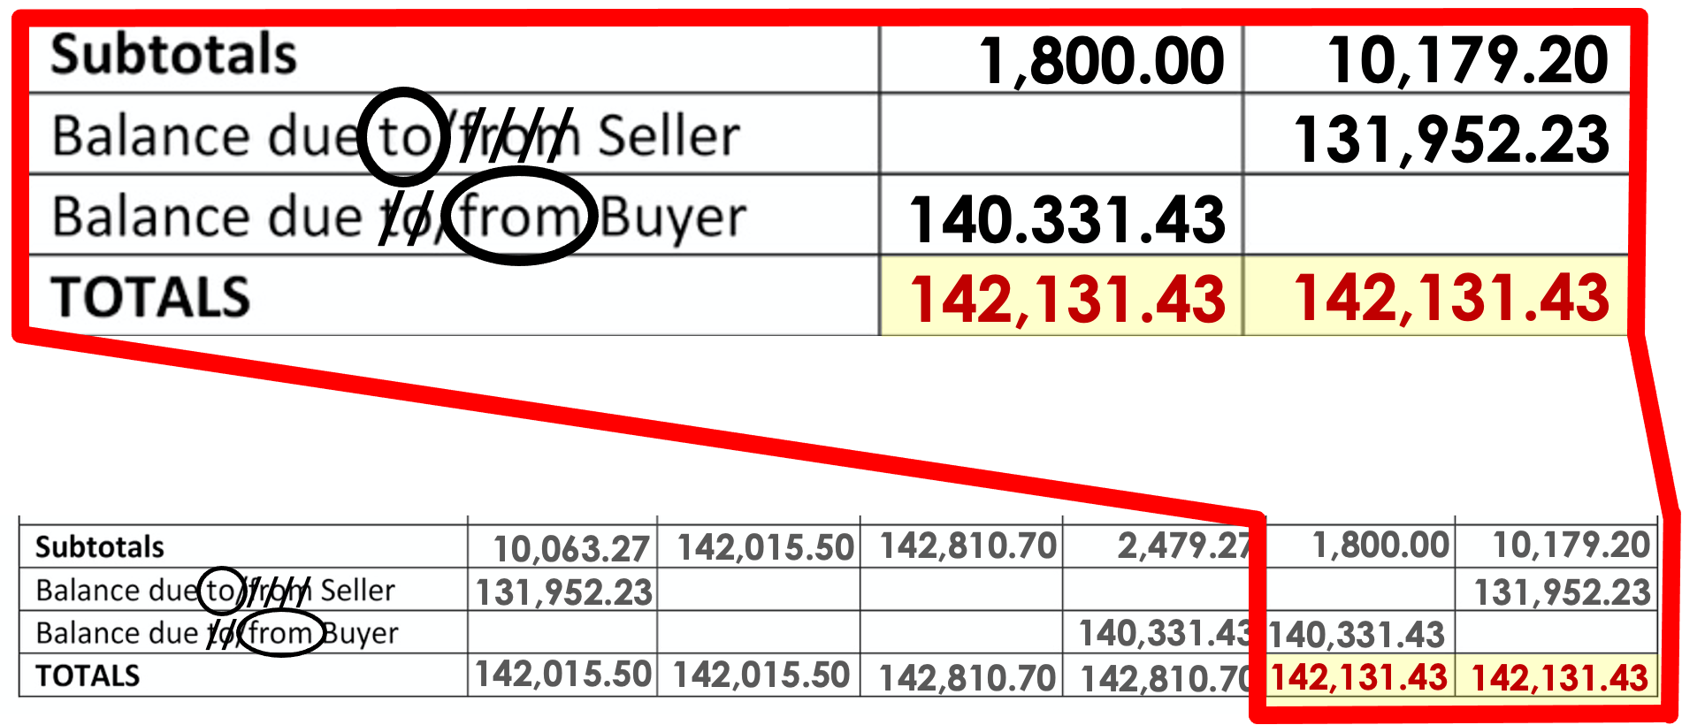

Slide 44
