Slide 1


Slide 2
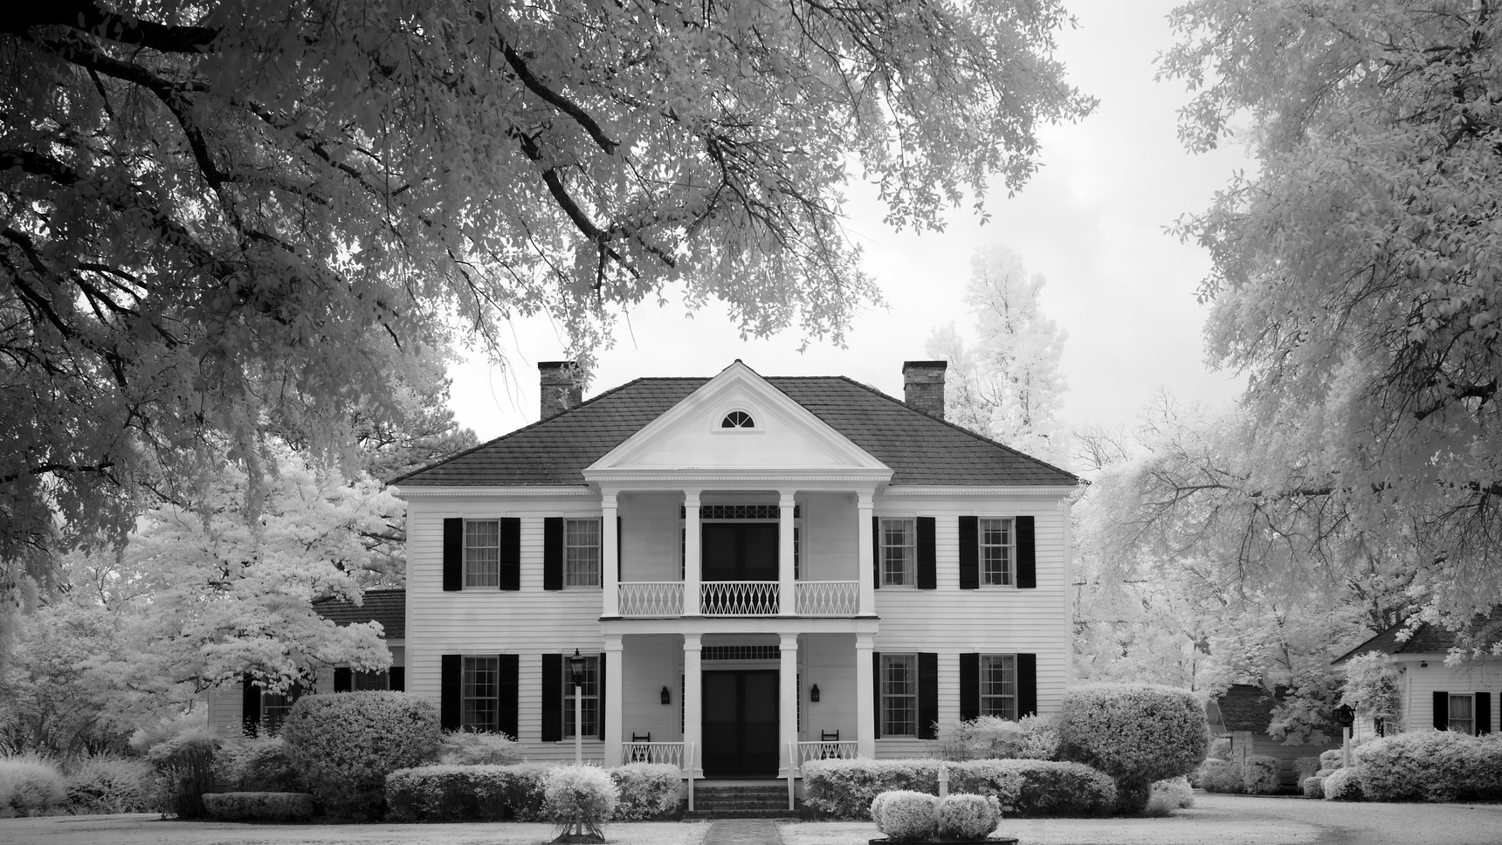
Colorado Closings and Settlement
Chapter 23
Filling Out the Settlement Sheet

Slide 3

Seller: John R. and Mary L. Winter?
Address: 7373 West Flamingo Rd.
?Settlement Date: May 10, 20XX
Buyer: Harold R. and A. Jean Blue
Legal: Lots 6 and 7, Block 14, Graham Heights
Proration Date: May 9, 20XX

Slide 4
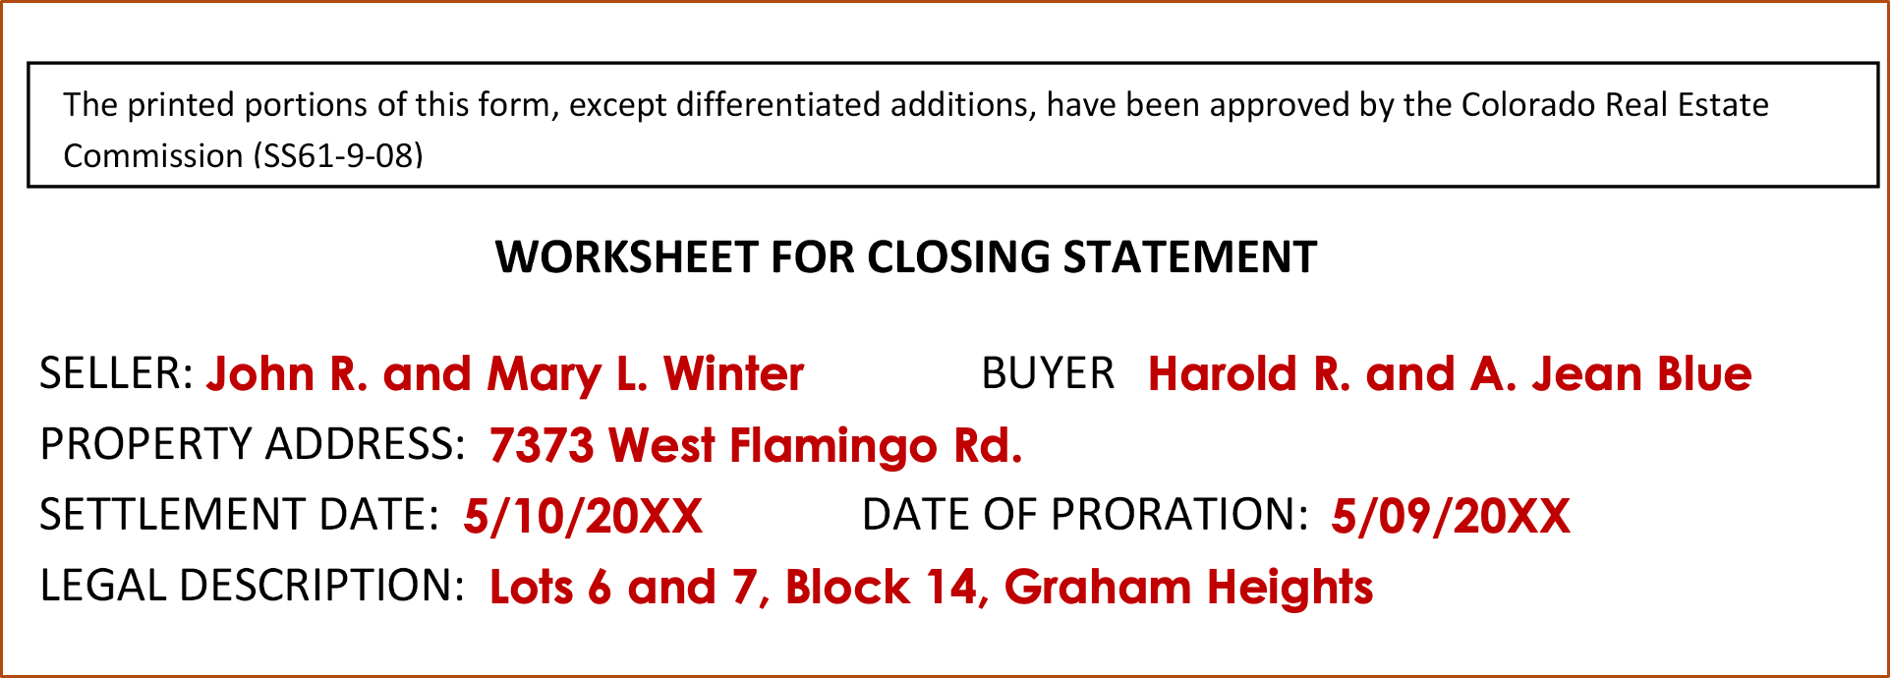

Slide 5

Selling Price
$250,000

Slide 6
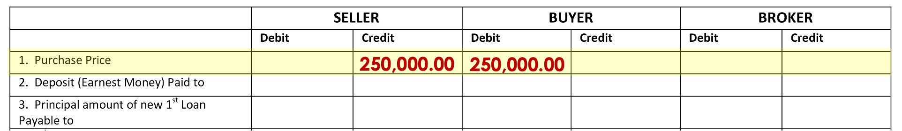
Line 1
Credit Seller / Debit Buyer
$250,000.00

Slide 7
Earnest Money
$5,000

Slide 8
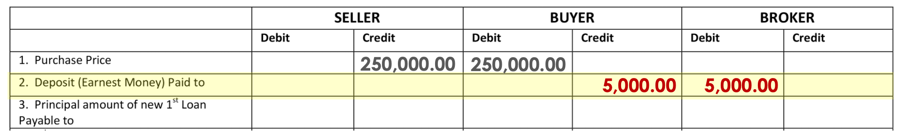
Line 2
Credit Buyer/ Debit Broker
$5,000.00

Slide 9
Seller Loan to Buyer
$200,000

Slide 10
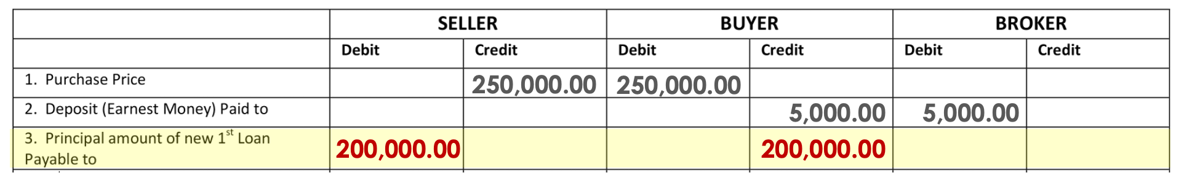
Line 3
Debit Seller/ Credit Buyer
$200,000.00

Slide 11
1st Loan Payoff
$30,000

Slide 12
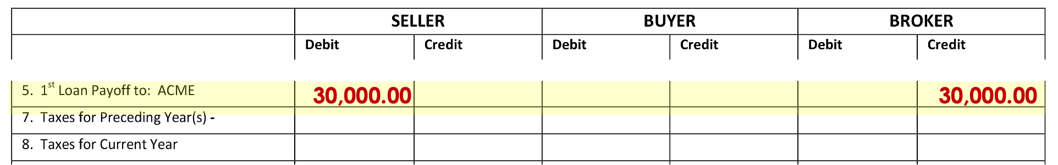
Line 5
Debit Seller/ Credit Broker
$30,000.00

Slide 13
Last Year’s Taxes
$2,051.30
(PAID)

Slide 14
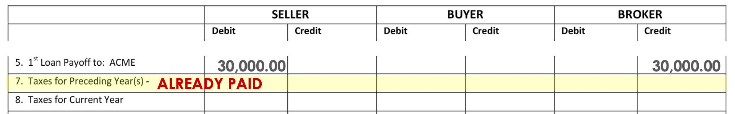
Line 7
ALREADY PAID

Slide 15
Current Year’s Taxes
$ ???

Slide 16
What’s the Date of Closing?
May 10
Who are we going to Debit?
Seller
How many days has
Seller owned:
129
$2,051.30 ÷ 365 x 129 =
$724.98

Slide 17
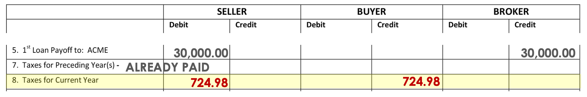
Line 8
Debit Seller/ Credit Buyer
$724.98

Slide 18
Appraisal Fee
$350

Slide 19
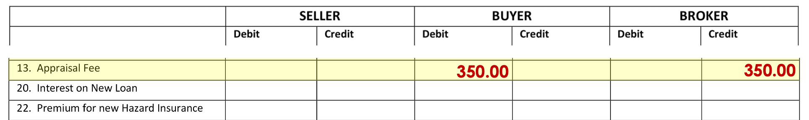
Line 13
Debit Buyer/ Credit Broker
$350.00

Slide 20
The Buyers’ loan application was approved, by the Sellers, in the amount of $200,000.00 at 7 ½% interest per year, amortized over a period of 30 years. The first payment on the new loan is due on July 1, the first day of the first complete month after the loan closing date.

Slide 21
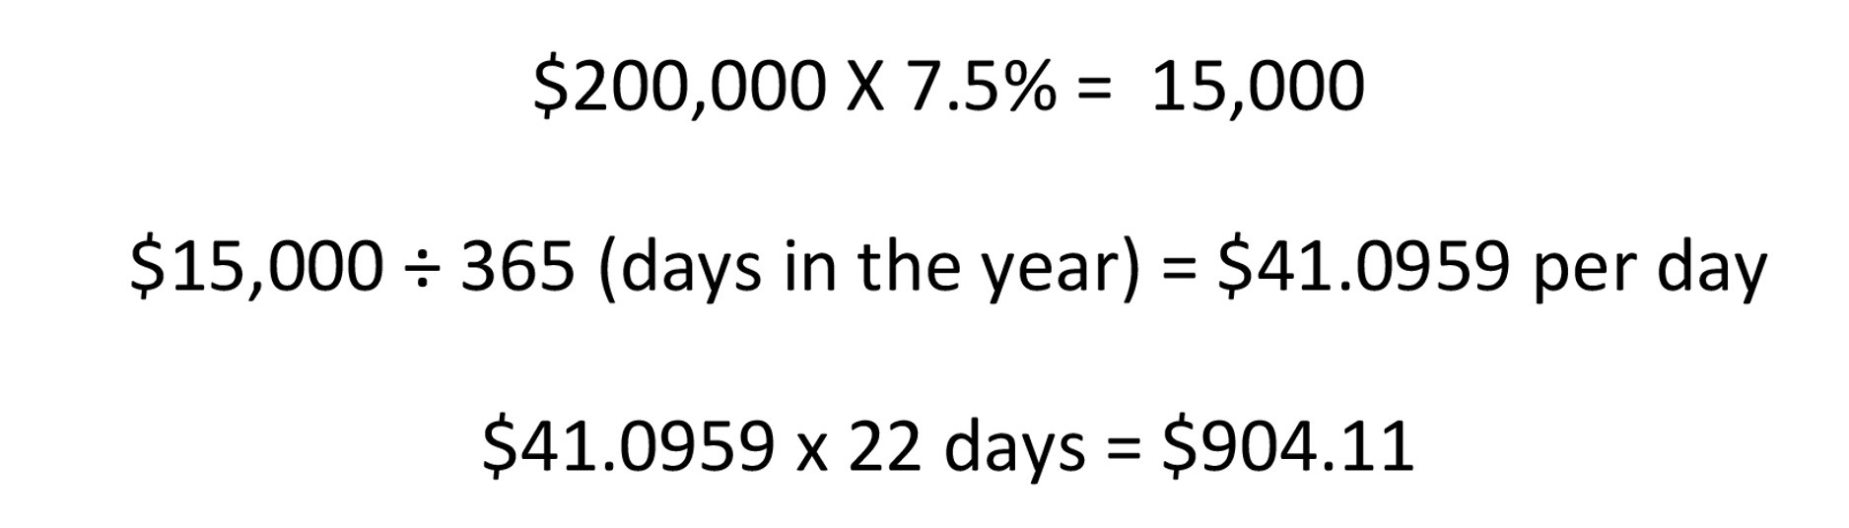

Slide 22
Interest on New Loan
$904.11

Slide 23
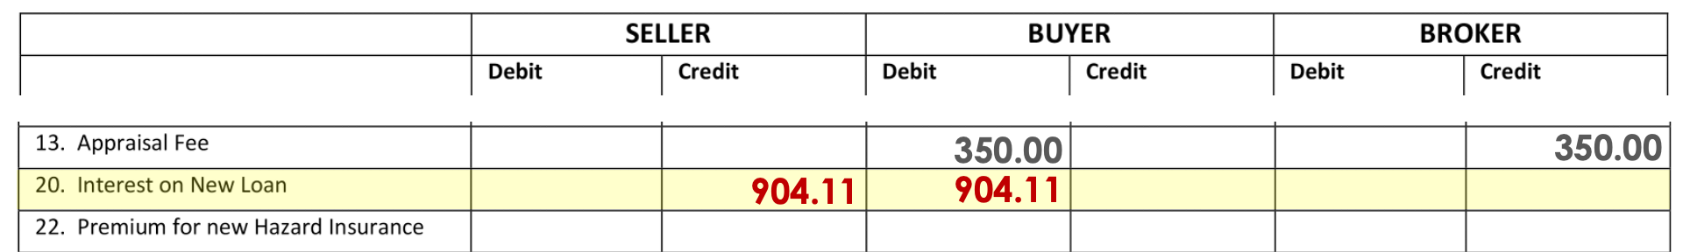
Line 20
Credit Seller/ Debit Buyer
$904.11

Slide 24
Hazard Insurance Premium
$675

Slide 25
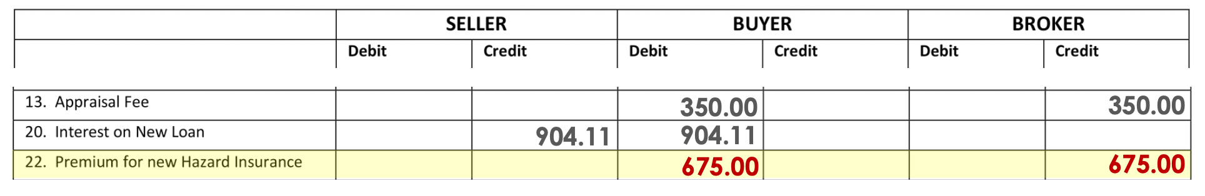
Line 22
Debit Buyer/ Credit Broker
$675.00

Slide 26
Hazard Insurance Reserve
$112.50

Slide 27
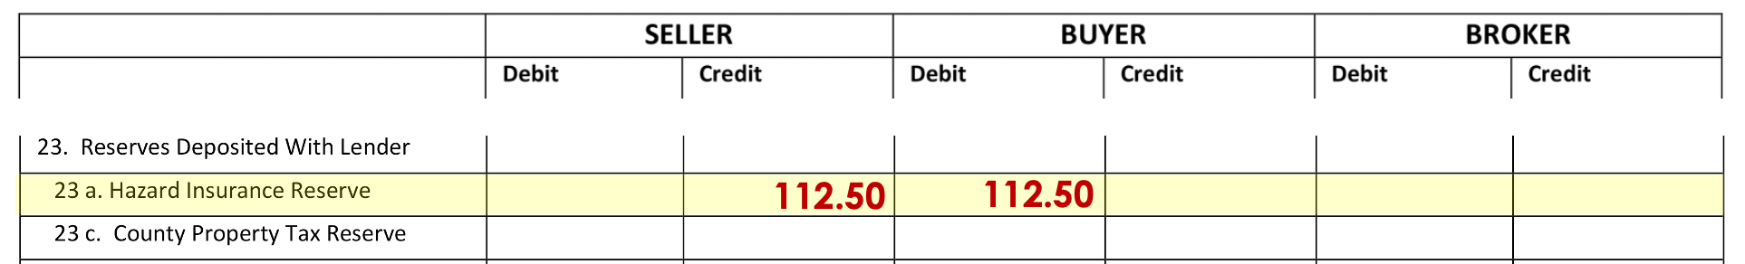
Line 23a
Credit Seller/ Debit Buyer
$112.50

Slide 28
Tax Reserve
$854.65

Slide 29
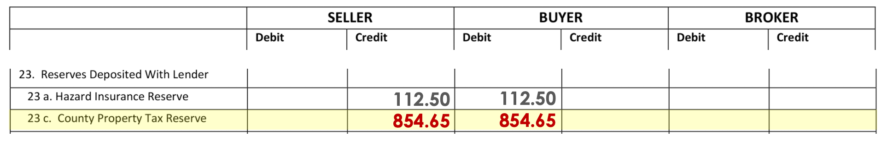
Line 23c
Credit Seller/ Debit Buyer
$854.65

Slide 30
Closing Fee
$200

Slide 31
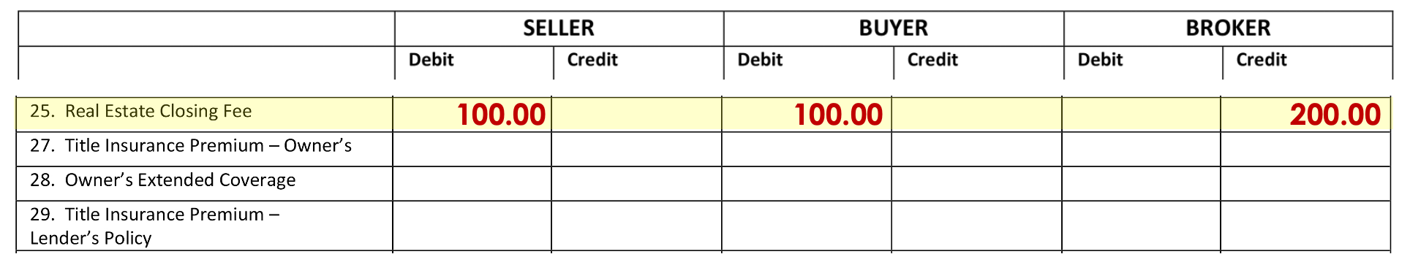
Line 25
Debit Seller/ Debit Buyer/ Credit Broker
$100.00 / $100.00 / $200.00

Slide 32
Title Insurance
$1,500

Slide 33
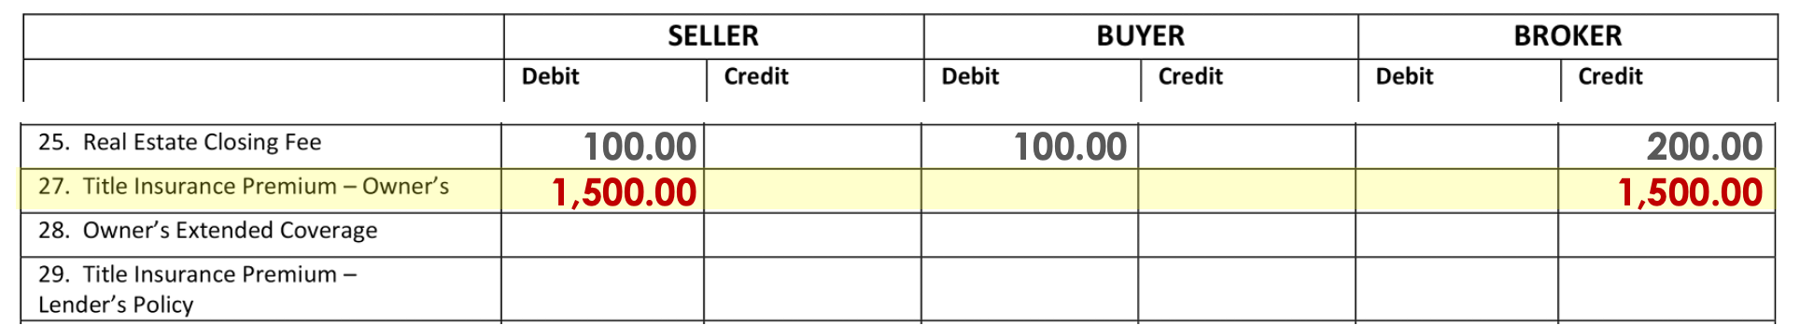
Line 27
Debit Seller/ Credit Broker
$1,500.00

Slide 34
Owner’s Extended Coverage
$100

Slide 35
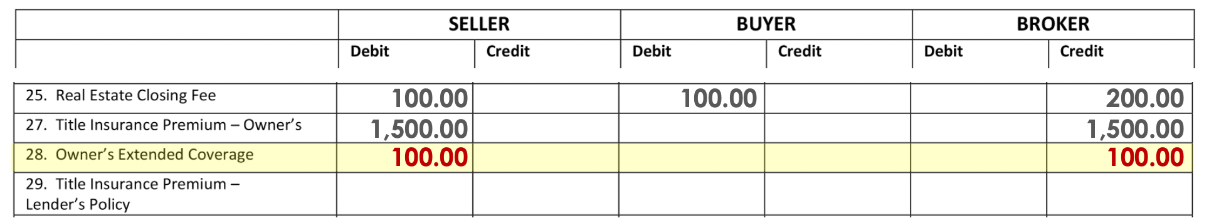
Line 28
Debit Seller/ Credit Broker
$100.00

Slide 36
Title Mortgagee’s Policy
$525

Slide 37
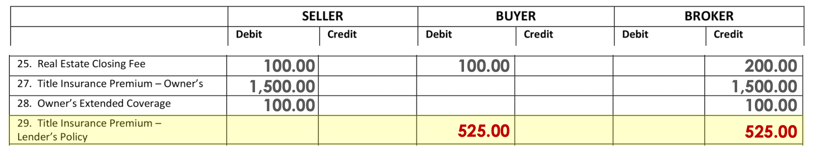
Line 29
Debit Buyer/ Credit Broker
$525.00

Slide 38
Certificate of Taxes Due
$15

Slide 39
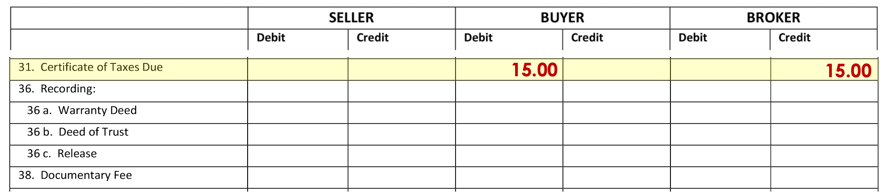
Line 31
Debit Buyer/ Credit Broker
$15.00

Slide 40
Warranty Deed
$10

Slide 41
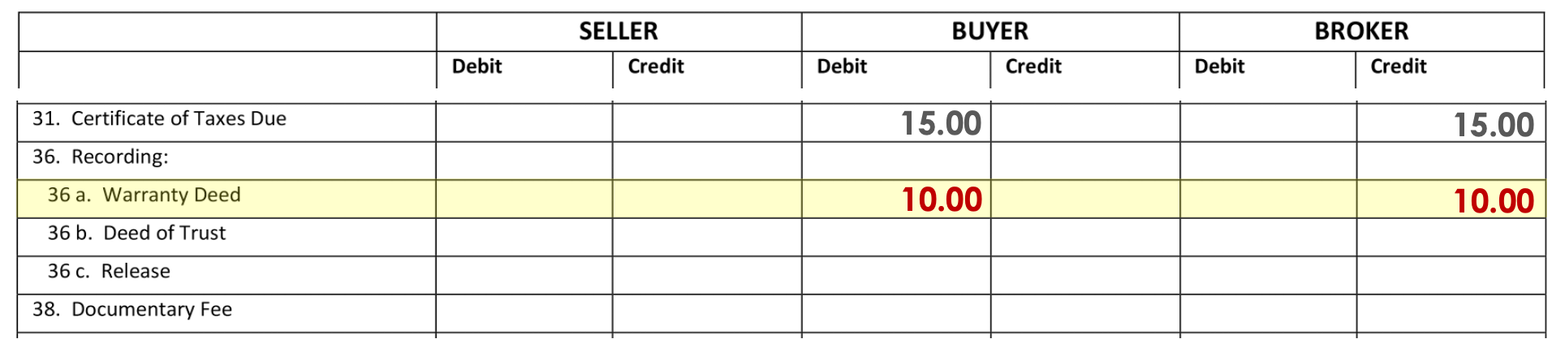
Line 36a
Debit Buyer/ Credit Broker
$10.00

Slide 42
Deeds of Trust
$31

Slide 43
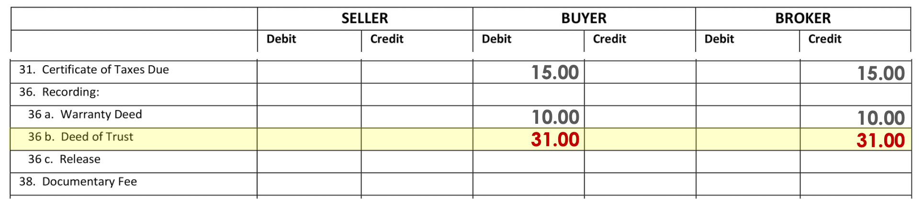
Line 36b
Debit Buyer/ Credit Broker
$31.00

Slide 44
Release of
Deeds of Trust
$20

Slide 45
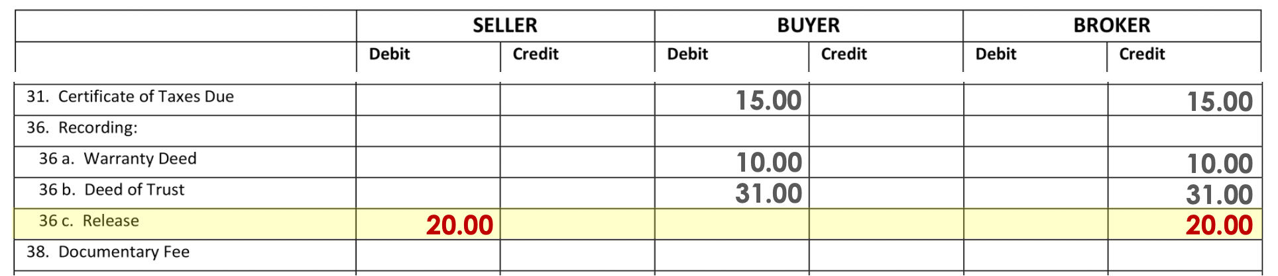
Line 36c
Debit Seller/ Credit Broker
$20.00

Slide 46
Doc Fee
$25

Slide 47
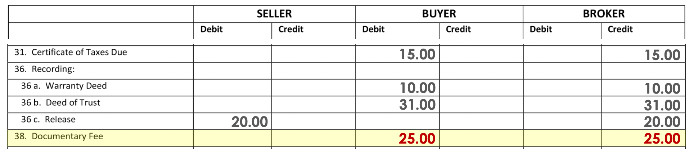
Line 38
Debit Buyer/ Credit Broker
$25.00

Slide 48
Water/Sewer Bill
$ ???

Slide 49
What’s the Date of Closing?
May 10
Who are we going to Debit?
Buyer – Paid in Advance
How many days in the period:
April – 30
May – 31
June – 30
91

Slide 50
What’s the Date of Closing?
May 10
Who are we going to Debit?
Buyer – Paid in Advance
How many days in the period:
91
How many days are we collecting for:
52
$96.40 ÷ 91 x 52 =
$55.09

Slide 51
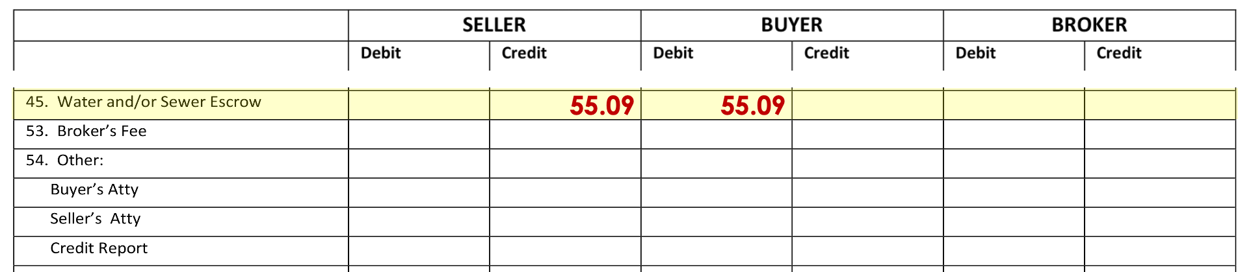
Line 45
Credit Seller/ Debit Buyer
$55.09

Slide 52
Broker’s Fee
$12,500

Slide 53
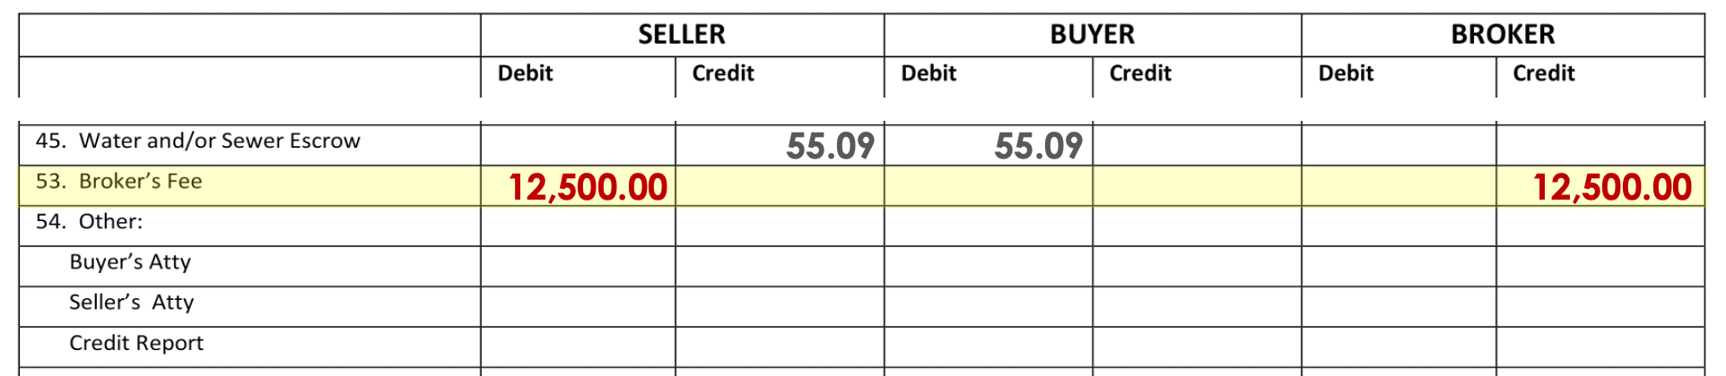
Line 53
Debit Seller/ Credit Broker
$12,500.00

Slide 54
Buyer’s Title Exam
$100

Slide 55
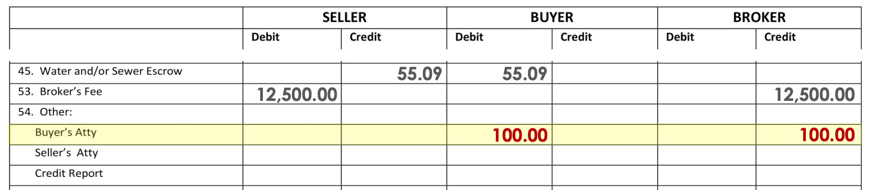
Line 54 - Buyer's Atty
Debit Buyer/ Credit Broker
$100.00

Slide 56
Seller’s Title Exam
$100

Slide 57
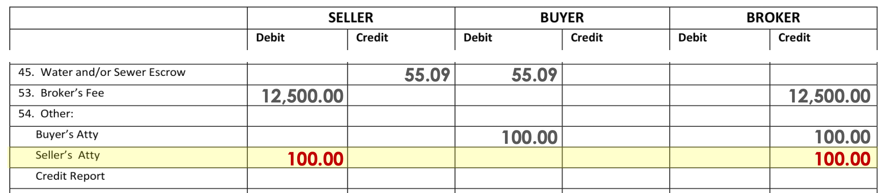
Line 54 - Seller's Atty
Debit Seller/ Credit Broker
$100.00

Slide 58
Credit Report
$65

Slide 59
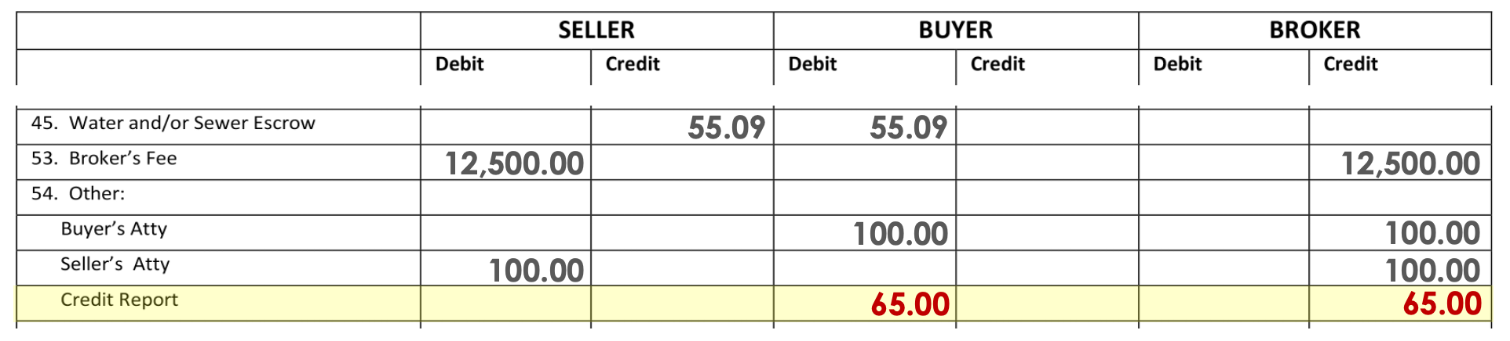
Line 54 - Credit Report
Debit Buyer/ Credit Broker
$65.00

Slide 60
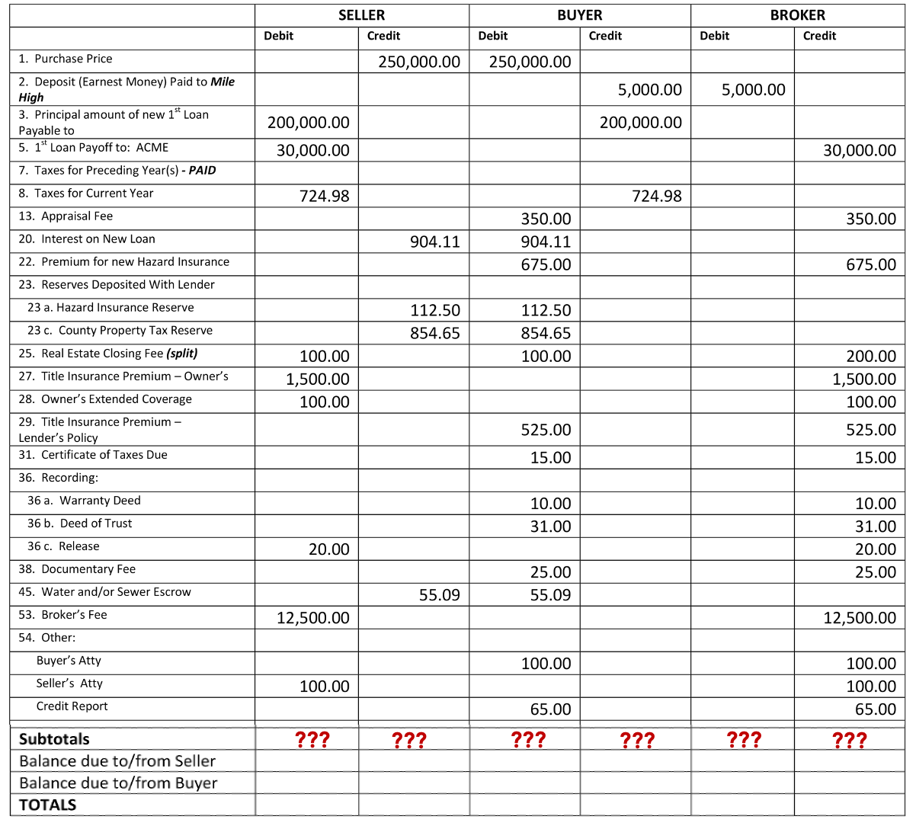

Slide 61
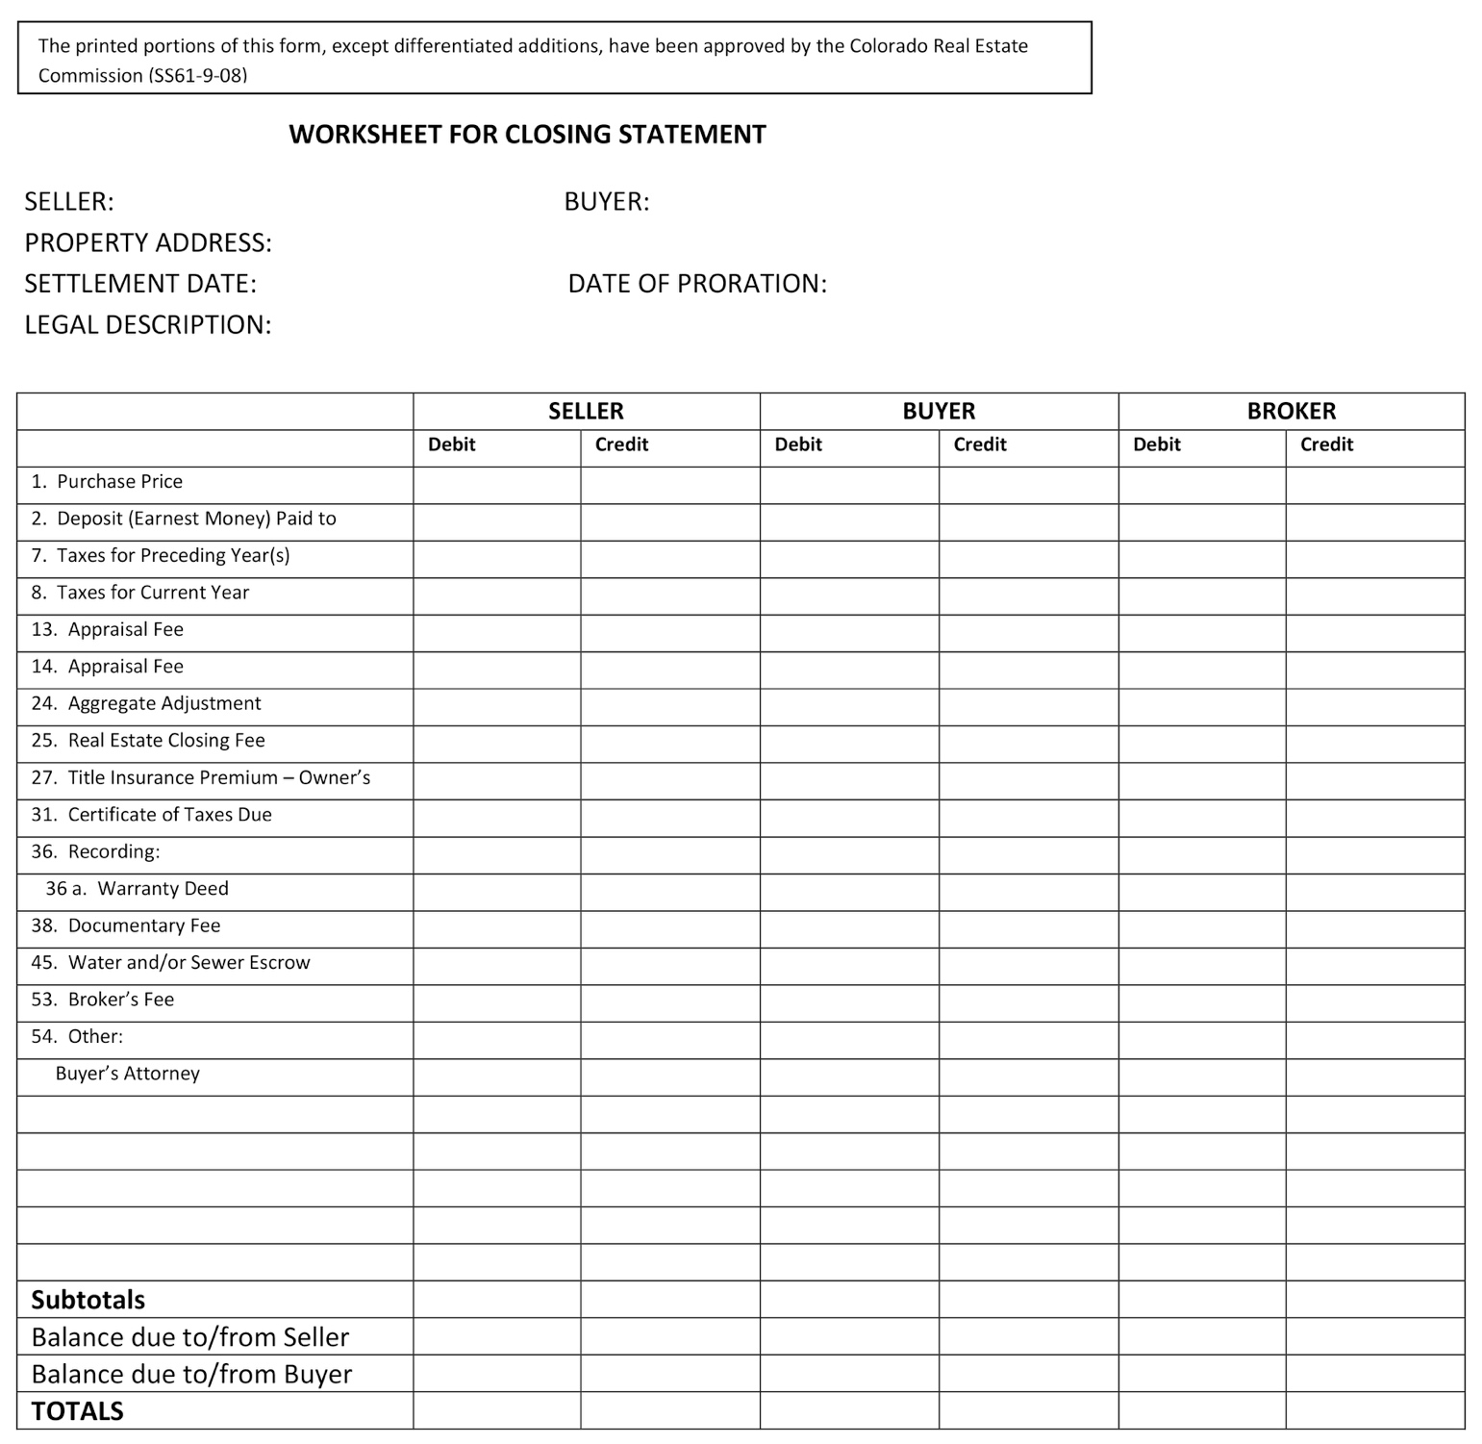
245,044.98
251,926.35
245,044.98
251,926.35

Slide 62
253,822.35
205,724.98
245,044.98
251,926.35
253,822.35
205,724.98

Slide 63
5,000.00
46,216.00
245,044.98
251,926.35
253,822.35
205,724.98
5,000.00
46,216.00

Slide 64
245,044.98
251,926.35
/////
6,881.37
251,926.35
251,926.35
245,044.98
251,926.35
253,822.35
205,724.98
5,000.00
46,216.00
////
6,881.37
251,926.35
251,926.35

Slide 65
5,000.00
46,216.00
/////
6,881.37
245,044.98
251,926.35
253,822.35
205,724.98
5,000.00
46,216.00
////
6,881.37
6,881.37
251,926.35
251,926.35

Slide 66
253,822.35
205,724.98
/////
//
48,097.37
253,822.35
253,822.35
245,044.98
251,926.35
253,822.35
205,724.98
5,000.00
46,216.00
////
6,881.37
6,881.37
//
48,097.37
251,926.35
251,926.35
253,822.35
253,822.35

Slide 67
5,000.00
46,216.00
/////
6,881.37
//
48,097.37
245,044.98
251,926.35
253,822.35
205,724.98
5,000.00
46,216.00
////
6,881.37
6,881.37
//
48,097.37
48,097.37
251,926.35
251,926.35
253,822.35
253,822.35

Slide 68
5,000.00
46,216.00
/////
6,881.37
//
48,097.37
53,097.37
53,097.37
245,044.98
251,926.35
253,822.35
205,724.98
5,000.00
46,216.00
////
6,881.37
6,881.37
//
48,097.37
48,097.37
251,926.35
251,926.35
253,822.35
253,822.35
53,097.37
53,097.37

Slide 69
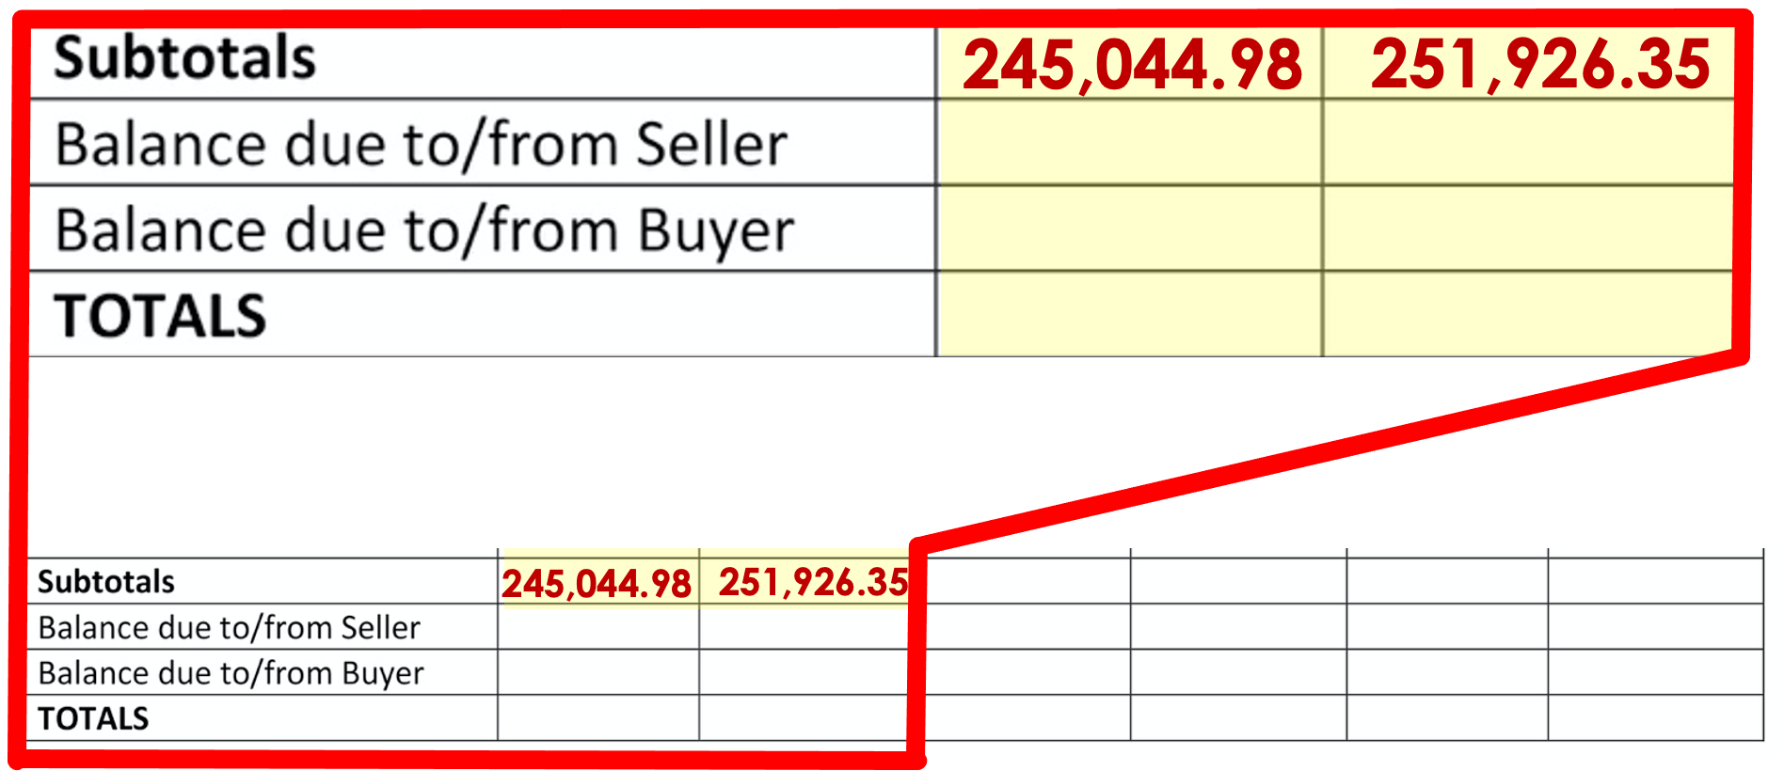

Slide 70
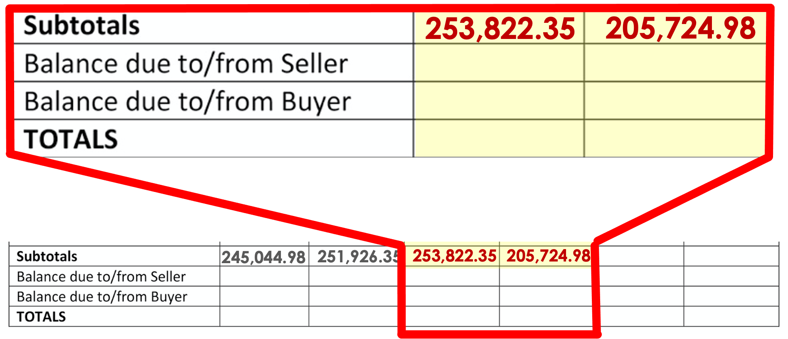

Slide 71
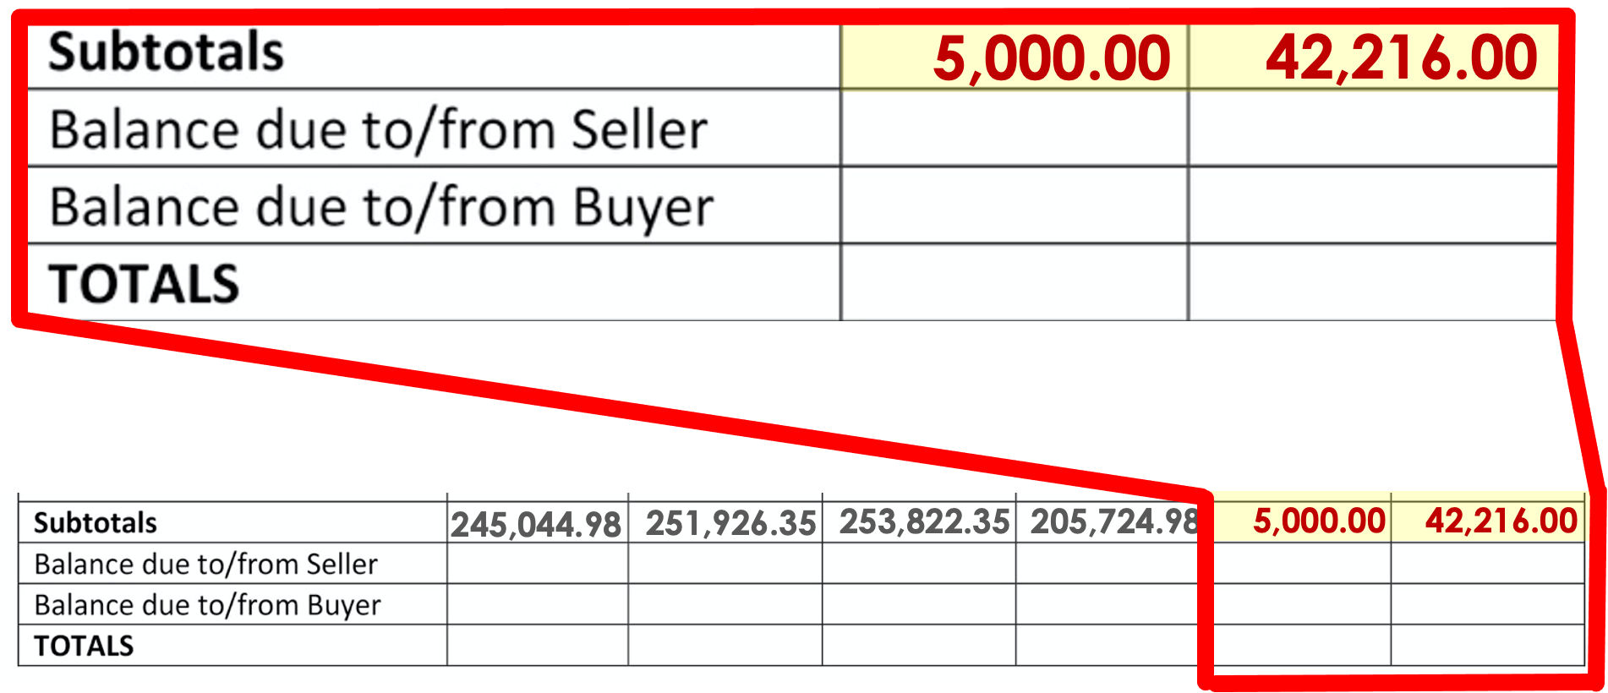

Slide 72
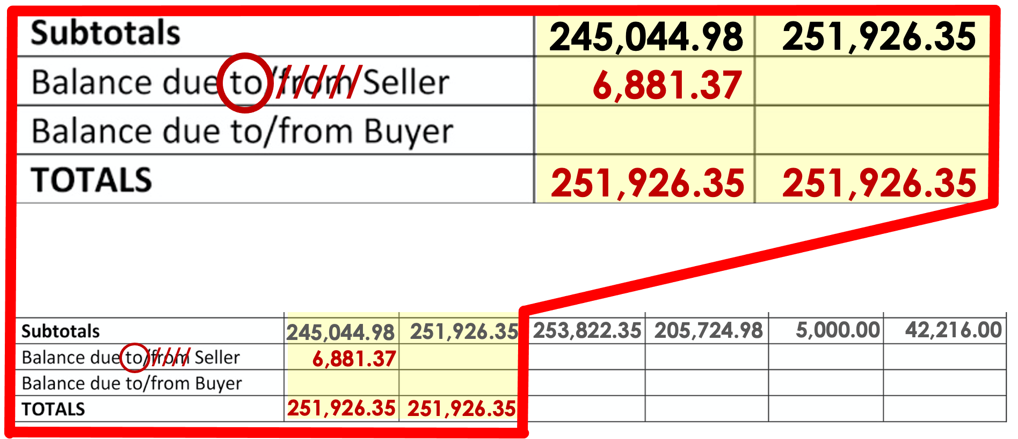

Slide 73
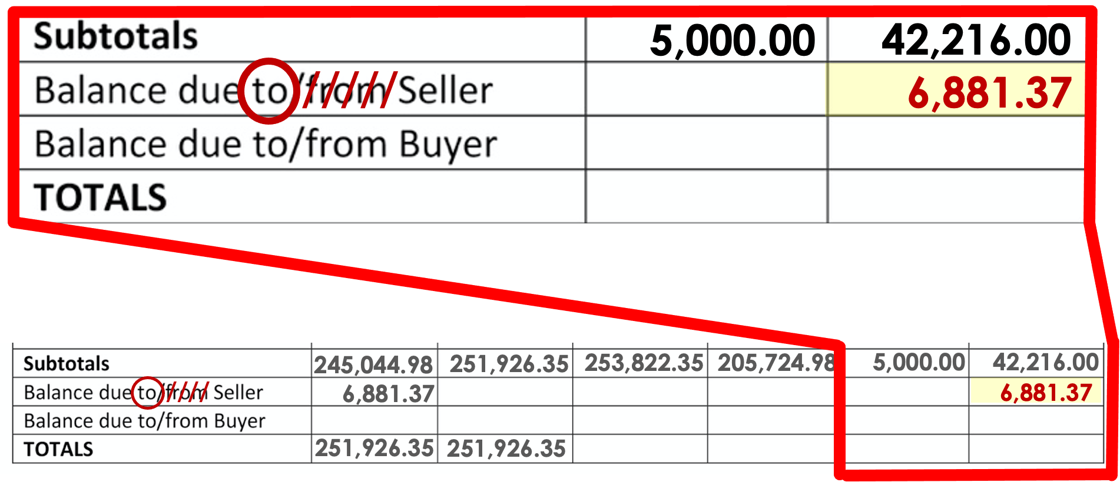

Slide 74
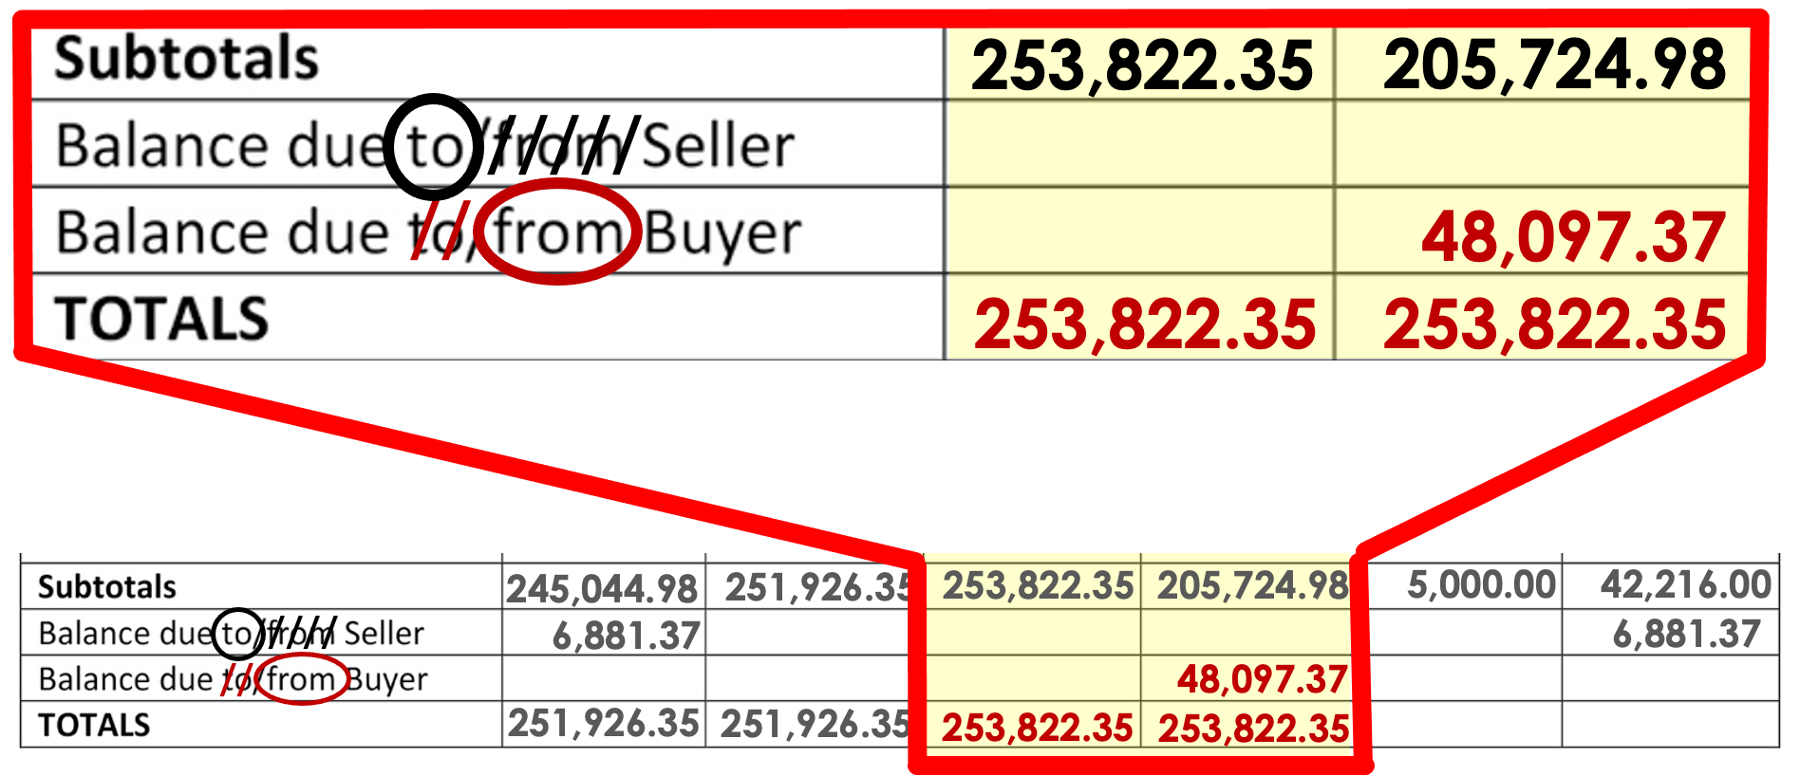

Slide 75
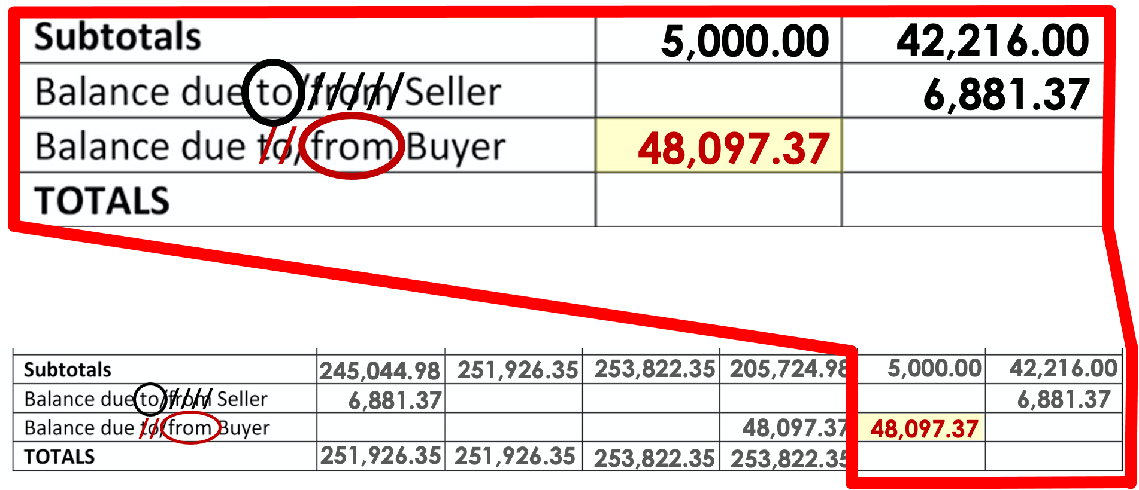

Slide 76
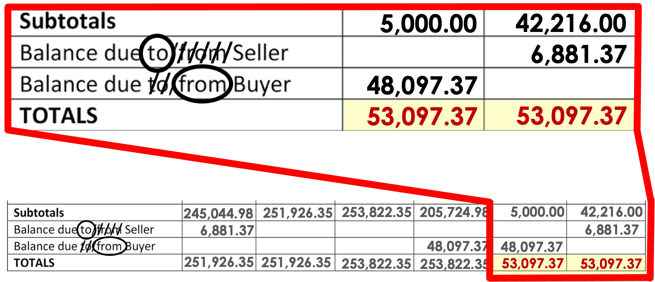

Slide 77
