Slide 1


National Law and practice
Chapter 6 – Land Use Controls
and Regulations

Slide 2
Land use controls – Government Rights in Land
P
E
T
E
Police Power – power of the state to adopt laws and regulations to promote health, safety and welfare. (Zoning, Building Codes)
Eminent Domain – (Condemnation) Governments right to take private property when it is decided that it is needed for the best interests of the public.
Taxation – imposes taxes upon real estate.
Escheat – when a property owner dies without heirs (intestate) and there are no legal heirs, the property reverts to the state.
Pg. 135

Slide 3
Land use controls – Government Rights in Land
P
Police Power
Zoning Laws – used to preserve property values and promote growth.
Master plan – provides guidelines for current and future growth.
Land use divided into six categories: Residential, Commercial, Industrial, Agricultural, Public and Planned Unit Development (PUD) and Buffer Zones.
Pg. 136

Slide 4
Land use controls – Government Rights in Land
Zoning Ordinances – specify land usage for every parcel in a jurisdiction.
Zoning Board of Appeals – allows property owners to appeal for a use of their property not currently allowed by zoning ordinances.
Pg. 136

Slide 5
Land use controls – Government Rights in Land
Non-Conforming Use
Legal Non-Conforming Use - A use that existed prior to the current zoning but does not comply with current zoning.
- Grandfather Clause
Illegal Non-Conforming Use – occurs when the use of a property conflicts with zoning ordinances that were already in place.
Pg. 136

Slide 6
Land use controls – Government Rights in Land
Variance
Where a property owner seeks an alteration to the current zoning regulations.
Special Exception (Conditional Use)
Granted when the desired use is not consistent with current zoning but is beneficial to the public.
Amendment
Used to fix zoning.
Pg. 137

Slide 7
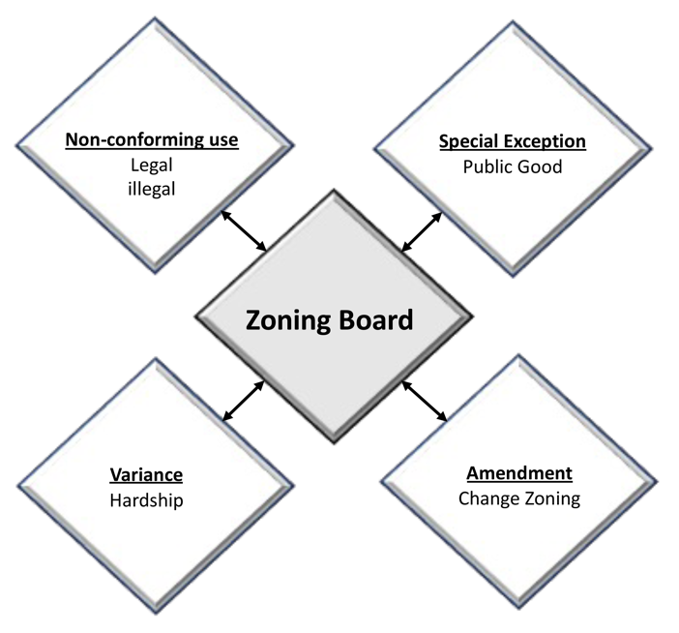
Land use controls – Government Rights in Land
Pg. 137

Slide 8
Land use controls – Government Rights in Land
Building Codes – regulate construction and material standards.
Building permits - from the county usually required for alterations or additions.
Certificate of Occupancy - issued once a project is completed and inspected.
Pg. 138

Slide 9
Land use controls – Government Rights in Land
E
Eminent Domain (Condemnation)
The government reserves the right to take private lands for public benefit.
Payment must be made based on the fair market value of the property.
Eminent Domain removes existing leases, liens and other encumbrances.
Severance damage can be awarded if only part of the parcel is taken which lowers the remaining property value.
Inverse condemnation can be requested of the government when the taking of part of the property effectively reduces the value of the whole property.
Pg. 138

Slide 10
Land use controls – Government Rights in Land
T
Taxation
There are no Federal Property Taxes.
States impose property taxes.
Usually delegated to local counties, cities or taxing districts.
Pg. 138

Slide 11
Land use controls – Government Rights in Land
Ad Valorem Taxes (According to Value)
Proportioned among landowners in a region.
Some properties are Exempt.
Governmental
Schools
Churches
Hospitals, etc.
Pg. 139

Slide 12
Land use controls – Government Rights in Land
Tax Rate = Revenue Needed ÷ Assessed Values (minus Exempt properties)
Millage Rate (Mill Rate)
One tenth of one cent (.001)
(For example): 40 mills
.04
$4/$100
$40/$1000
Pg. 139

Slide 13
Land use controls – Government Rights in Land
Assessed Value
County assessor determines the fair value of a property.
Assigns an assessed value
Also known as the Tax Ratio
It is a percentage of Market Value
Pg. 140

Slide 14
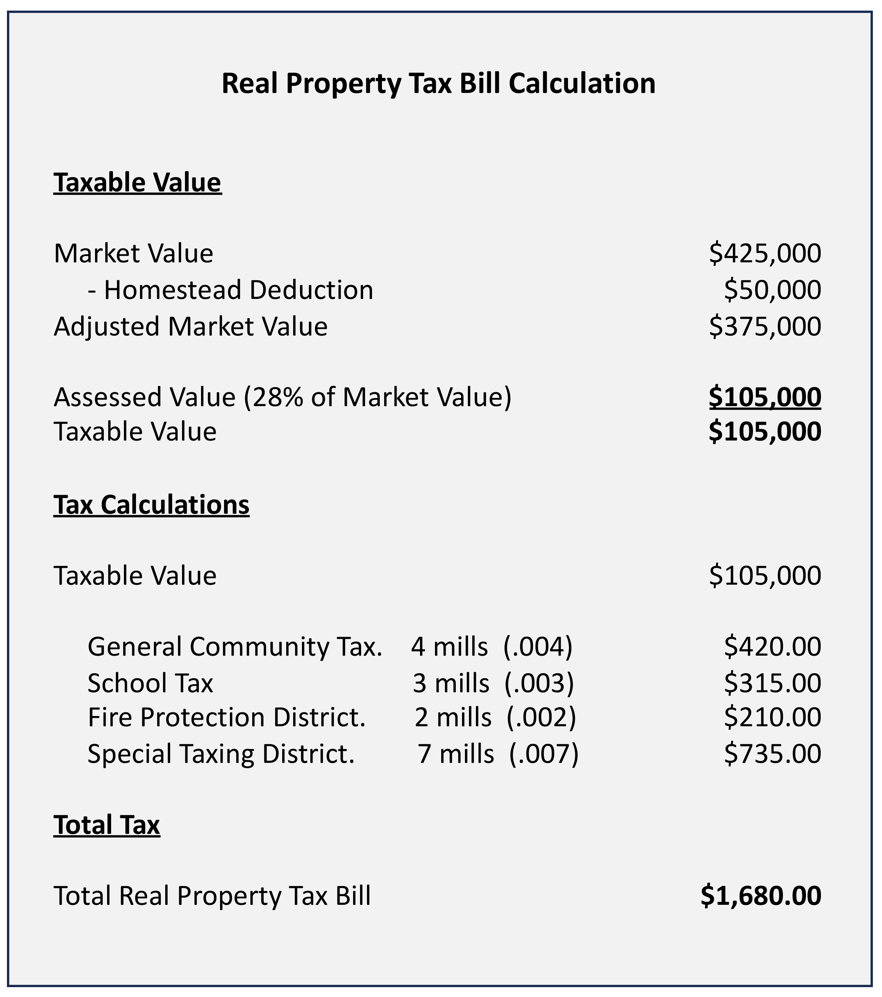
Pg. 140

Slide 15
Land use controls – math (taxes)
Calculating the Assessed Value
AMT
Market Value x Tax Ratio (Rate) = Assessed Value
The Market Value of a property is $375,000. The Tax Rate is 30%. What is the Assessed Value.
A
M
T
Pg. 141

Slide 16
Land use controls – math (taxes)
Calculating the Assessed Value
AMT
Market Value x Tax Ratio (Rate) = Assessed Value
The Market Value of a property is $375,000. The Tax Rate is 30%. What is the Assessed Value.
A
$112,500
$375,000 x .30 = $112,500
M
$375,000
T
.30
Assessed Value is always a percentage of Market Value
Pg. 141

Slide 17
Land use controls – math (taxes)
Calculating the Taxes Owed
TAM
Tax Dollars = Assessed Value x Millage Rate
The tax rate of a property is 42 mills. The Assessed Value of the property is 112,500. What are the taxes owed?
T
A
M
Pg. 141

Slide 18
Land use controls – math (taxes)
Calculating the Taxes Owed
TAM
Tax Dollars = Assessed Value x Millage Rate
The tax rate of a property is 42 mills. The Assessed Value of the property is 112,500. What are the taxes owed?
T
$4,725
42 (mills) x .001 = .042 (millage Rate)
A
$112,500
M
.042
.042 x 112,500
.042 x 112,500 = $4,725
Pg. 141

Slide 19
Land use controls – math (taxes) – Problem #1
Calculating the Assessed Value
AMT
The Market Value of a property is $325,000. If the tax ratio is 30% and the tax rate is 27 mills, what is the annual tax?
We must first calculate the Assessed Value of the property.
A
$97,500
M
$325,000
T
.30
$325,000 x .30 = $97,500
Assessed Value is always a percentage of Market Value
Pg. 142

Slide 20
Land use controls – math (taxes) – Problem #1
Calculating the Taxes Owed
TAM
The Market Value of a property is $325,000. If the tax ratio is 30% and the tax rate is 27 mills, what is the annual tax?
We need to calculate the assessed value
Next, we need to calculate the millage percentage for our formula
T
$2,632.50
27 (mills) x .001 = .027 (millage Rate)
We then multiply the Assessed Value x the Millage percentage.
A
$97,500
M
.027
.027 x $97,500
.027 x $97,500 = $2,632.50
$325,000 x .30 =
$97,500
Pg. 142

Slide 21
Land use controls – math (taxes) – Problem #2
Calculating the Taxes Owed
TAM
The tax rate is 42 mills. If the quarterly tax is $189, what is the assessed value of the property?
We need to first convert our quarterly taxes into an annual tax figure.
T
$756
$189 x 4 = $756
We then convert 42 mills into a decimal.
42 x .001 = .042
A
$18,000
M
.042
We apply our formula: $756 ÷ .042
$756 ÷ .042 = $18,000
Pg. 143

Slide 22
Land use controls – math (taxes) – Problem #3
Calculating the Taxes Owed
TAM
What is the millage rate on a property with an annual tax bill of $1,120 and an assessed value of $40,000?
T
$1,120
We apply our formula: $1,120 ÷ 40,000
$1,120 ÷ 40,000 = .028
A
$40,000
M
.028
28 MILLS
Pg. 143

Slide 23
Land use controls – Government Rights in Land
Taxes become a superior lien on the property.
Has the highest lien priority of any lien.
States determine when property taxes are due.
If taxes are not paid, they may be sold at a public auction to pay the delinquent taxes.
Pg. 144

Slide 24
Land use controls – Government Rights in Land
Tax Certificate – issued to the winning bidder at the tax sale.
Property owner has a redemption period to pay off the property tax.
If unpaid, the certificate holder may apply for a tax deed or treasurer’s deed and receive the property free and clear of any liens.
Pg. 144

Slide 25
Land use controls – Government Rights in Land
Special Assessments
Pay for local improvements like street paving, curbs, gutters, etc.
Levied only against the property that will benefit.
Amounts usually billed based on front footage.
Senior lien, second in priority to General Real Estate Taxes.
Pg. 144

Slide 26
Land use controls – Government Rights in Land
E
Escheat
The government retains the right to retake ownership of property if the owner dies intestate (without a will) and there are no legal heirs.
Abandoned property can also escheat to the government.
Pg. 145

Slide 27
Land use controls – Other Government Controls
Environmental Impact Reports – an examination of the effects of a projects impact on the surrounding area.
Wetlands – regulated at federal, state and local levels. Oversees and protects water, ponds, streams, oceanfront, etc.
Pg. 145

Slide 28

Land use controls – Other Government Controls
Federal Emergency Management Agency (FEMA)
Flood Plains – areas with a 1% or greater chance of flooding.
Flood Insurance – required if property is in a flood plain.
100- and 500-year flood plains
Detailed on Army Corps of Engineers flood plain
maps.
Pg. 146

Slide 29
Land use controls – Other Government Controls
Coastal Zone Management Act – allows the federal government to control and protect coastal land use.
Pg. 146

Slide 30
Land use controls – Other Government Controls
Residential Lead Based Paint Disclosure Program
Section 1018 of Title X, Toxic Substances Control Act
Requires owners of residential properties built prior to 1978 to disclose the presence of known lead-based paint to Buyers or Tenants.
Buyer or Tenant has a right to a 10-day review period.
Pg. 146

Slide 31
Land use controls – Other Government Controls
Environmental Protection Agency (EPA)
Asbestos – used in pipe insulation, tiles and building materials. Friable materials (airborne particles) are linked to lung cancer.
Urea-Formaldehyde Foam Insulation – used prior to 1978 for insulation.
PCB’s (Polychlorinated Biphenyls) – used prior to 1977 in the production of electrical products.
Pg. 147

Slide 32
Land use controls – Other Government Controls
Environmental Protection Agency (EPA)
Groundwater contamination – contamination of water that might be a source of well water.
Waste-disposal sites (landfills)
Underground Storage Tanks
Pesticides and Herbicides
Pg. 147

Slide 33
Land use controls – Other Government Controls
Environmental Protection Agency (EPA)
Electromagnetic Fields (EMF’s) – caused by high tension power lines.
Mold – organism that may cause allergic reactions, infections and respiratory problems.
Disclosure not required by federal government.
Guidelines established for schools and commercial.
Pg. 147

Slide 34
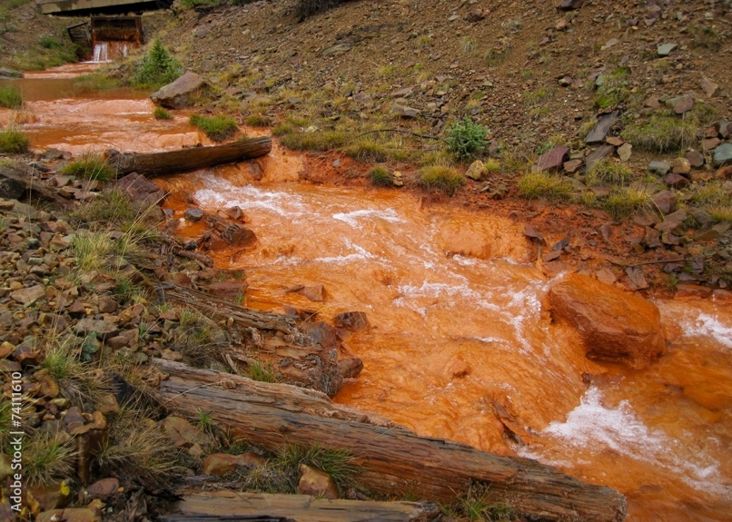
Land use controls – Other Government Controls
CERCLA (Comprehensive Environmental Response, Compensation, and Liability Act)
Created in 1980.
Superfund was created to pay for the cleanup of uncontrolled hazardous waste sites.
Enforced by the EPA.
Pg. 148

Slide 35
Land use controls – Other Government Controls
CERCLA (Comprehensive Environmental Response, Compensation, and Liability Act)
Identifies responsible parties for contamination and orders them to take accountability.
Strict Liability – owner is responsible to the injured party.
Joint and Several Liability – each individual owner is personally responsible for the damages as a whole.
Pg. 148

Slide 36
Land use controls – Other Government Controls
CERCLA (Comprehensive Environmental Response, Compensation, and Liability Act)
Burden to disclose both known and latent (hidden) property defects to the buyer rests on the seller.
The Broker is not obligated to discover issues, but if the broker is aware of an issue, they must disclose what they know.
Pg. 148

Slide 37
Land use controls – Private Controls
Deed Restrictions – commonly called Covenants, Conditions and Restrictions (CC&Rs)
Commonly place setback requirements, square footage minimum and maximums, paint color, etc.
HOA’s institute and enforce their own rules and regulations.
Nonpayment of fees can lead to foreclosure.
Pg. 149

Slide 38
Land use controls – Private Controls
Deed Conditions
Restrict property uses.
Violating a Deed Condition gives the grantor the right to re-take possession of the property and file a suit for legal title.
Pg. 149

Slide 39
The purpose of zoning laws is to preserve property values.
1) True
2) False

Slide 40
The purpose of zoning laws is to preserve property values.
1) True
2) False

Slide 41
A non-profit organization wants to erect a much-needed daycare center in a residential zone. Given other favorable circumstances, the local authorities grant permission by allowing
1) A special exception.
2) An illegal nonconforming use.
3) A variance.
4) A license.

Slide 42
A non-profit organization wants to erect a much-needed daycare center in a residential zone. Given other favorable circumstances, the local authorities grant permission by allowing
1) A special exception.
2) An illegal nonconforming use.
3) A variance.
4) A license.

Slide 43
In addition to government entities, organizations that may be able to condemn property under the power of eminent domain include
1) Public utilities.
2) Financial institutions.
3) Major employers.
4) Neighborhood associations.

Slide 44
In addition to government entities, organizations that may be able to condemn property under the power of eminent domain include
1) Public utilities.
2) Financial institutions.
3) Major employers.
4) Neighborhood associations.

Slide 45
Which of the following situations is most likely to represent an illegal nonconforming use?
1) A homeowner in a residential zone converts her residence to rental offices.
2) A homeowner builds an attached garage in a neighborhood where all the garages are detached.
3) A storeowner remodels a storefront in accordance with regulations, and then the zoning is changed to residential.
4) A new zoning ordinance outlaws two-story additions after a homeowner completes an addition.

Slide 46
Which of the following situations is most likely to represent an illegal nonconforming use?
1) A homeowner in a residential zone converts her residence to rental offices.
2) A homeowner builds an attached garage in a neighborhood where all the garages are detached.
3) A storeowner remodels a storefront in accordance with regulations, and then the zoning is changed to residential.
4) A new zoning ordinance outlaws two-story additions after a homeowner completes an addition.

Slide 47
As evidence that building inspectors have found that a structure complies with building codes and is ready for use, the municipality or county issues a(n)
1) Inspection report.
2) Release bond.
3) Certificate of occupancy.
4) User permit.

Slide 48
As evidence that building inspectors have found that a structure complies with building codes and is ready for use, the municipality or county issues a(n)
1) Inspection report.
2) Release bond.
3) Certificate of occupancy.
4) User permit.

Slide 49
A mineral used for many years as insulation on heat ducts is
1) asbestos.
2) lead.
3) urea-formaldehyde foam.
4) radon.

Slide 50
A mineral used for many years as insulation on heat ducts is
1) asbestos.
2) lead.
3) urea-formaldehyde foam.
4) radon.

Slide 51
Which of the following statements concerning deed restrictions is NOT true?
1) Violation of a deed condition may result in the forfeiture of title to real property.
2) Encumbrances in the form of deed conditions generally run with restricted land into the indefinite future.
3) The penalty for violation or breach of a restrictive covenant is more severe than that for breach of a restrictive covenant.
4) The general goal of deed restrictions is to protect the value of all properties in a development.

Slide 52
Which of the following statements concerning deed restrictions is NOT true?
1) Violation of a deed condition may result in the forfeiture of title to real property.
2) Encumbrances in the form of deed conditions generally run with restricted land into the indefinite future.
3) The penalty for violation or breach of a restrictive covenant is more severe than that for breach of a deed restriction.
4) The general goal of deed restrictions is to protect the value of all properties in a development.

Slide 53
The millage rate (MILL) is equal to one tenth of one cent ($.001)
1) True
2) False

Slide 54
The millage rate (MILL) is equal to one tenth of one cent ($.001)
1) True
2) False

Slide 55
A tax levied against real estate based on its value is:
1) Contrary to the constitutional right to keep private property.
2) An ad nauseam tax.
3) A special assessment.
4) An ad valorem tax.

Slide 56
A tax levied against real estate based on its value is:
1) Contrary to the constitutional right to keep private property.
2) An ad nauseam tax.
3) A special assessment.
4) An ad valorem tax.

Slide 57
A municipality wants to build a water treatment facility and requires some privately owned land to do so. What procedure enables the municipality to buy the property, even against the owner’s wishes?
1) Escheat.
2) Alienation.
3) Estoppel.
4) Eminent Domain.

Slide 58
A municipality wants to build a water treatment facility and requires some privately owned land to do so. What procedure enables the municipality to buy the property, even against the owner’s wishes?
1) Escheat.
2) Alienation.
3) Estoppel.
4) Eminent Domain.

Slide 59
A town is replacing a sidewalk that serves five homes. The length of the sidewalk is 200 feet. Mary’s property has 38 feet of front footage. If the cost of the project to be paid by special assessment is $7,000, what will Mary’s assessment be?
1) $1,400
2) $1,330
3) $184
4) $1,840

Slide 60
A town is replacing a sidewalk that serves five homes. The length of the sidewalk is 200 feet. Mary’s property has 38 feet of front footage. If the cost of the project to be paid by special assessment is $7,000, what will Mary’s assessment be?
1) $1,400
2) $1,330 ($7,000 ÷ 200 = $35/ft. 38 feet x $35 = $1,330)
3) $184
4) $1,840

Slide 61
Which of the following can legally levy real property taxes?
1) The Internal Revenue Service.
2) A utility company.
3) A tax district.
4) A court of law.

Slide 62
Which of the following can legally levy real property taxes?
1) The Internal Revenue Service.
2) A utility company.
3) A tax district.
4) A court of law.

