Slide 1


Slide 2

Colorado Contracts and Regulations
Chapter 17
Closing and Settlement Documents

Slide 3
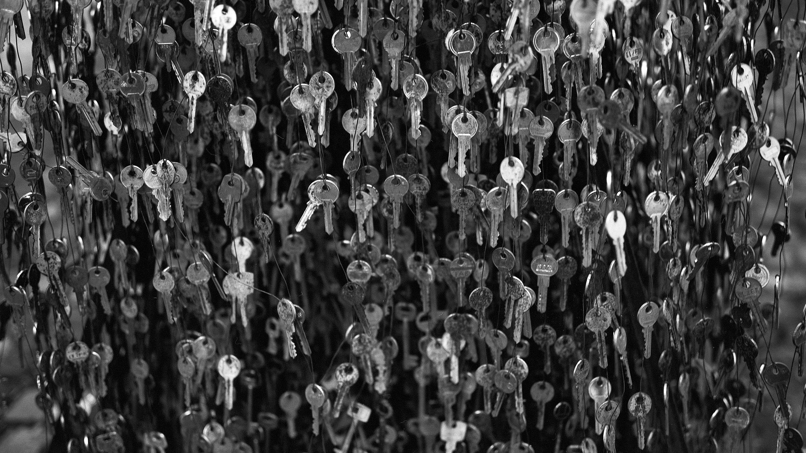
Promissory Notes
  A promissory note is the written promise of one person to pay a certain sum of money to another at a future specified time.
  An acceleration clause is a clause in a promissory note that gives the lender the right to call all sums due and payable in advance of the fixed payment date upon the occurrence of a specified event.
pg. 427

Slide 4
Promissory Notes
  Due on sale or alienation clause. This clause makes it possible for a lender to eliminate low interest rate loans should the property be sold during a period when interest rates are higher than the rate called for in the note.
pg. 427

Slide 5
Promissory Notes
  There are several Real Estate Commission approved promissory note forms for specific situations.
- The Earnest Money Promissory Note is to be
used when the prospective purchaser is not
providing earnest money in cash, check or
property.
pg. 428

Slide 6
Promissory Notes
  There are several Real Estate Commission approved promissory note forms for specific situations. (cont.)
- A signed earnest money promissory note should
be due prior to closing so the funds will be
available in the escrow account as “Good
Funds” to be disbursed at closing. The note
would be payable to the listing broker for
collection and deposited into the listing broker’s
trust account.
pg. 428

Slide 7
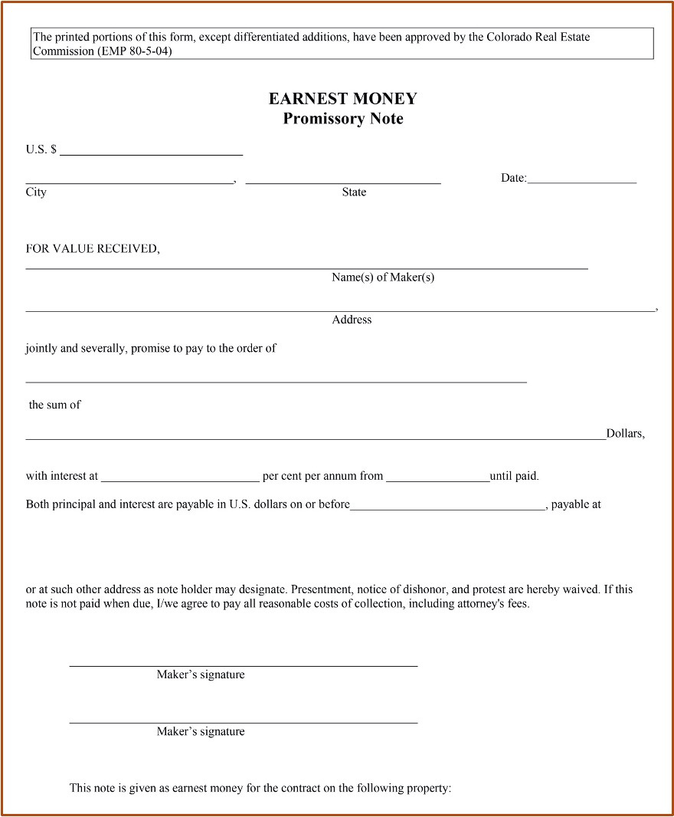

Slide 8
Uniform Commercial Credit Code (UCCC)
  The Colorado UCCC contains provisions for disclosure, the right of rescission, and advertising similar to Regulation Z of the Federal Truth-in-Lending Act (T.I.L.).
  The fundamental purpose of the UCCC is to protect the consumer in consumer credit transactions.
pg. 430

Slide 9
Uniform Commercial Credit Code (UCCC)
  One of the major distinctions between Regulation Z and the UCCC is that the UCCC establishes finance charge limitations as they apply to consumer credit sales, consumer loans, supervised loans, consumer related sales, and consumer related loans.
pg. 430

Slide 10
Uniform Commercial Credit Code (UCCC)
  The maximum rates allowed depend on whether the lender is classified as a “creditor.”
  For UCCC purposes, a creditor is someone who has had more than five consumer credit transactions in the preceding calendar year or in the current year.
pg. 430

Slide 11
Uniform Commercial Credit Code (UCCC)
  The following limitations are currently in effect:
- If the seller (lender) is not a creditor, he may
charge up to 21% on a loan of $3,000 or less
and up to 45% on loans above $3,000.
- If there is a prearranged sale of the loan to a
creditor, the finance charge may not exceed
21%.
pg. 430

Slide 12
Uniform Commercial Credit Code (UCCC)
  The following limitations are currently in effect (cont.):
- If the seller (lender) is a creditor, the maximum
finance charge is 21% for any size loan except
that a creditor lender may charge up to 45% on
a first loan against a residence to finance the
purchase of the residence.
pg. 430

Slide 13
Uniform Commercial Credit Code (UCCC)
  A broker who takes his commission in the form of a note secured by the property is subject to the same limits.
pg. 430

Slide 14
Uniform Commercial Credit Code (UCCC)
  Another provision of the Colorado UCCC states that if a promissory note secured by a second or lower priority Deed of Trust has a balloon payment, the debtor has a right to the following disclosure in writing at the time the credit is consummated: “Purchaser has the right to refinance the balloon payment at the time due; (1) at the lender’s prevailing interest rates at the time due; (2) if the purchaser meets the lender’s normal credit standards at the time due; and (3) if the lender is in the business of extending such credit at the time the balloon payment is due.”
pg. 430

Slide 15
Uniform Commercial Credit Code (UCCC)
  This disclosure may be required in the sales contract if the contract obligates the borrower to a loan.
  If the Seller is a creditor, the note called “UCCC – No Default Rate” (NTD 82-10-06) must be used. If the Seller appears to be a creditor due to a large number of seller financed transactions within the last year or because of other business for which the Seller is a creditor, it is crucial to have the credit transaction drafted by an attorney representing the Seller.
pg. 431

Slide 16
Uniform Commercial Credit Code (UCCC)
  The Contract to Buy and Sell now stipulates that an attorney should be involved with regard to any Seller Financing Scenario. Licensees must exercise extreme caution in their involvement with Seller financing scenarios.
pg. 431

Slide 17
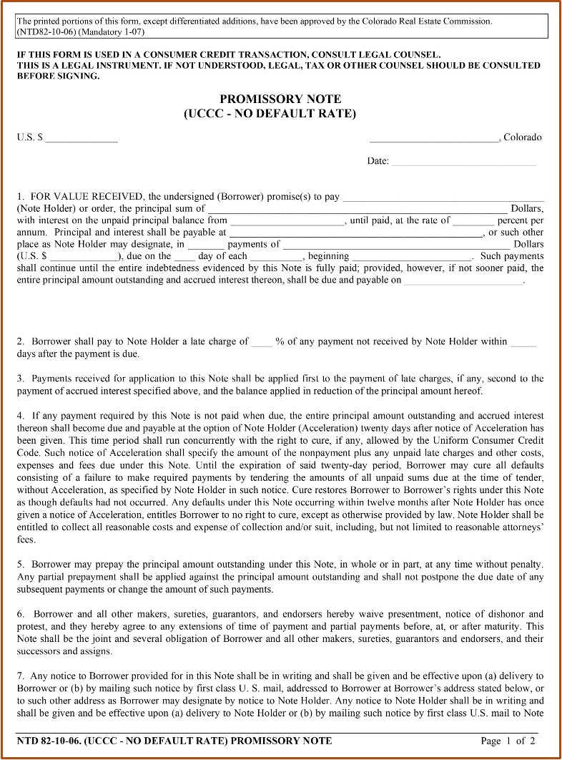

Slide 18
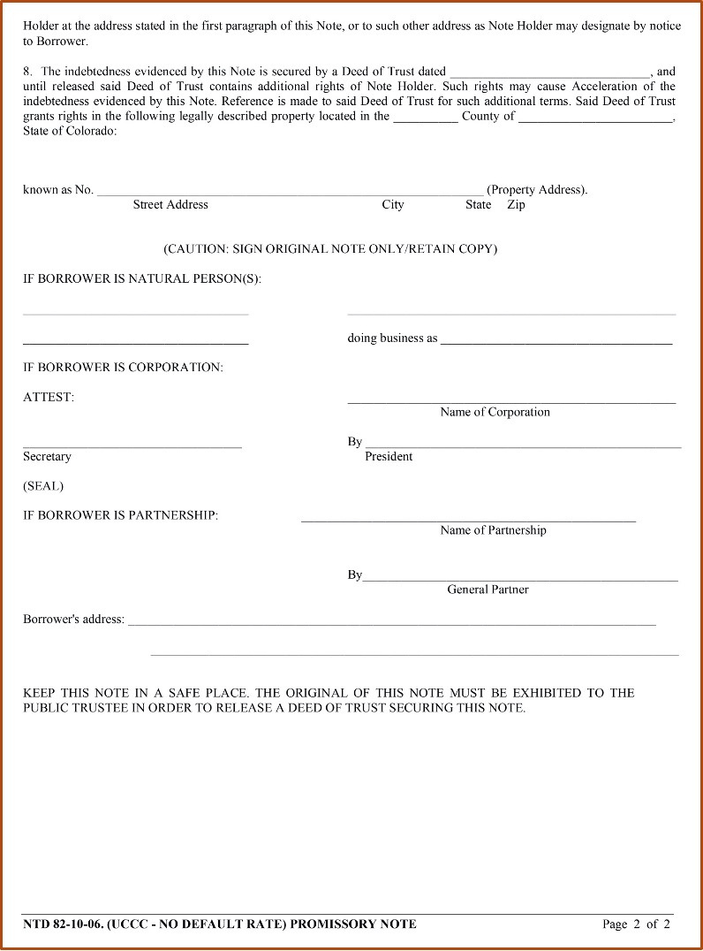

Slide 19
Security Instruments
  One of the basic legal differences between a mortgage and a Deed of Trust is that a mortgage is a two-party instrument between a mortgagor and a mortgagee, while a Deed of Trust is a three-party agreement between a borrower, a lender, and a third party, called a Trustee.
pg. 432

Slide 20
Security Instruments
  The Deed of Trust is a deed by the borrower to a trustee for the purposes of securing a debt.
  Colorado is a lien theory state, it creates a lien on the title and not a title transfer. It can be foreclosed by a non-judicial sale held by the trustee.
pg. 432

Slide 21
Security Instruments
  A mortgage is the pledging of a property to a lender as a security for a mortgage loan. It is evidence of a debt.
  The mortgage is security for the loan that the lender makes to the borrower.
  The main function of the mortgage is to provide security to the lender.
pg. 432

Slide 22
Security Instruments
  A deed of trust differs from a mortgage in that it can be foreclosed by a non-judicial sale held by the public trustee.
  Can be much faster for a deed of trust than for a mortgage (usually completed with a judicial foreclosure), on the order of 3-4 months rather than a year, or longer.
pg. 432

Slide 23
Security Instruments
  Because the foreclosure does not require actions by the court, the foreclosure costs can be quite a bit less.
  A deed of trust may need to be foreclosed through a judicial proceeding if a PRIVATE (not public) trustee is utilized.
pg. 432

Slide 24
Security Instruments
  The type of financing involving real estate is referred to as hypothecation.
  The borrower remains the legal owner and retains the right of possession and control of the property while the lender has “bare (naked) title”, which is an equitable title in the property.
  Under hypothecation the lender only has a security interest in the property, which ends when the loan is paid off.
pg. 432

Slide 25
Security Instruments
  The borrower has the right to have the mortgage discharged from the title once the debt is paid.
  The lender (mortgagee) executes a release or satisfaction of mortgage.
  The mortgagor should record this in the office of the county clerk and recorder in which the property is located.
pg. 432

Slide 26
Security Instruments
  When an indebtedness secured by a mortgage has been paid in full by the borrower without default, the mortgagee (lender) executes a release or satisfaction of mortgage.
  The borrower should record this in the office of the county clerk and recorder in which the property is situated.
pg. 432

Slide 27
Security Instruments
  When indebtedness secured by a Deed of Trust is paid, the beneficiary (lender) should deliver a request for Release of Deed of Trust together with the cancelled Note and the Deed of Trust itself to the Public Trustee.
  Upon payment of the administrative fee, the trustee will execute the Release of Deed of Trust, which should be recorded in the office of the county clerk and recorder.
pg. 432

Slide 28
Security Instruments
  The borrowers promise the lender that:
- They will pay the taxes on the property
- They will keep the property insured
- They will keep the property free of debris
- They will not remove any improvements without the lender’s permission
pg. 433

Slide 29
Security Instruments
  The borrowers promise the lender that (cont.):
- The lender can have reasonable access to the
property to verify the agreements are being
kept
- They will not contain hazardous materials
(drugs, explosives, chemicals) etc. on the
property
pg. 433

Slide 30
Security Instruments
  Clauses usually found in a Deed of Trust may be:
- Acceleration Clause
- Alienation Clause
- Prepayment Penalties
- Lock-in Clause
- Defeasance Clause
- Riders (Second Home, One to Four Family, PUD,
Condominium, Adjustable Rate)
pg. 433

Slide 31
Deeds of Trust
  There are three Real Estate Commission approved Deed of Trust forms. If the broker is preparing the Deed of Trust one of these approved forms must be used.
pg. 435

Slide 32
Deeds of Trust
  TD 72-8-10 contains a Strict Due on Transfer provision. If any of the things which are defined as constituting a “transfer” of the property occur, the lender may immediately call the note due.
  TD 73-8-10 makes the loan assumable by a qualified new borrower.
  TD 74-8-10 makes the loan freely assumed without any restrictions.
pg. 435

Slide 33
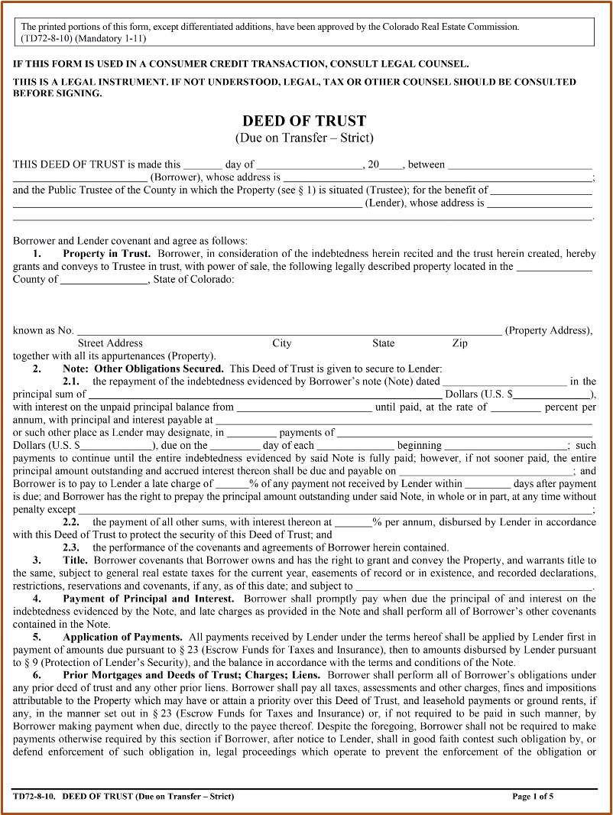

Slide 34
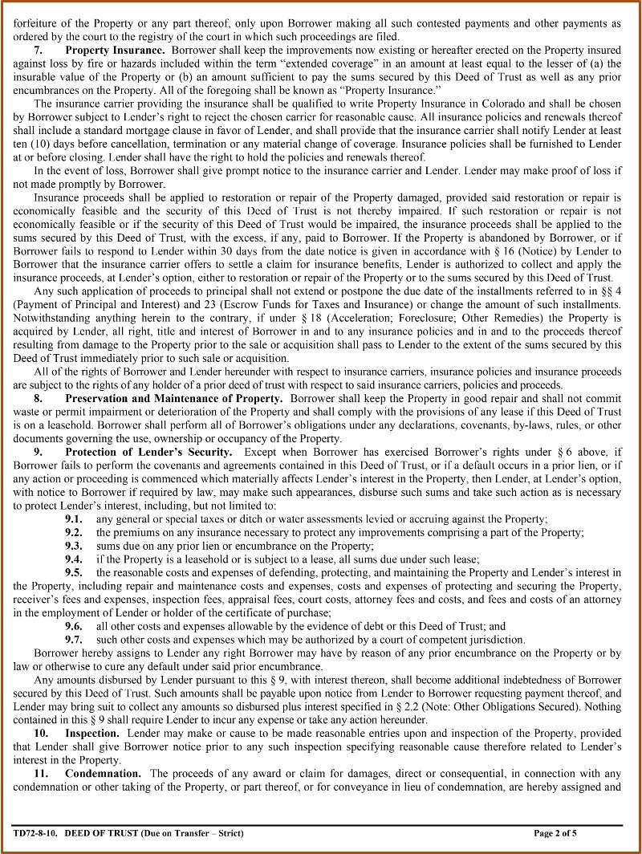

Slide 35
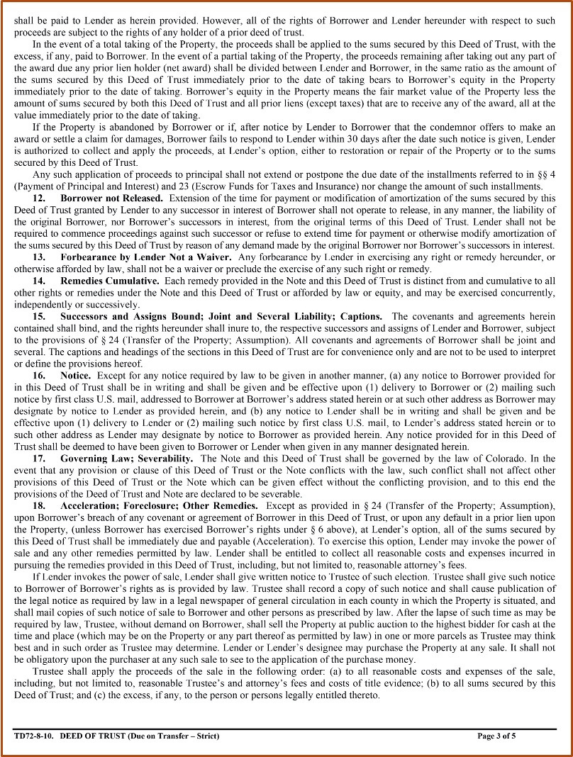

Slide 36
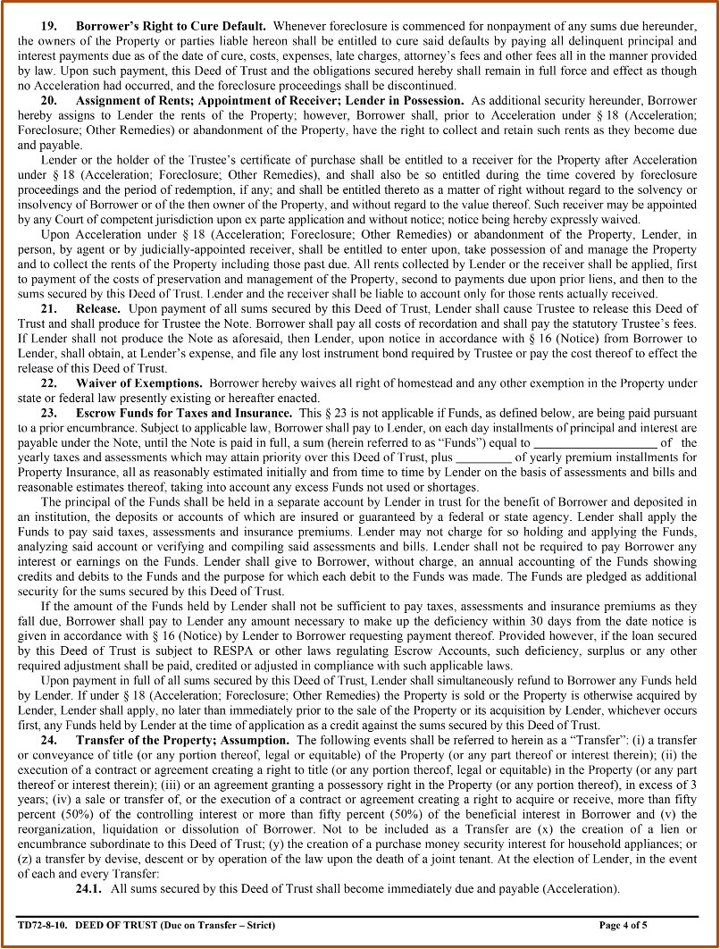

Slide 37
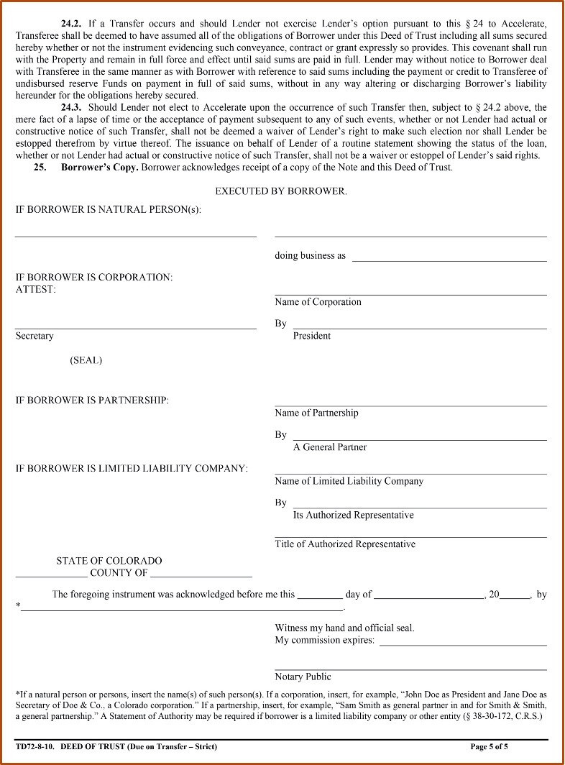

Slide 38
Closing and Closing Statements
  Purpose of closing is to finalize the sales contract and provide the parties with a proper accounting of their transaction with each other.
  The worksheet shows the complete settlement picture for all of the parties.
pg. 442

Slide 39
Closing and Closing Statements
  Listing Brokerage firm has the overall responsibility of the closing.
  Each designated broker has responsibility for the closing statement of the party they represent.
pg. 442

Slide 40
Closing and Closing Statements
  Most of the money amounts and their distributions are a direct result of what the buyer and seller have agreed to in the Contract to Buy and Sell.
  Other items may depend upon state or federal law, requirements of a particular loan program (i.e. VA) or even consideration on who would benefit from an item.
pg. 442

Slide 41
Closing and Closing Statements
  All changes to a contract must be codified on an Agreement to Amend/Extend.
  Licensees cannot close when there is an oral agreement. All terms must be in writing.
  Buyers and Sellers will pay their respective closing costs as defined in the written agreements. (CBS, Amendments, Post Closing Occupancy, Closing Instructions, etc.)
pg. 442

Slide 42
Closing and Closing Statements
  Using the CBS and other documents the closer produces a closing statement for the seller and buyer.
  This statement will show all the debits and credits of the party and the final balance of money the party is to receive or needs to bring to closing.
pg. 442

Slide 43
Closing and Closing Statements
  Most brokers traditionally use title companies to actually calculate and carry out the closing. The Broker retains all of the responsibility for the accuracy of the information.
pg. 443

Slide 44
Closing and Closing Statements
  Once completed the buyer and seller figures are transferred to a separate two-column individualized settlement statement. The 2-column settlement statement is a mandatory form.
  Each broker is required to retain the information and documentation pertaining to the closing for at least four years.
pg. 443

Slide 45
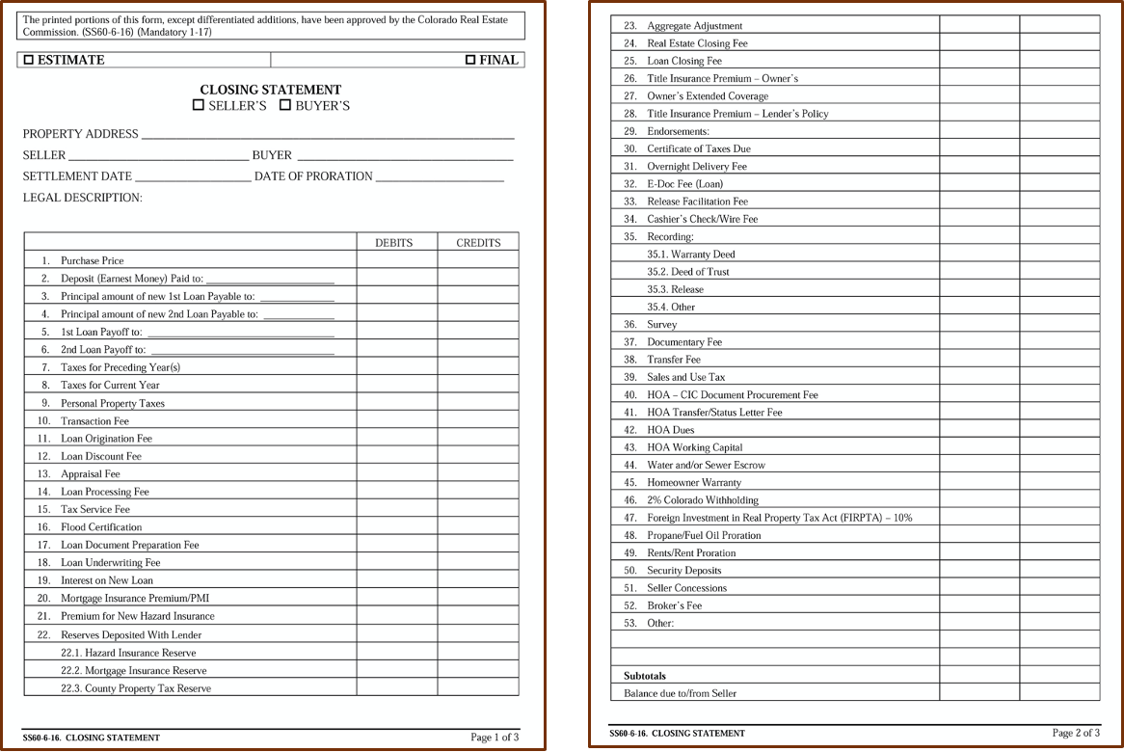

Slide 46
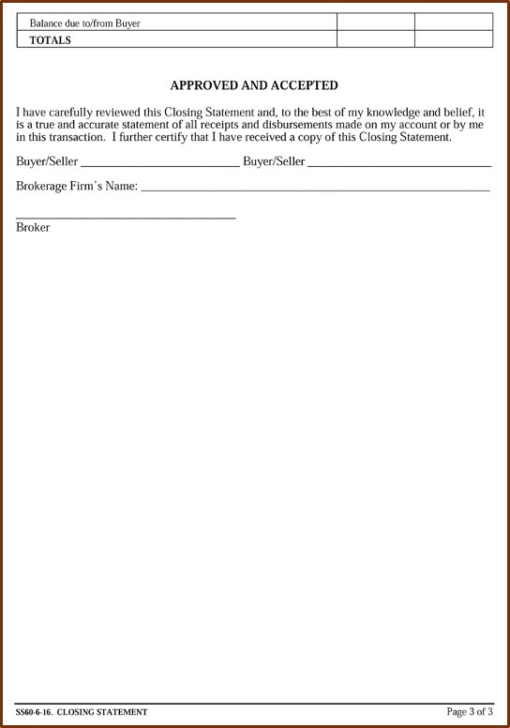

Slide 47
Deeds of Conveyance
  A Deed of Conveyance is a legal document that serves as proof of the transference of deed (or title) from one owner to another.
  The Real Estate Commission has approved forms for the Warranty Deed, Special Warranty Deed, Bargain and Sale Deed and Quit Claim Deed.
pg. 447

Slide 48
Deeds of Conveyance
  Though permitted to fill them out, it is highly recommended that brokers don’t do it and have title professionals or attorneys prepare deeds on their behalf.
pg. 447

Slide 49
Bills of Sale
  A legal document prepared by the Seller and given to the Buyer conveying specific items of personal property.
  Two bills of sale have been created in Colorado for the transfer of personal property. Both Bills of Sale have language that directly mirrors the Contract to Buy and Sell Real Estate or the language in the Personal Property Agreement.
pg. 448

Slide 50
Bills of Sale
  Most title companies will prepare Bills of Sale on behalf of the Broker for real estate transaction.
pg. 448

Slide 51
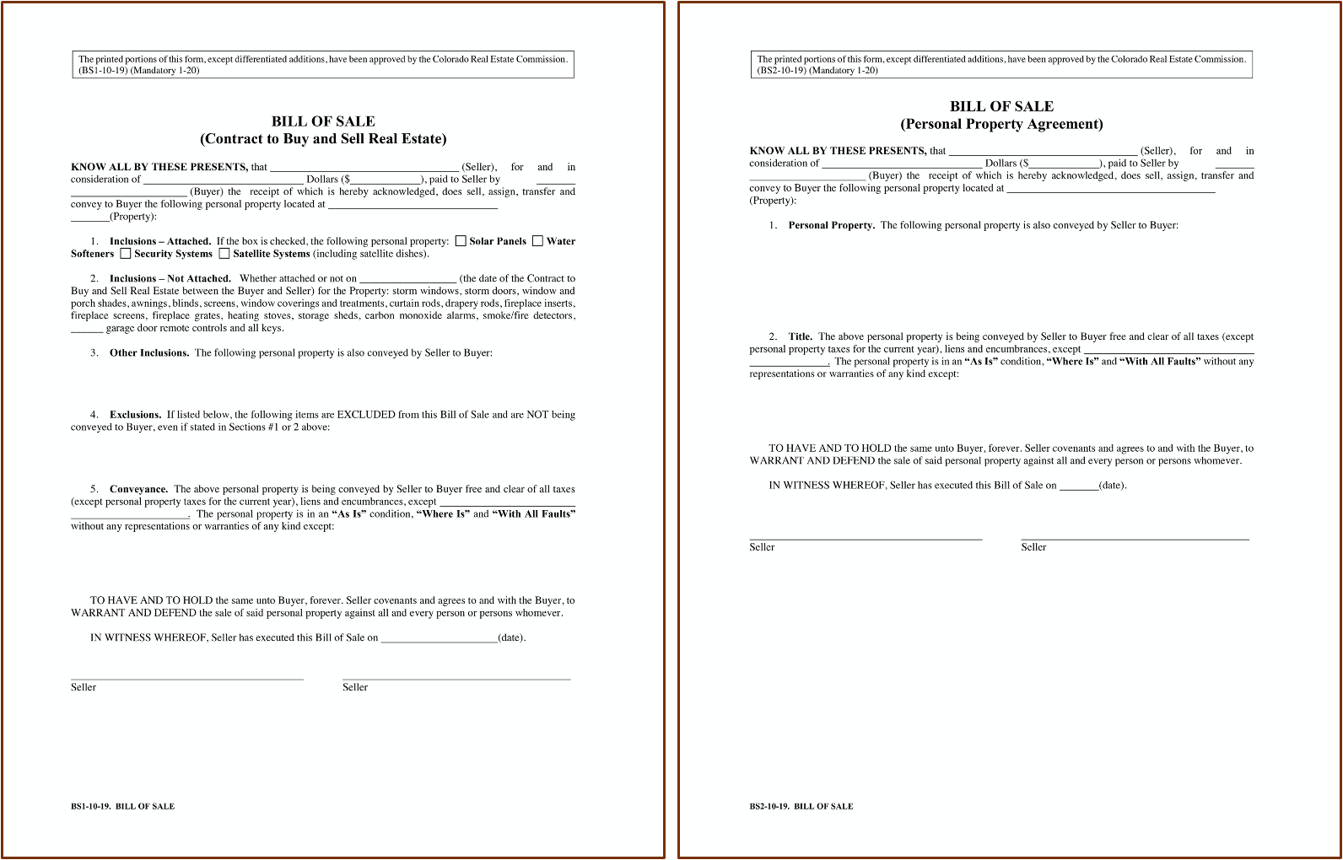

Slide 52
Real Property Transfer Declaration (TD-1000)
  The Real Property Transfer Declaration provides essential information to the County Assessor to help insure fair and uniform assessments of all property for property tax purposes.
  All documents of conveyance (deeds) subject to the documentary fee submitted to the County Clerk and Recorder for recordation must be accompanied by a Real Property Transfer Declaration.
pg. 451

Slide 53
Real Property Transfer Declaration (TD-1000)
  This declaration must be completed and signed by the grantor (seller) or grantee (buyer).
  Whenever a Real Property Transfer Declaration does not accompany the deed, the Clerk and Recorder notifies the county assessor who will send a notice to the buyer requesting that the declaration be returned within thirty days after the notice is mailed.
pg. 451

Slide 54
Real Property Transfer Declaration (TD-1000)
  If the completed Real Property Transfer Declaration is not returned to the County Assessor within the 30 days of notice, the assessor may impose a penalty of $25.00 or .025% of the sale price, whichever is greater.
  In most cases the title company will handle the completion of the Real Property Transfer Declaration as part of their customary duties in assisting the Broker in closing the transaction.
pg. 451

Slide 55
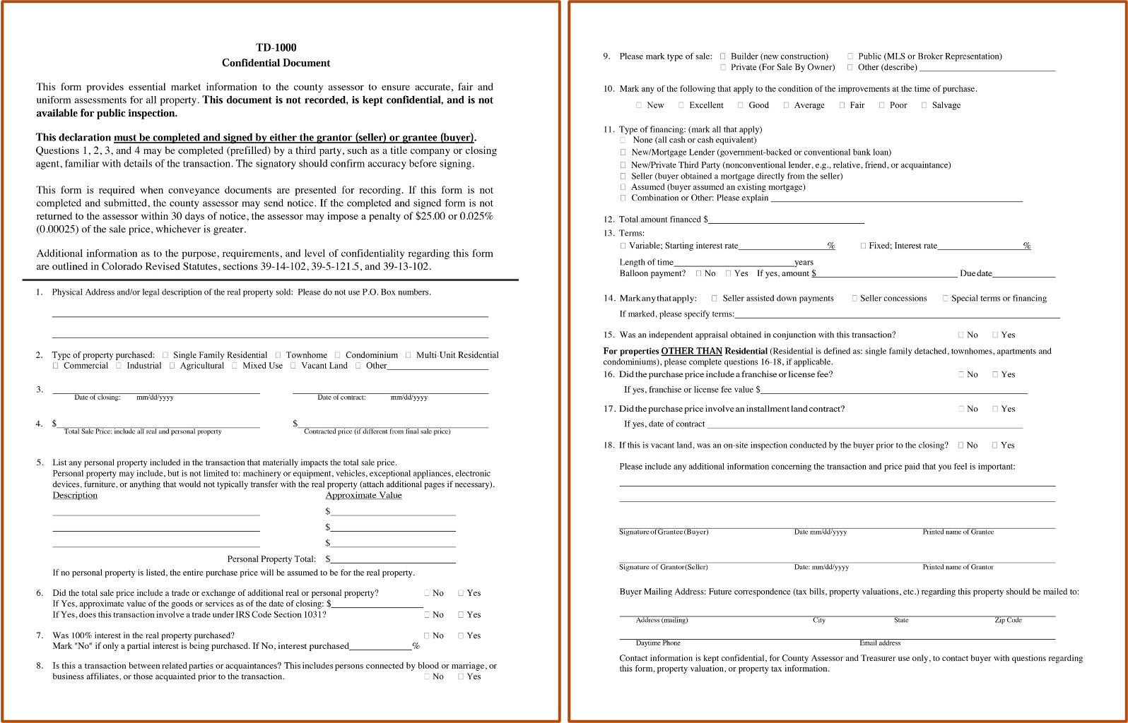

Slide 56
A promissory note for earnest money should be made payable to the listing brokerage firm.
1) True
2) False

Slide 57
A promissory note for earnest money should be made payable to the listing brokerage firm.
1) True
2) False

Slide 58
What is the primary difference between the Commission-approved Deed of Trust forms?
1) Forms are specific for residential, agricultural, and investment loans.
2) Forms are specific for Public Trustee or private trustee loans.
3) Forms contain different provisions for assumption of the loan upon sale of the property.
4) Forms contain different provisions depending on the loan program to be used for funding the loan.

Slide 59
What is the primary difference between the Commission-approved Deed of Trust forms?
1) Forms are specific for residential, agricultural, and investment loans.
2) Forms are specific for Public Trustee or private trustee loans.
3) Forms contain different provisions for assumption of the loan upon sale of the property.
4) Forms contain different provisions depending on the loan program to be used for funding the loan.

Slide 60
The Commission-approved Deed of Trust form has options for fully assumable, strict due-on-sale, or assumable if creditworthy.
1) True
2) False

Slide 61
The Commission-approved Deed of Trust form has options for fully assumable, strict due-on-sale, or assumable if creditworthy.
1) True
2) False

Slide 62
The Commission-approved Deed of Trust form has an option for an automatic 1 percent increase in the interest rate if the loan is assumed.
1) True
2) False

Slide 63
The Commission-approved Deed of Trust form has an option for an automatic 1 percent increase in the interest rate if the loan is assumed.
1) True
2) False

Slide 64
The Earnest Money Promissory Note
1) should not be used because earnest money should be in good funds.
2) must be due early enough to ensure good funds for closing.
3) should be accompanied by any of the three Deed of Trust forms.
4) allows the Seller to sue for the earnest money in case the closing fails.

Slide 65
The Earnest Money Promissory Note
1) should not be used because earnest money should be in good funds.
2) must be due early enough to ensure good funds for closing.
3) should be accompanied by any of the three Deed of Trust forms.
4) allows the Seller to sue for the earnest money in case the closing fails.

Slide 66
If an Earnest Money Promissory Note is used, it must be described in the Contract to Buy and Sell.
1) True
2) False

Slide 67
If an Earnest Money Promissory Note is used, it must be described in the Contract to Buy and Sell.
1) True
2) False

Slide 68
If the Buyer fails to redeem the Earnest Money Promissory Note, they will be liable for all reasonable costs of collections.
1) True
2) False

Slide 69
If the Buyer fails to redeem the Earnest Money Promissory Note, they will be liable for all reasonable costs of collections.
1) True
2) False

Slide 70
When the Earnest Money Promissory Note is used to provide earnest money, another condition that must be met includes that the
1) Buyer must provide a financial statement to qualify for the note.
2) Note must be specifically mentioned in the contract.
3) Note must be held by the Buyer’s Broker until it is honored.
4) Listing broker will be responsible to sue the Buyer if the note is not honored.

Slide 71
When the Earnest Money Promissory Note is used to provide earnest money, another condition that must be met includes that the
1) Buyer must provide a financial statement to qualify for the note.
2) Note must be specifically mentioned in the contract.
3) Note must be held by the Buyer’s Broker until it is honored.
4) Listing broker will be responsible to sue the Buyer if the note is not honored.

Slide 72
An Earnest Money Promissory Note may be redeemed with the Buyer’s check at closing.
1) True
2) False

Slide 73
An Earnest Money Promissory Note may be redeemed with the Buyer’s check at closing.
1) True
2) False

Slide 74
Commission-approved Deed of Trust forms all contain strict due-on-sale clauses.
1) True
2) False

Slide 75
Commission-approved Deed of Trust forms all contain strict due-on-sale clauses.
1) True
2) False

