Slide 1


Slide 2

Colorado Closings and Settlement
Chapter 22
Prorations

Slide 3

How to Calculate Prorations
  In Colorado, we use a 365 day year (366 days for a leap year) for prorating.
  Every separate month must be calculated according to the exact number of days in that particular month.
pg. 577

Slide 4
How to Calculate Prorations
  In Colorado, the buyer is considered to own the property all day on the day of closing. Day of closing belongs to the BUYER.
pg. 577

Slide 5
How to Calculate Prorations
  NEVER PRORATE:
    Tax Reserve
    Hazard Insurance Reserve
    FHA Insurance Reserve
    Security Deposits
    Mortgage Payment
    Special Taxes (assessments)
pg. 577

Slide 6
Prorating Real Property Taxes
  Using the closing date of July 1 for this problem and annual real estate taxes of $1,366.00, compute the dollar amount of tax adjustment to be made.
  Remember in Colorado, real estate taxes become a lien on real property on January 1 of the current year and are due and payable on January 1 of the next year. Therefore, real estate taxes are paid in arrears.
pg. 578

Slide 7
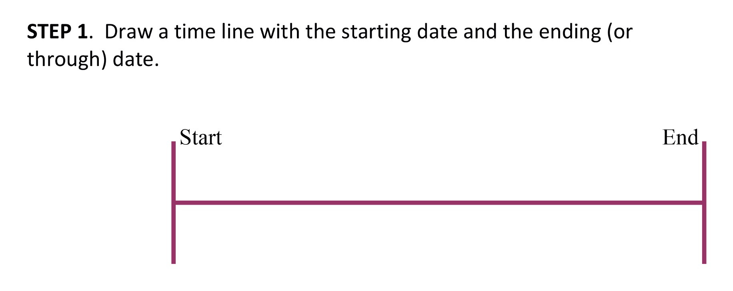
  On a July 1 closing, how many days has the seller owned the property?

Slide 8
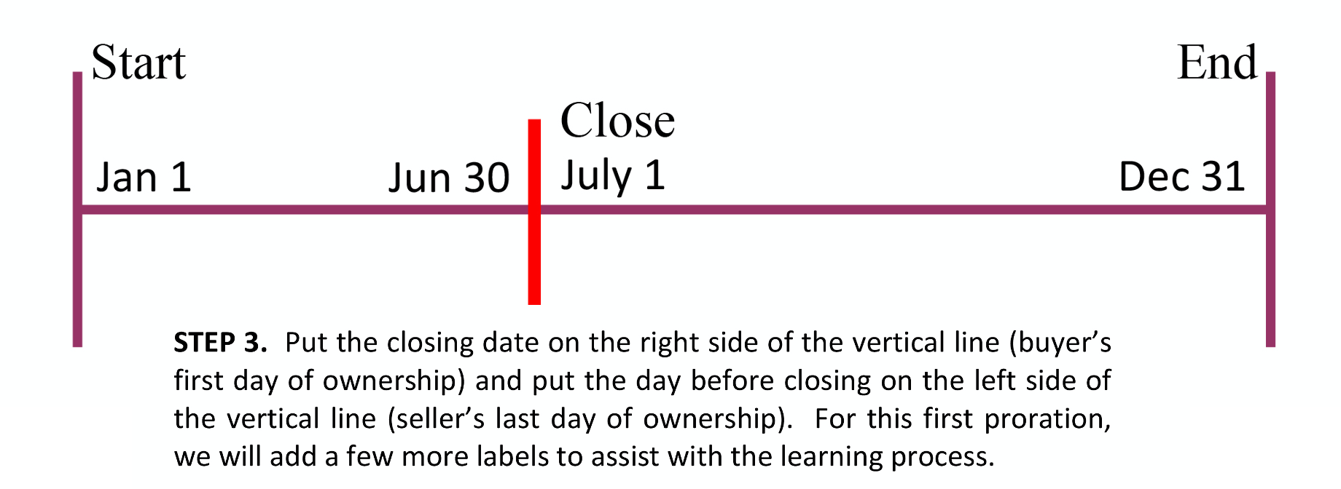
  Using the closing date of July 1 for this problem and annual real estate taxes of $1,366.00, compute the dollar amount of tax adjustment to be made.

Slide 9
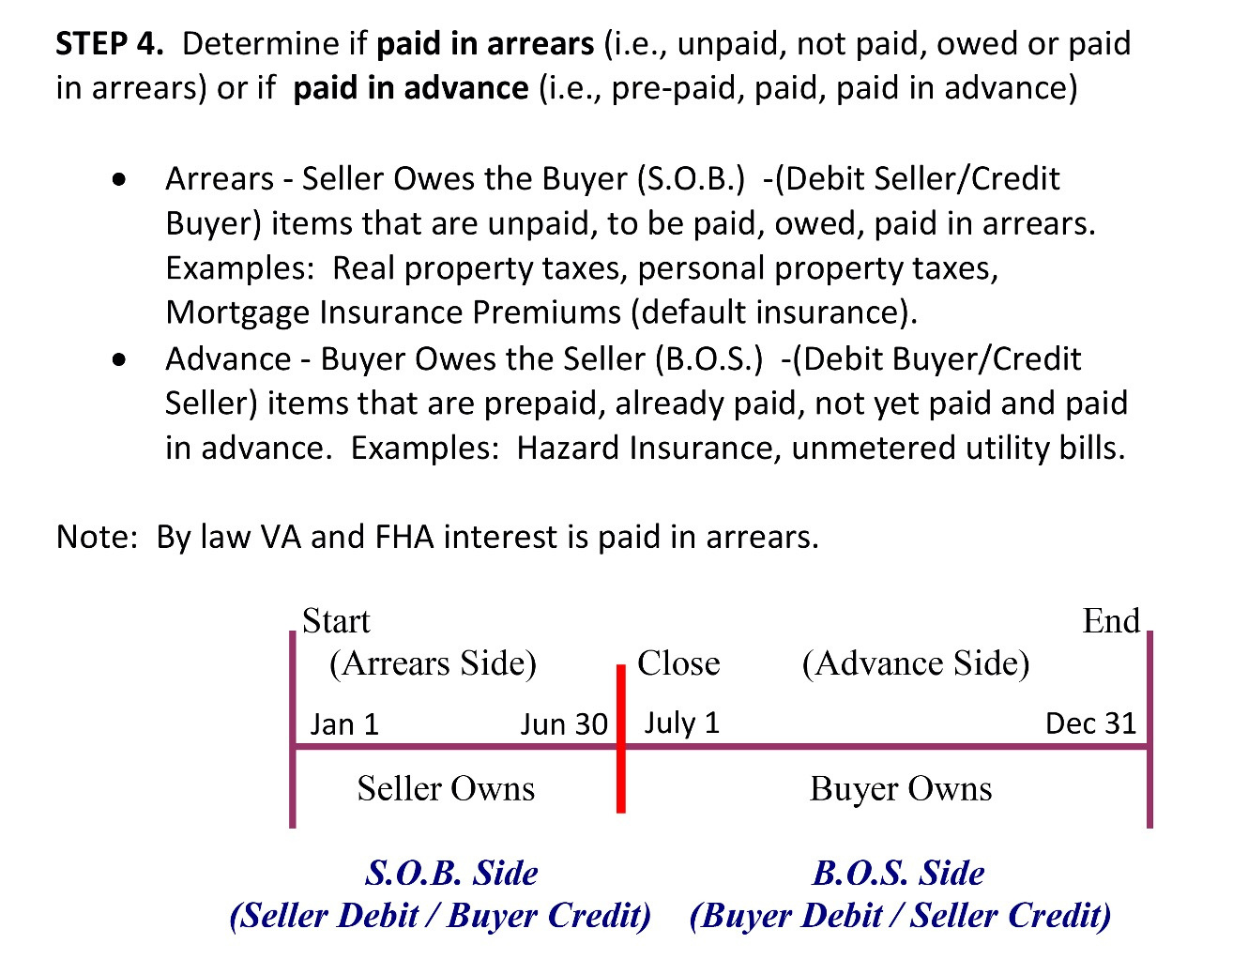
  Using the closing date of July 1 for this problem and annual real estate taxes of $1,366.00, compute the dollar amount of tax adjustment to be made.
pg. 579

Slide 10
Prorating Real Property Taxes
  Count the days (remember to use actual number of days in each month) and label the sides (arrears and advance) appropriately. Various different methods can be utilized to calculate the days accurately. The “knuckle method” and the “song.”
pg. 580

Slide 11
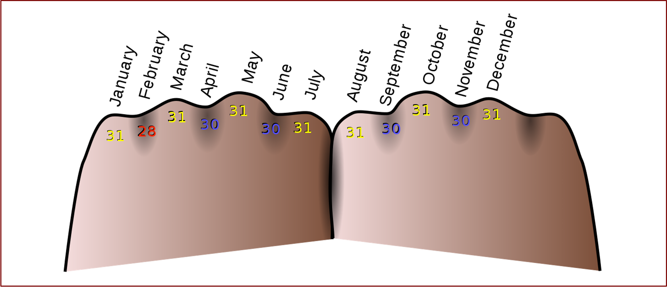

Slide 12
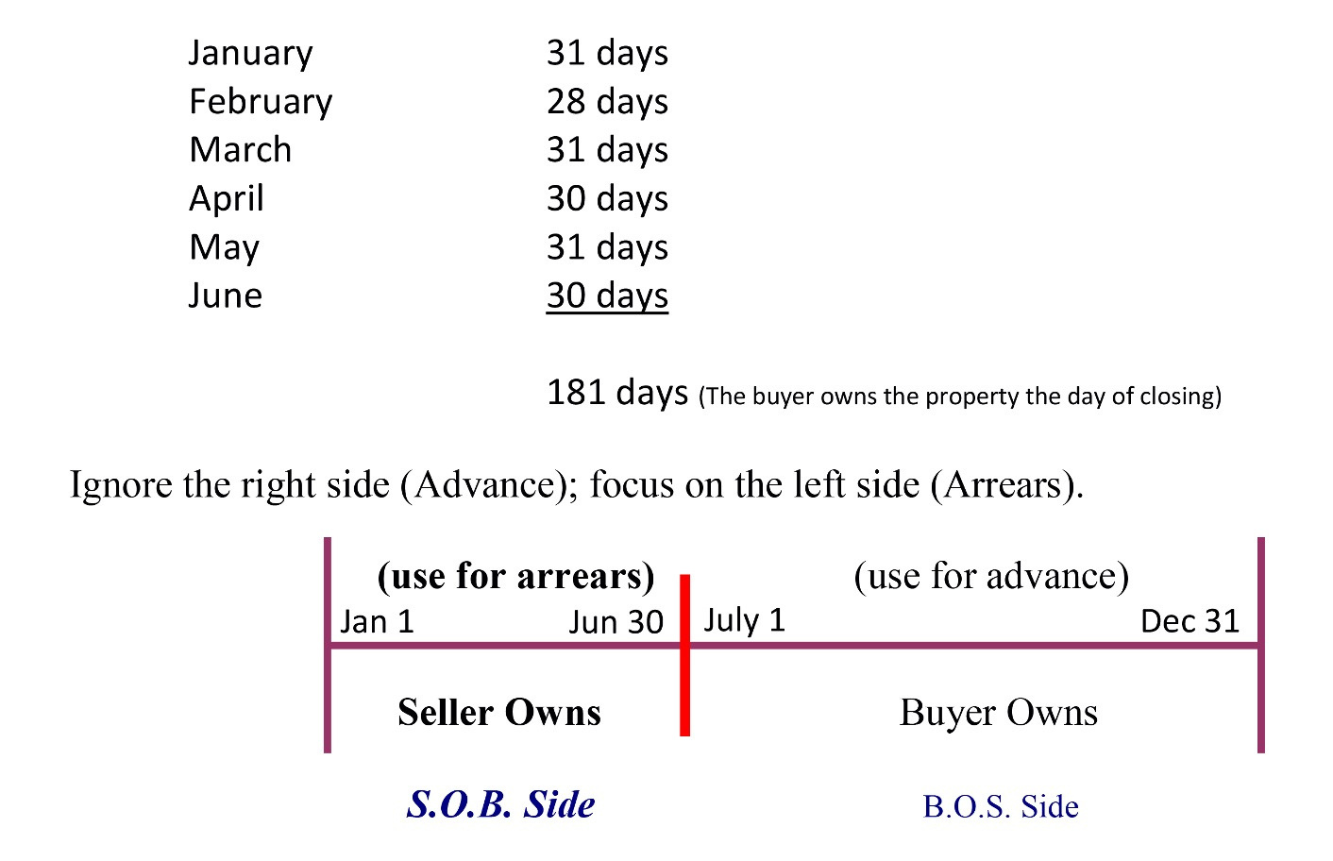
  Using the closing date of July 1 for this problem and annual real estate taxes of $1,366.00, compute the dollar amount of tax adjustment to be made.
pg. 580

Slide 13
Prorating Real Property Taxes
Step 6: Per Diem Method
  To calculate the prorated amount owed by the Seller follow the following steps:
pg. 581

Slide 14
Prorating Real Property Taxes
Step 6: Per Diem Method
  Divide the total dollar amount ($1,366.00) by the total number of days in the period (365 days).
$1,366 ÷ 365 = $3.74246575 (per diem)
pg. 581

Slide 15
Prorating Real Property Taxes
Step 6: Per Diem Method
  Multiply the per diem amount ($3.74246575) by the number of days the Seller is responsible for.
$3.74246575 x 181 = $677.386301
pg. 581

Slide 16
Prorating Real Property Taxes
Step 6: Per Diem Method
$1,366.00 ÷ 365 = $3.74246575 x 181 =
$677.39 (rounded up)
pg. 581

Slide 17
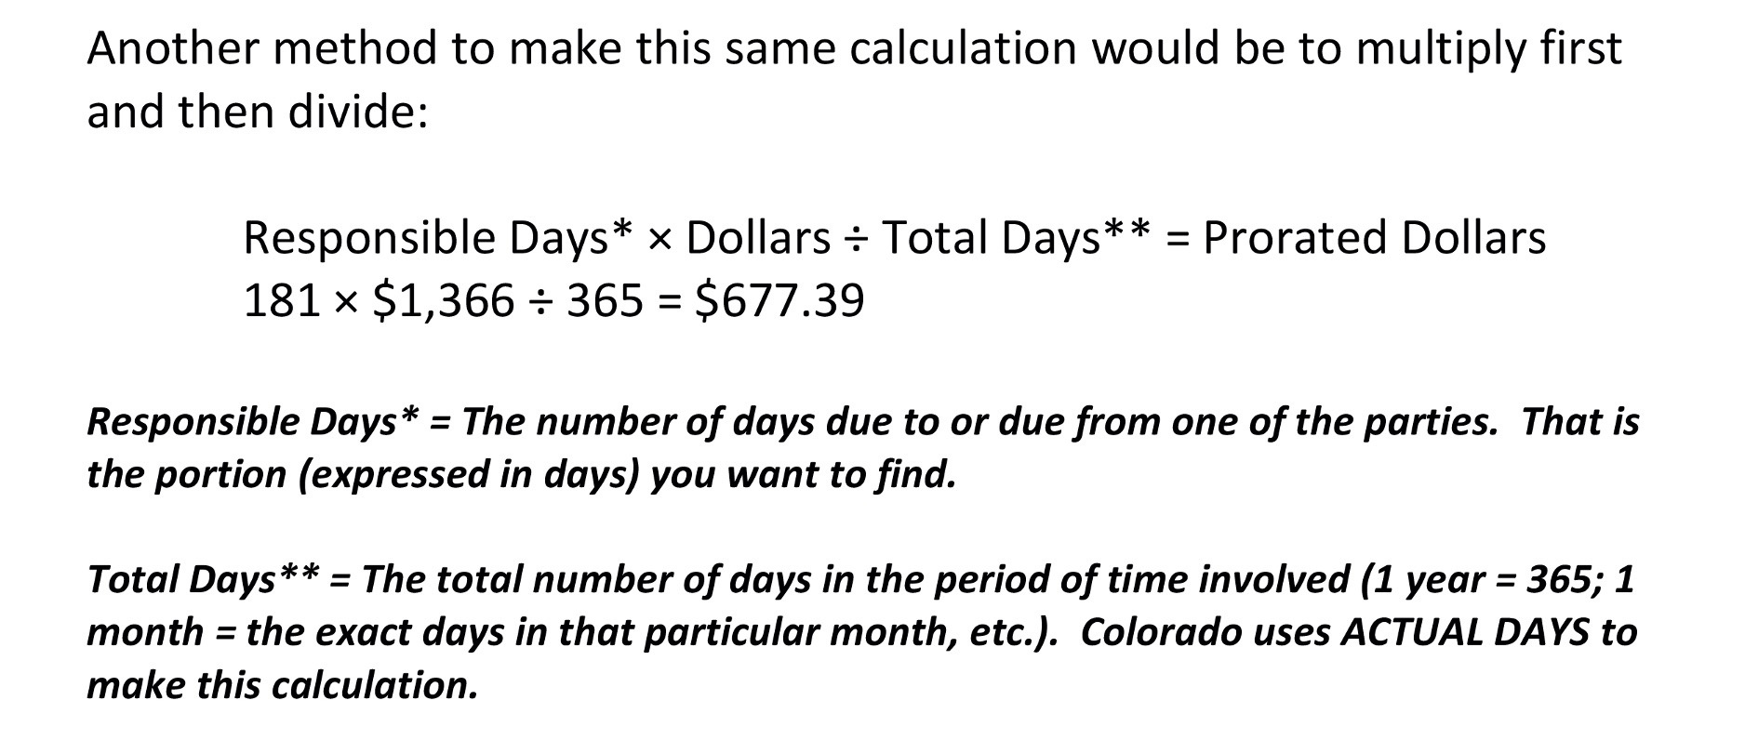

Slide 18
Prorating Insurance Premiums
  Hazard Insurance is seldom assumed because of problems with coverage and permission from the insurer.
  Hazard insurance is normally paid by the seller in advance of the covered period.
  Prorations are based on the effective date of the policy and not on the date the premium may have been paid.
pg. 583

Slide 19
Prorating Insurance Premiums
  For test purposes you will be given the first or last day of the policy:
- If a policy is issued on February 1st, it will expire
midnight January 31st, one year later. January
31st will be the last day for which a premium
will be charged.
pg. 583

Slide 20
Prorating Insurance Premiums
  For test purposes you will be given the first or last day of the policy (cont.):
- If you are told the policy expires at 12:01 a.m.,
February 1, again January 31st is the last full day
of insurance coverage.
- If you are told only that the policy expires
February 1st and nothing more, you must consider
February 1st as the last premium day.
pg. 583

Slide 21
Prorating Insurance Premiums
  An insurance policy was issued on February 1st of this year and the last day of insurance will be January 31st of next year.
  Insurance premiums are paid in advance, so the seller has already paid this bill of $480.00.
pg. 583

Slide 22
Prorating Insurance Premiums
  The number of days remaining of prepaid insurance needs to be calculated and the buyer needs to be charged accordingly at closing.
  Date of closing is July 1.
pg. 583

Slide 23
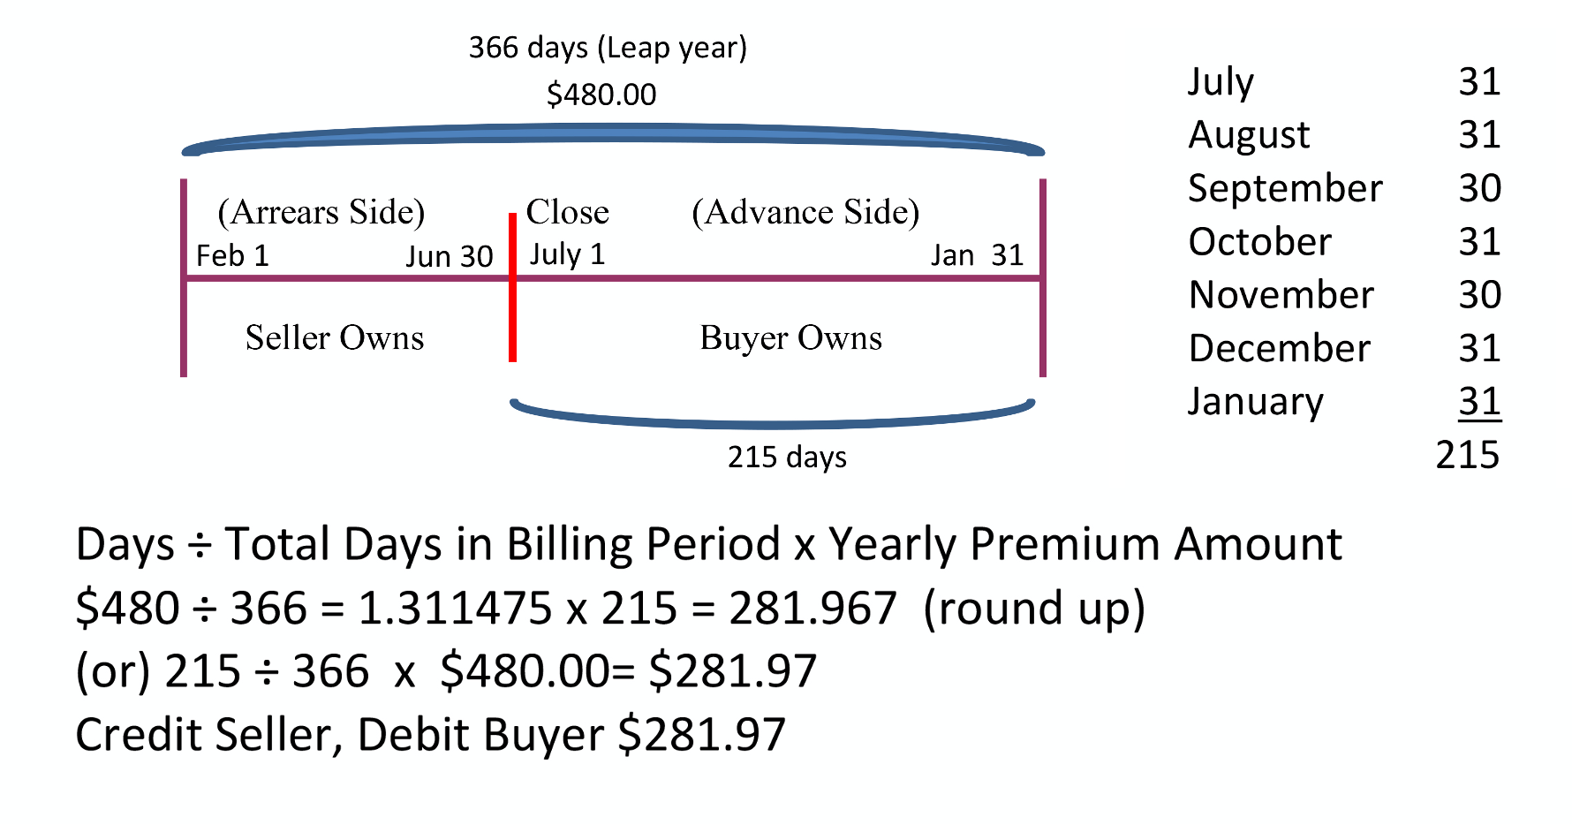

Slide 24
Prorating Water/Sewer/Utility Bills
  Unmetered water and sewer charges are sometimes billed and paid in advance and sometimes in arrears.
  If the bill is paid in advance by the seller, the buyer will owe the seller the prorated share.
  If the water bill is paid in arrears (i.e. to be paid by the buyer) the seller will owe the buyer his pro rata share beginning on the first day of the billing cycle to the date of closing.
pg. 584

Slide 25
Prorating Water/Sewer/Utility Bills
  Generally, all utility adjustments are between the seller and buyer and do not involve the broker except:
- If the utility is delinquent, the entirety of the delinquent amount will need to be collected from the seller.
- If the utility bill is due but unpaid, the parties may agree to each pay their respective shares and have the broker pay the bill (Debit Buyer / Debit Seller / Credit Broker)
pg. 584

Slide 26
Prorating Water/Sewer/Utility Bills
  A seller has already paid a water bill in the amount of $23.00 for June 1 through August 31.
  Date of closing is July 1.
pg. 585

Slide 27
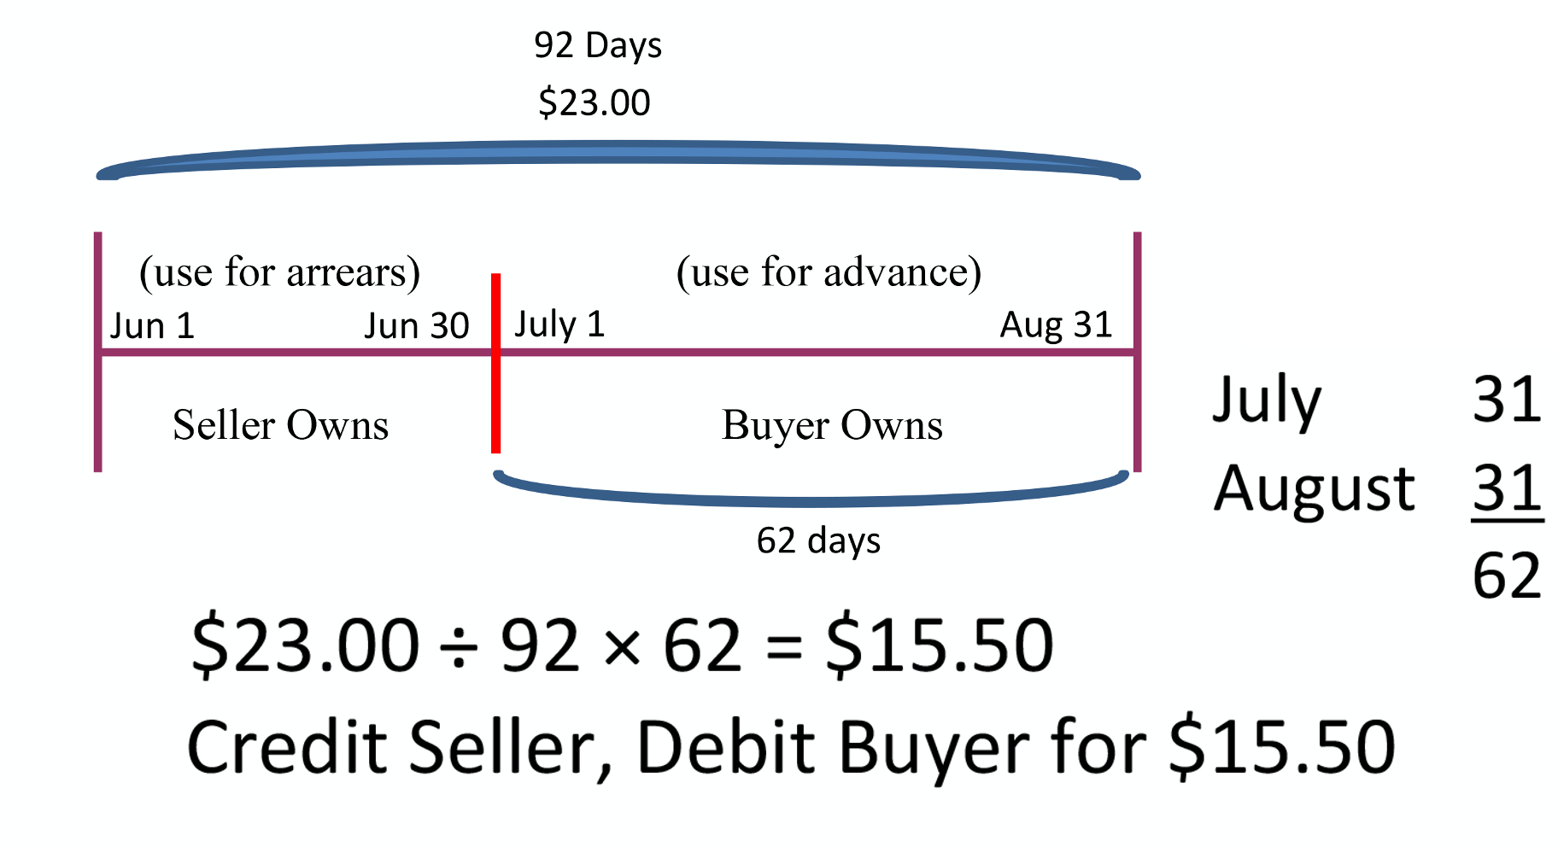

Slide 28
Prorating Interest on Existing (Assumed) Loans
  Mortgage interest is paid in arrears, the seller will owe the buyer for interest to the closing date, as the buyer will be paying that interest on the next payment after closing.
  When a sale is made with a loan that will be assumed by the buyer, when the interest is charged in arrears, then interest due on the loan from the due date of the last payment to the date of settlement will be a seller debit and a buyer credit.
pg. 586

Slide 29
Prorating Interest on Existing (Assumed) Loans
  Three steps in calculating the proration:
- Calculate the days of interest the seller owes
the buyer.
- Determine the amount of per diem (per day)
interest specific to the month that interest is
owed for.
- Multiply the number of days by the per diem
amount for the total proration.
pg. 586

Slide 30
Prorating Interest on Existing (Assumed) Loans
  The buyer is assuming the sellers loan which has an unpaid principal balance of $200,000 at 7.5% interest, paid in arrears.
  The closing will be on May 10th.
  Seller will owe for 9 days of interest (May 1 – 9) – Buyer owns the day of closing.
pg. 586

Slide 31
Prorating Interest on Existing (Assumed) Loans
  $200,000 x 7.5% = $15,000 (annual interest) ÷ 12 = $1,250 interest per month.
  $1,250 ÷ 31 days (total days in May) = $40.3226 per day
9 days (May 1 - 9 … Seller owned) x $40.3226 =
$362.90 (Debit Seller / Credit Buyer)
pg. 586

Slide 32
Prorating Interest on New Loans
  Mortgage interest is paid in arrears, when a payment is made on July 1st it pays the interest for the month of June.
pg. 587

Slide 33
Prorating Interest on New Loans
  On new loans, lenders want to collect interest up to 30 days before the first payment of the new loan is due. If the closing is on May 10th and the first mortgage payment is due on July 1st, the July payment will pay for the interest accrued in June. It does not pay for the interest accrued from May 10 – 31. That interest would have to be collected from the Buyer at the time of closing.
pg. 587

Slide 34
Prorating Interest on New Loans
  Three steps in calculating the proration:
- Calculate the days of interest the buyer owes
the lender.
- Determine the amount of per diem (per day)
interest.
- Multiply the number of days by the per diem
amount for the total proration.
pg. 587

Slide 35
Prorating Interest on New Loans
  The buyer is obtaining a new loan of $200,000 at 7.5%.
  The closing will be on May 10th. Buyer’s first new loan payment is July 1st.
  Buyer will owe for 22 days of interest (May 10 – 31). Interest only needs to be collected for the month of May as June interest will be reflected in the loan payment of July 1st.
pg. 587

Slide 36
Prorating Interest on New Loans
  $200,000 x 7.5% = $15,000 (annual interest)
  $15,000 ÷ 365 days (total days in the year) = $41.0959 per day
22 days (May 10 - 31) x $41.0959 =
$904.11 (Debit Buyer / Credit Broker-Closer)
pg. 587

