Slide 1


Slide 2

Trust Accounts and Record Keeping
Chapter 18
Trust Account Basics

Slide 3

What is a Trust Account?
  It is a demand account.
  Set up to contain money held for the benefit of others.
  Might also be called an “escrow account,” “trustee account,” or “impound account.”
pg. 457

Slide 4
What is a Trust Account?
  Distinct from business accounts, personal accounts and investment accounts of the person or entity holding the money in trust.
  Money belongs to other people (beneficiaries).
  In the temporary control of the trustee or fiduciary.
pg. 457

Slide 5
Commission Rules
  Separate Accounts and Accounting
Commission Rules in are at the core of handling Trust Accounts. These rules deal exclusively with the safeguarding of funds for others.
Trust Account rules are found in Commission Rules Chapter 5: Separate Accounts and Accounting.
pg. 457

Slide 6
Who Needs a Trust Account?
  Brokers who hold money belonging to others are required to place that money in a trust account.
  “Broker” in this context really means an Employing
  Broker.
  Associate Brokers are not authorized to keep or maintain trust accounts. (Rule 5.3.)
pg. 458

Slide 7
Who Needs a Trust Account?
  Brokers must establish a trust account by the time they first receive “money belonging to others.”
  If a Broker doesn’t hold any money belonging to others, they do not need a separate trust account. (Rule 5.2)
pg. 459

Slide 8
How Many Accounts Does a Broker Need?
  Companies may need many trust accounts for various purposes. Different accounts are established for different types of beneficiaries.
pg. 460

Slide 9
How Many Accounts Does a Broker Need?
  Sales Trust Account – for money held in connection with a sales transaction pending closing. (Beneficiary - Buyer/Seller)
  Property Management Trust Account – For money received for providing property management services. (Beneficiary – Lessor)
pg. 460

Slide 10
How Many Accounts Does a Broker Need?
  Advance Rental Trust Account – For rental money collected in advance. Found in resort and vacation rentals. (Beneficiary – Lessee until earned then Lessor)
  Security Deposit Trust Account – For refundable security deposits (Beneficiary – Lessee)
pg. 460

Slide 11
How Many Accounts Does a Broker Need?
  Owners Association Trust Account – For funds held on behalf of condominium or community association. (Beneficiary – Association)
pg. 461

Slide 12
How Many Accounts Does a Broker Need?
  A branch office may use the trust account(s) of the primary office or may maintain a separate trust account for the branch location.
  Each brokerage will also have a company operating account. Funds in the operating account will be the property of the Employing Broker or the Brokerage Firm.
pg. 461

Slide 13
Setting Up a Trust Account
  Must be in a “bank or recognized depository in Colorado.”
- Insured by an agency of the United States
Government (FDIC).
  Credit Unions only protect members of the credit union.
- Most beneficiaries in a trust account will not be
credit union members.
pg. 462

Slide 14
Setting Up a Trust Account
  The account must be identified in the bank records and on bank statements with the following specific information:
- Licensed Company or individual proprietors name.
- Type of Account – (i.e. Sales, Security Deposit, Advance Rental, etc.)
- The word “trust,” “trustee,” or “escrow.”
pg. 462

Slide 15
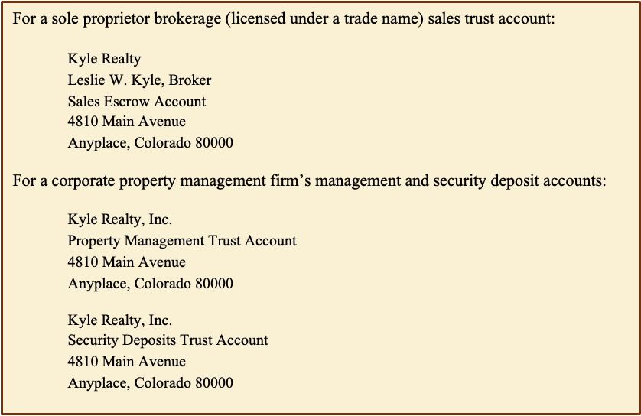

Slide 16
Setting Up a Trust Account
  For each trust account established, the broker must obtain a “Notice of Trustee or Escrow Account” signed by an officer of the bank.
  This notice is then retained with the account records.
pg. 463

Slide 17
Setting Up a Trust Account
  This Notice is the first thing a Real Estate Commission representative will review during an audit of a firm’s escrow accounts.
  Operating accounts are not ordinarily scrutinized by the Real Estate Commission.
pg. 463

Slide 18
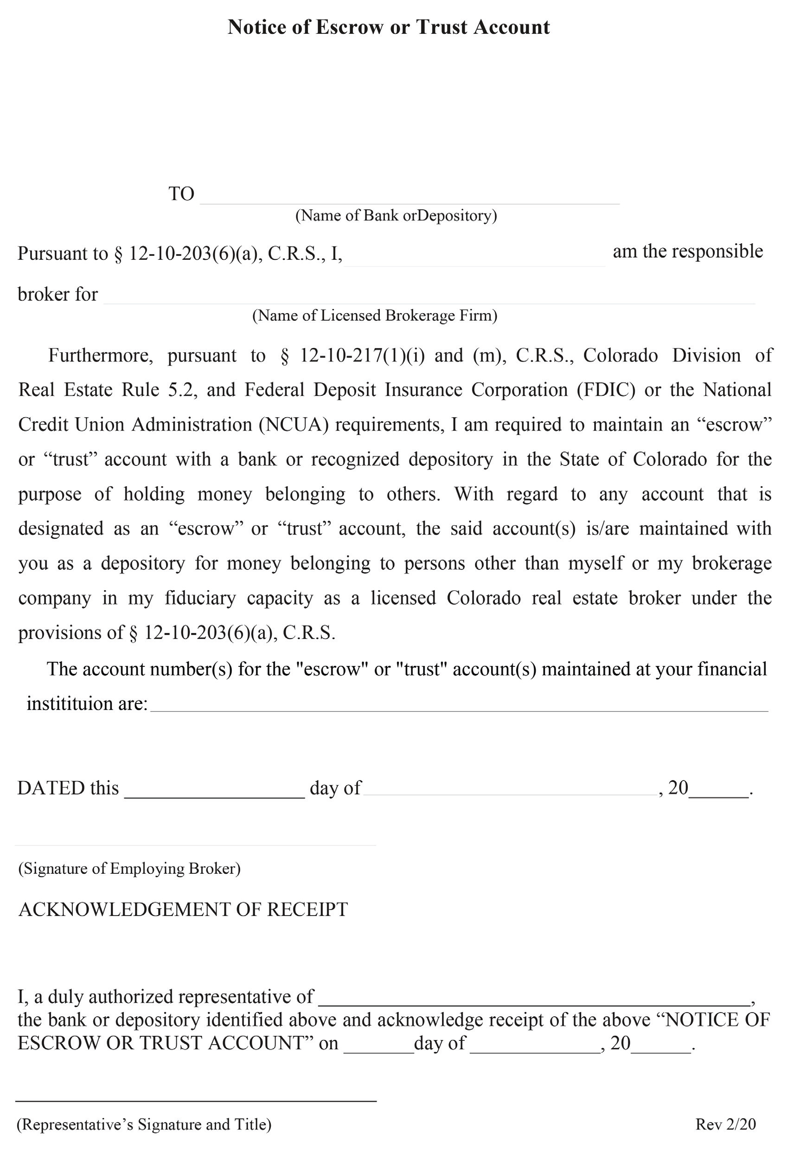
pg. 464

Slide 19
Operating the Trust Account
  The Broker of Record has responsibility for the trust accounts.
  Broker is required to actively:
- Supervise the accounting system,
- Keep track of the accounts;
- Maintain adequate security over the money in
the accounts.
pg. 465

Slide 20
Operating the Trust Account
  Must be able to withdraw funds from the trust account.
- Must have no restrictions on his/her ability to
withdraw funds.
- May authorize other signers who may be
licensed or unlicensed.
pg. 465

Slide 21
Operating the Trust Account
  Broker’s (or Brokerage Firm’s) funds must not be commingled with funds belonging to beneficiaries of the trust account.
  An amount of Broker’s funds sufficient to maintain the account and pay any bank or service charges may be kept in the trust account. (Rule 5.14.E)
pg. 465

Slide 22
Operating the Trust Account
  Commission earned by the firm and payable from funds in the trust account must be withdrawn monthly and moved to the operating account once they are available for use. (Rule 5.10.A)
- Funds are considered available for use, “only
after all contracted services have been
performed and there Is no remaining right of
recall by others for such money.” (Rule 5.10.C)
pg. 466

Slide 23
Operating the Trust Account
  Trust accounts should not be used for employee benefit funds or tax withholding.
  If a broker advances funds for the benefit of a client,
- The funds may be placed in the trust account
and identified as an Advance;
- The funds may not be withdrawn except on
behalf of the client;
pg. 467

Slide 24
Operating the Trust Account
  If a broker advances funds for the benefit of a client (cont.),
- Funds may be repaid to Broker or withdrawn
for the Broker’s use only with the consent and
permission of the client.
pg. 467

Slide 25
Interest Bearing Trust Account
  A broker may not use trust account funds to earn undisclosed profits [C.R.S. 12-61-113(1)(g.5)] .
pg. 468

Slide 26
Interest Bearing Trust Account
  Commission rules do permit the funds to be held in interest bearing trust accounts under the following conditions:
- If the Broker or one party to the transaction is to
benefit from the interest income, all parties with
an interest in the funds must provide their
written consent. They must agree to any risks for
early withdrawal and who owns the interest in
the event the transaction is completed or fails.
pg. 468

Slide 27
Interest Bearing Trust Account
  Commission rules do permit the funds to be held in interest bearing trust accounts under the following conditions (cont.):
- If an “Affordable Housing” program benefiting
Colorado residents will receive the interest, the
broker must post a notice in the office indicating
that the company participates in such a program.
(i.e. CARHOF – Colorado Association of
REALTORS Housing Opportunity Fund.)
pg. 469

Slide 28
Earnest Money Deposits
  Earnest money received in cash or by check must be deposited in the trust account not later than the third business day following notice of acceptance of the contract [Rule 5.7.A]
  Property Management funds must be deposited no later than the fifth business day.
pg. 470

Slide 29
Earnest Money Deposits
  In a cooperative transaction, the selling broker must deliver the earnest money deposit to the listing broker for deposit in the Listing Company’s (or whomever they designate) trust account within the required three day window of time.
pg. 470

Slide 30
Earnest Money Deposits
  Personal checks for earnest money should be identified in the Contract to Buy and Sell.
  If a check is to be withheld from deposit for any reason, the reason should be disclosed in the contract, or the seller should provide written instructions to withhold the check. (Rule 5.12)
pg. 470

Slide 31
Earnest Money Deposits
  A Promissory Note accepted as earnest money should be identified as a note in the contract and the due date of the note must be included.
  The broker is responsible to present the Promissory Note for payment in a timely manner and inform the seller if it is not paid.
pg. 471

Slide 32
Earnest Money Deposits
  Notes or checks for earnest money should be made out to the Earnest Money Holder (Either the Listing Broker or whomever they designate to hold the earnest money.
pg. 471

Slide 33
Earnest Money Deposits
  In case there is a dispute regarding the earnest money:
- the broker may hold the money in the trust
account until the parties provide mutual
written instructions for the dissolution of the
earnest money.
pg. 472

Slide 34
Earnest Money Deposits
  In case there is a dispute regarding the earnest money (cont.):
- The broker may also choose to interplead the
money into the court. The Broker may recover
court costs and attorney’s fees.
pg. 472

Slide 35
Earnest Money Deposits
  In case there is a dispute regarding the earnest money (cont.):
- The broker (or earnest money holder) may
provide notice that unless a copy of a Summons
and Complaint or Claim containing a case
number of a lawsuit is received within 120 days
the earnest money will be returned to the Buyer.
pg. 472

Slide 36
Trust Account Record Keeping Systems
  The Broker must maintain a record keeping system for each trust account.
- Can be computerized or manual.
- Should utilize the “cash basis” of accounting.
(Rule 5.16)
  Trust accounts must be maintained at the Brokerage Firm’s licensed place of business.
pg. 472

Slide 37
Trust Account Record Keeping Systems
  Trust accounts must contain the following types of records and reports:
- ACCOUNT RECORDS – including bank account
agreement and “Notice of Escrow or Trust
Account”.
- CASH RECEIPTS/DISBURSEMENTS ACCOUNT
JOURNAL – showing, in chronological order, all of
the money going into and out of the account plus a
running balance of the account at any time.
pg. 473

Slide 38
Trust Account Record Keeping Systems
  Journal entries must include: date, name of the party giving the money, name of the principal (usually seller), property identification, document reference and amount. For disbursements, include the check number.
  Disbursement of funds from a trust account must be supported by bids, invoices, contracts or other written documents.
pg. 473

Slide 39
Trust Account Record Keeping Systems
  Receipts should be accompanied by the deposit slip or an attached schedule detailing the person paying, the type of funds tendered, the property address and the account or principal involved [Rule E-1(o)(6)].
pg. 473

Slide 40
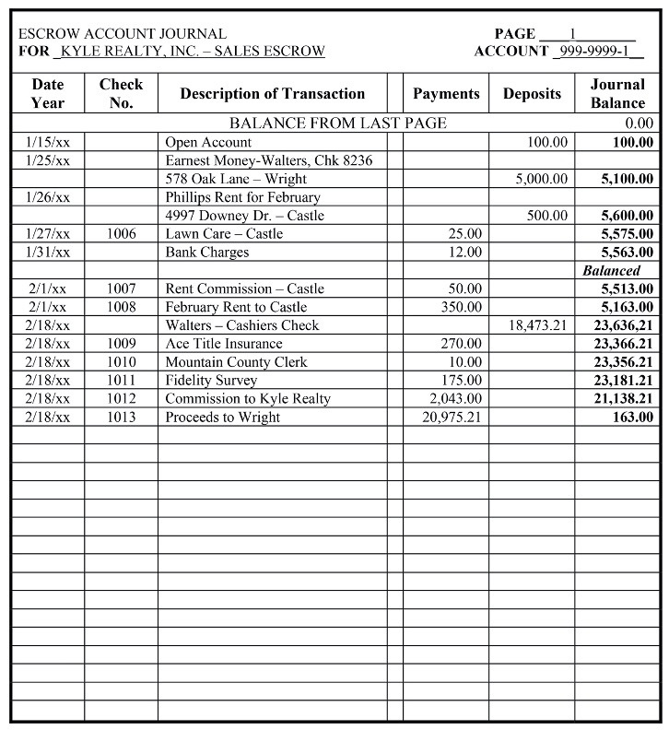
Cash Receipts / Disbursements Account Journal
pg. 474

Slide 41
  For funds received the journal must include:
    Date of receipt and deposit;
    Name of the person giving the money;
    Name of the person and the property for which the money was received;

Slide 42
  For funds received the journal must include (cont):
    Purpose of the receipt;
    The amount;
    A cash balance for the account.
    Date of payment;

Slide 43
  For funds received the journal must include (cont):
    Check number or electronic transfer record;
    Reference to vendor records authorizing payment;

Slide 44
  For funds received the journal must include (cont):
    Amount paid;
    Resulting cash balance for the account.

Slide 45
Trust Account Record Keeping Systems
  Trust accounts must contain the following types of records and reports (cont.):
- LEDGER ACCOUNT SYSTEM – a series of individual records
segregating the receipts and disbursements as they affect
an individual beneficiary, transaction or property.
pg. 475

Slide 46
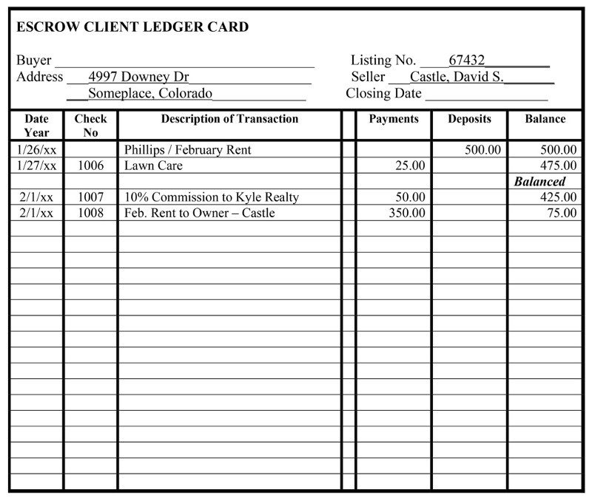
  Ledger Account System – Individual records for an individual beneficiary, transaction or property.
  Must contain the same transactional information as is required for journal entries.

Slide 47
  No ledger may ever be allowed to have a negative balance.
  The sum of all ledger balances must agree at all times with the corresponding journal after each transaction has been posted.

Slide 48
Trust Account Record Keeping Systems
  Trust accounts must contain the following types of records and reports (cont.):
- BROKER LEDGER CARD – showing amount of broker funds in
the account to open the account and cover bank or service
charges as they are incurred.
pg. 476

Slide 49
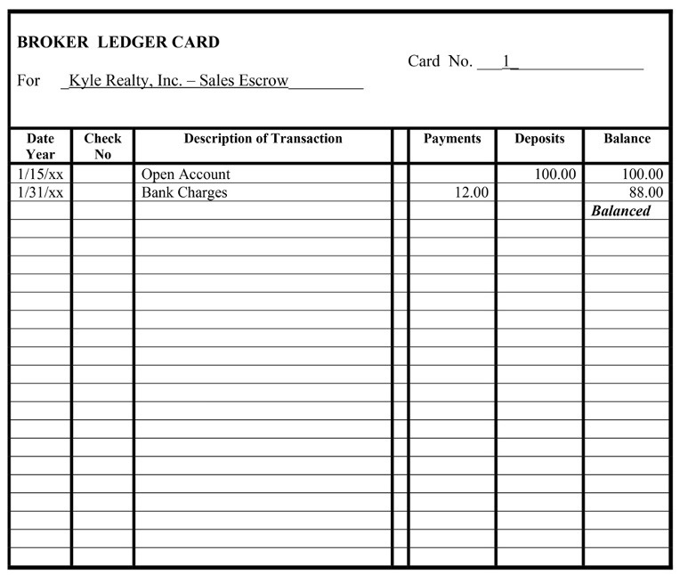
Broker Ledger Card
  Showing amount of broker funds in the account to open the account and cover bank or service charges as they are incurred.

Slide 50
Trust Account Record Keeping Systems
  Trust accounts must contain the following types of records and reports (cont.):
- BANK RECONCILIATION RECORDS – the trust
account must be reconciled to the bank statement
at least once a month in any month where there is
account activity. The reconciliation records must
be retained.
pg. 476

Slide 51
Trust Account Record Keeping Systems
  Trust accounts must contain the following types of records and reports (cont.):
- TRANSACTION FILES – these are the individual
transaction records which back up the financial
activity in the account including invoices or other
documents to support disbursements.
pg. 477

Slide 52
Trust Account Record Keeping Systems
  Transaction Files – Individual transaction records which back up the financial activity in the account.
- Invoices and other documents supporting
disbursements.
- Receipts should be accompanied by deposit
slips.
pg. 477

Slide 53
Trust Accounts and Record Keeping
Trust Account Exercise #1
pg. 486

Slide 54
IMPORTANT NOTE:
This exercise has both rental receipts and transaction monies being placed in the same trust account.
Normally rental receipts would be placed in a Property Management Trust Account and transaction monies would be placed in a Sales Trust Account. They would NOT normally be combined in the same trust account. This is done for brevity in the exercise.

Slide 55
1. The Broker for Kyle Realty, Inc. opens a new Sales Escrow Account on January 15, 20xx, with First National Bank. He deposits $100.00 to open the account.
- Fill in the heading for the form “Escrow Account
Journal” and enter the “Balance from Last
Page” of $0.00

Slide 56
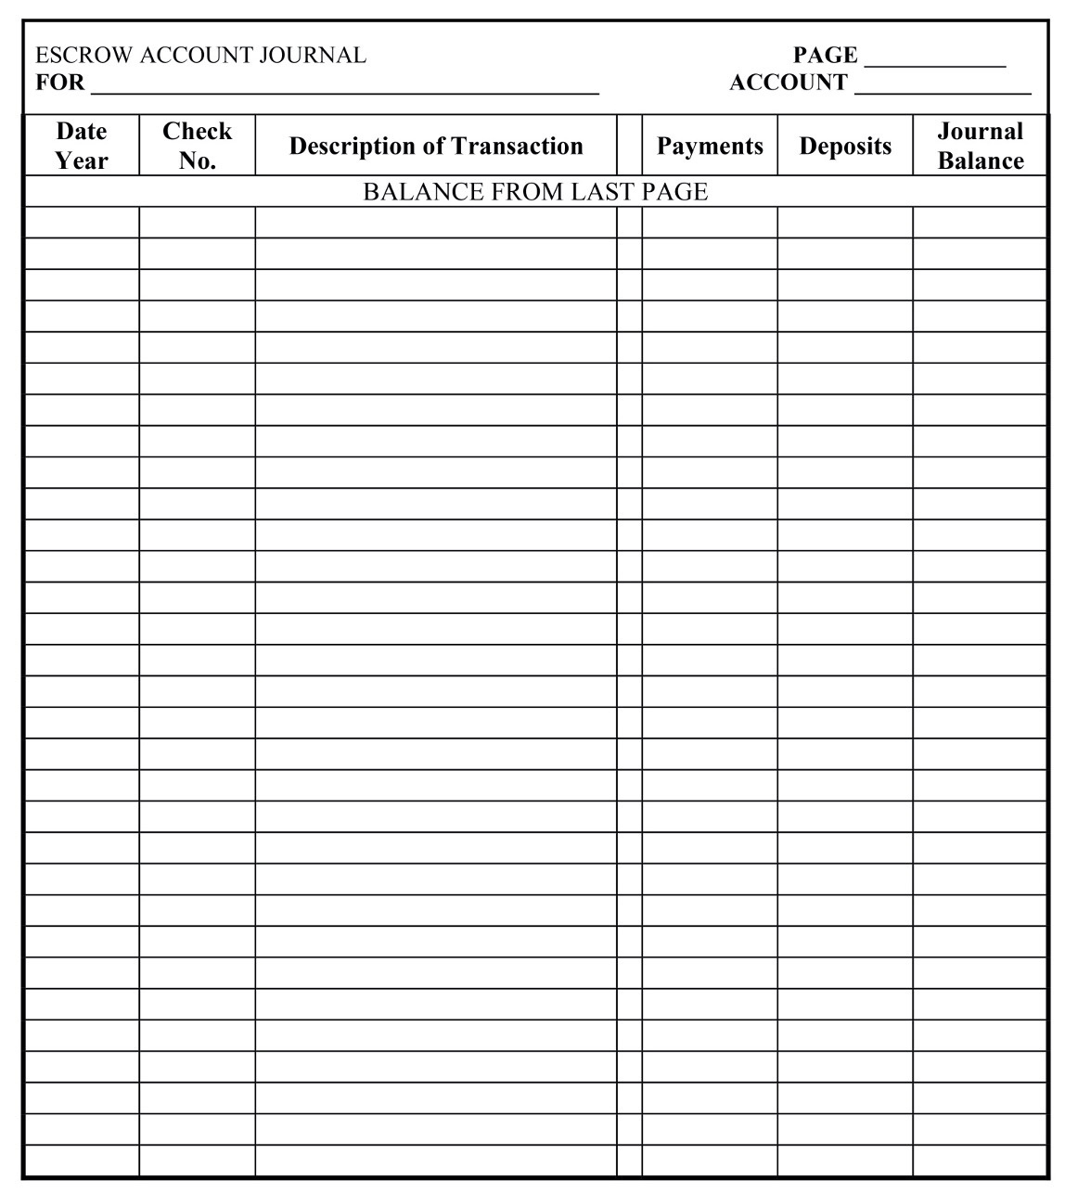
1
Kyle Realty, Inc. - Sales Escrow
999-9999-01
0.00

Slide 57
1. The Broker for Kyle Realty, Inc. opens a new Sales Escrow Account on January 15, 20xx, with First National Bank. He deposits $100.00 to open the account.
- Enter the deposit that opened the account.

Slide 58
1
Kyle Realty, Inc. - Sales Escrow
999-9999-01
0.00
1/15/24
Open Account
100.00
100.00

Slide 59
1. The Broker for Kyle Realty, Inc. opens a new Sales Escrow Account on January 15, 20xx, with First National Bank. He deposits $100.00 to open the account.
- Enter the opening deposit on the “Broker Ledger Card”

Slide 60
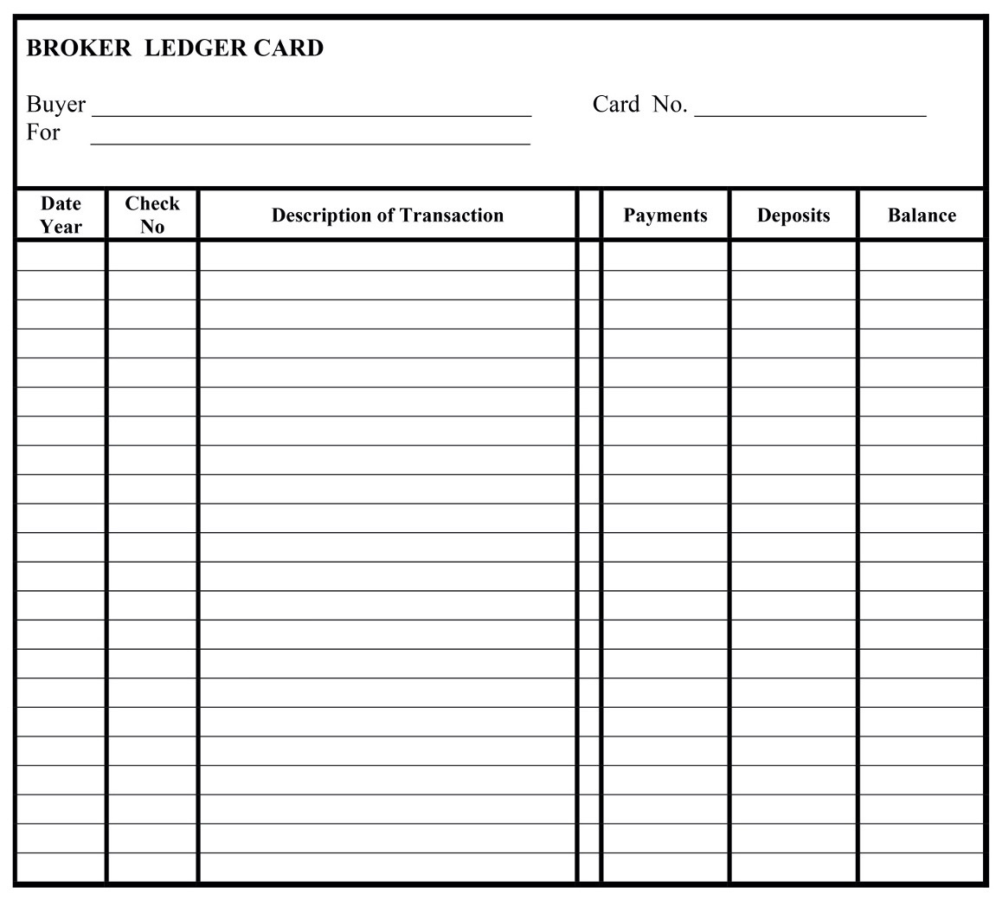
Kyle Realty, Inc. - Sales Escrow
1
1/15/24
Open Account
100.00
100.00

Slide 61
2. On January 25 an offer is accepted on Kyle Realty’s listing at 578 Oak Lane in Anytown, Colorado. Susan Wright is the seller and Donald Walters is the buyer. The contract calls for a closing date of February 18, 20xx. Your broker associate, Jean Price, is both the listing and selling broker. Mr. Walters submitted his personal check, number 8236, in the amount of $5,000 as earnest money. A separate deposit slip would be used to deposit this amount in the new trust account. The separate deposit slip allows the broker to fully identify the transaction and parties and provides a separate deposit receipt for the file.

Slide 62
  Record the deposit in the Escrow Account Journal and update the balance in the journal.

Slide 63
1
Kyle Realty, Inc. - Sales Escrow
999-9999-01
0.00
1/15/24
Open Account
100.00
100.00
1/25/24
Earnest Money - Walters #8236
578 Oak Lane - Wright
5,000.00
5,100.00

Slide 64
  Establish a new Escrow Client Ledger Card” for this transaction and record the deposit as the first entry. (Note: If the earnest money had been in the form of a promissory note, the ledger card and journal entries would not be made until the note was presented and paid. The cash deposit would be recorded at that time.)

Slide 65
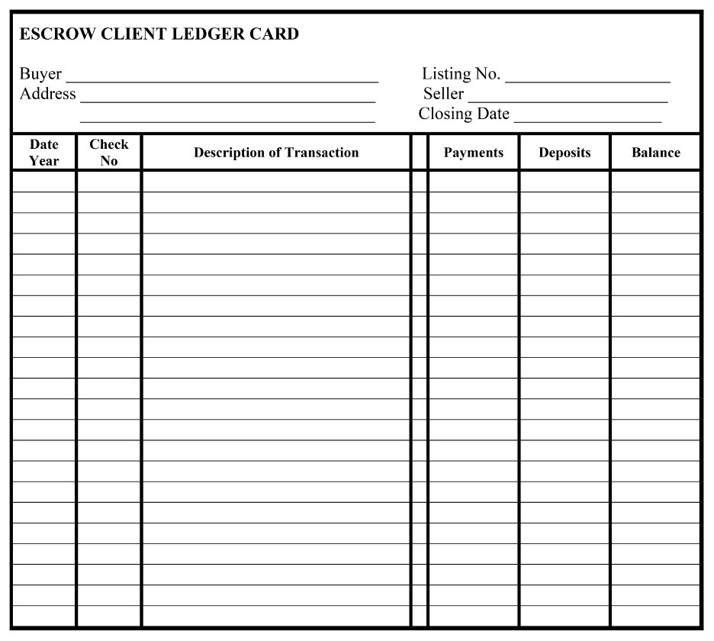
Walters, Donald
578 Oak Lane
Wright, Susan
Anytown, CO 80000
2/18/24
1/25/24
Earnest Money - Walters #8236
578 Oak Lane - Wright
5,000.00
5,000.00

Slide 66
3.On January 26, Tom Phillips pays $1,500 rent on a property temporarily managed by Kyle Realty for David S. Castle at 4997 Downey Dr., Someplace, CO. The property is listed with Kyle Realty, but there is no sale pending.
- Record the receipt of the check in the journal
and update the balance in the journal.

Slide 67
1
Kyle Realty, Inc. - Sales Escrow
999-9999-01
0.00
1/15/24
Open Account
100.00
100.00
1/25/24
Earnest Money - Walters #8236
578 Oak Lane - Wright
5,000.00
5,100.00
1/26/24
Phillips Rent for February
4997 Downey Dr. - Castle
1,500.00
6,600.00

Slide 68
3.On January 26, Tom Phillips pays $1,500 rent on a property temporarily managed by Kyle Realty for David S. Castle at 4997 Downey Dr., Someplace, CO. The property is listed with Kyle Realty, but there is no sale pending.
- Establish a client ledger card for Mr. Castle and
record the transaction.

Slide 69
4997 Downey Dr.
Castle, David S
someplace, CO 80000
1/26/24
Phillips – February Rent
1,500.00
1,500.00

Slide 70
4. On January 27, use check number 1006 in the amount of $125.00 to pay Lawn Care for mowing the lawn at the Castle property, 4997 Downey Dr.
- Make journal and ledger card entries to
account for this payment.

Slide 71
1
Kyle Realty, Inc. - Sales Escrow
999-9999-01
0.00
1/15/24
Open Account
100.00
100.00
1/25/24
Earnest Money - Walters #8236
578 Oak Lane - Wright
5,000.00
5,100.00
1/26/24
Phillips Rent for February
4997 Downey Dr. - Castle
1,500.00
6,600.00
1/27/24
1006
Lawn Care - Castle
125.00
6,475.00

Slide 72
4997 Downey Dr.
Castle, David S
someplace, CO 80000
1/26/24
Earnest Money - Walters #8236
1,500.00
1,500.00
1/27/24
1006
Lawn Care
125.00
1,375.00

Slide 73
5. On February 1, you receive a bank statement from First National Bank and you reconcile the Bank Account with your records.
- Record the $12 bank charges on both the
Journal and the Broker Ledger Card.

Slide 74
1
Kyle Realty, Inc. - Sales Escrow
999-9999-01
0.00
1/15/24
Open Account
100.00
100.00
1/25/24
Earnest Money - Walters #8236
578 Oak Lane - Wright
5,000.00
5,100.00
1/26/24
Phillips Rent for February
4997 Downey Dr. - Castle
1,500.00
6,600.00
1/27/24
1006
Lawn Care - Castle
125.00
6,475.00
1/31/24
Bank Charges
12.00
6,463.00

Slide 75
Kyle Realty, Inc. - Sales Escrow
1
1/15/24
Open Account
100.00
100.00
1/31/24
Bank Charges
12.00
88.00

Slide 76
5. On February 1, you receive a bank statement from First National Bank and you reconcile the Bank Account with your records.
- Make a notation that the account was
Balanced and Reconciled on the appropriate
ledger and journal forms. It is common practice
to draw a line below the last entry in the journal
and each ledger card with a note that a bank
reconciliation was done at this time.

Slide 77
1
Kyle Realty, Inc. - Sales Escrow
999-9999-01
0.00
1/15/24
Open Account
100.00
100.00
1/25/24
Earnest Money - Walters #8236
578 Oak Lane - Wright
5,000.00
5,100.00
1/26/24
Phillips Rent for February
4997 Downey Dr. - Castle
1,500.00
6,600.00
1/27/24
1006
Lawn Care - Castle
125.00
6,475.00
1/31/24
Bank Charges
12.00
6,463.00
Balanced

Slide 78
Walters, Donald
578 Oak Lane
Wright, Susan
Anytown, CO 80000
2/18/24
1/25/24
Earnest Money - Walters #8236
578 Oak Lane - Wright
5,000.00
5,000.00
Balanced

Slide 79
4997 Downey Dr.
Castle, David S
someplace, CO 80000
1/26/24
Earnest Money - Walters #8236
1,500.00
1,500.00
1/27/24
1006
Lawn Care
125.00
1,375.00
Balanced

Slide 80
Kyle Realty, Inc. - Sales Escrow
1
1/15/24
Open Account
100.00
100.00
1/31/24
Bank Charges
12.00
88.00
Balanced

Slide 81
6. Now that the account is reconciled, on February 1, Kyle Realty takes a 10% commission on the rent collected for Mr. Castle and forwards $1,000 to Castle leaving a balance in the escrow account in case there are other expenses. All of this is allowed by the property management agreement Kyle Realty has with Mr. Castle.
- Make the appropriate journal and ledger
entries and update the balances.

Slide 82
1
Kyle Realty, Inc. - Sales Escrow
999-9999-01
0.00
1/15/24
Open Account
100.00
100.00
1/25/24
Earnest Money - Walters #8236
578 Oak Lane - Wright
5,000.00
5,100.00
1/26/24
Phillips Rent for February
4997 Downey Dr. - Castle
1,500.00
6,600.00
1/27/24
1006
Lawn Care - Castle
125.00
6,475.00
1/31/24
Bank Charges
12.00
6,463.00
Balanced
2/01/24
1007
Rent Commission - Castle
150.00
6,313.00
2/01/24
1008
February Rent to Castle
1,000.00
5,313.00

Slide 83
Feb
4997 Downey Dr.
Castle, David S
someplace, CO 80000
1/26/24
Phillips February Rent
1,500.00
1,500.00
1/27/24
Lawn Care
125.00
1,375.00
Balanced
2/01/24
1007
10% Commission to Kyle Realty
150.00
1,225.00
2/01/24
1008
February Rent to Owner - Castle
1,000.00
225.00

Slide 84
7. On February 18 it is time for the closing on 578 Oak Lane. This is a simple cash transaction and Kyle Realty will close it in-house. The selling price is $254,000 and the commission rate is 5%.
The buyer, Mr. Walters brings a cashier’s check from First National Bank in the required amount of $249,435.

Slide 85
The broker will pay the following bills from the closing:
·Ace Title Insurance for the owner’s policy: $1,500.00
·Mountain County Clerk and Recorder for recording fees: $35.00
·Fidelity Survey for a property survey: $400.00
·Kyle Realty – Commission for 5% of the $254,000 price: $12,700
The balance from the client escrow card for this transaction will be paid to Susan Wright as proceeds of the sale.

Slide 86
Enter the closing entries to the journal and ledger cards.

Slide 87
1
Kyle Realty, Inc. - Sales Escrow
999-9999-01
0.00
1/15/24
Open Account
100.00
100.00
1/25/24
Earnest Money - Walters #8236
578 Oak Lane - Wright
5,000.00
5,100.00
1/26/24
Phillips Rent for February
4997 Downey Dr. - Castle
1,500.00
6,600.00
1/27/24
1006
Lawn Care - Castle
125.00
6,475.00
1/31/24
Bank Charges
12.00
6,463.00
Balanced
2/01/24
1007
Rent Commission - Castle
150.00
6,313.00
2/01/24
1008
February Rent to Castle
1,000.00
5,313.00
2/18/24
Walters - Cashier's Check
249,435.00
254,748.00
2/18/24
1009
Ace Title Insurance
1,500.00
253,248.00
2/18/24
1010
Mountain County Clerk
35.00
253,213.00
2/18/24
1011
Fidelity Survey
400.00
252,813.00
2/18/24
1012
Commission to Kyle Realty
12,700.00
240,113.00
2/18/24
1013
Proceeds to Wright
???????
???????

Slide 88
Walters, Donald
578 Oak Lane
Wright, Susan
Anytown, CO 80000
2/18/24
1/25/23
1/25/24
Earnest Money - Walters #8236
578 Oak Lane - Wright
5,000.00
5,000.00
Balanced
2/18/24
Walters - Cashier's Check
249,435.00
254,435.00
2/18/24
1009
Ace Title Insurance
1,500.00
252,935.00
2/18/24
1010
Mountain County Clerk
35.00
252,900.00
2/18/24
1011
Fidelity Survey
400.00
252,500.00
2/18/24
1012
Commission to Kyle Realty
12,700.00
239,800.00
2/18/24
1013
Susan Wright - Net Proceeds
239,800.00
0.00

Slide 89
1
Kyle Realty, Inc. - Sales Escrow
999-9999-01
0.00
1/15/24
Open Account
100.00
100.00
1/25/24
Earnest Money - Walters #8236
578 Oak Lane - Wright
5,000.00
5,100.00
1/26/24
Phillips Rent for February
4997 Downey Dr. - Castle
1,500.00
6,600.00
1/27/24
1006
Lawn Care - Castle
125.00
6,475.00
1/31/24
Bank Charges
12.00
6,463.00
Balanced
2/01/24
1007
Rent Commission - Castle
150.00
6,313.00
2/01/24
1008
February Rent to Castle
1,000.00
5,313.00
2/18/24
Walters - Cashier's Check
249,435.00
254,748.00
2/18/24
1009
Ace Title Insurance
1,500.00
253,248.00
2/18/24
1010
Mountain County Clerk
35.00
253,213.00
2/18/24
1011
Fidelity Survey
400.00
252,813.00
2/18/24
1012
Commission to Kyle Realty
12,700.00
240,113.00
2/18/24
1013
Proceeds to Wright
239,800.00
313.00

Slide 90
Trust Accounts and Record Keeping
Chapter 19
Advanced Trust Account Issues

Slide 91
Safeguards
  The Employing Broker has personal responsibility for the proper maintenance and security of the escrow or trust accounts.
pg. 495

Slide 92
Safeguards
  Safeguards can include:
- Frequent reconciliation to the bank.
- Separation of duties.
- An outside audit.
- Real Estate Commission assistance.
pg. 495

Slide 93
Property Management Accounting
  The Real Estate Commission is concerned with the protection of other people’s money and the accurate accounting for funds held in trust.
  A Broker that performs property management will need a Property Management and a Security Deposit trust account. (Rule 5.5)
pg. 496

Slide 94
Property Management Accounting
  A single trust account may be used for a number of managed properties and different owners.
pg. 497

Slide 95
Commingling of Trust Funds
  Most common type of commingling (mixing) of funds is between broker funds and trust funds.
  Once a commission or fee is earned, it should be withdrawn from the trust account immediately and transferred to the broker’s operating account. (Rule 5.10)
pg. 497

Slide 96
Commingling of Trust Funds
  Conversion – Use of funds of one beneficiary for the benefit of another beneficiary.
  Diversion – Use of a clients money by the broker (theft).
  Owner’s ledger card should be reconciled before funds are disbursed to the owner. (Rule 5.9)
pg. 498

Slide 97
Commingling of Trust Funds
  The Broker must furnish accurate and timely accounting reports to the owner within thirty (30) days after the end of the month in which funds were disbursed or received. (Rule 5.15)
pg. 498

Slide 98
Commingling of Trust Funds
  Various arrangements could be used in the event an owner’s ledger card is in danger of potentially showing insufficient funds.
- A bill could be sent to the owner for payment.
- The owner could be asked to send in additional
funds to be deposited in the trust account and
credited to their ledger.
- The Broker could advance funds to the owner.
pg. 499

Slide 99
Commingling of Trust Funds
  A negative balance automatically means funds have been improperly commingled or converted. At no time should a balance be below zero.
pg. 499

Slide 100
Security Deposits
  Security deposits are one of the most common causes for complaints regarding property management firms.
  Funds belong to the tenants.
  Must be held in a separate trust account set aside for security deposits.
pg. 499

Slide 101
Security Deposits
  A Broker cannot give the security deposit to an owner without the tenant’s written authorization in a lease or unless written notice has been given to the tenant by first class mail.
- The tenant needs to know who to go to for
return of the funds. (Rule 5.8.A)
pg. 500

Slide 102
Security Deposits
  When funds are transferred to a new property manager the tenant must be notified in writing within 30 days of the change.
  The previous property manager must account fully for the funds to both the owner and the new property management firm.
pg. 500

Slide 103
Security Deposits
  Failure to provide notice of transfer of the security deposits to the owner or to a new manager could leave the previous management firm liable for return of the funds to tenants.
pg. 500

Slide 104
Security Deposits
  Deposits must be returned within one month after the termination of the lease or surrender and acceptance of the premises.
  The lease may specify a longer period, but no more than 60 days.
pg. 501

Slide 105
Security Deposits
  If any funds are retained the landlord must provide a statement itemizing the exact reasons for the retention of the deposit.
  Payment of the balance of deposit, if any, must accompany the list.
pg. 501

Slide 106
Security Deposits
  Improper retention of deposit can leave the landlord liable for treble damages of the wrongfully withhold amount plus attorney fees.
  Lease should clearly state the security deposit is not an advance payment of rent.
pg. 501

Slide 107
Funds Involving Short-Term Occupancy Agreements
  Brokers may collect deposits or advance rental payments for short term occupancy agreements.
- Resort condominiums or properties.
  These funds need to be held in appropriate trust accounts labeled Advanced Rental Trust Account.
pg. 502

Slide 108
Broker-Owned Properties
  Brokers may manage properties in which they have a part ownership interest.
  The broker may have a personal interest in some of the funds held in connection with this property. Brokers funds must not be commingled with the funds of others.
pg. 504

Slide 109
Broker-Owned Properties
  A separate trust account must be maintained to keep the broker’s funds segregated.
  If the property is wholly owned by the broker no trust account is required.
pg. 504

Slide 110
Transaction Records
  The Colorado Real Estate Manual has a checklist for common records to retain in both the Listing and Selling Broker’s Transaction Files.
  The records of licensed brokerage activity must be kept for four (4) years.
  The current transaction files should be kept at the Broker’s office in a secure location.
pg. 504

Slide 111
Transaction Records
  Duplicate signatures are acceptable for all records maintained in the Broker’s transaction files. Duplicate applies to:
- Photocopy;
- Carbon copy;
- Facsimile;
- Electronic copies that contain a digital or
electronic signature.
pg. 505

Slide 112
Transaction Records
  Brokers must maintain a duplicate of the original of any document (except deeds, promissory notes and deeds of trust or mortgages.)
  Payoff statements and new loan statements affect the closing statement and should be retained by the listing brokerage firm.
pg. 505

Slide 113
Transaction Records
  Brokers should retain copies of contracts and documents specific to their client (i.e. Selling Broker would retain an Exclusive Right to Buy Agreement.)
  A Broker is not required to retain copies of existing public records, title commitments, loan applications, lender required disclosures after the settlement date.
pg. 508

Slide 114
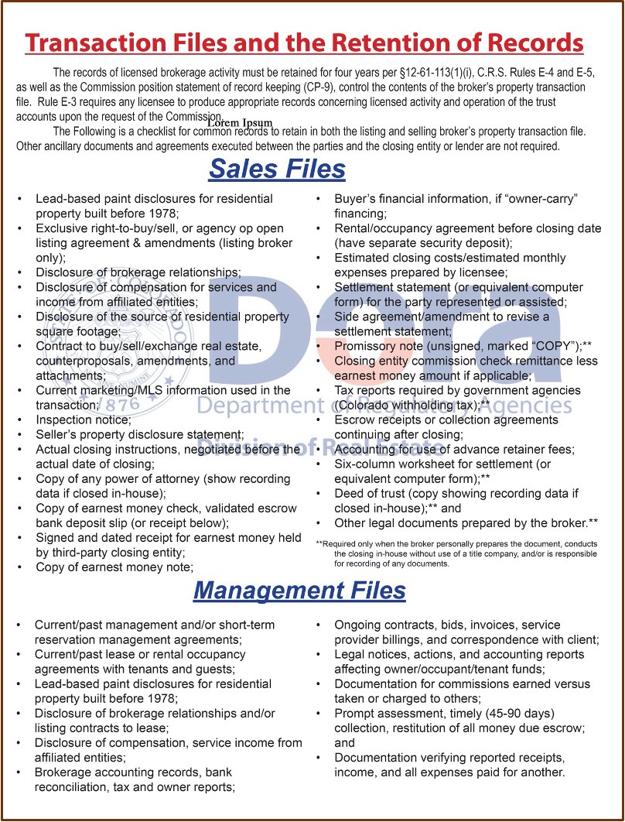

Slide 115
Preparing for a Closing
  Rule 6.19.E requires that “good funds” be available before money is disbursed at a closing.
  Generally, this means that a bank will immediately issue cash for whatever form the funds are in.
pg. 520

Slide 116
Preparing for a Closing
  Not good funds:
    Personal check;
    Trust account check;
    Business check.
  Good funds may be:
    Wire transfers;
    Cashier's check;
    Teller’s check.
pg. 508

Slide 117
Preparing for a Closing
  If a transaction to be closed by a title company, attorney or other closing agent, the broker may transfer funds to the closing entity from the broker’s escrow account with enough lead time for the check to “clear” and provide “good funds.”
pg. 509

Slide 118
Trust Accounts and Record Keeping
Trust Account Exercise #2
Pg. 517

Slide 119
