Slide 1


Slide 2

Colorado Contracts and Regulations
Chapter 15
Sales Contracts for Non-Residential Properties

Slide 3
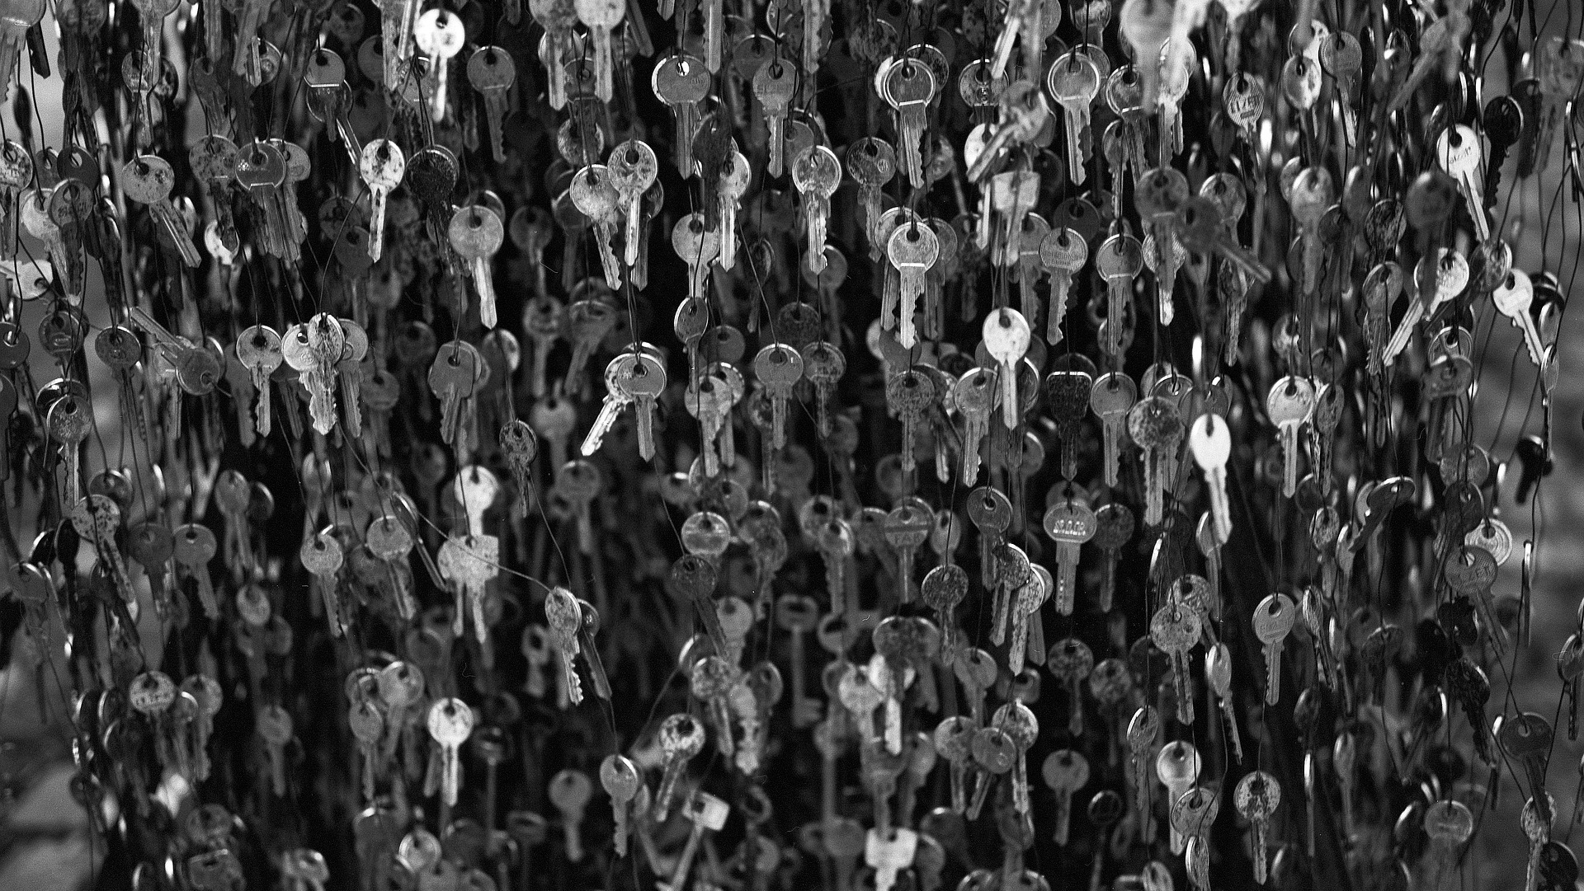
CBS4-05-23 Contract to Buy and Sell Real Estate (Land)
  The majority of this Contract to Buy and Sell is identical to the Residential Contract to Buy and Sell Real Estate
  There are some distinctive differences.
pg. 349

Slide 4
CBS4-05-23 Contract to Buy and Sell Real Estate (Land)
  Section 2.8 Growing Crops
pg. 350

Slide 5
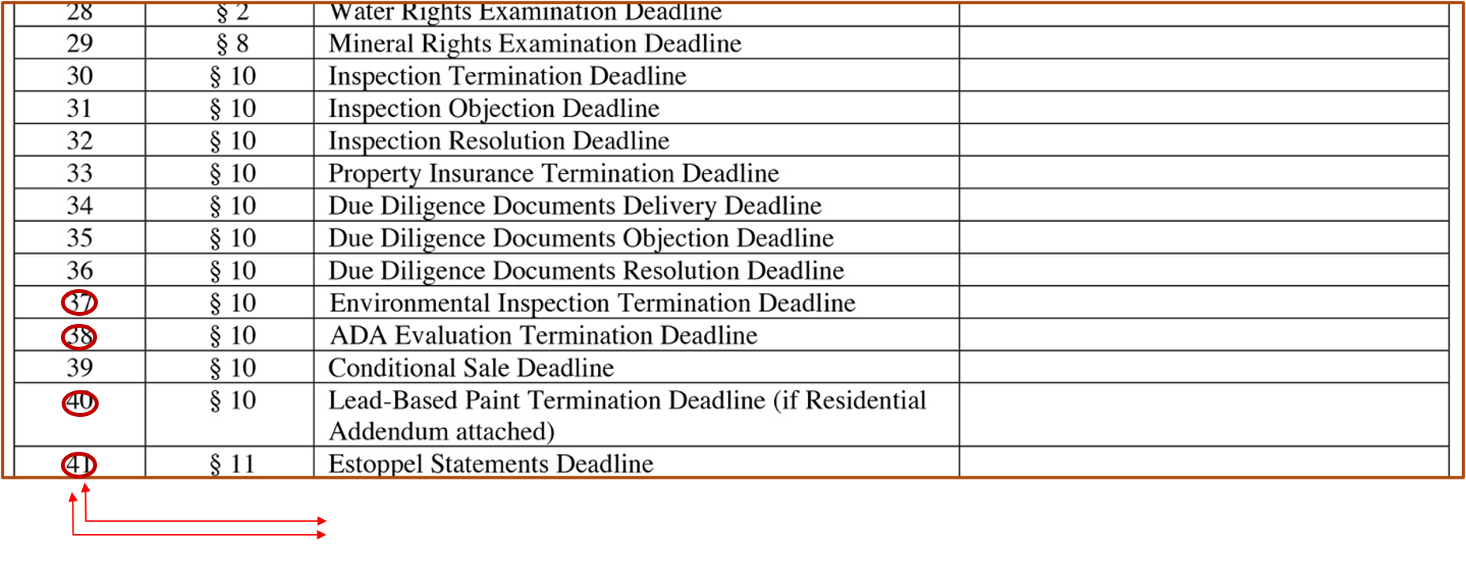
  Section 3 Dates and Deadlines Table
Please edit graphic in textbook only #37, 38, 40, and 41 should be circled.
pg. 350

Slide 6
  Section 10.6.1 Due Diligence – Documents and 10.6.2 Due Diligence – Documents Review and Objection
- These two sections expand the due diligence
language.
- The sections include Environmental Site
Assessments and an Evaluation for ADA
compliance (which would primarily be utilized
for commercial transactions).
pg. 350

Slide 7
  Section 10.6.1 Due Diligence – Documents and 10.6.2 Due Diligence – Documents Review and Objection (cont.)
- These sections add a number of items which the
Seller would need to provide to the Buyer for
their review.
- If the Seller does not wish to provide some of
these items, they would need to counter the
request for them on a Counterproposal to the
offer.
pg. 350

Slide 8
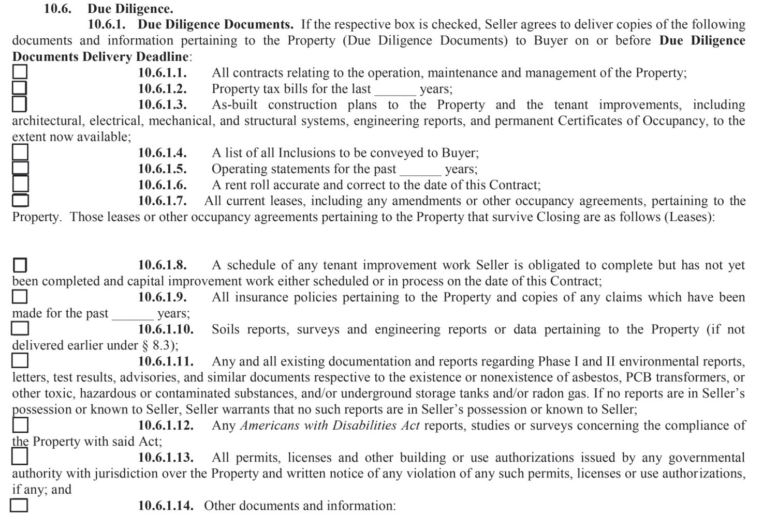

Slide 9
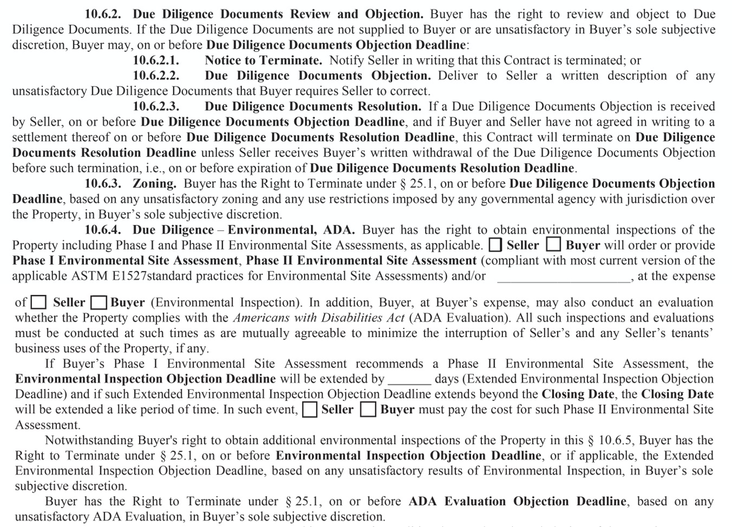

Slide 10
  Section 11 Tenant Estoppel Statements
- Estoppel language appears in CBS2, CBS3 and
CBS4.
- An estoppel statement is typically used when
the buyer of a commercial property or their
lender requires confirmation of the status of all
leases in the property, to ensure that the
tenant(s) do not have any claims against the
landlord which would allow the tenants to
offset or withhold future rent payments.
pg. 352

Slide 11
  Section 11 Tenant Estoppel Statements (cont.)
- The contract requires the seller to provide the
buyer with Estoppel statements from each
tenant stating certain lease terms including the
amount of rents payable and whether or not
any default by landlord or tenant currently
exists.
- The language in the contract permits buyer to
terminate based on review of the Estoppel
Statements.
pg. 352

Slide 12
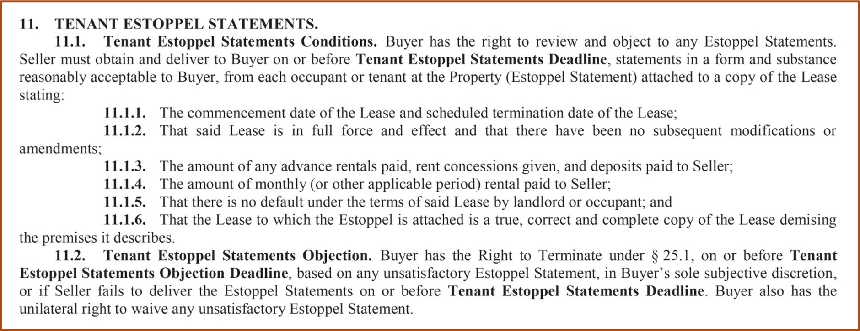

Slide 13
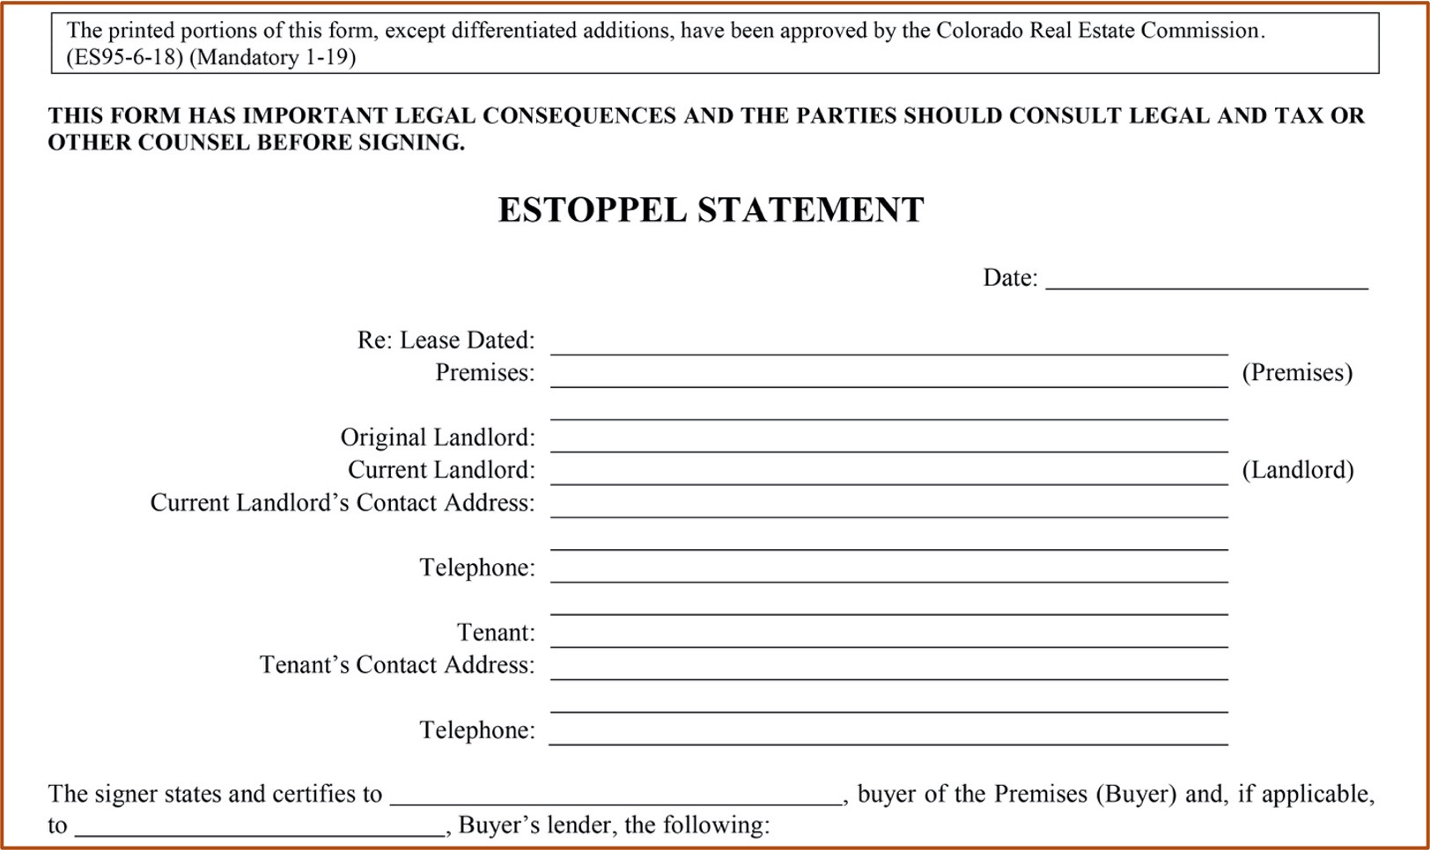

Slide 14
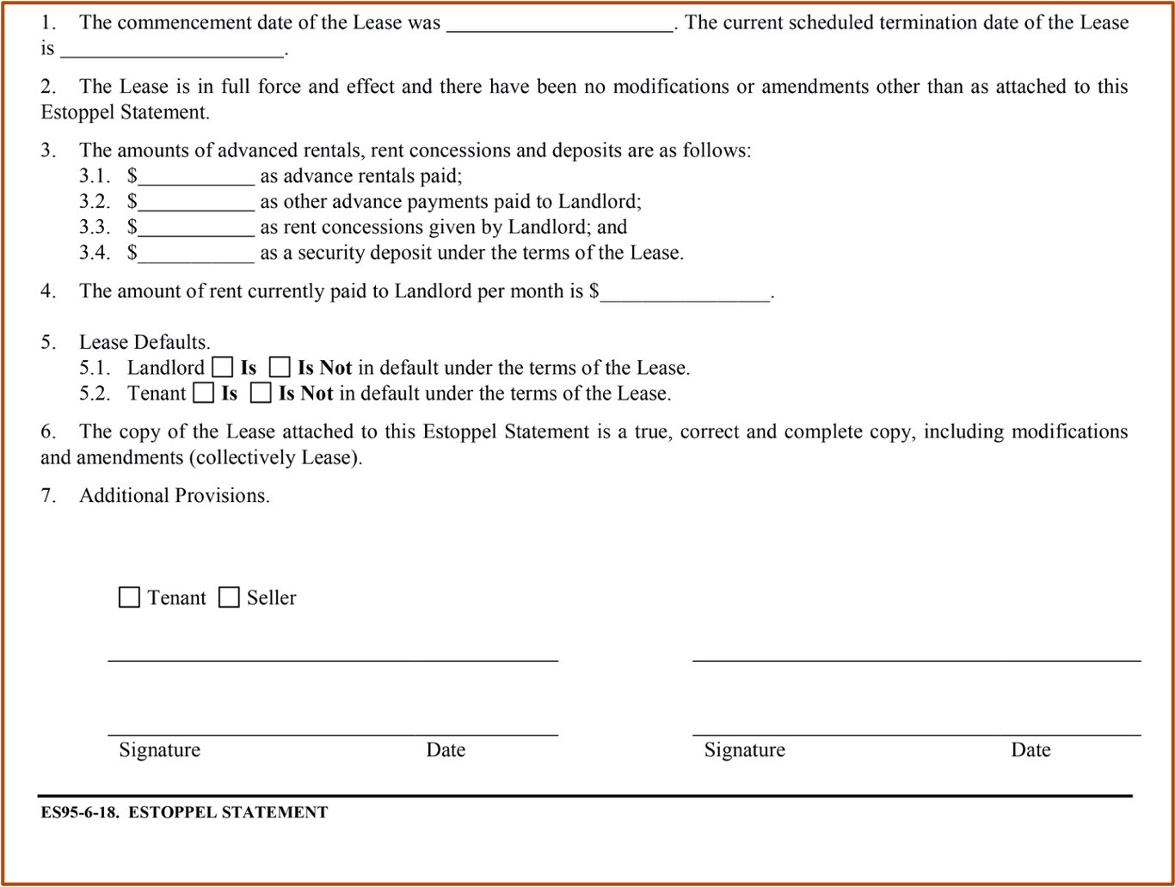

Slide 15
CBS2 (Income-Residential) Contract to Buy and Sell
  The Real Estate Commission has approved a contract specifically for the use in Income-Residential transactions such as rental units, duplexes, triplexes, apartment complex, etc.
  CBS2-6-23 Contract to Buy and Sell Real Estate (Income-Residential)
  This form is utilized regardless of the number of units involved in the complex.
pg. 354

Slide 16
Residential Addendum
  This is a form created for “mixed use” transactions where a Contract to Buy and Sell other than the Residential (CBS1 or 2) version is used.
  For example, when a sale where the primary asset is land, but the property includes residential structures.
  The Addendum addresses the residential aspect of the transaction, permitting the use of CBS3 (Commercial) or CBS4 (Land) without the use of a separate residential contract.
pg. 354

Slide 17
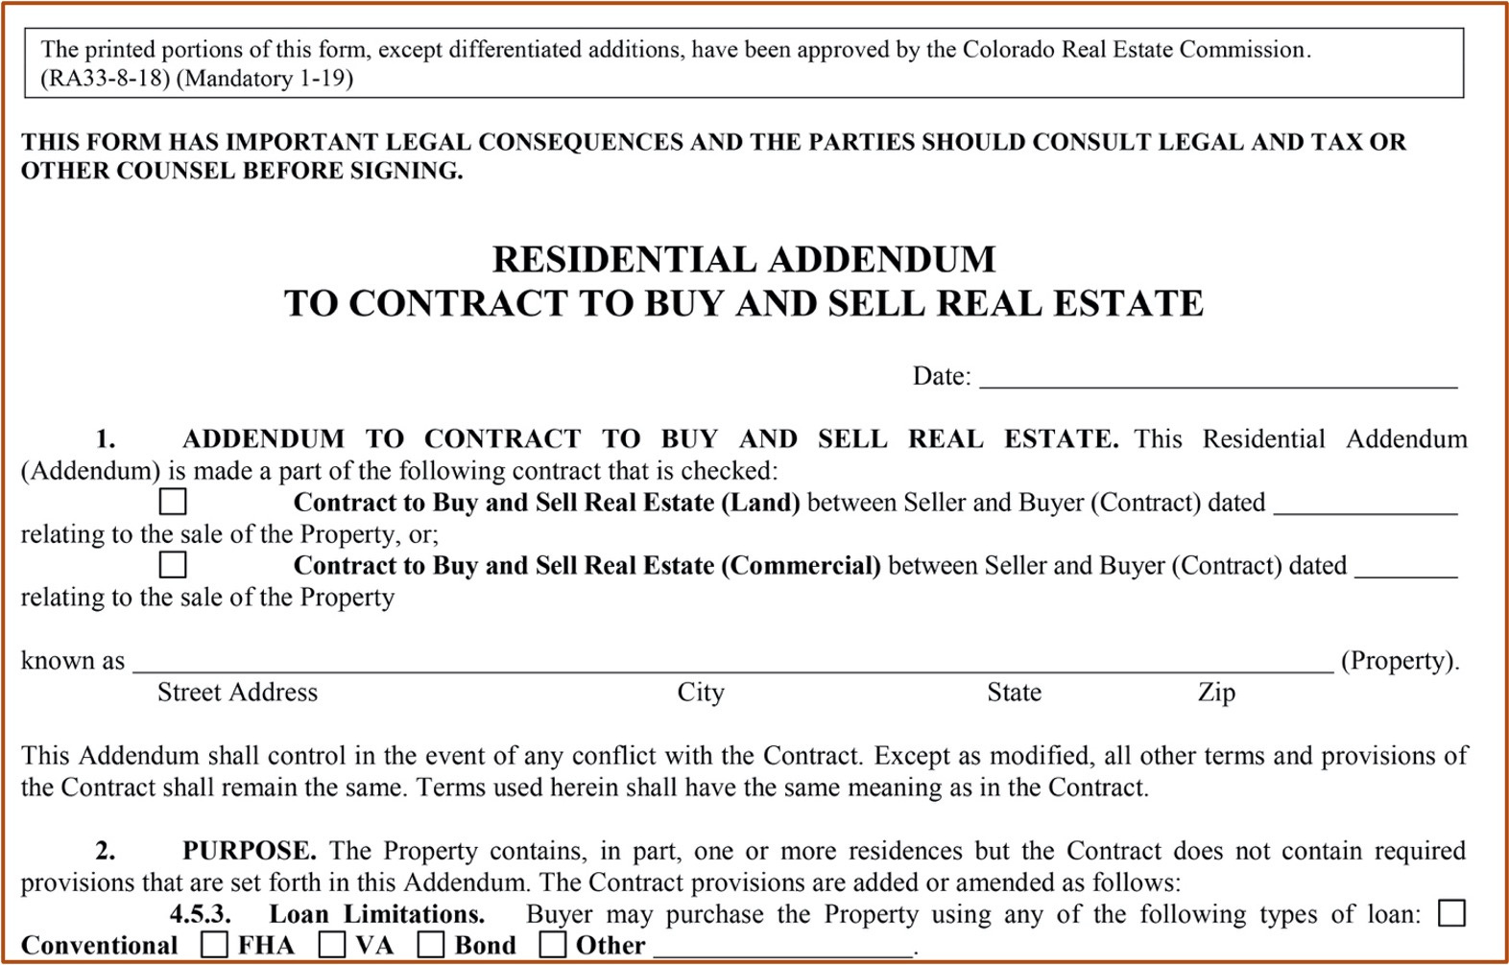

Slide 18
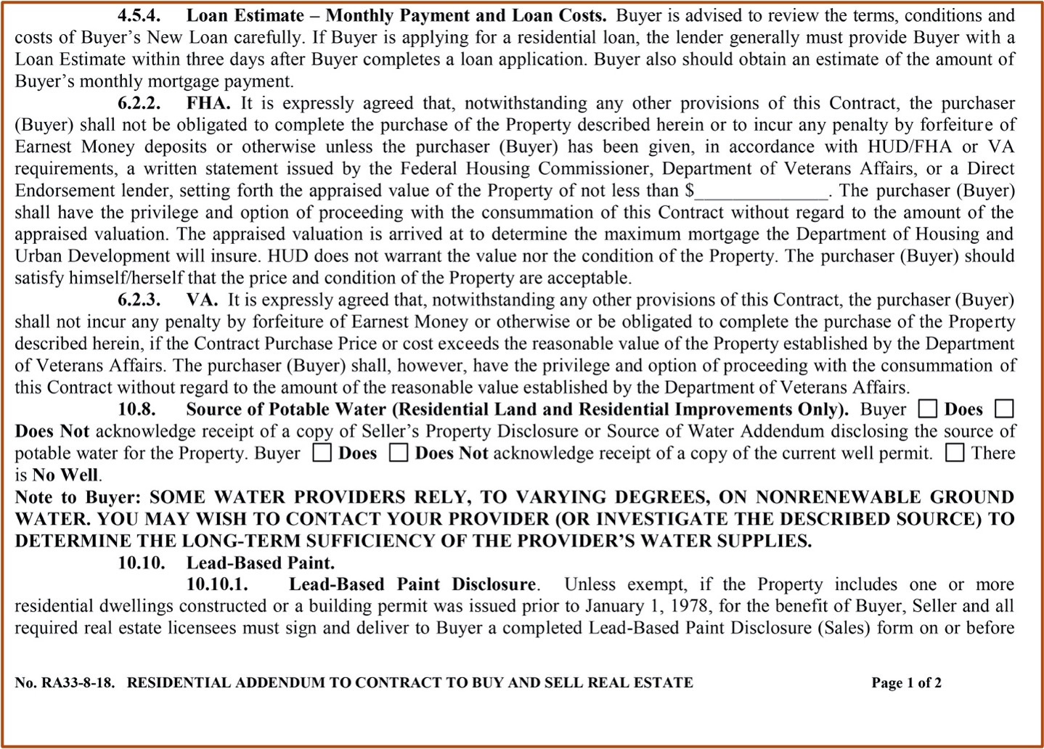

Slide 19
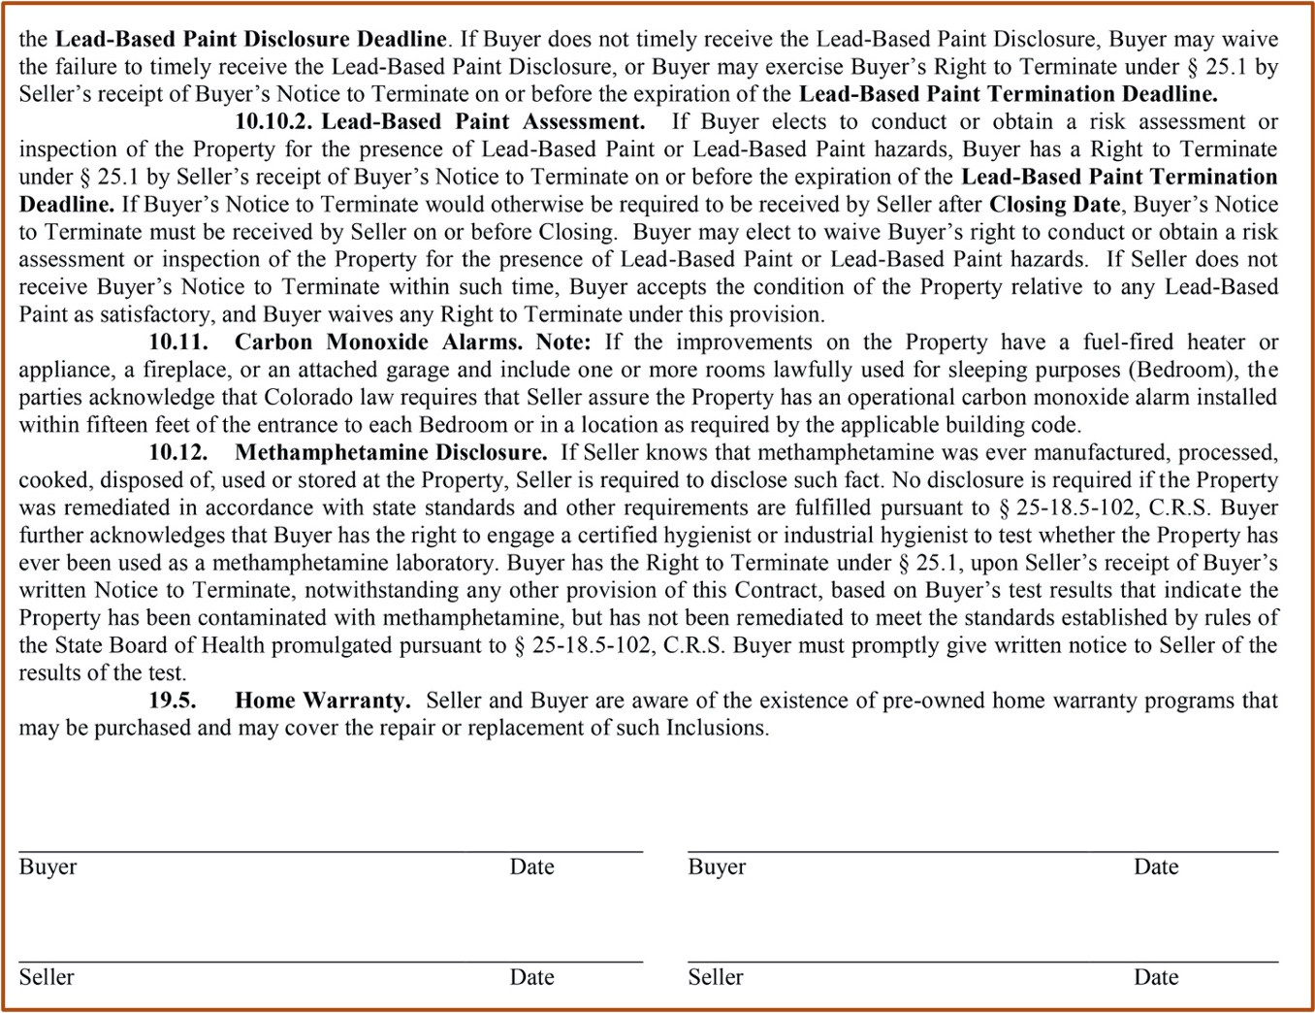

Slide 20
Manufactured Home Addendum to the CBS
  Utilized when the manufactured home is located on a piece of property that the buyer is also purchasing.
  The Manufactured Home Addendum becomes an attachment to the Vacant Land Contract.
  This form would not be necessary if the title to the manufactured home has been “purged” and the home and the land are considered to be one piece of real property.
pg. 357

Slide 21
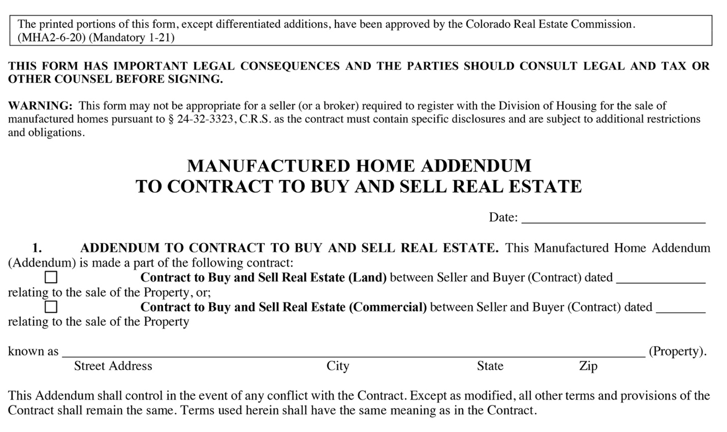

Slide 22
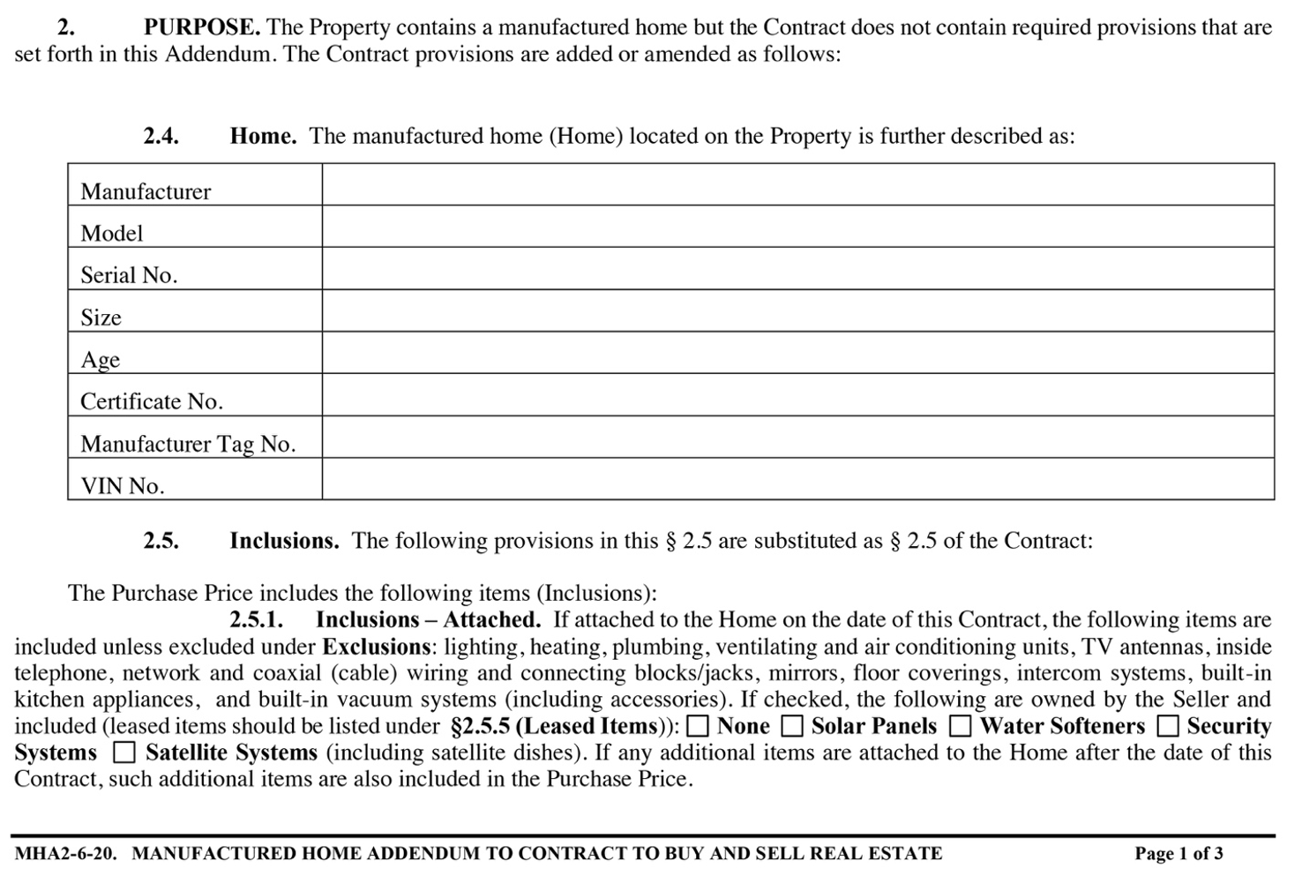

Slide 23
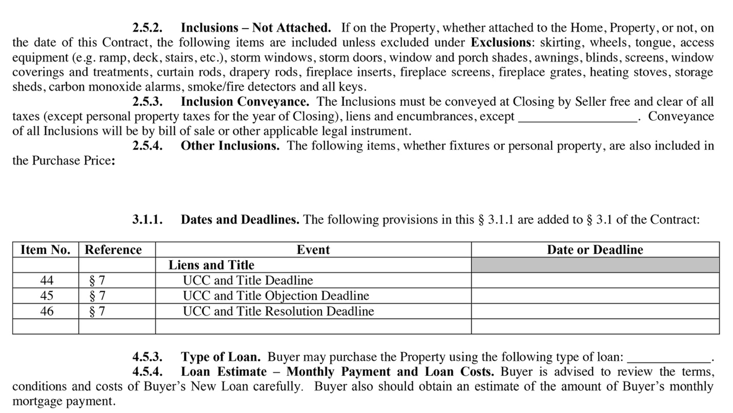

Slide 24
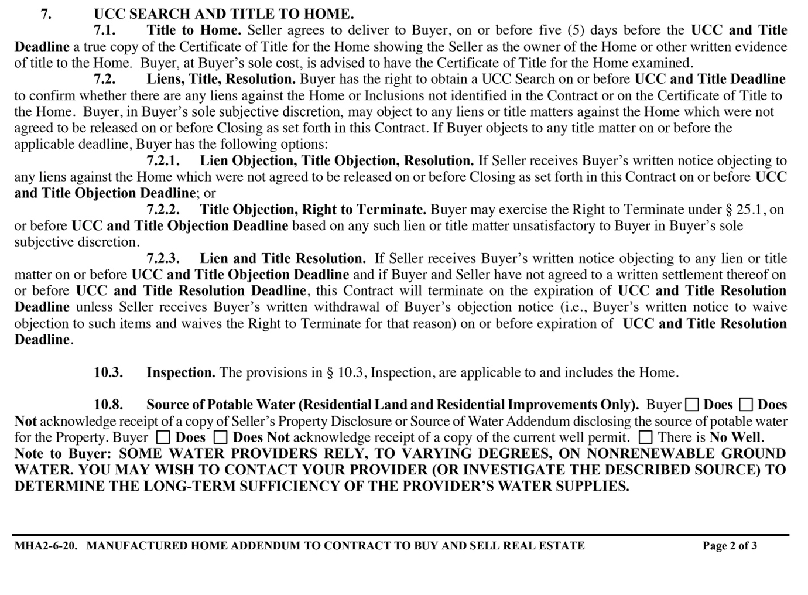

Slide 25
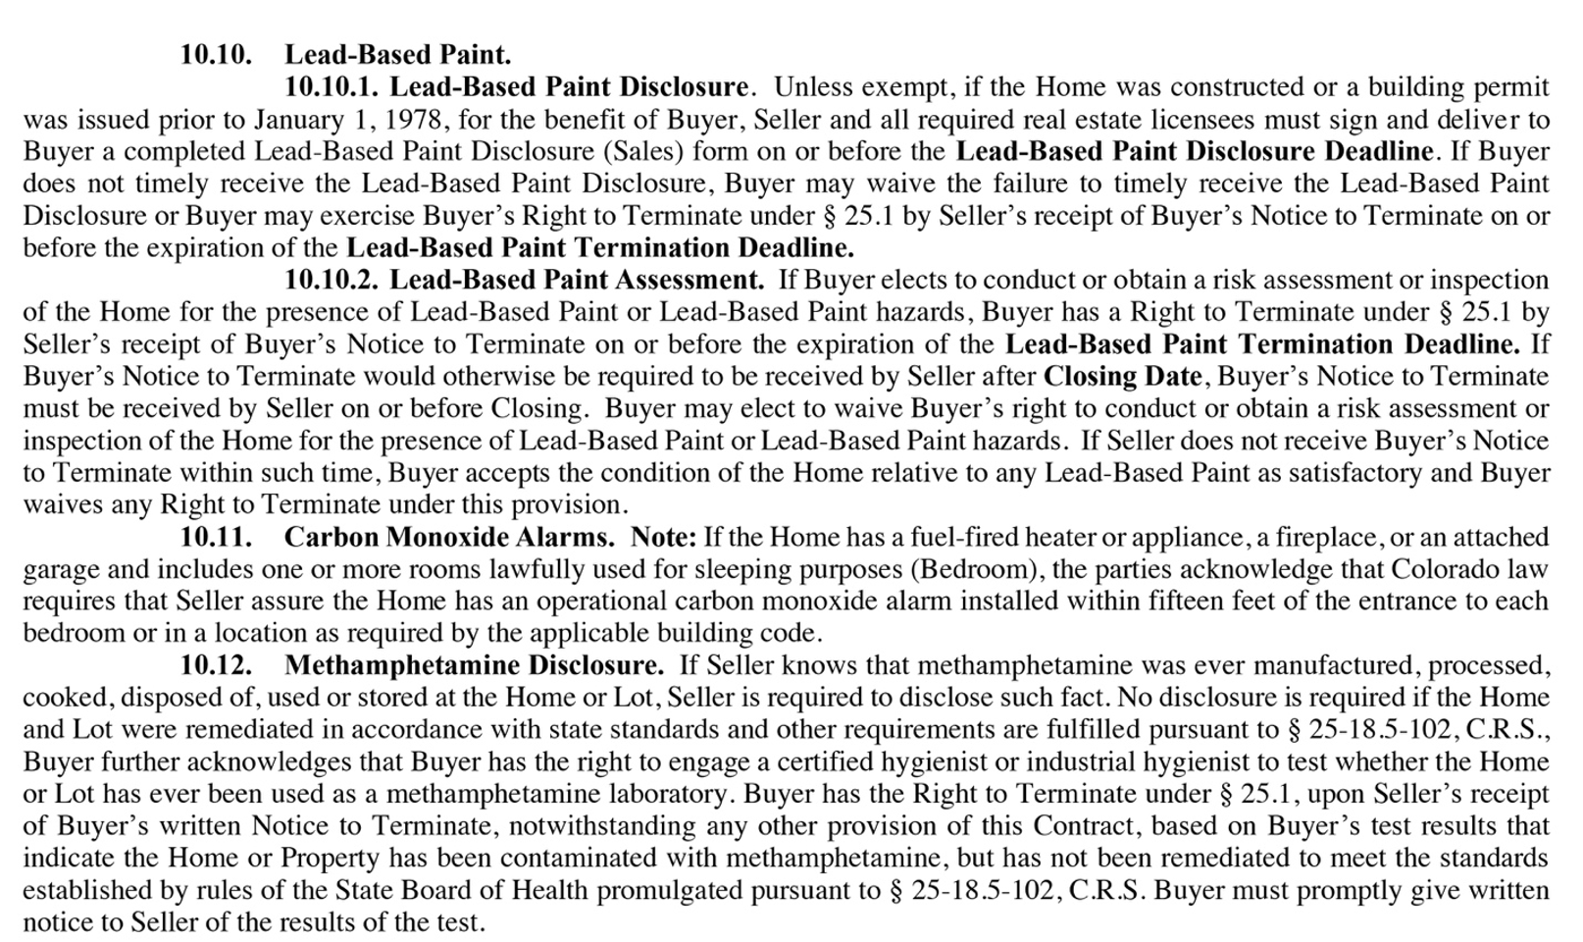

Slide 26
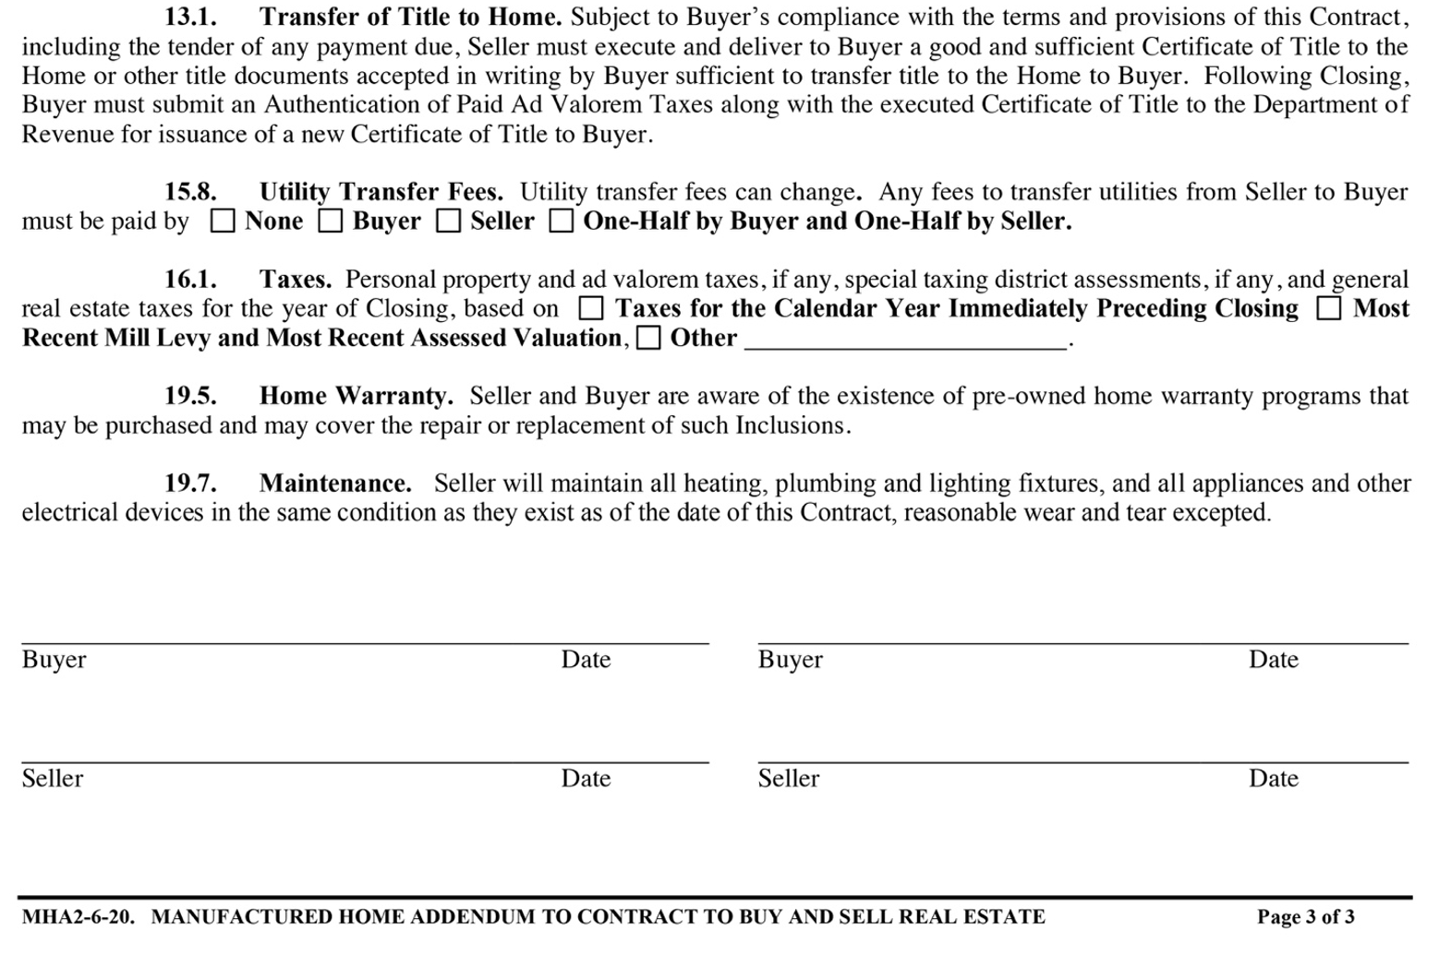

Slide 27
A broker selling a 200-unit apartment building would use which Contract to Buy and Sell?
1) Contract to Buy and Sell (Residential)
2) Contract to Buy and Sell (Income- Residential)
3) Contract to Buy and Sell (Commercial) with Residential Addendum.
4) Contract to Buy and Sell (Land) with Residential Addendum.

Slide 28
A broker selling a 200-unit apartment building would use which Contract to Buy and Sell?
1) Contract to Buy and Sell (Residential)
2) Contract to Buy and Sell (Income- Residential)
3) Contract to Buy and Sell (Commercial) with Residential Addendum.
4) Contract to Buy and Sell (Land) with Residential Addendum.

Slide 29
It is acceptable to utilize the Residential Contract to Buy and Sell Real Estate for a Farm and Ranch property as long as clauses pertaining to the sale of the land are included.
1) True
2) False

Slide 30
It is acceptable to utilize the Residential Contract to Buy and Sell Real Estate for a Farm and Ranch property as long as clauses pertaining to the sale of the land are included.
1) True
2) False

Slide 31
The Residential Addendum should be attached to the Land or Commercial Contract to Buy and Sell if any residential component exists on the property being purchased.
1) True
2) False

Slide 32
The Residential Addendum should be attached to the Land or Commercial Contract to Buy and Sell if any residential component exists on the property being purchased.
1) True
2) False

Slide 33
A Residential Addendum is utilized
1) as an attachment to a Contract to Buy and Sell Commercial and Land form.
2) as an attachment to an Income-Residential Contract to Buy and Sell.
3) as an attachment to a Foreclosure Contract to Buy and Sell.
4) None of the above.

Slide 34
A Residential Addendum is utilized
1) as an attachment to a Contract to Buy and Sell Commercial and Land form.
2) as an attachment to an Income-Residential Contract to Buy and Sell.
3) as an attachment to a Foreclosure Contract to Buy and Sell.
4) None of the above.

Slide 35
Due Diligence documents are arbitrary and are a suggestion of documents that can be provided but they are not considered a binding contingency in the Contract to Buy and Sell.
1) True
2) False

Slide 36
Due Diligence documents are arbitrary and are a suggestion of documents that can be provided but they are not considered a binding contingency in the Contract to Buy and Sell.
1) True
2) False

Slide 37
The Contract to Buy and Sell Income- Residential is utilized for
1) only commercial properties.
2) only apartment complexes with over 10 dwelling units.
3) rental units, duplexes, triplexes, apartment complexes regardless of the number of units involved in the complex.
4) single family homes that might be rented out in the future.

Slide 38
The Contract to Buy and Sell Income- Residential is utilized for
1) only commercial properties.
2) only apartment complexes with over 10 dwelling units.
3) rental units, duplexes, triplexes, apartment complexes regardless of the number of units involved in the complex.
4) single family homes that might be rented out in the future.

Slide 39
Estoppel Statements are utilized to verify the condition of the current leases to the Buyer in their purchase of real property.
1) True
2) False

Slide 40
Estoppel Statements are utilized to verify the condition of the current leases to the Buyer in their purchase of real property.
1) True
2) False

Slide 41
An Estoppel statement is utilized for
1) the purpose of stopping an action of one of the parties to the contract.
2) confirmation of the status of all leases on a property.
3) a court action when rental amounts and security deposits are in question.
4) only for Commercial real estate transactions.

Slide 42
An Estoppel statement is utilized for
1) the purpose of stopping an action of one of the parties to the contract.
2) confirmation of the status of all leases on a property.
3) a court action when rental amounts and security deposits are in question.
4) only for Commercial real estate transactions.

Slide 43
Estoppel statements must be prepared by an attorney.
1) True
2) False

Slide 44
Estoppel statements must be prepared by an attorney.
1) True
2) False

