Slide 1

L’
‘ljhhgtfrdd

Slide 2

Colorado Closings and Settlement
Chapter 21
Introduction to a Six Column Worksheet

Slide 3

Introduction to a Six Column Worksheet
  The purpose of the closing is to finalize the sales contract as well as fulfill the broker’s statutory obligation to furnish the buyer and seller with a proper accounting of the transaction.
pg. 545

Slide 4
Introduction to a Six Column Worksheet
  The worksheet shows the complete settlement picture for the seller, the buyer and the broker, title company or other person who will close the transaction.
  When all items are entered correctly, the worksheet will balance and it can be seen at a glance how much is owed by, or due to, each party.
pg. 545

Slide 5
Introduction to a Six Column Worksheet
  Where there is a real property listing, the listing broker is required to furnish the closing statement to each buyer and seller.
pg. 545

Slide 6
Introduction to a Six Column Worksheet
  If there is a cooperating broker, then it shall be a joint responsibility of both the listing and selling broker to carefully review their respective closing statements for accuracy even if they are not conducting the actual closing.
  Each broker has responsibility for the closing statement of the party they represent.
pg. 545

Slide 7
Introduction to a Six Column Worksheet
  Most of the major money amounts and their distribution are a direct result of what the buyer and seller have agreed to in the Contract to Buy and Sell Real Estate.
  Other items may depend upon state or federal law, requirements of a specific loan program or the lender, or even a consideration of who will benefit from the expense charged.
pg. 546

Slide 8
Introduction to a Six Column Worksheet
  If the buyer and seller, after entering into a buy and sell contract, agree to change anything, it is critical that an Agreement to Amend/Extend Contract be prepared.
  A licensee should not close when there is an oral agreement between the parties to change anything that is in the written and signed contract.
pg. 546

Slide 9
Introduction to a Six Column Worksheet
  A licensee not only does not have the authority to close, but any later examination of the transaction by the Real Estate Commission, or in court, could cost the designated broker money damages and the loss of his/her license.
pg. 546

Slide 10
Introduction to a Six Column Worksheet
  There will be fees and costs that are charged to the responsible parties.
pg. 546

Slide 11
Introduction to a Six Column Worksheet
  Examples of these fees and costs might include:
- Recording Fees- (whomever benefits, pays)
+ Warranty Deed – Charged to the Buyer
+ Trust Deed – Charged to the Buyer
+ Release of Trust Deed paid off – Charged to the Seller
+ Assumption Agreement – Charged to the Buyer
pg. 546

Slide 12
Introduction to a Six Column Worksheet
  Examples of these fees and costs might include (cont.):
- Documentary fee – Charged to the Buyer
- Certificate of Taxes Due – Charged to the
Buyer
pg. 546

Slide 13
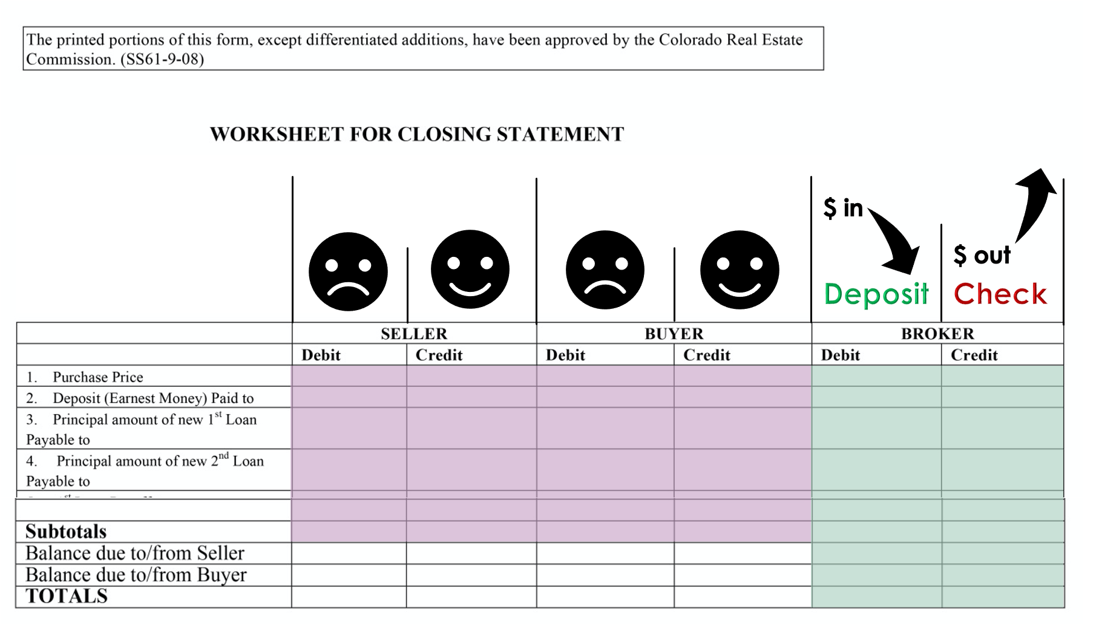

Slide 14
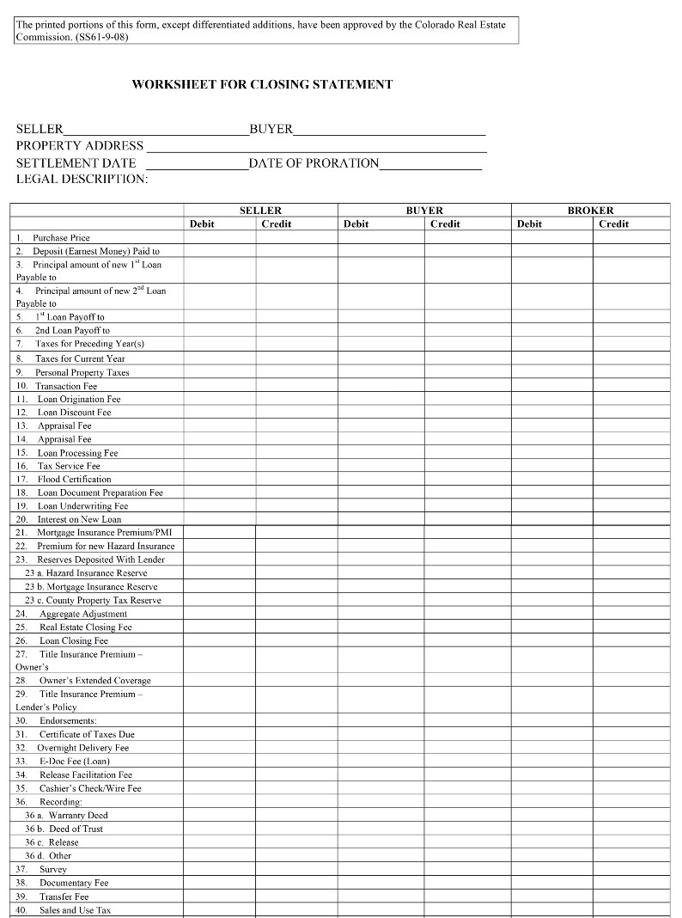







Slide 15
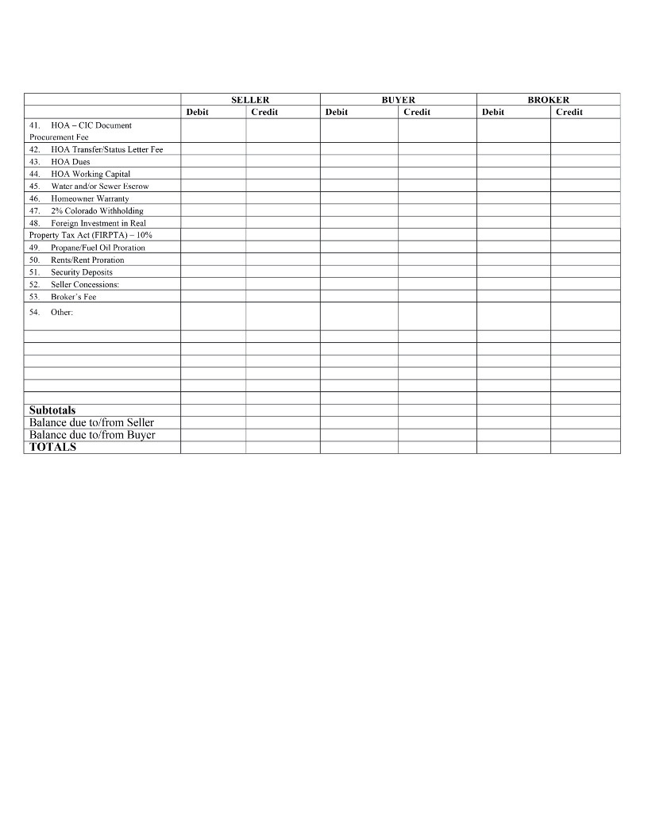




Seller
more debits = $
more credits = $
Buyer
more debits = $
more credits = $

Slide 16
Introduction to a Six Column Worksheet
  The 6-column worksheet is a Commission-approved form and is provided for the convenience of the broker or closer. Use of the form is not mandatory.
  When the worksheet is balanced, the buyer and seller figures are transferred onto a separate two-column settlement sheet providing an individualized settlement statement for each of the parties.
pg. 549

Slide 17
Introduction to a Six Column Worksheet
  The two-column settlement sheet is a required form under Commission Rules. The broker is required to retain information in the permanent file regarding money the broker has received and money paid out.
pg. 549

Slide 18
Introduction to a Six Column Worksheet
  Using the Contract to Buy and Sell and other documents, the closer produces a closing statement for the seller or buyer.
  This statement will show all the debits and credits of the party and the final balance of money the party is to receive or needs to bring to close the transaction.
pg. 549

Slide 19
Introduction to a Six Column Worksheet
  Typically, the seller receives money from, and the buyer brings money to, the closing.
  A number of items in the closing are simply debits and credits between the seller and buyer, such as sales price, prorated property taxes, water, and HOA dues. Other items will be deducted from the party who agreed by contract or tradition to pay the bill.
pg. 549

Slide 20
Introduction to a Six Column Worksheet
  Most brokers use title companies or other services to actually calculate and carry out the closing. They do this by acting as the scrivener of the broker.
  The broker retains all of the responsibility for the accuracy of the information and for properly carrying out the wishes of the parties as stated in the Contract to Buy and Sell Real Estate.
pg. 549

Slide 21
Introduction to a Six Column Worksheet
  Every broker must know how to organize and calculate the figures for a closing and complete the settlement documents.
pg. 549

Slide 22
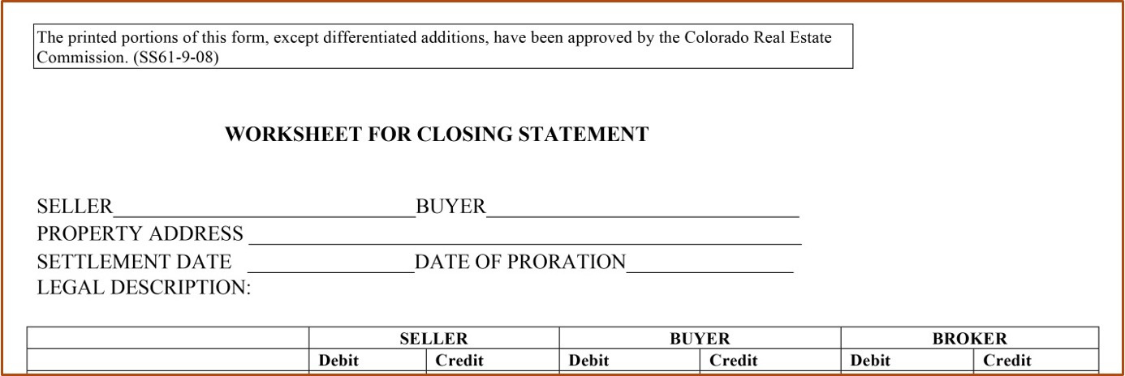
  Debit
    Seller - A charge or amount the won’t receive at closing.
    Buyer – A charge that increases the amount the Buyer must bring to close.
pg. 550

Slide 23
  Credit
    Seller – Increases the check that the Seller will receive at closing.
    Buyer – Money the Buyer will not have to pay at the time of closing.
pg. 550

Slide 24
  Broker
    Debit - money deposited or paid into the Broker’s account.
    Credit – an amount that must be paid out of the account for closing.
pg. 550

Slide 25
  When the worksheet is completed, the broker will have written checks in an amount equal to the money he has deposited in his trust account so that he will have a zero balance in the account for that particular transaction.
pg. 551

Slide 26
  In a cash, assumption or owner financing closing, on any given horizontal line on the settlement sheet you must have equal dollar amounts of debits and credits.
pg. 551

Slide 27
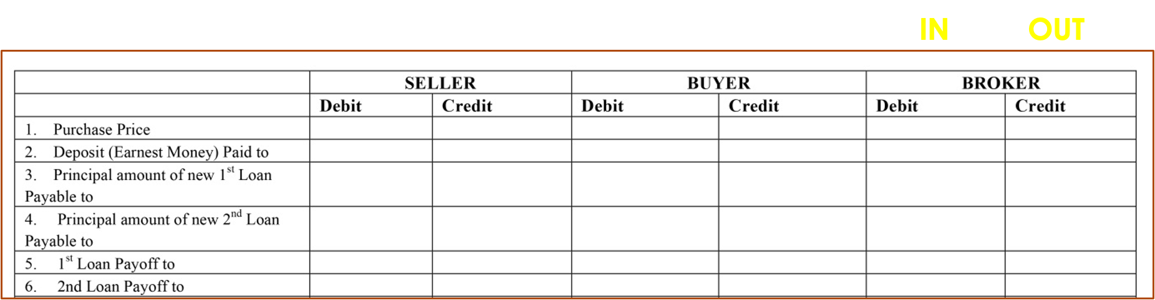

Line 1
Credit Seller / Debit Buyer
pg. 552

Slide 28

Line 2
Credit Buyer / Debit Broker
pg. 552

Slide 29
Line 3
Credit Buyer
pg. 552

Slide 30
Line 4
Credit Buyer
pg. 552

Slide 31
Line 5
Debit Seller / Credit Broker
pg. 553

Slide 32
Line 6
Debit Seller / Credit Broker
pg. 553

Slide 33
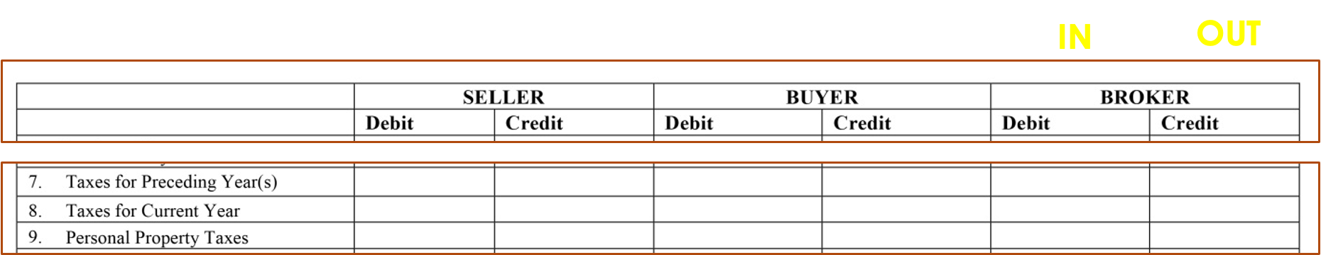
Line 7
Debit Seller / Credit Broker
pg. 553

Slide 34
Line 8
Debit Seller/ Credit Buyer
pg. 553

Slide 35
MOSTLY ONLY APPLICABLE WITH BUSINESS TRANSACTIONS
Line 9
Mostly Only Applicable with Business Transactions
pg. 554

Slide 36
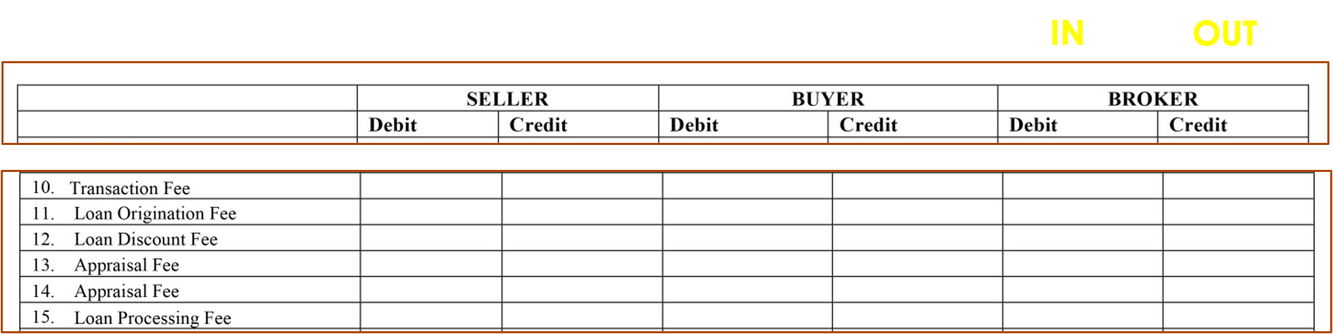
Most
CONTROVERSIAL - CHARGE DEPENDS ON CLIENT
Line 10
Controversial – Charge depends on client
pg. 554

Slide 37
Most
CONTROVERSIAL - CHARGE DEPENDS ON CLIENT
Line 11
Debit Buyer
pg. 554

Slide 38
Most
CONTROVERSIAL - CHARGE DEPENDS ON CLIENT
Line 12
Debit Seller/ Debit Buyer/ Credit Broker
pg. 555

Slide 39
Most
CONTROVERSIAL - CHARGE DEPENDS ON CLIENT
Line 13 (and 14)
Debit Buyer/ Credit Broker
pg. 555

Slide 40
Most
CONTROVERSIAL - CHARGE DEPENDS ON CLIENT
Line 15
Debit Buyer
pg. 555

Slide 41
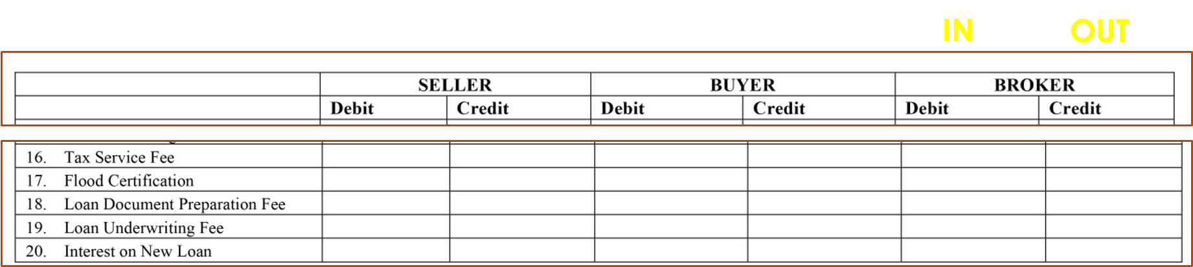
Most
Line 16
Debit Buyer
pg. 555

Slide 42
Most
Line 17
Debit Buyer
pg. 555

Slide 43
Most
Line 18
Debit Buyer
pg. 556

Slide 44
Most
Line 19
Debit Buyer
pg. 556

Slide 45
Most
Line 20
Debit Buyer
pg. 556

Slide 46
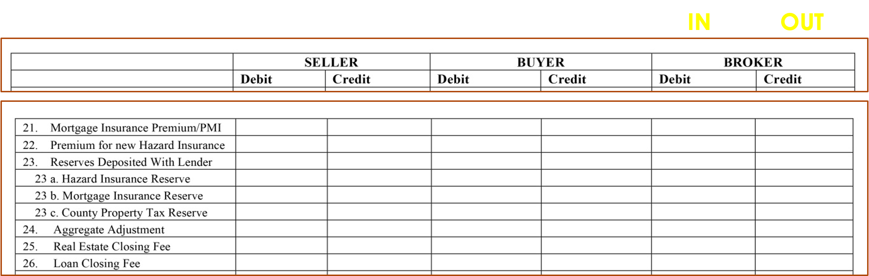
Most
Line 21
Debit Buyer
pg. 556

Slide 47
Most
Line 22
Debit Buyer/ Credit Broker
pg. 556

Slide 48
Most
Line 23 & 23. a - c
Debit Buyer
pg. 557

Slide 49
Most
Line 24
Credit Buyer
pg. 557

Slide 50
Most
Line 25
Debit Seller/ Debit Buyer/ Credit Broker
pg. 558

Slide 51
Most
Line 26
Debit Buyer / Credit Broker
pg. 558

Slide 52
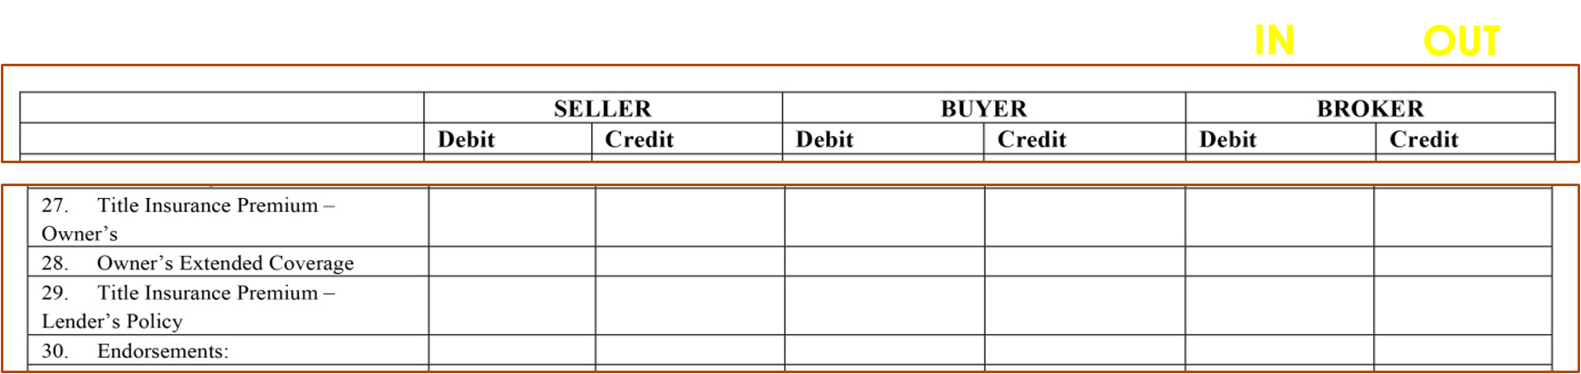
Most
Line 27
Debit Seller/ Debit Buyer/ Credit Broker
pg. 558

Slide 53
Most
Line 28
Debit Seller/ Debit Buyer/ Credit Broker
pg. 559

Slide 54
Most
Line 29
Debit Buyer/ Credit Broker
pg. 559

Slide 55
Most
Line 30
Debit Buyer / Credit Broker
pg. 559

Slide 56
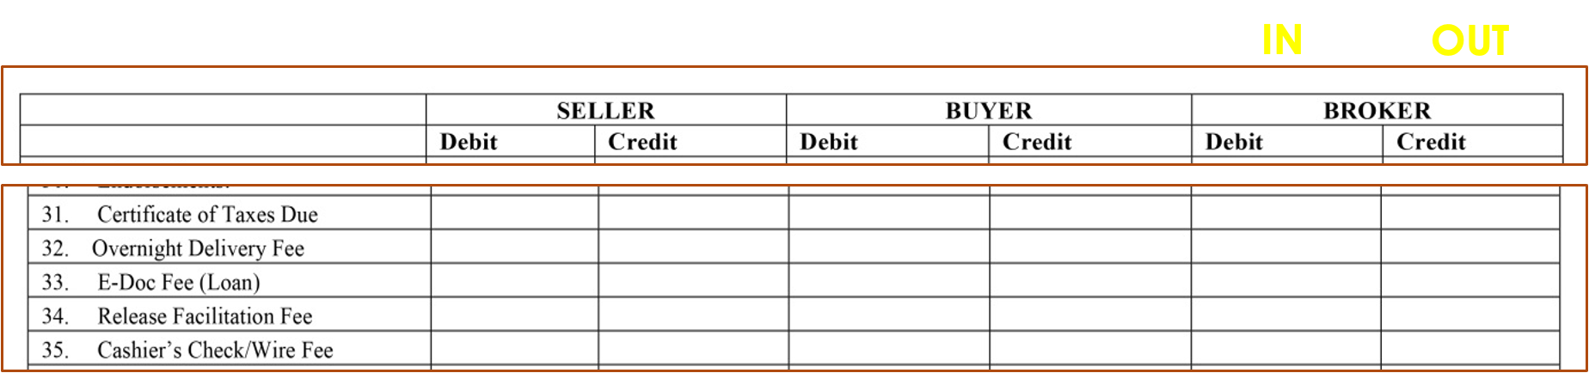
Most
Line 31
Debit Buyer/ Credit Broker
pg. 560

Slide 57
Most
Line 32
Debit Seller/ Debit Buyer/ Credit Broker
pg. 560

Slide 58
Most
Line 33
Debit Buyer
pg. 560

Slide 59
Most
Line 34
Debit Seller/ Credit Broker
pg. 560

Slide 60
Most
Line 35
Debit Seller/ Credit Broker
pg. 560

Slide 61
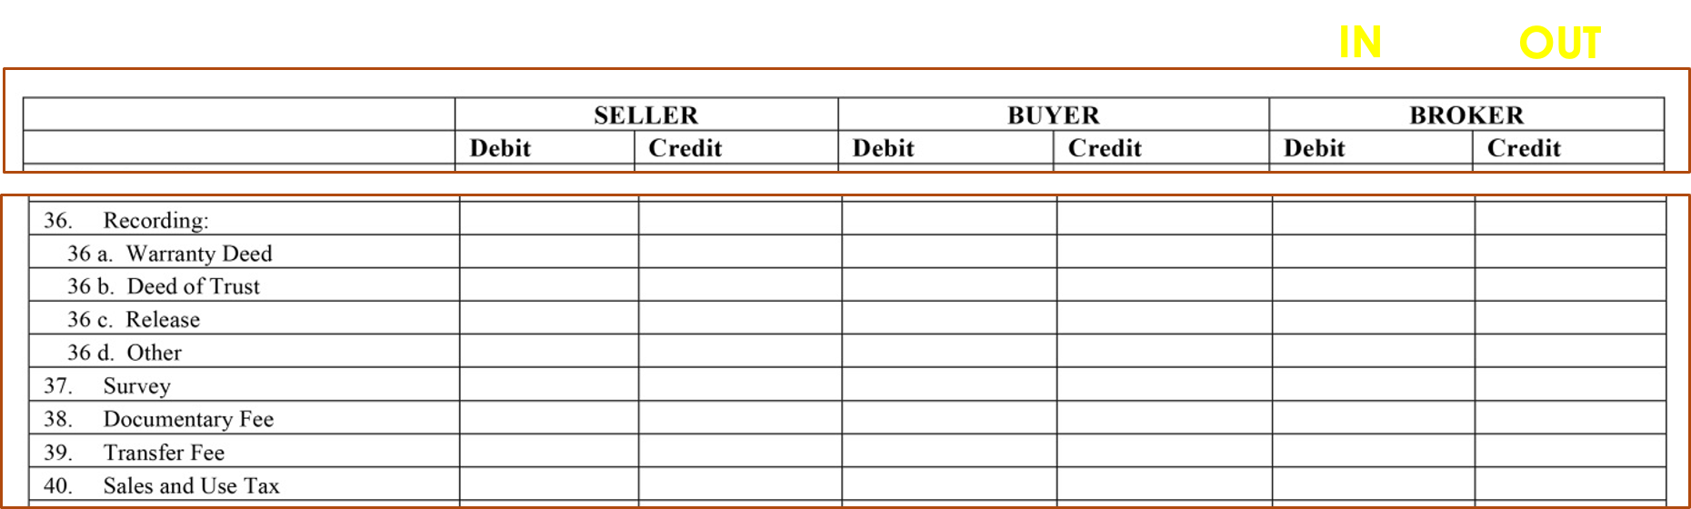
Most
Line 36.a
Debit Buyer/ Credit Broker
pg. 561

Slide 62
Most
Line 36.b
Debit Buyer/ Credit Broker
pg. 561

Slide 63
Most
Line 36.c
Debit Seller/ Credit Broker
pg. 561

Slide 64
Most
Line 36.d
Debit Seller/ Debit Buyer/ Credit Broker
pg. 561

Slide 65
Most
Line 37
Debit Seller/ Debit Buyer/ Credit Broker
pg. 561

Slide 66
Most
Line 38
Debit Buyer/ Credit Broker
pg. 561

Slide 67
Most
Line 39
Debit Buyer/ Credit Broker
pg. 562

Slide 68
Most
Line 40
Debit Buyer/ Credit Broker
pg. 562

Slide 69
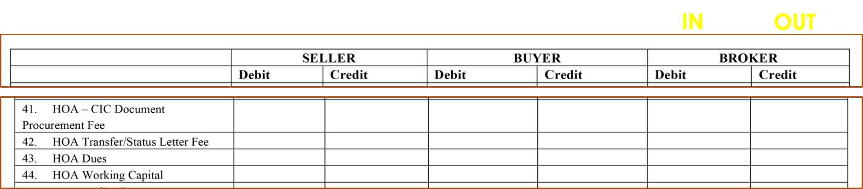
Most
Line 41
Debit Seller/ Credit Broker
pg. 562

Slide 70
Most
Line 42
Debit Seller/ Debit Buyer/ Credit Broker
pg. 562

Slide 71
Most
Line 43
Credit Seller/ Debit Buyer
pg. 563

Slide 72
Most
Line 44
Debit Seller/ Debit Buyer/ Credit Broker
pg. 563

Slide 73
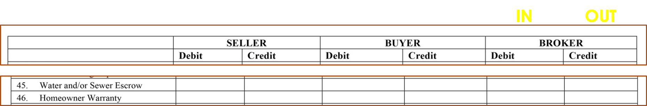
Most
USUALLY PRORATED BETWEEN BUYER AND SELLER
Line 45
Usually prorated between Buyer and Seller
pg. 563

Slide 74
Most
USUALLY PRORATED BETWEEN BUYER AND SELLER
Line 46
Debit Seller/ Debit Buyer/ Credit Broker
pg. 564

Slide 75
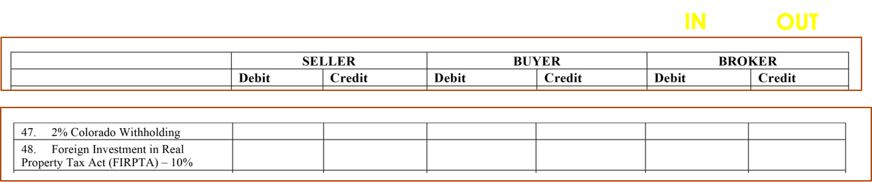
Most
Line 47
Debit Seller/ Credit Broker
pg. 564

Slide 76
Most
Line 48
Debit Seller/ Credit Broker
pg. 564

Slide 77
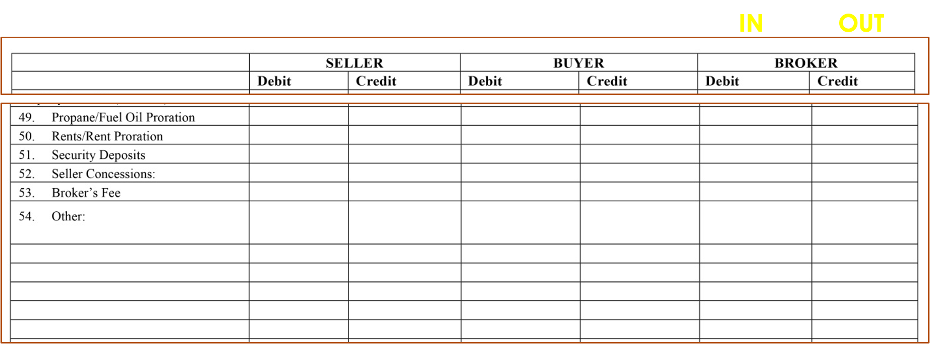
Most
Line 49
Credit Seller/ Debit Buyer

Slide 78
Most
Line 50
Debit Seller/ Credit Buyer

Slide 79
Most
Line 51
Debit Seller/ Credit Buyer

Slide 80
Most
Line 52
Debit Seller/ Credit Buyer

Slide 81
Most
Line 53
Debit Seller/ Debit Buyer/ Credit Broker

Slide 82
Most
Notary Fees Debit party who's signature is being acknowledged and Credit the Broker
Line 54 – Notary Fees
Debit party who's signature is being acknowledged and Credit the Broker.

Slide 83
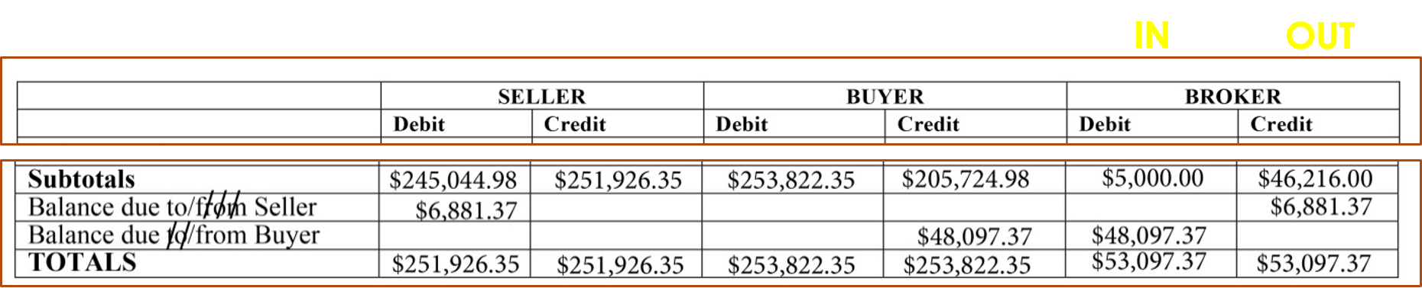
pg. 567

Slide 84
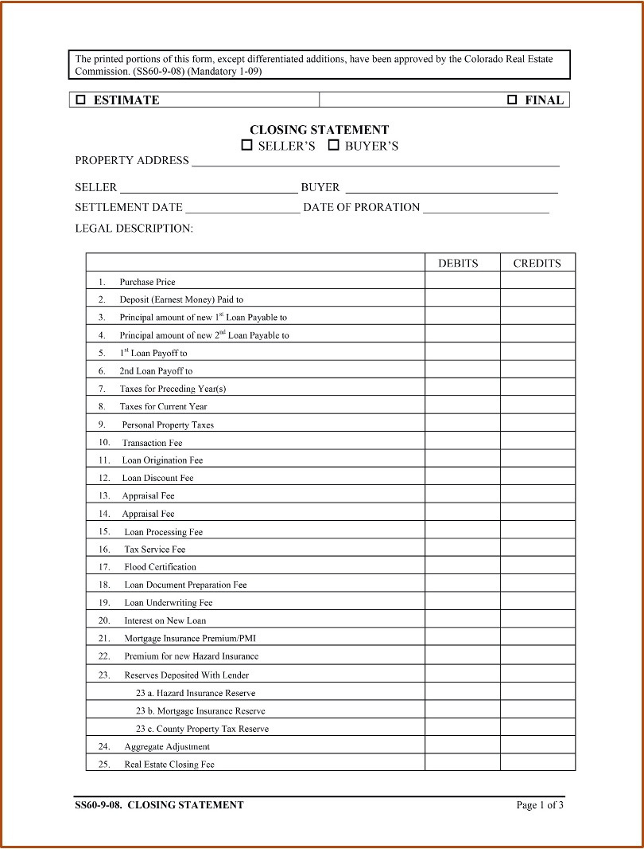

Slide 85
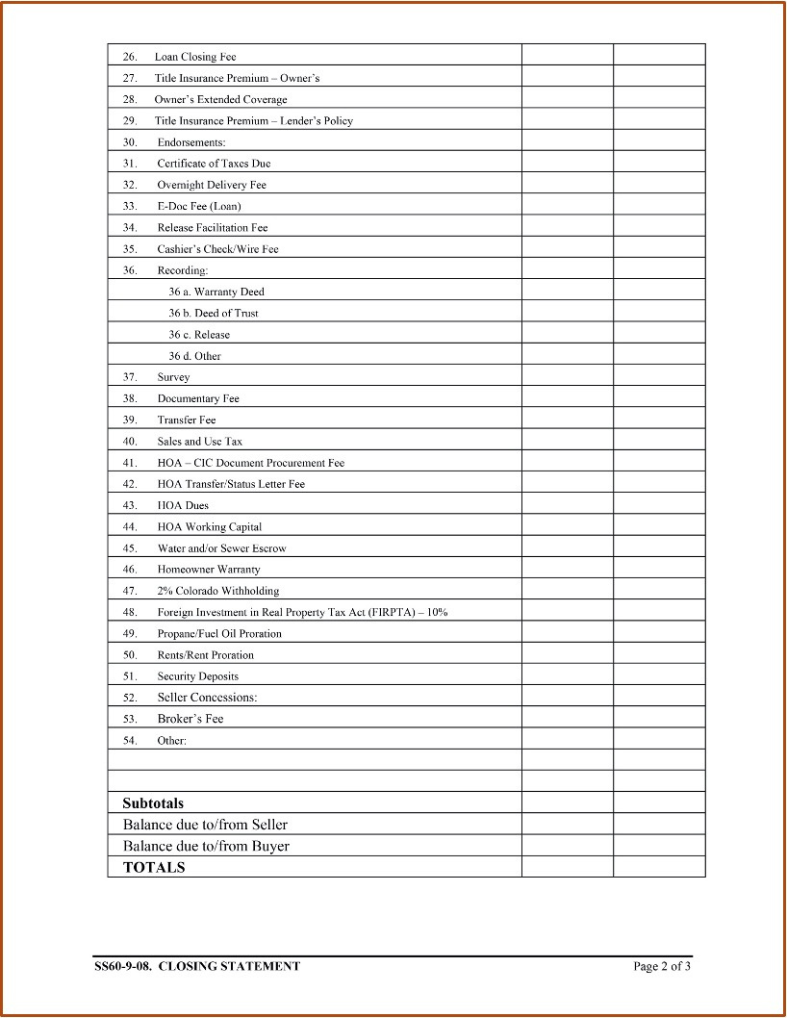

Slide 86
