Slide 1

National Law and practice
Chapter 11 – Closing A Real
Estate Transaction

Slide 2
Closing a real estate transaction –
Escrow or Closing
Responsibilities of escrow agent.
An escrow or closing agent is a neutral third party authorized to coordinate the closing activities of a real estate transaction.
Responsibilities include:
- Holding financial documents in trust.
- Gather required legal documents.
- Ordering an examination on the property.
- Preparing specific closing instructions.
- Gathering documents from the buyer’s lender.
- Ensuring that all terms of the offer to purchase have been completed.
- Recording any necessary documents such as the deed.
Pg. 299

Slide 3
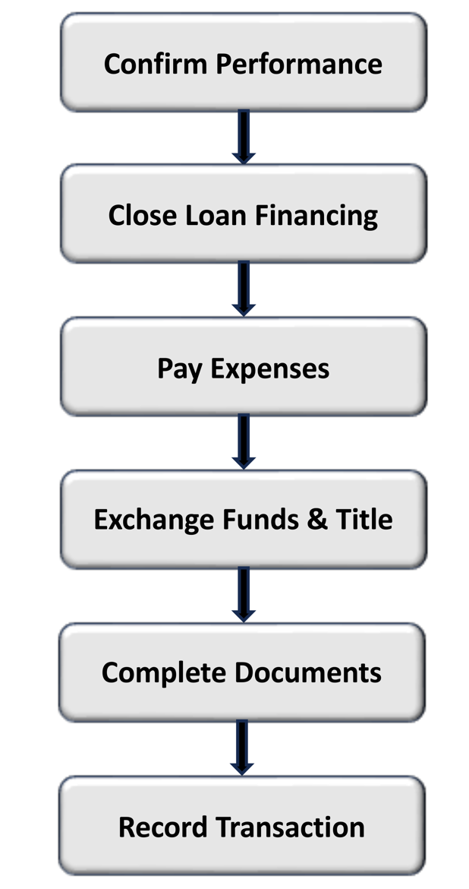
If there are any encumbrances or liens that affect the title, the seller is expected to remove these prior to closing.
The lender should provide a payoff statement specifying the amount of unpaid principal and interest due as of the closing date.
The buyer should inspect the property (walkthrough) to make certain that the property is in the condition that they expect it to be in, immediately prior to closing.
Pg. 300

Slide 4
Closing a real estate transaction –
Escrow or Closing
Closings Statements / RESPA / TRID Disclosures
The TILA - RESPA Integrated Disclosure (TRID) rule became effective on October 3, 2015.
The rule requires the use of new integrated disclosure forms for consumers at the time of application (Loan Estimate) and Settlement (Closing Disclosure).
The Loan Estimate must be placed in the mail or delivered to the buyer no later than the third business day after receiving their application.
Pg. 301

Slide 5
Closing a real estate transaction –
Escrow or Closing
Closings Statements / RESPA / TRID Disclosures
The Buyer must receive the Closing Disclosure at least three days prior to closing.
- A new three-day Closing Disclosure may be required to be provided to the buyer if
certain items change.
- Saturday is considered a business day for the Closing Disclosure.
Pg. 301

Slide 6
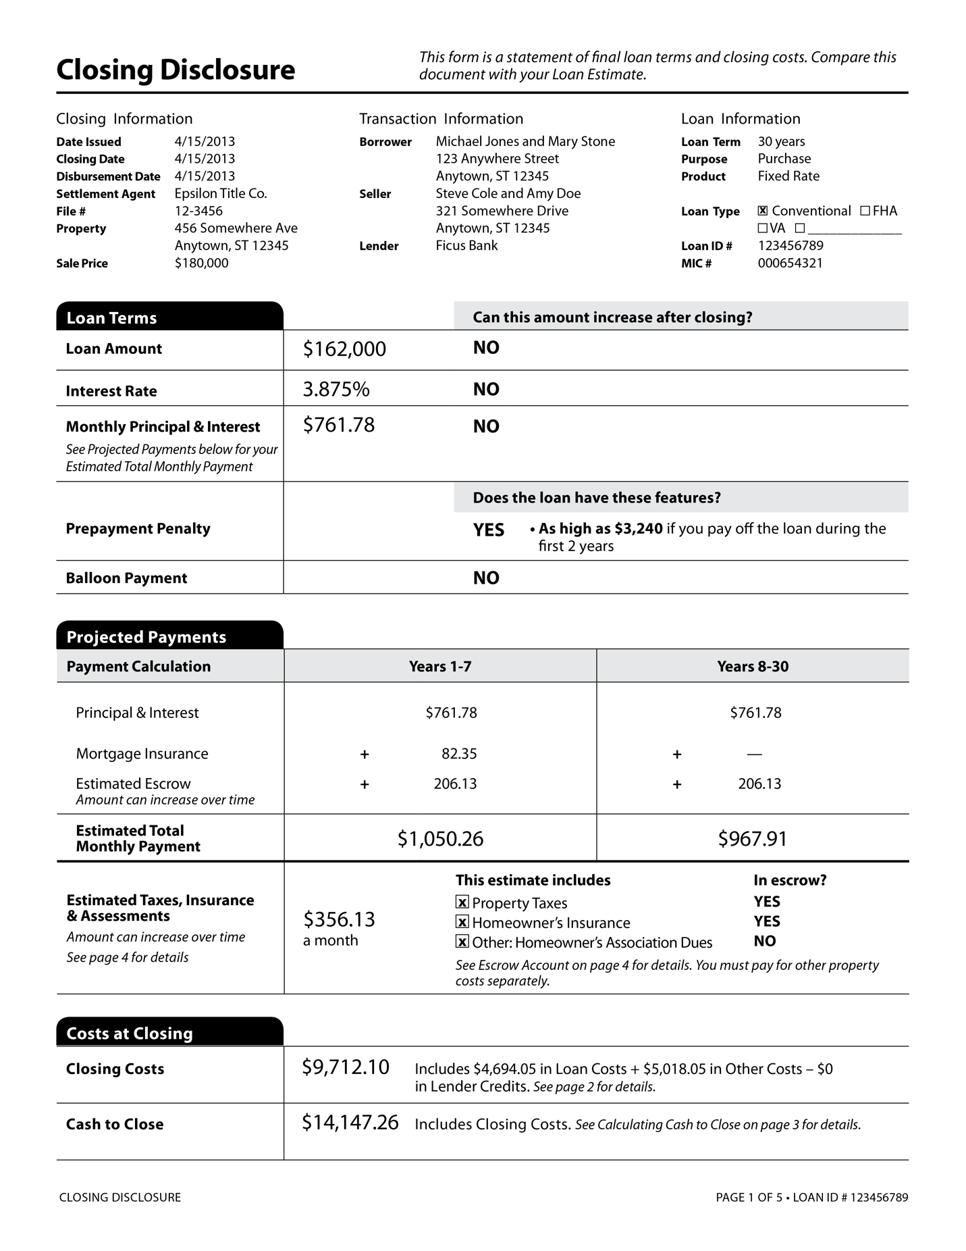
Pg. 302

Slide 7
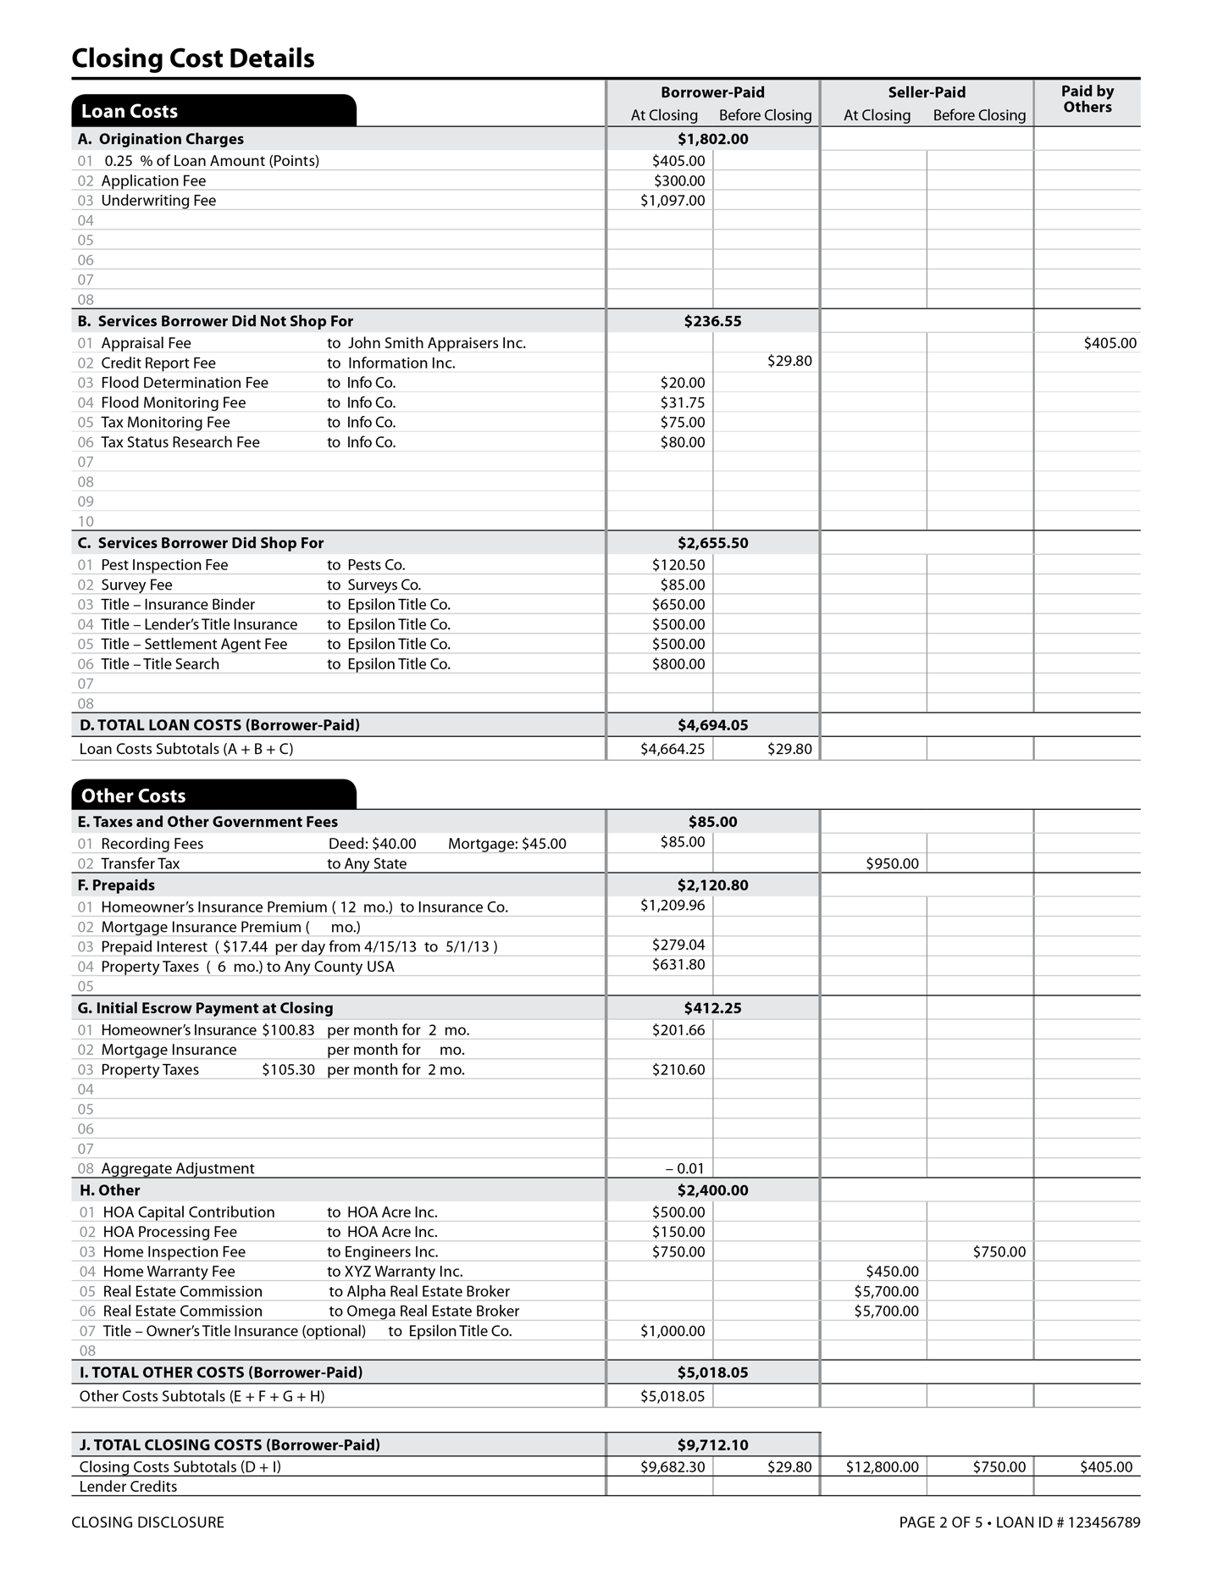
Pg. 303

Slide 8
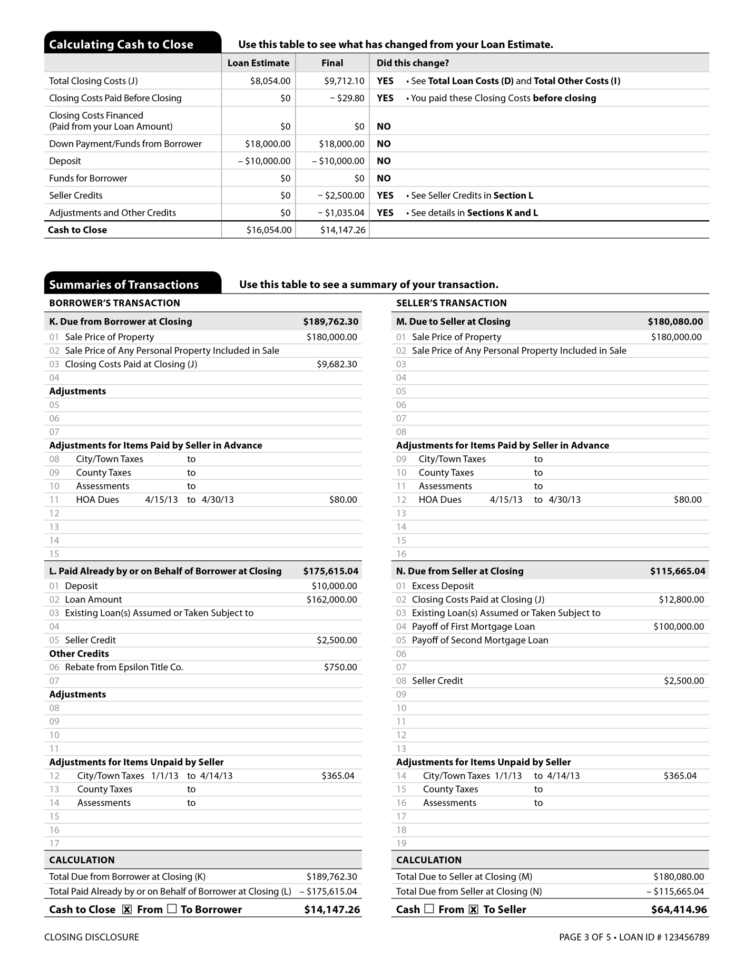
Pg. 304

Slide 9
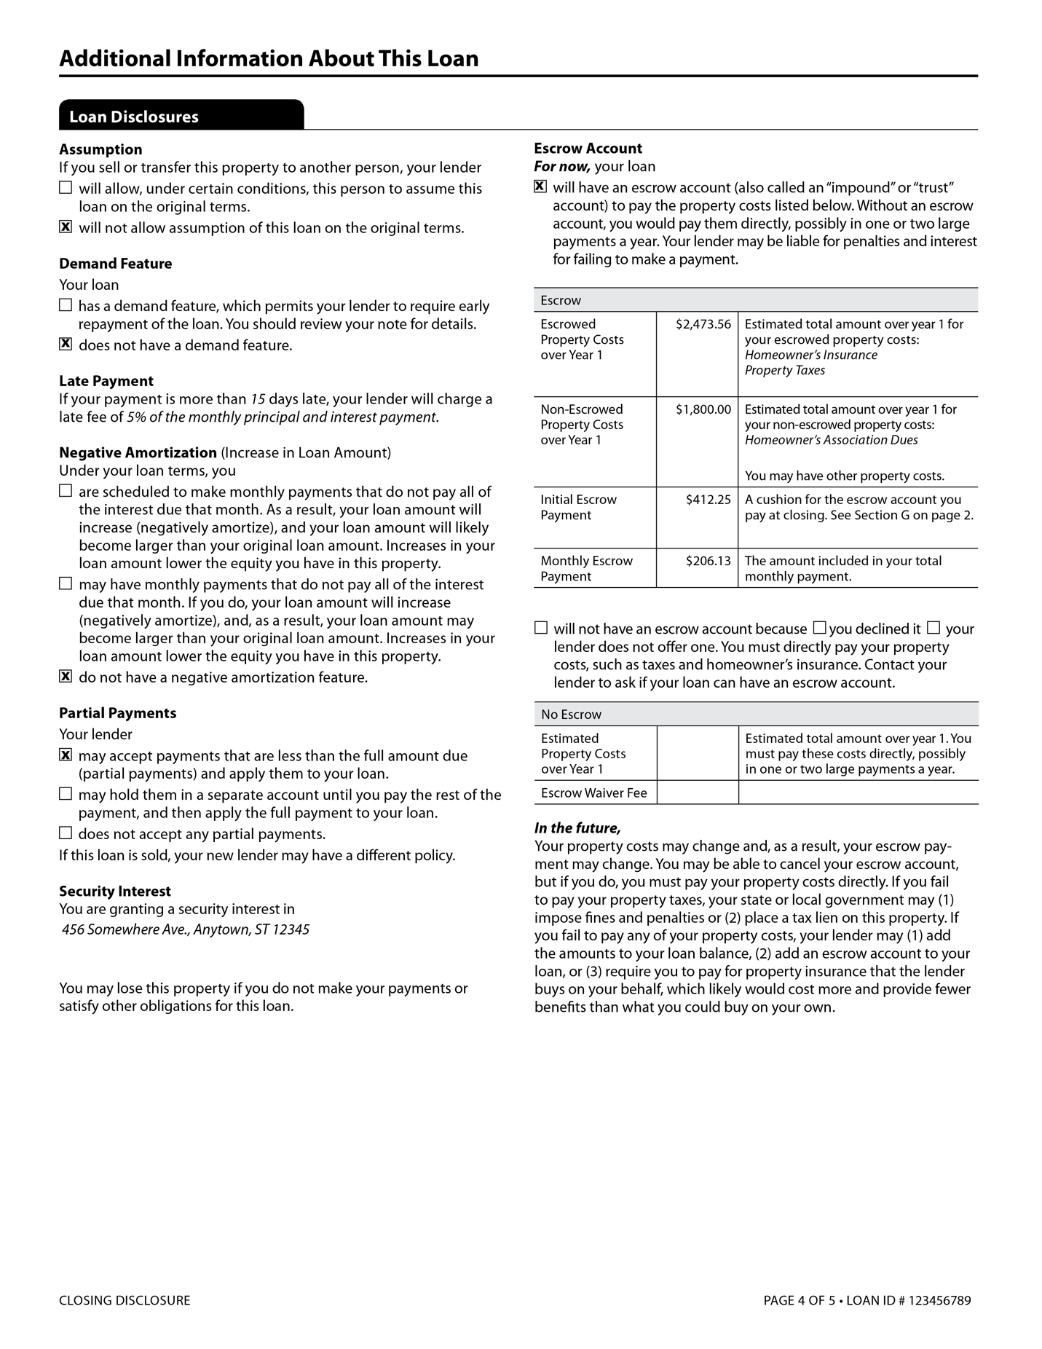
Pg. 305

Slide 10
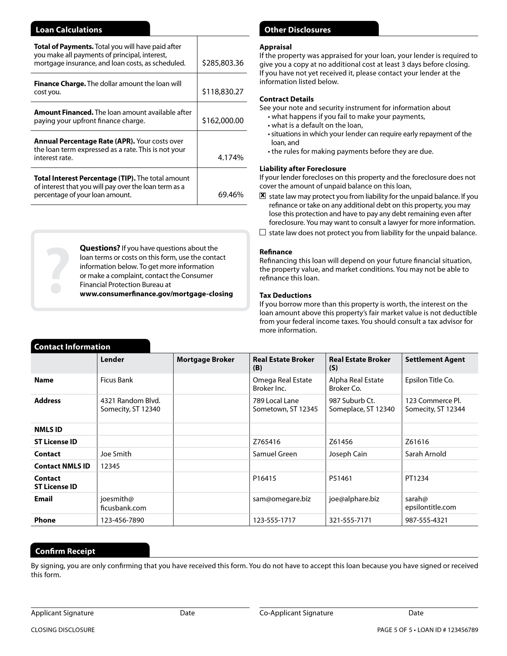
Pg. 306

Slide 11
Closing a real estate transaction –
Escrow or Closing
Closings Statements / RESPA / TRID Disclosures
Affiliated Business Arrangements
- Parties who are providing services to the buyer or seller must disclose in writing any
business relationship they have with other parties involved in the transaction.
- Used to avoid conflicts of interest.
Pg. 307

Slide 12
Closing a real estate transaction –
Escrow or Closing
Title Insurance
Protects the insured party against loss resulting from certain defects in the title, such as a forgery or defect in the public record, other than those items listed in the policy as exceptions (items already known about).
Two types of policies: Owner’s (covering the buyer) and Mortgagee’s (covering the lender.)
Pg. 307

Slide 13
Closing a real estate transaction –
Escrow or Closing
Title Insurance
Standard Coverage
- Usually, will not cover situations arising from questions of survey, defects of which the
policy-holder has knowledge or unrecorded documents.
Extended Coverage
- Usually, will cover additional risks that may be discovered only by inspection of the
property, including unrecorded rights of people in possession, or by examination of an
accurate survey.
Pg. 307

Slide 14
Closing a real estate transaction –
Escrow or Closing
Title Search
An inspection of public records to determine if any defects exist in the chain of title.
The inspection begins with the present owner and is traced backward for a period of time.
The inclusion of documents in title records (recorded with the Clerk and Recorders Office) is known as Constructive Notice. The ability to determine title related issues. As opposed to Actual Notice – knowing something specifically about a title related issue.
Pg. 308

Slide 15
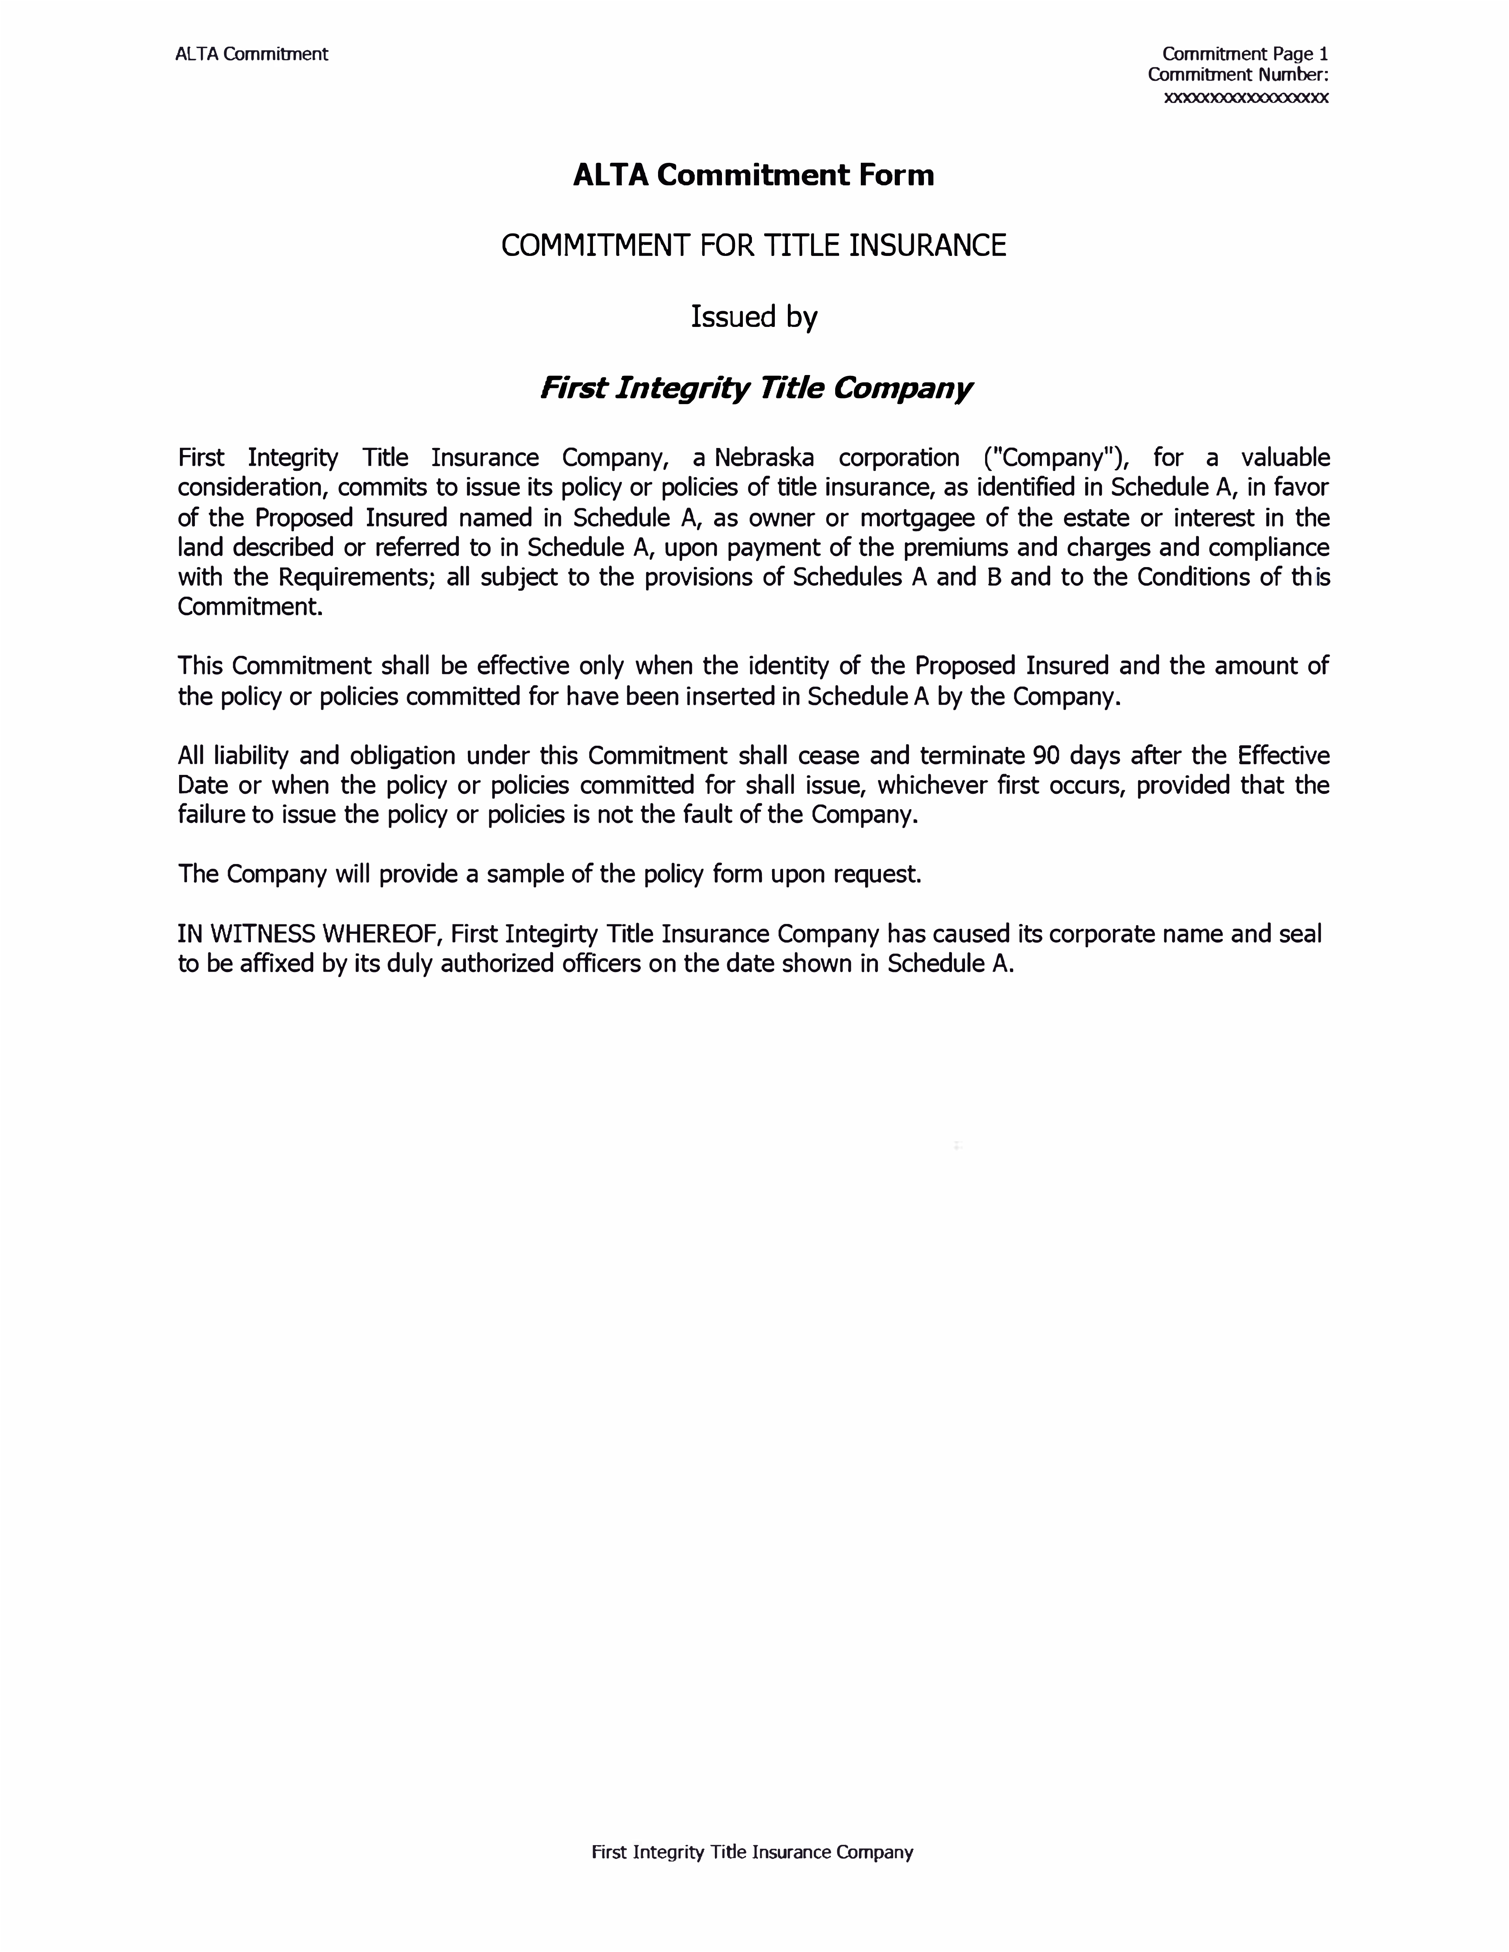
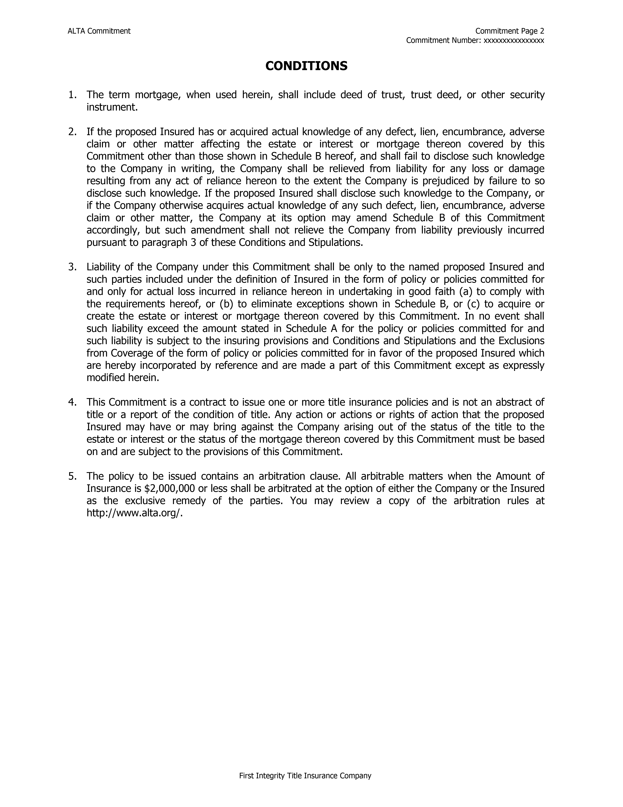
Pg. 309 & 310

Slide 16
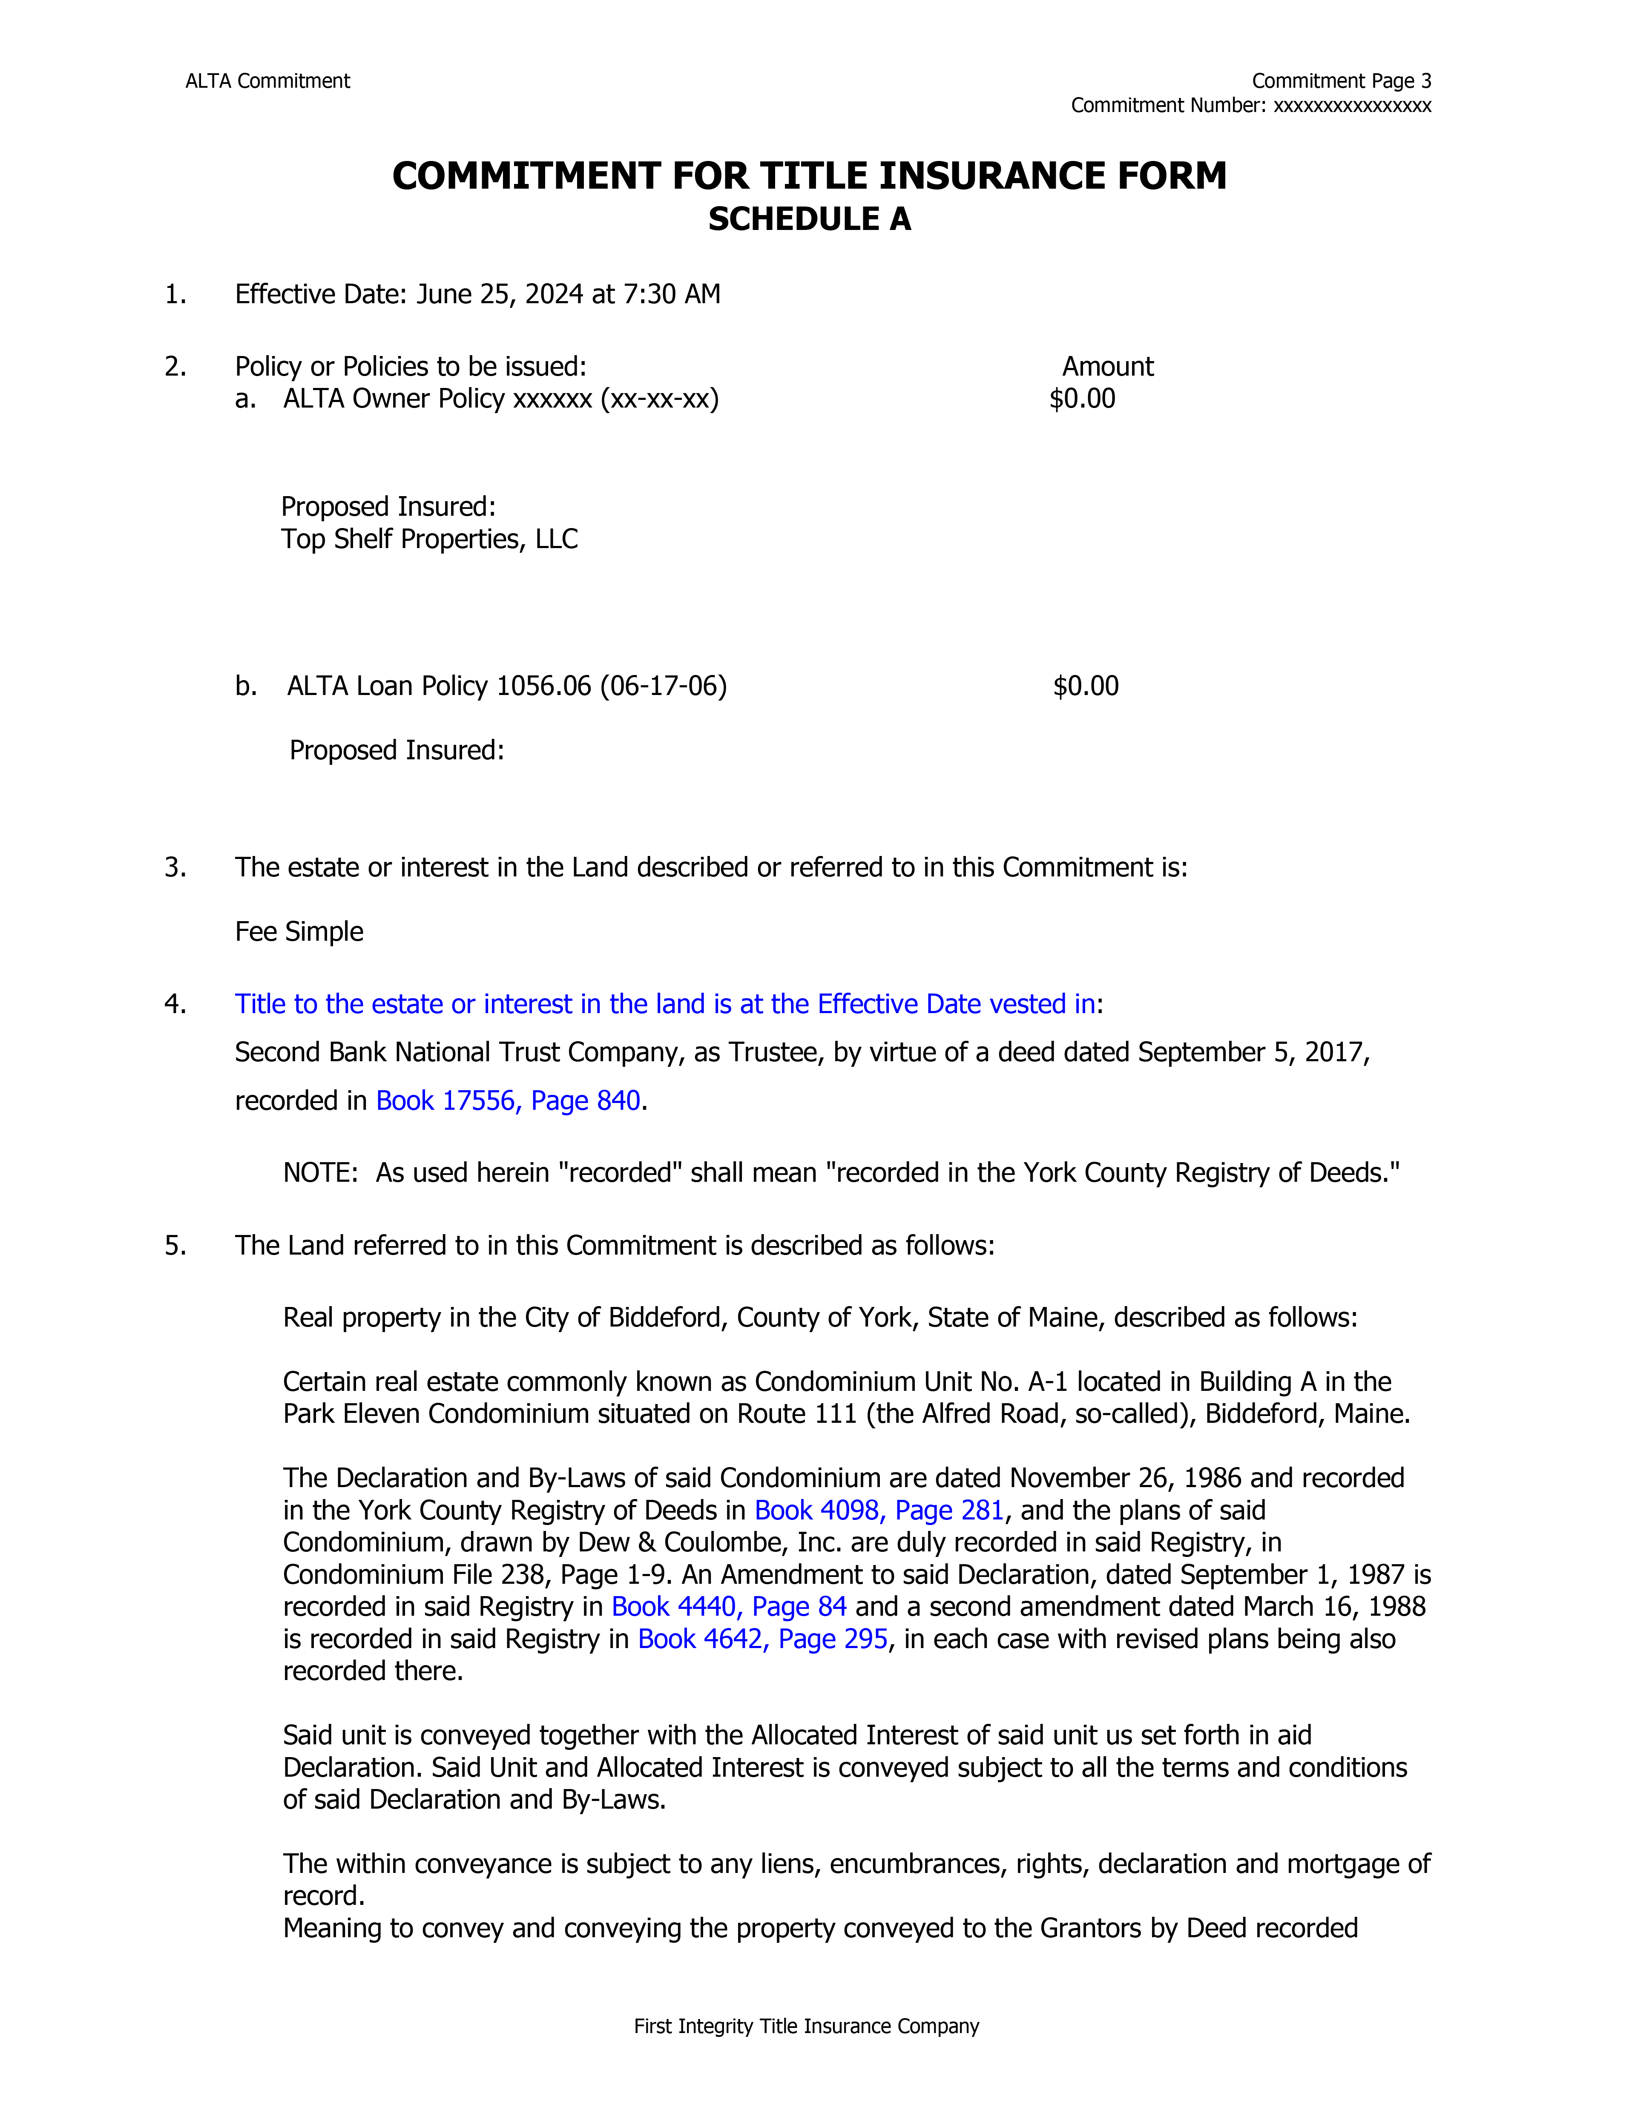
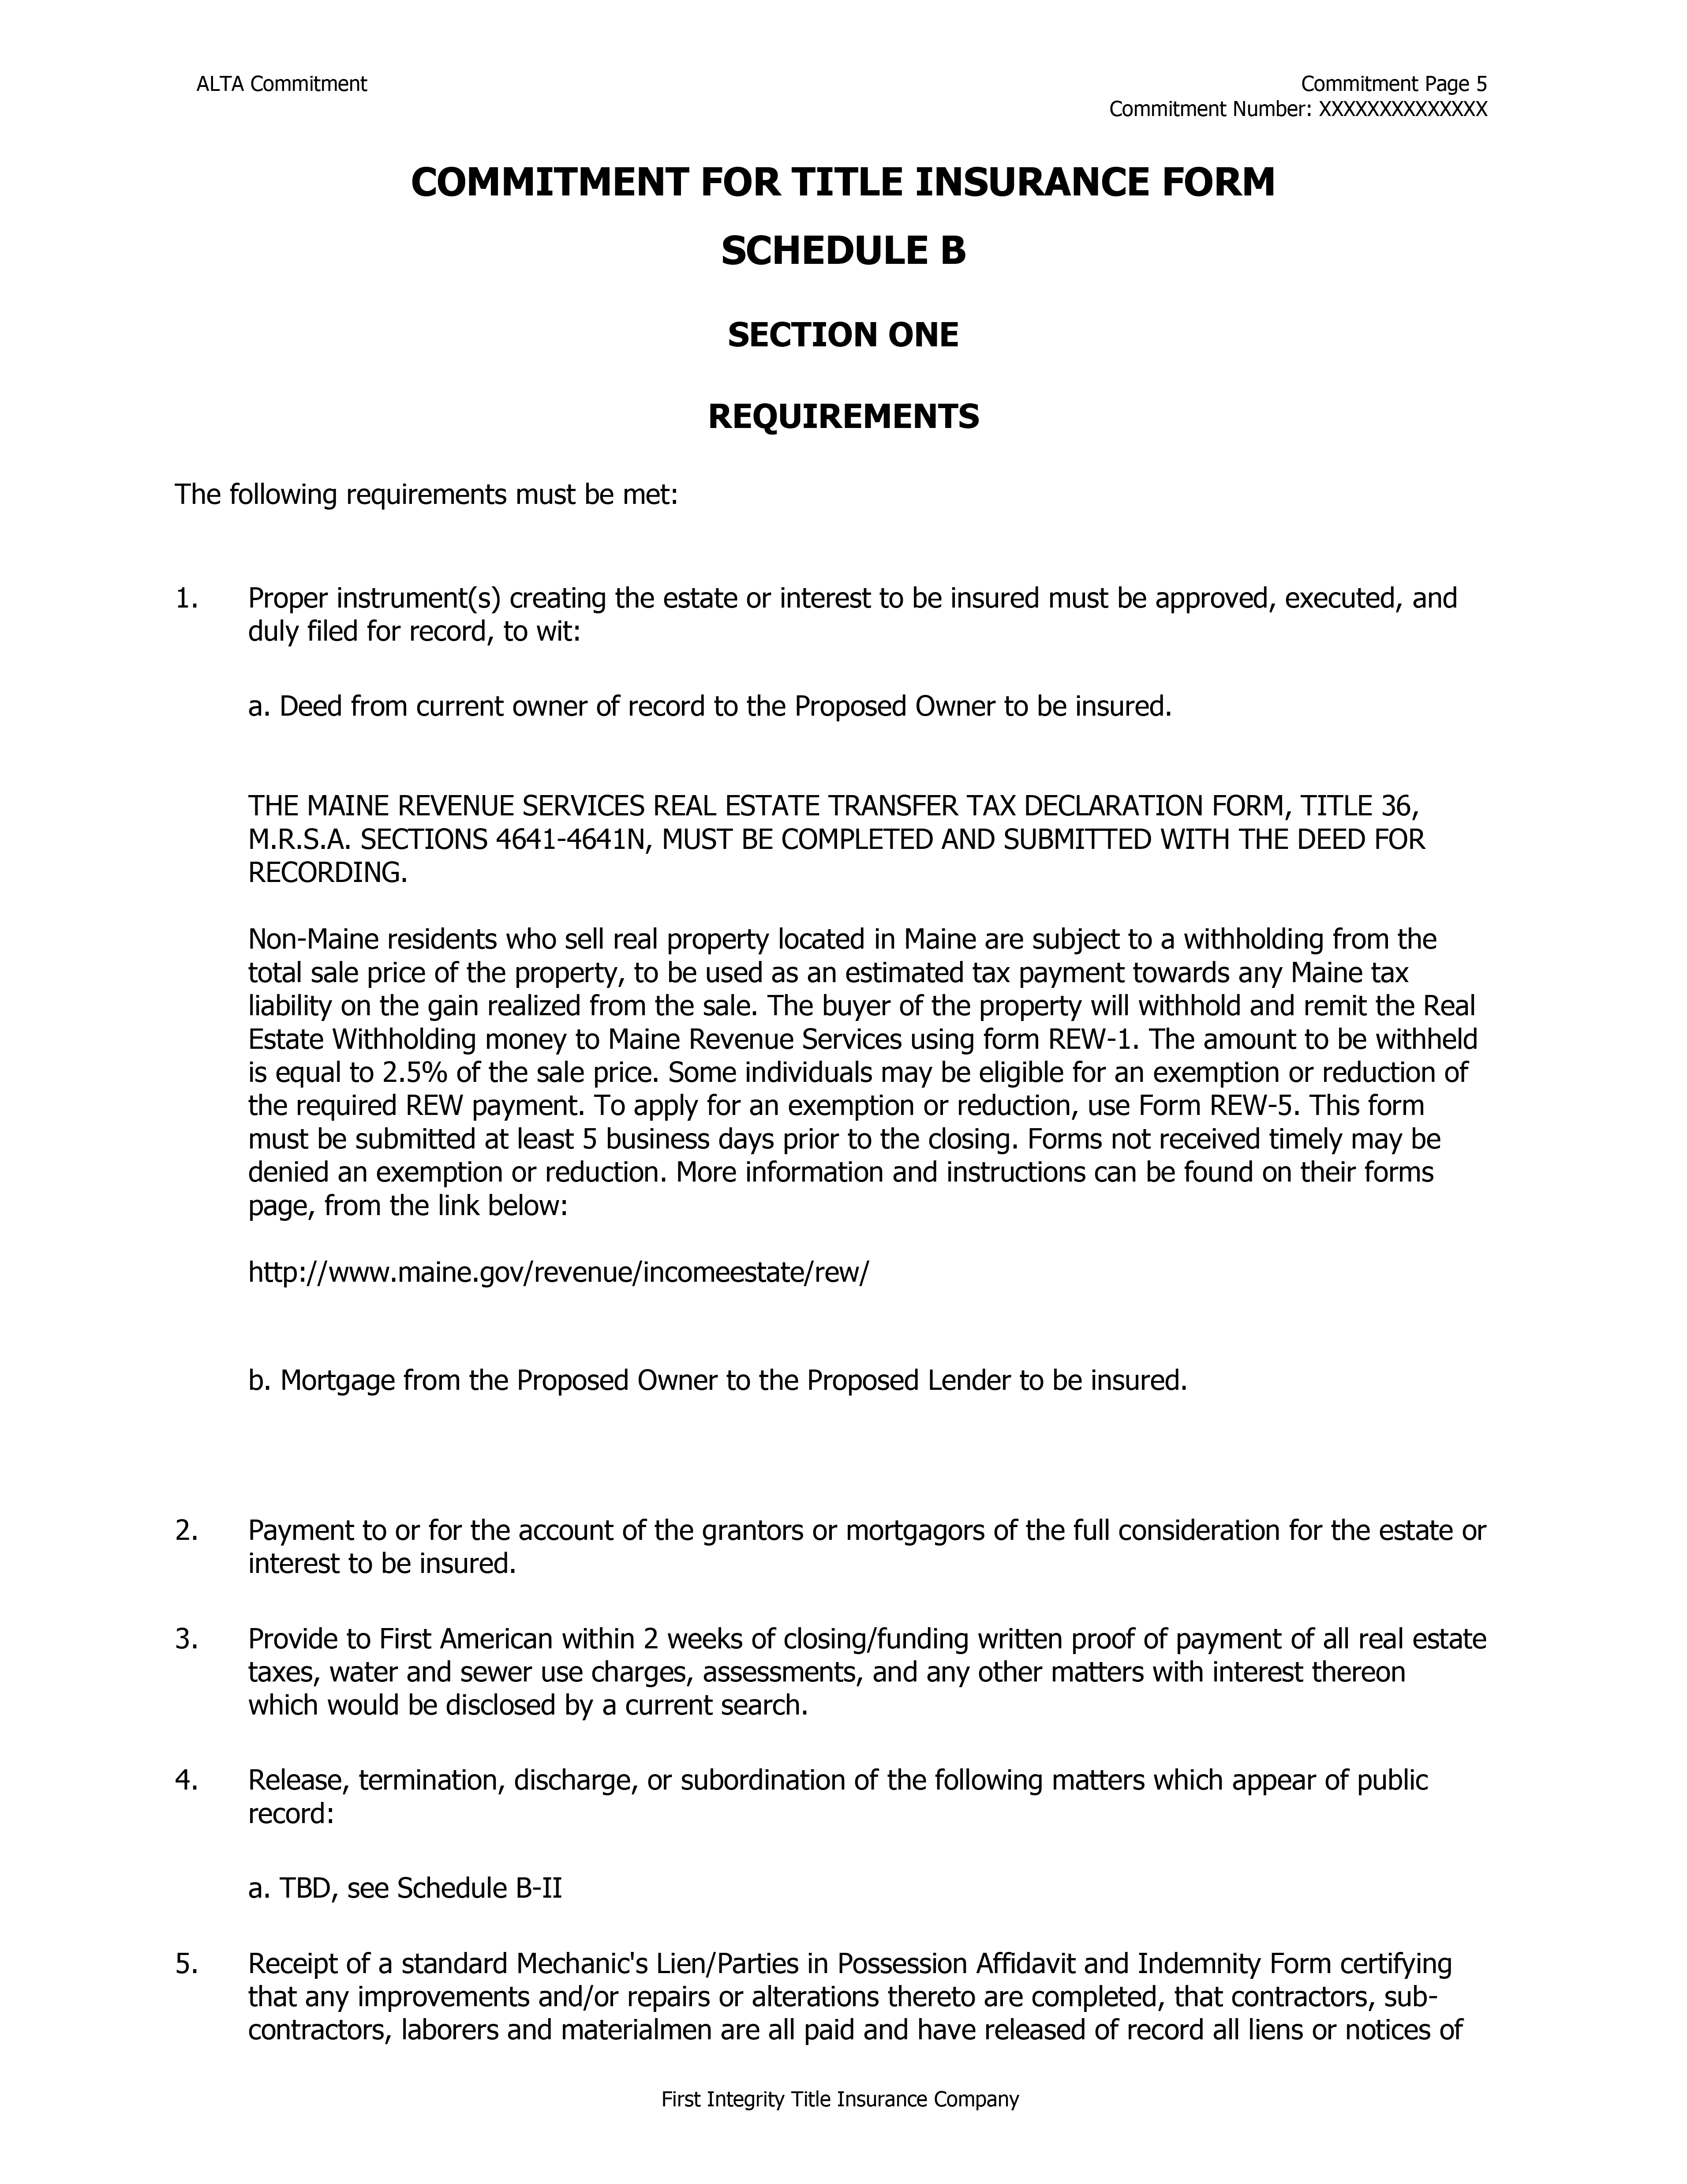
Pg. 311 & 312

Slide 17
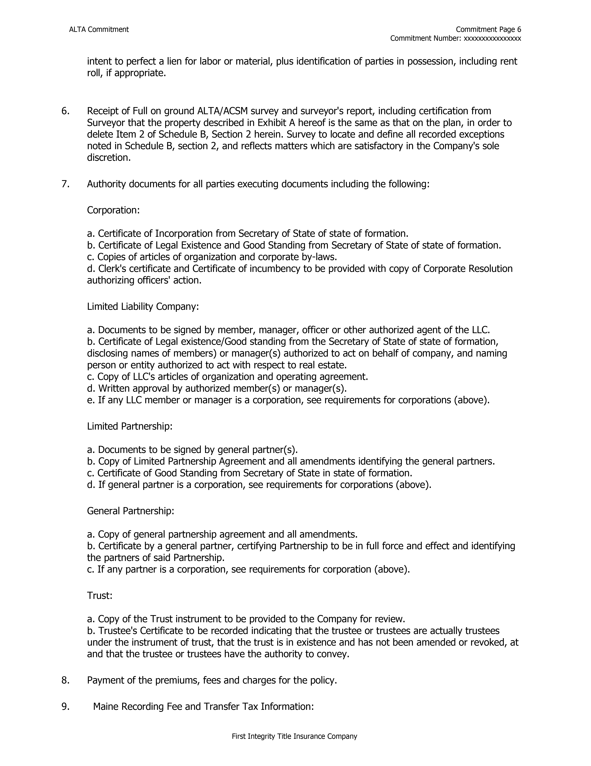
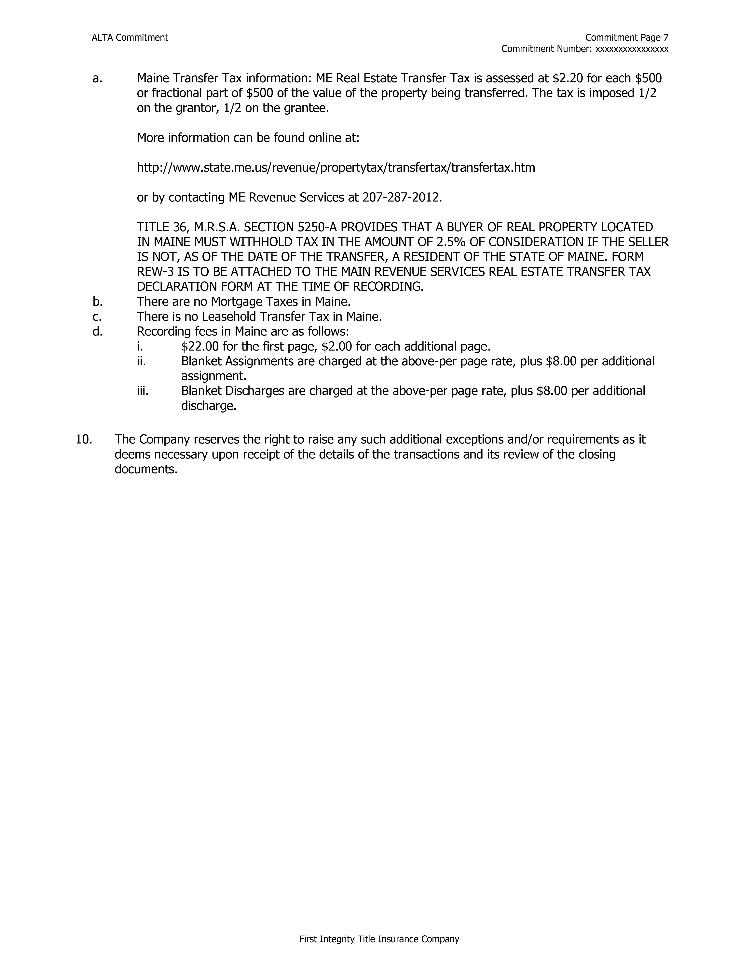
Pg. 313 & 314

Slide 18
Closing a real estate transaction –
Escrow or Closing
Title Abstract
A written, chronological summary of the property’s title records and other public records affecting rights and interests in the property.
Usually requires an attorney’s review.
Pg. 315

Slide 19
Closing a real estate transaction –
Escrow or Closing
Torrens System
Title only passes when the conveyance has been registered on the title certificate itself.
The Torrens title record is the title itself.
Encumbrances have no legal effect until they are recorded on the title certificate.
Only used in a few states and counties.
Pg. 315

Slide 20
Closing a real estate transaction –
Escrow or Closing
Chain of Title
A record of ownership of a property that connects the present owner back to the earliest recorded owner.
A break in the chain of ownership would create a gap or “cloud” in the chain of title.
Pg. 315

Slide 21
Closing a real estate transaction –
Escrow or Closing
Marketable vs. Insurable Title
Marketable Title
- The chain of ownership (title) to a particular piece of property is clear and free from
defects.
- It can be marketed for sale without additional effort by the seller or potential buyer.
Pg. 315

Slide 22
Closing a real estate transaction –
Escrow or Closing
Marketable vs. Insurable Title
Insurable Title
- May have, or does have, a known defect or defects in the chain of title.
- A title insurance company has agreed in advance to provide insurance against the
defect affecting the property.
Pg. 315

Slide 23
Closing a real estate transaction –
Escrow or Closing
Marketable vs. Insurable Title
Insurable Title
- If a property does not have a current, valid title insurance policy and there is a defect in
the chain of title, the defect must be cured or repaired before a seller can convey
marketable title.
- If there is a current policy, rather than curing or fixing the defect, the title insurance
company may elect to insure against any problem the defect may cause in the future.
- The insurance company agrees to fix the defect only when, and if, it becomes an
immediate problem.
Pg. 315

Slide 24
Closing a real estate transaction –
Escrow or Closing
Potential Title Problems and Resolutions
Errors in the public records -
- Clerical or filing errors could affect the deed or survey of a property.
Pg. 315

Slide 25
Closing a real estate transaction –
Escrow or Closing
Potential Title Problems and Resolutions
Unknown Liens -
- Sometimes liens from previous owners may exist and have been placed on the property.
(i.e. mechanic’s liens).
Pg. 315

Slide 26
Closing a real estate transaction –
Escrow or Closing
Potential Title Problems and Resolutions
Illegal Deeds-
- While the chain of title may appear sound, it is possible that a prior deed was made by a
minor, a person of unsound mind, or someone who was not legally allowed to create the
deed. These cases may affect the enforceability of prior deeds.
Pg. 315

Slide 27
Closing a real estate transaction –
Escrow or Closing
Potential Title Problems and Resolutions
Missing Heirs -
- When a person dies, the ownership of their home may fall to their heirs, or those named in
their will. Sometimes those heirs are missing or unknown at the time of death. Family
members who may contest a will for their own property rights could also affect the rights
of current owners of a property.
Pg. 315

Slide 28
Closing a real estate transaction –
Escrow or Closing
Potential Title Problems and Resolutions
Forgeries -
- Sometimes forged or fabricated documents that affect property ownership are filed within
public records. Once these forgeries come to light it can affect ownership.
Pg. 315

Slide 29
Closing a real estate transaction –
Escrow or Closing
Potential Title Problems and Resolutions
Undiscovered Encumbrances -
- Sometimes parties may hold a claim to a property through a former mortgage or lien.
Also, other non-financial claims may come to light such as deed restrictions/conditions or
covenants.
Pg. 316

Slide 30
Closing a real estate transaction –
Escrow or Closing
Potential Title Problems and Resolutions
Boundary / Survey Disputes -
- Previous surveys may exist on a property that show different boundary measurements
leading to boundary disputes by neighbors.
Pg. 316

Slide 31
Closing a real estate transaction –
Escrow or Closing
Potential Title Problems and Resolutions
Undiscovered Will-
- When a property owner dies with no apparent will or heir, the state may sell their assets,
including real property. Years later, the deceased owner’s will may come to light and
could seriously jeopardize a current property owner.
Pg. 316

Slide 32
Closing a real estate transaction –
Escrow or Closing
Potential Title Problems and Resolutions
False Impersonation of Previous Owner -
- Common and similar names can make it possible to falsely “impersonate” a property
owner.
Pg. 316

Slide 33
Closing a real estate transaction –
Escrow or Closing
Cloud on Title, Suit to Quiet Title
Cloud on Title – a defect in title, such as a recorded mortgage that had been paid in full but for which a satisfaction was never recorded.
Suit to Quiet Title – a court action to cure a cloud or gap in the chain of title.
Pg. 316

Slide 34
Closing a real estate transaction –
Trust/Escrow Accounts
Utilized for holding of funds entrusted to the brokerage or closing entity for the benefit of the buyer or seller.
Held for Closing
Held for Earnest Money
Sometimes held for repairs on the property (post closing)
Improperly using or mixing brokerage funds with clients' funds is called commingling.
Pg. 316

Slide 35
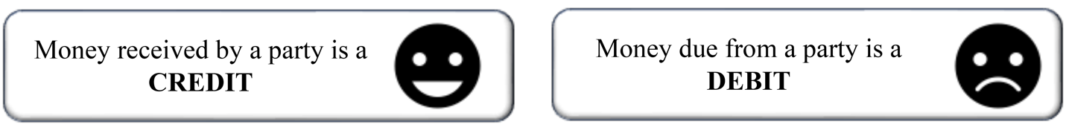
Closing a real estate transaction –
Dollars and Cents
Closing entity prepares a settlement statement for both parties to the transaction.
The Settlement statement itemizes the money each party receives or pays.
- Monies owner are called debit.
- Monies received are called credits.
Pg. 317

Slide 36
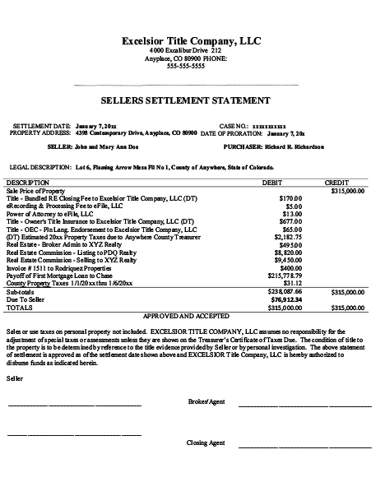
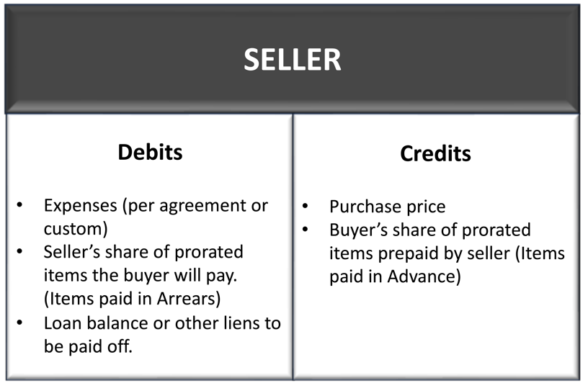
Seller’s Statement contains the seller’s Debits and Credits.
Includes the bottom-line net (net proceeds) Seller will receive from the closing.
Pg. 318

Slide 37
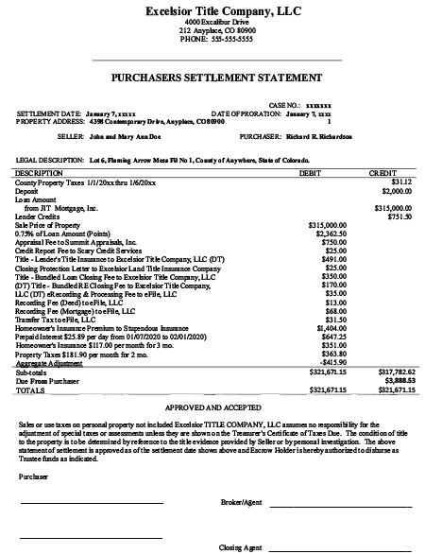
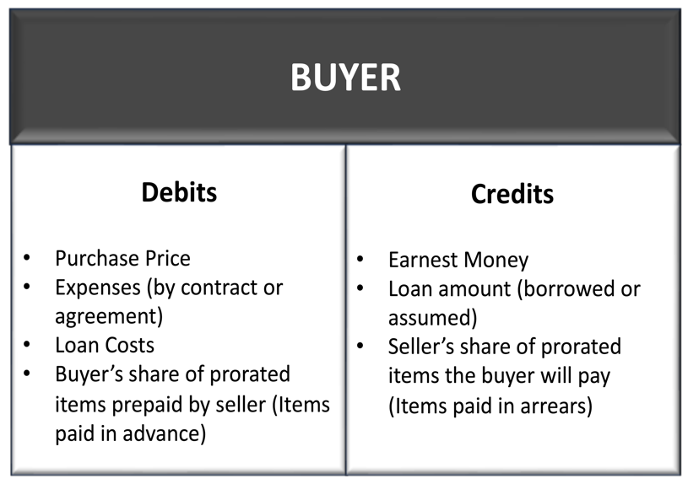
Buyer’s Statement contains the buyer's Debits and Credits.
Includes the amounts the Buyer will need to bring to closing in Good Funds.
Pg. 319

Slide 38
Closing a Real Estate transaction – math
(Prorating Expenses)
In prorations there are a few rules to remember:
360 days in a year
30 days per month
Seller owns day of closing
Pg. 320

Slide 39
Closing a Real Estate transaction – math
(Prorating Expenses)
The steps of a proration:
Identify the total dollar amount to be prorated
Determine the number of days in the period (Year, quarter, month)
Determine if the Bill was paid in advance (beginning of the period) or arrears (after the period).
Divide the total amount by the number of days in the term to get a daily rate.
Multiply the daily rate times the number of days of ownership.
Pg. 320

Slide 40
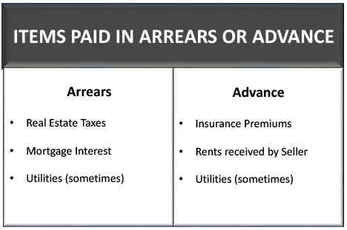
Closing a Real Estate transaction – math
(Prorating Expenses)
The seller should be reimbursed or credited for the amount the buyer is responsible for when bills are paid by the seller in advance.
Debit buyer / Credit Seller
Pg. 320

Slide 41
Closing a Real Estate transaction – math
(Prorating Expenses)
The buyer should be reimbursed or credited for the amount the seller is responsible for when bills are paid in arrears by the buyer (the homeowner at the time the bill is presented.)
Debit Seller / Credit Buyer
Pg. 320

Slide 42
Closing a Real Estate transaction – math
(Prorating Expenses)
Bills paid in advance are always Buyer Owes Seller – Debit Buyer / Credit Seller
Bills paid in arrears are always Seller Owes Buyer – Debit Seller / Credit Buyer
Only the buyer and the seller are affected, not the broker, the lender, the title company, etc.
The same dollar amount is always debited from one party and credited to the other.
Pg. 322

Slide 43
Closing a Real Estate transaction – math
(Prorating Expenses) – Problem #1
The property taxes for this year are $1,682 and are due in arrears. The property closes on October 13th. What is the proration for the buyer and the seller?
Step 1 – Determine the total amount to be prorated - $1,682
Step 2 – Determine the total amount of time in the period -
360 days (taxes are usually paid on an annual basis)
Step 3 – Determine who receives the Debit and Credit -
(The bill is due in arrears; therefore, the Seller owes the Buyer.)
Debit Seller / Credit Buyer
Step 4 – Determine the per diem (Daily) rate - $1,682 ÷ 360 = $4.67 per day
Pg. 321

Slide 44
Closing a Real Estate transaction – math
(Prorating Expenses) – Problem #1
The property taxes for this year are $1,682 and are due in arrears. The property closes on October 13th. What is the proration for the buyer and the seller?
Step 5 – Determine the number of days the Seller owes for. The seller owes for all of the days he or she owned the house (January 1 – day of closing on October 13). Utilizing 30 days in every month, the number of days is determined by adding all days of seller’s ownership, including the day of closing.
January 30 JULY 30
February 30 August 30
March 30 September 30
April 30 October 13
May 30 TOTAL 283 days
June 30
Step 6 – Determine amount seller owes - 283 (days) x $4.67 (per diem) – 1,321.61
$1,321.61 Debit Seller / $1,321/61 Credit Buyer
Pg. 321

Slide 45
Closing a Real Estate transaction – math
(Prorating Expenses) – Problem #2
The Seller paid the quarterly homeowner’s association fee of $125 in advance. The property closes on April 24th. What is the proration for the buyer and the Seller?
Step 1 – Determine the total amount to be prorated - $125
Step 2 – Determine the total amount of time in the period -
90 days (quarterly fee)
Step 3 – Determine who receives the Debit and Credit -
(The bill was paid in advance; therefore, the Buyer owes the Seller.)
Debit Buyer / Credit Seller
Step 4 – Determine the per diem (Daily) rate - $125 ÷ 90 = $1.39 per day
Pg. 322

Slide 46
Closing a Real Estate transaction – math
(Prorating Expenses) – Problem #2
The Seller paid the quarterly homeowner’s association fee of $125 in advance. The property closes on April 24th. What is the proration for the buyer and the Seller?
Step 5 – Determine the number of days the Buyer owes for. The Buyer owes for the days he or she will own the house covered by the bill, so from the day AFTER closing (April 25th) through the end of June. April 25th will be counted as a day of ownership for the Buyer, however the day of closing belongs to the seller.
April 6
May 30
June 30
TOTAL 66 days
Step 6 – Determine amount Buyer owes - 66 (days) x $1.39 (per diem) – $91.67
$91.67 Debit Buyer / $91.67 Credit Seller
Pg. 322

Slide 47
Closing a real estate transaction –
Dollars and Cents
Income Taxes
Real Estate Transactions must be reported to the Internal Revenue Service
Closing Escrow Agent submits and files an IRS Form 1099-S.
If the transaction involves a non-resident alien, the reporting person may also have tax reporting and withholding responsibilities under the Foreign Investment and Real Property Tax Act (FIRPTA)
- Withholding can be up to 15% of the amount realized in the sale.
- If the Seller doesn’t have the funds withheld, the IRS can pursue the buyer for collection.
Pg. 323

Slide 48
Closing a real estate transaction –
Dollars and Cents
Income Taxes
Capital Gains Tax may be an issue in the sale of real property.
The Tax Relief Act of 1997 provides an exclusion for married couples of up to $500,000 of capital gains when selling their principal residence. Individuals are entitled to up to $250,000 capital gains exclusion of their principal residence.
- Allowed for one sale every two years. No limit on the number of times a homeowner
can utilize the exclusion.
- Must own and utilize the property as a principal residence for at least two out of the
last five years to qualify for the exclusion.
Pg. 323

Slide 49
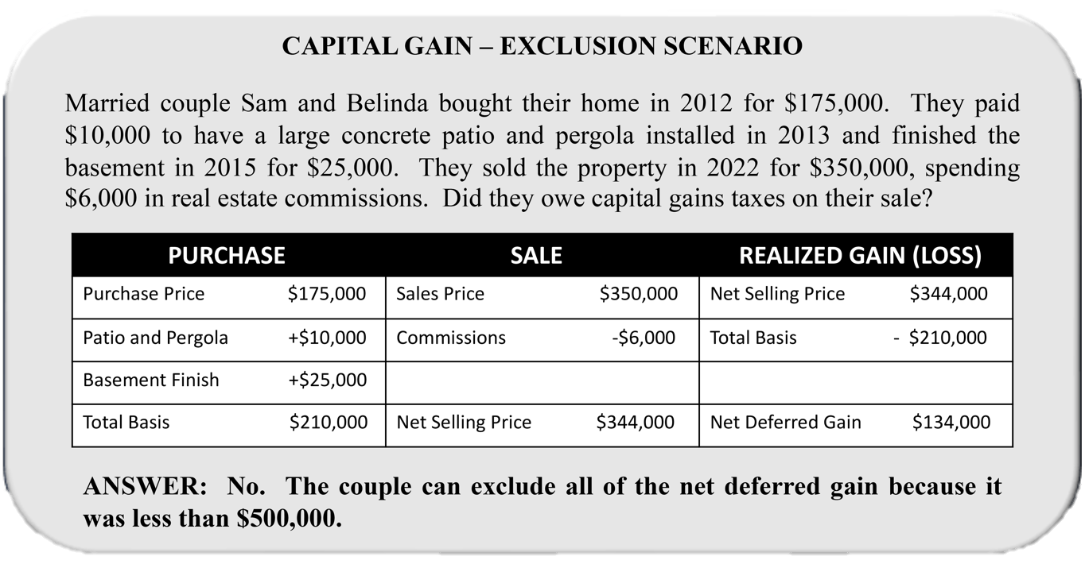
Closing a real estate transaction –
Dollars and Cents
Pg. 324

Slide 50
Closing a real estate transaction –
Dollars and Cents
Section 1031 Property Exchange
Investors can defer taxation of capital gains by performing a 1031 Property Exchange.
An investor may exchange their non-owner-occupied property for another like-kind property and defer payment on the recognized tax liability.
Like-kind refers to any real property to be held for the purposes of investment. (i.e Artwork would not be considered like-kind property).
Tax on the exchange is deferred – NOT eliminated.
Use of a qualified intermediary (accommodator) to retain the money in the tax-deferred exchange is required. The investor can never touch the money. If they did, they would be required to pay tax on the gain, then and there.
Pg. 324

Slide 51
Closing a real estate transaction –
Dollars and Cents
Other Taxes
Transfer fees, conveyance tax or revenue stamps are taxes charged on the sales price of the property.
Usually associated with the recording of the Deed of Conveyance.
Usually, the taxes are calculated as an amount per $100 or $1000 of the value of the property or the sales price.
Pg. 324

Slide 52
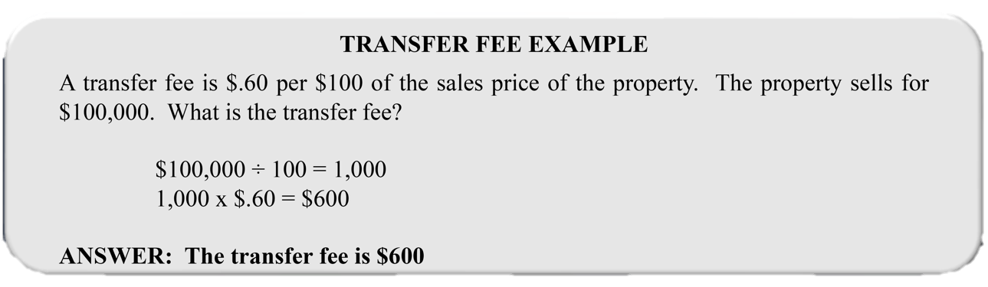
Closing a real estate transaction –
Dollars and Cents
Pg. 324

Slide 53
Commingling is mixing of trust funds with broker’s operating funds.
1) True
2) False

Slide 54
Commingling is mixing of trust funds with broker’s operating funds.
1) True
2) False

Slide 55
A title insurance policy that protects the interests of a mortgagee is referred to as a(n)
1) Leasehold policy.
2) Lender’s (Mortgagee’s) policy.
3) ALTA policy.
4) Certificate of sale policy.

Slide 56
A title insurance policy that protects the interests of a mortgagee is referred to as a(n)
1) Leasehold policy.
2) Lender’s (Mortgagee’s) policy.
3) ALTA policy.
4) Certificate of sale policy.

Slide 57
A break in the chain of title to a property results in
1) A lien of indeterminate ownership.
2) A duplicate title.
3) A clouded title.
4) A title plant.

Slide 58
A break in the chain of title to a property results in
1) A lien of indeterminate ownership.
2) A duplicate title.
3) A clouded title.
4) A title plant.

Slide 59
A one-time tax levied on a property for purposes of recording a transaction is called
1) An intangible sales tax.
2) A documentary stamp tax.
3) A franchise tax.
4) An ad valorem tax.

Slide 60
A one-time tax levied on a property for purposes of recording a transaction is called
1) An intangible sales tax.
2) A documentary stamp tax.
3) A franchise tax.
4) An ad valorem tax.

Slide 61
To be marketable, title must be
1) Free of undisclosed defects and encumbrances.
2) Registered in Torrens.
3) Abstracted by an attorney.
4) Guaranteed by a title certificate.

Slide 62
To be marketable, title must be
1) Free of undisclosed defects and encumbrances.
2) Registered in Torrens.
3) Abstracted by an attorney.
4) Guaranteed by a title certificate.

Slide 63
Which of the following problems would be revealed by the public records?
1) Encroachments
2) A mortgage
3) Rights of the parties in possession
4) A surveying error

Slide 64
Which of the following problems would be revealed by the public records?
1) Encroachments
2) A mortgage
3) Rights of the parties in possession
4) A surveying error

Slide 65
Wilma is buying a house. In Wilma’s area, closings are traditionally conducted in escrow. Which of the following items will Wilma deposit with the escrow agent before the closing date?
1) Deed to the property.
2) Title evidence.
3) Estoppel Certificate.
4) Cash needed to complete the purchase.

Slide 66
Wilma is buying a house. In Wilma’s area, closings are traditionally conducted in escrow. Which of the following items will Wilma deposit with the escrow agent before the closing date?
1) Deed to the property.
2) Title evidence.
3) Estoppel Certificate.
4) Cash needed to complete the purchase.

Slide 67
The earnest money will show up on the buyer’s settlement statement.
1) True
2) False

Slide 68
The earnest money will show up on the buyer’s settlement statement.
1) True
2) False

Slide 69
How would you enter the payoff of an existing loan amount on a settlement sheet?
1) Debit the seller
2) Credit the seller
3) Debit the buyer
4) Debit the broker

Slide 70
How would you enter the payoff of an existing loan amount on a settlement sheet?
1) Debit the seller
2) Credit the seller
3) Debit the buyer
4) Debit the broker

Slide 71
Real Estate taxes of $1,800, based on a calendar year and which are paid in arrears, had not been paid when a property sold on August 15. How would this be entered on the settlement statement?
1) $1,125 debit the seller
2) $1,125 debit the buyer
3) $1,175 debit the seller
4) $675 debit the buyer

Slide 72
Real Estate taxes of $1,800, based on a calendar year and which are paid in arrears, had not been paid when a property sold on August 15. How would this be entered on the settlement statement?
1) $1,125 debit the seller. (1,800 ÷ 360 = $5 x 225 days = $1,125)
2) $1,125 debit the buyer
3) $1,175 debit the seller
4) $675 debit the buyer

Slide 73
The person conducting the closing must report details on closing to the IRS on
1) IRS Form 1099.
2) IRS Form 1099 S.
3) IRS Form 1099 MISC.
4) IRS Form 1099 R.

Slide 74
The person conducting the closing must report details on closing to the IRS on
1) IRS Form 1099.
2) IRS Form 1099 S.
3) IRS Form 1099 MISC.
4) IRS Form 1099 R.

Slide 75
TRID requires that borrowers be provided with a Closing Disclosure no later than how many business days prior to closing?
1) One
2) Two
3) Three
4) Four

Slide 76
TRID requires that borrowers be provided with a Closing Disclosure no later than how many business days prior to closing?
1) One
2) Two
3) Three
4) Four

