Slide 1


National Law and practice
Chapter 7 – Valuation and
Market Analysis

Slide 2
Valuation and Market Analysis – Real Estate market Economics
The goal of an economic system is to produce and distribute a supply of goods and services to satisfy the demand of its constituents.
Supply – the quantity of a product or service available at any given time.
Demand – the quantity of a product or service that is desired at any given time.
Pg. 159

Slide 3
Valuation and Market Analysis – Real Estate market Economics
Difference between price and value.
Price – the amount of money, or another asset, that a buyer will pay, and that a seller will sell for
Value – determined by:
How much something is desired.
How useful it is.
How scarce it is.
If someone can afford it.
Pg. 160

Slide 4
Valuation and Market Analysis – Real Estate market Economics
Difference between price and value.
Components of value:
Desire / Demand
Utility
Scarcity
Transferability / Purchasing power
Pg. 160

Slide 5
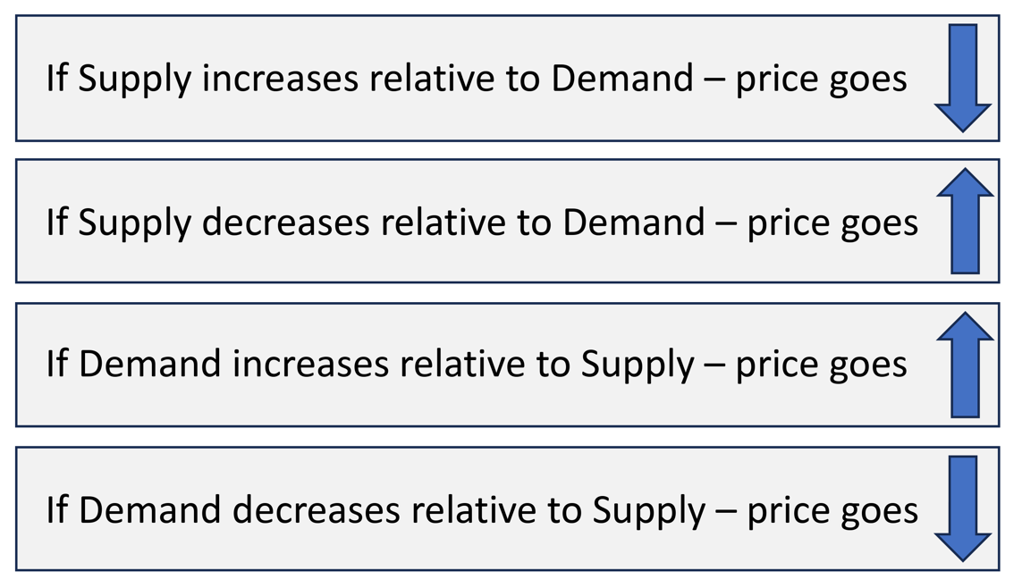
Valuation and Market Analysis – Real Estate market Economics
Real Estate Supply and Demand:
Pg. 161

Slide 6
Valuation and Market Analysis – Real Estate market Economics
The most important factor that drives demand for real estate of all types is employment.
Base Employment – the number of employed people in businesses that comprise the economic foundation of an area.
Total Employment – includes base employment but also secondary and support industries as well.
Markets tend toward a state of equilibrium where supply equals demand, and price, cost and value are identical.
Pg. 162

Slide 7
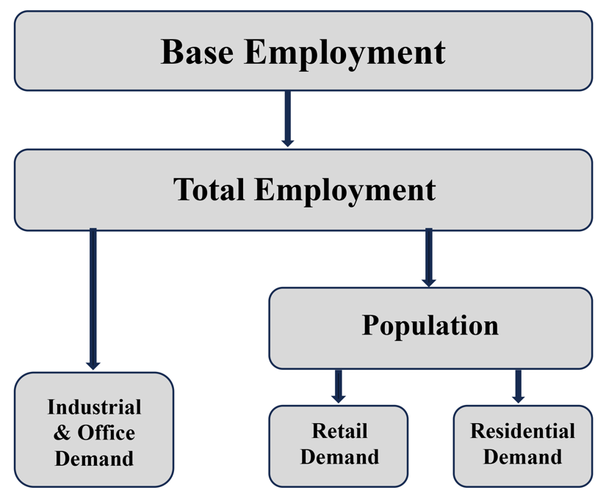
Valuation and Market Analysis – Real Estate market Economics
Pg. 162

Slide 8
Valuation and Market Analysis – Real Estate market Economics
Vacancy and Absorption:
Vacancy – the amount of total real estate inventory of a certain type that is unoccupied at a given time.
Absorption – the amount of available property that become occupied over a period of time.
Pg. 164

Slide 9
Valuation and Market Analysis – Real Estate market Economics
Other Economic Principles:
Anticipation – how value can increase or decrease in anticipation of some future benefit or detriment that will affect the property.
Substitution – a buyer will pay no more for a property than they would pay for an equally desirable and available substitute property.
Contribution – the amount that a particular improvement affects the market value of a property.
Pg. 165

Slide 10
Valuation and Market Analysis – Real Estate market Economics
Other Economic Principles:
Change – fluctuations in market conditions and neighborhoods may positively or negatively affect property values.
Highest and Best Use – the single use for a property that produces the greatest income and return.
Conformity – when a property conforms to others around it, it’s more valuable.
Pg. 165

Slide 11
Valuation and Market Analysis – Real Estate market Economics
Other Economic Principles:
Progression – the worth of a lesser property tends to increase if it is located among better properties.
Regression – the worth of a better property is affected adversely by the presence of a lesser-quality property.
Assemblage – the combining of adjacent properties can sometimes create a combined value that is greater than the values of the properties individually. Plottage is the difference in value.
Pg. 165

Slide 12
Valuation and Market Analysis – Appraisals
An appraisal is an educated opinion of value used to determine market value.
Market Value – the most probable price a property will bring in a competitive market.
Market Price – the price a property actually sells for.
Pg. 166

Slide 13
Valuation and Market Analysis – Appraisals
Many different types of appraised values:
Assessed Value – a percentage of market value to establish property tax.
Insurable Value – replacement cost of a building minus the land value.
Book Value – value of an asset, less depreciation, as it appears on the accounts of a business/owner.
Salvage Value – value of an asset at the end of its economic life.
Reproduction Value – value based on the cost of constructing a precise duplicate of a property assuming current construction costs.
Replacement Value – value based on the cost of constructing a functional equivalent of a property assuming current construction costs.
Pg. 166

Slide 14
Valuation and Market Analysis – Appraisals
Many different types of appraised values:
Condemned Value – value set by a governmental authority for a property being taken by eminent domain.
Depreciated Value – value established by subtracting accumulated depreciation from the purchase price of a property.
Rental Value – an estimate of a rental rate a property could command for a specific period of time.
Pg. 167

Slide 15
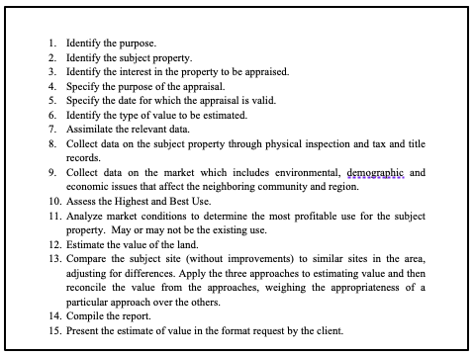
Steps in the Appraisal Process
Pg. 167

Slide 16
Valuation and Market Analysis – Appraisals
Financial Institutions Reform, Recovery, and Enforcement Act (FIRREA)
Requires appraisals be completed by a state-licensed appraiser for all federally related transactions having a transaction value of $250,000 or more.
Pg. 168

Slide 17
Valuation and Market Analysis – Appraisals
Sales Comparison (Market Data Approach)
The most reliable of the three approaches to value.
Compares the subject property with recent sales of comparable properties.
Uses the theory/principle of Substitution.
Comparable properties utilized should be “arm’s length” transactions.
Pg. 168

Slide 18
Valuation and Market Analysis – Appraisals
Sales Comparison (Market Data Approach)
Comparable properties may be adjusted to be more like the subject property in four areas:
Date of sale – more recent is preferred.
Location - its location in relation to the subject property.
Physical characteristics – age, size, square footage, etc.
Terms of sale – unusual terms or financing.
Because the sold price of the comparable property is known, adjustments are only made to the value of the comparables to make them more like the subject property.
Pg. 169

Slide 19
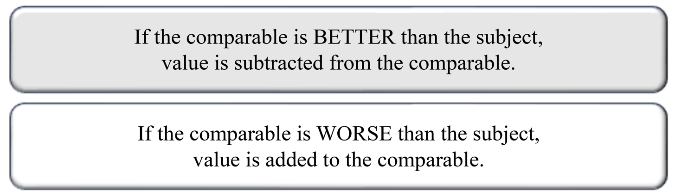
Valuation and Market Analysis – Appraisals
Sales Comparison (Market Data Approach)
Usually, three to four comparable properties are utilized.
Pg. 169

Slide 20
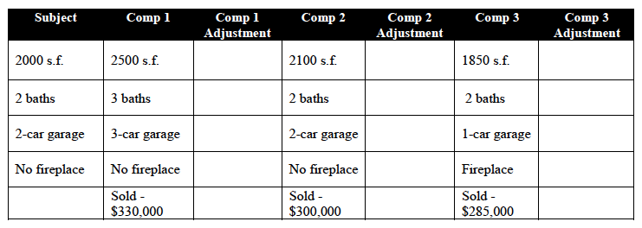
Valuation and Market Analysis – Appraisals
$35 X 500 sf
-$17,500
$35 X 100 sf
-$3,500
$35 X 150 sf
+$5,250
-$10,000
0
0
-$7,500
0
+$7,500
0
0
-$3,500
$295,000
$296,500
$294,250
For comparables assume that the value of a bathroom is $10,000, a garage bay is $7,500, a fireplace is $3,500 and finished square footage is $35/sf.
Pg. 170

Slide 21
Valuation and Market Analysis – Appraisals
$35 X 500 sf
-$17,500
$35 X 100 sf
-$3,500
$35 X 150 sf
+$5,250
-$10,000
0
0
-$7,500
0
+$7,500
0
0
-$3,500
$295,000
$296,500
$294,250
The best comparable has the fewest numbers and lowest dollar amounts, in adjustments.
Pg. 170

Slide 22
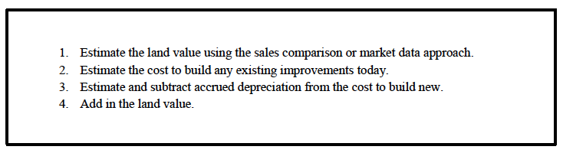
Valuation and Market Analysis – Appraisals
Cost Approach (Summation Approach)
Most reliable for new or special purpose buildings where it might be difficult to find recent sold comparable properties.
Steps in the Cost Approach
Pg. 171

Slide 23
Valuation and Market Analysis – Appraisals
Cost Approach (Summation Approach)
Land never depreciates, only improvements are depreciated.
Appraiser utilizes one of two ways to determine improvement values.
Reproduction Cost – the cost to build an exact duplicate of the
property.
Replacement Cost – the cost to build a functional replacement of
the property. Most commonly utilized in
residential appraisals.
Pg. 171

Slide 24
Valuation and Market Analysis – Appraisals
Cost Approach (Summation Approach)
Appraiser determines depreciation of the improvements.
Three different types of depreciation are taken into consideration:
Physical Deterioration – loss of property value because of decay or excessive wear and tear.
Can be curable or incurable.
Pg. 172

Slide 25
Valuation and Market Analysis – Appraisals
Cost Approach (Summation Approach)
Appraiser determines depreciation of the improvements.
Three different types of depreciation are taken into consideration:
Functional Obsolescence – properties may be outdated based on consumer’s current needs.
Can be curable or incurable.
Pg. 172

Slide 26
Valuation and Market Analysis – Appraisals
Cost Approach (Summation Approach)
Appraiser determines depreciation of the improvements.
Three different types of depreciation are taken into consideration:
Economic (External/Locational) Obsolescence – loss of value because of external factors generally beyond the owner’s control.
Considered incurable.
Pg. 172

Slide 27
Valuation and Market Analysis – Appraisals
Cost Approach (Summation Approach)
Depreciation is assumed to occur at an even rate over a structure’s economic life.
Straight Line Depreciation– property’s cost is divided by the number of years of its expected economic life to determine the amount of annual depreciation.
NOTE: (Not in the text) Most residential property is typically depreciated at a rate of 3.636% each year for 27.5 years.
Pg. 172

Slide 28
Valuation and Market Analysis – math (Calculating Appreciation and Depreciation)
Formula:
APerB
A= After Value Change
Per = Percentage Change
B = Before Value Change
A
Percentage Change will be an amount in relation to 100%
If a question states, there is a 15% profit (or 15% appreciation) enter 100% + 15% or 1.00 + .15 (1.15)
Per
B
If a question states, there is a 15% loss (or 15% depreciation) enter 100% - 15% or 1.00 - .15 (.85)
Pg. 173

Slide 29
Valuation and Market Analysis – math (Calculating Appreciation and Depreciation) – Problem #1
Formula
APerB
A property has been depreciating at 3% per year. If it is valued at $70,000 today, what was it worth 10 years ago?
Step 1 – Calculate the Rate of Depreciation.
3% per year x 10 years = 30% depreciation
100% - 30% or 1.00 - .30 = .70
A
70,000
Step 2 – Insert the parts known into the circle formula
Per
B
.70
???
A (After Value Change) = 70,000
Per (percentage Change) = .70
70,000 ÷ .70 = $100,000 (Before The Change)
Pg. 174

Slide 30
Valuation and Market Analysis – math (Calculating Appreciation and Depreciation) – Problem #2
Formula
APerB
A property A property that was purchased for $75,000 was later sold for $105,000. What was the profit realized?
Step 1 – Insert the information known into the circle formula.
A
105,000
A (After Value Change) = 105,000
B (Before Value Change) = 75,000
Per
B
???
75,000
105,000 ÷ 75,000 = 1.4 or 140%
Pg. 174

Slide 31
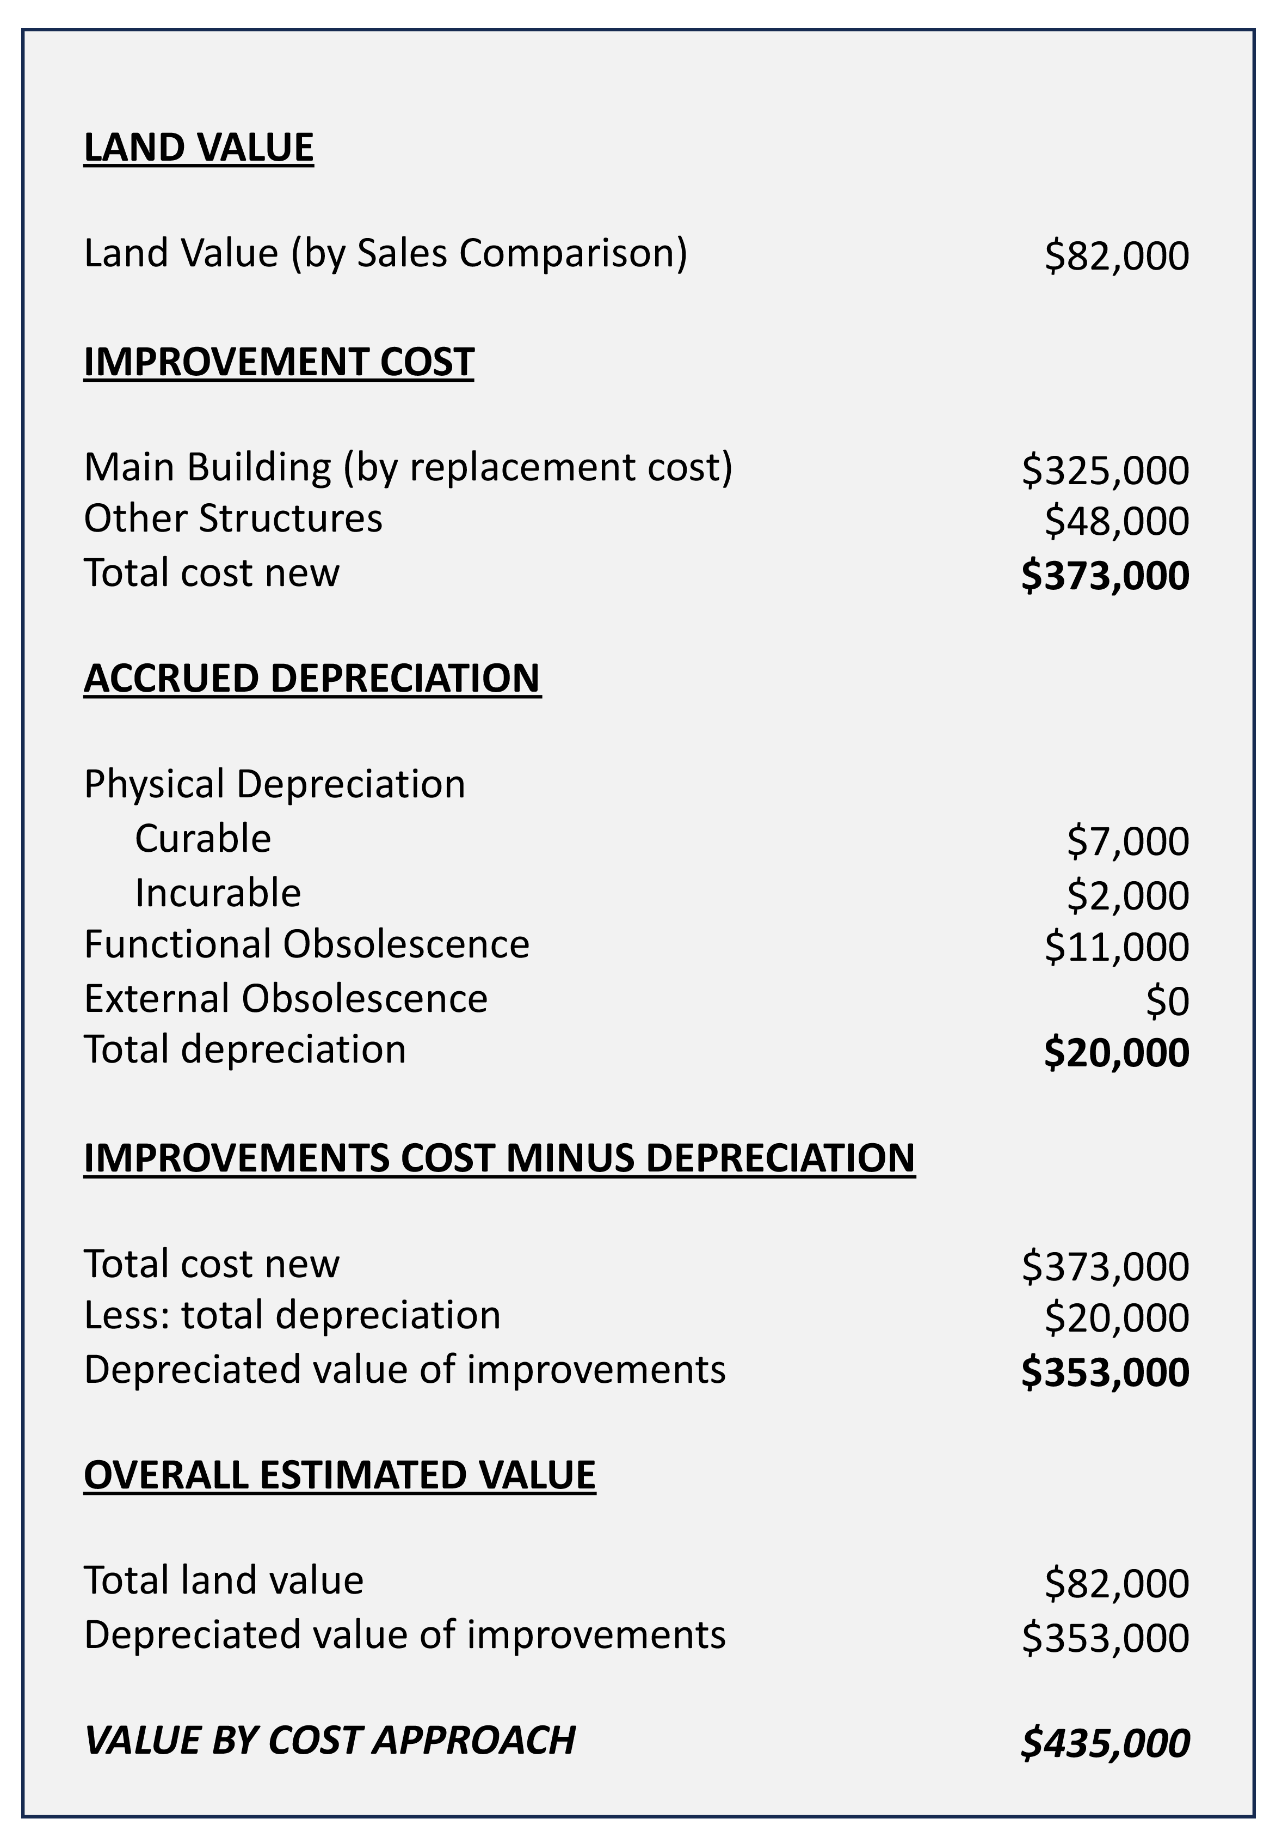
Cost Approach Illustration
Pg. 175

Slide 32

Valuation and Market Analysis – Appraisals
Income Analysis Approach
Most reliable approach for income producing property.
Based off a property’s Net Operating Income
Pg. 176

Slide 33
Valuation and Market Analysis – Appraisals
Income Analysis Approach
Revenues – facility rental, vending proceeds, parking fees, service charges, etc. Subject to vacancy and collection losses.
Expenses
Variable – repairs, management fees, utilities, etc.
Fixed – taxes, insurance.
Income taxes and interest (mortgage) expense are not considered in
operating expenses.
Pg. 176

Slide 34
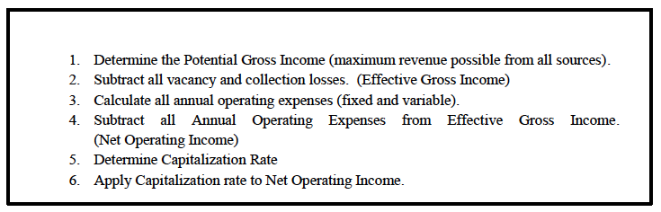
Valuation and Market Analysis – Appraisals
Income Analysis Approach
The Steps in the Income Approach
Pg. 177

Slide 35
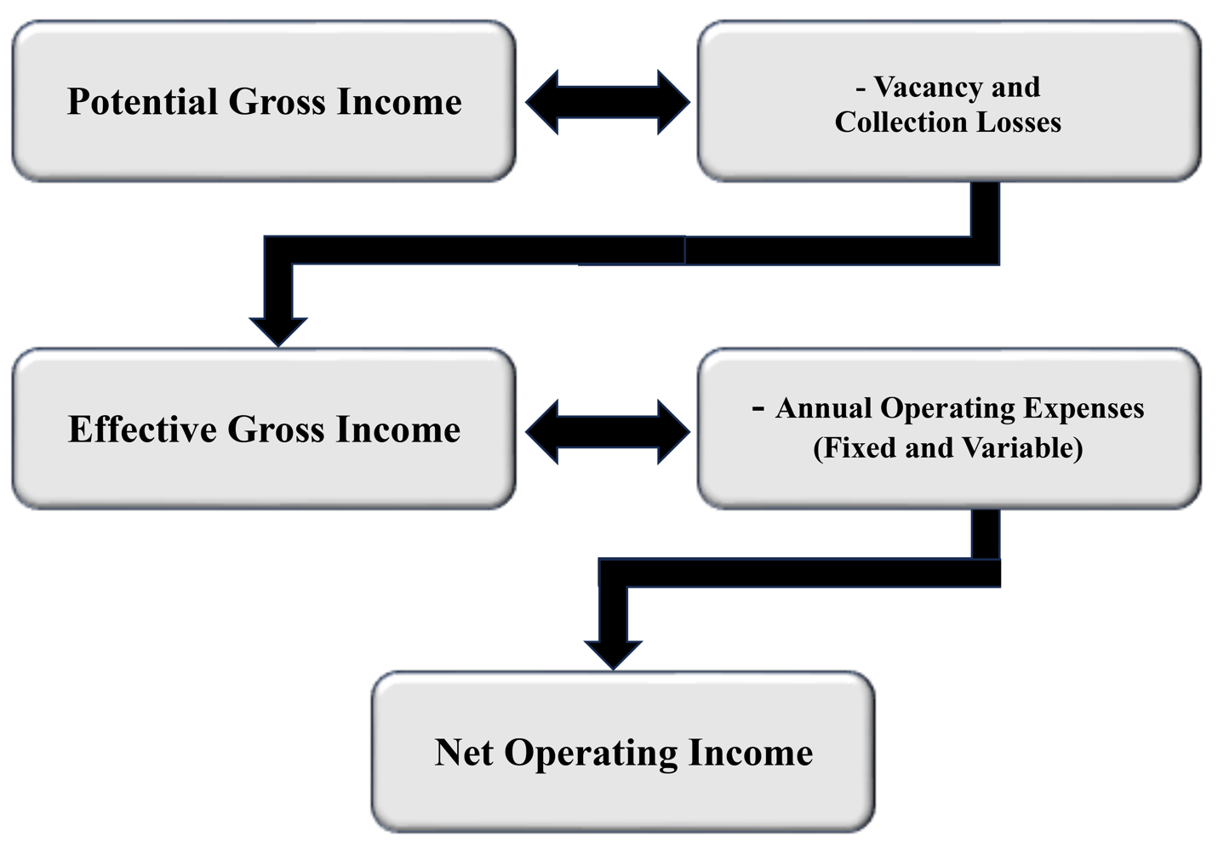
Valuation and Market Analysis – Appraisals
Pg. 177

Slide 36
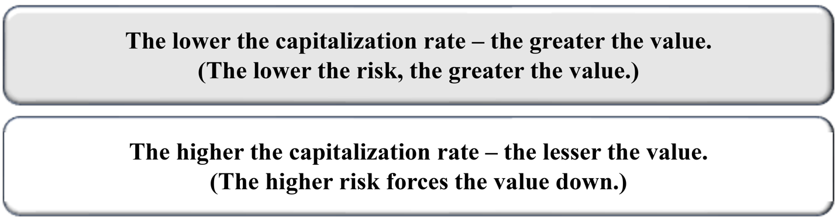
Valuation and Market Analysis – Appraisals
Income Analysis Approach
Apply a Capitalization Rate
Capitalization Rate – the estimated rate of return (ROI) a investor will demand on their investment capital for a property.
Pg. 178

Slide 37
Valuation and Market Analysis – math (Calculating Income Approach to Value)
Formula:
IRV
I = Net Operating Income
R = Rate (Capitalization Rate)
V = Value
I
R
V
Pg. 178

Slide 38
Valuation and Market Analysis – math (Calculating Income Approach to Value) – Problem #1
Formula
IRV
An appraiser is trying to determine the best cap rate to use to determine value on a subject property. The subject is a small apartment complex that produces an annual net income of $80,000. A similar property sold for $550,000. What was the property's capitalization rate.
I
80,000
Step 1 – Place the information known in the circle formula
(I)ncome = $80,000
(V)alue = $550,000
R
V
???
550,000
Step 2 – 80,000 ÷ 550,000 = .14545 or 14.5%
Pg. 179

Slide 39
Valuation and Market Analysis – math (Calculating Income Approach to Value) – Problem #2
Formula
IRV
An investor wants to purchase a property that generates $15,000 in annual net income, but only if she can realize an 8% return on that purchase. How much can she spend and get her desired cap rate?
I
15,000
Step 1 – Place the information known in the circle formula
(I)ncome = $15,000
(R)ate = .08
R
V
.08
???
Step 2 – 15,000 ÷ .08 = $187,500
Pg. 179

Slide 40
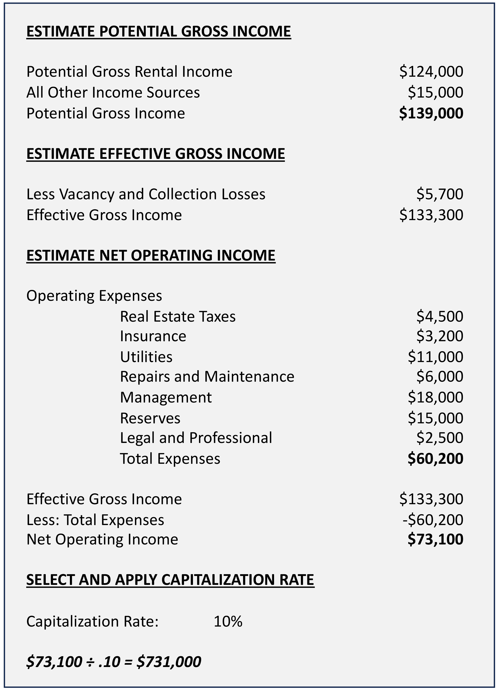
Income Capitalization Method
Illustration
Pg. 180

Slide 41
Valuation and Market Analysis – Appraisals
Income Analysis Approach
Pg. 180

Slide 42
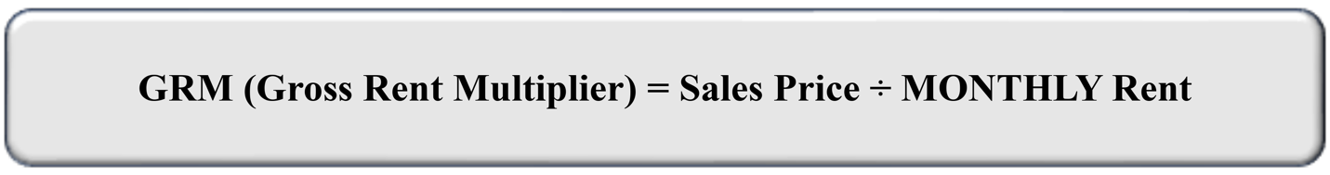
Valuation and Market Analysis – Appraisals
Alternatives to the Income Approach
Gross Rent Multiplier (GRM) – used when appraising residential property – single family residential up to a four-unit complex.
Based on monthly rental income.
GRM = Sales Price ÷ MONTHLY rent.
Appraiser identifies a factor of many similar rented properties to calculate a rough approximation of value.
Pg. 181

Slide 43
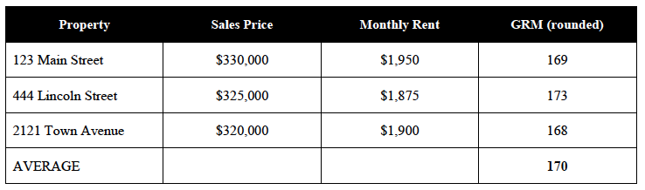
Valuation and Market Analysis – Appraisals
Alternatives to the Income Approach
Gross Rent Multiplier (GRM) – used when appraising residential property – single family residential up to a four-unit complex.
Pg. 181

Slide 44
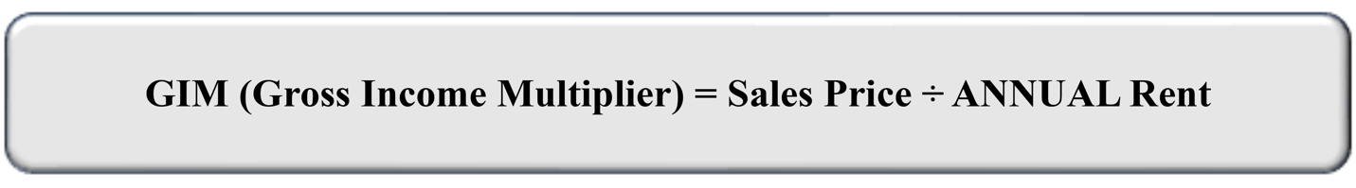
Valuation and Market Analysis – Appraisals
Alternatives to the Income Approach
Gross Income Multiplier (GIM) – used when appraising commercial and industrial properties.
Based on annual income.
GIM = Sales Price ÷ ANNUAL rent.
Appraiser identifies a factor of many similar rented properties to calculate a rough approximation of value.
Pg. 182

Slide 45
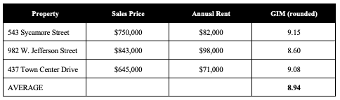
Valuation and Market Analysis – Appraisals
Alternatives to the Income Approach
Gross Income Multiplier (GIM) – used when appraising residential property – single family residential up to a four-unit complex.
Pg. 182

Slide 46
Valuation and Market Analysis – Appraisals
What Happens Next?
After reviewing all three approaches to value, they will then weigh the appropriateness of each to the property.
Usually, they will pick one approach as the best.
For residential properties it is usually the Sales Comparison
Approach with a limited Cost Approach analysis.
For residential, multi-family, or commercial property the income
approach might be more appropriate.
The data is memorialized in a report. Usually, the standardized URAR form.
Pg. 183

Slide 47
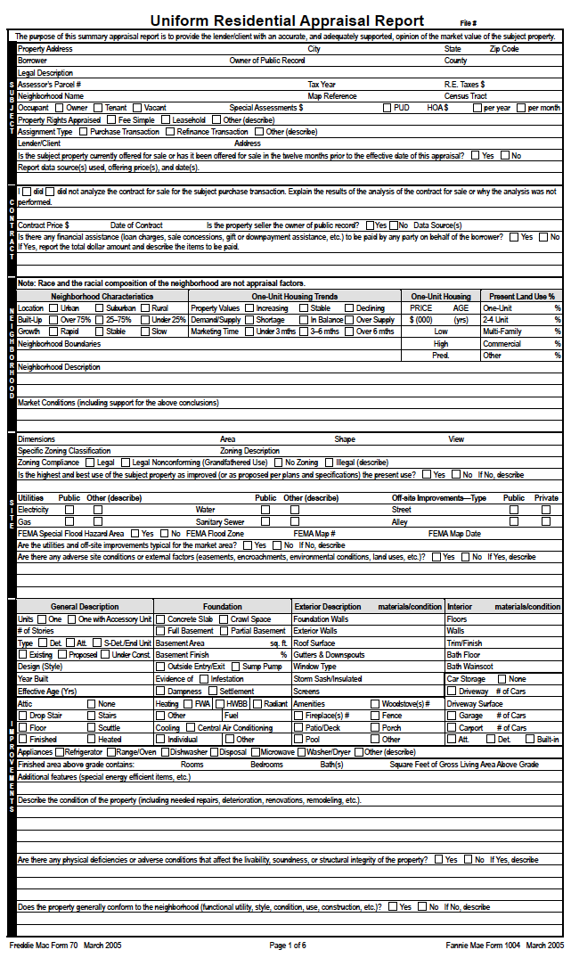
Standardized
URAR
(Uniform Residential Appraisal Report)
Form
Pg. 184

Slide 48
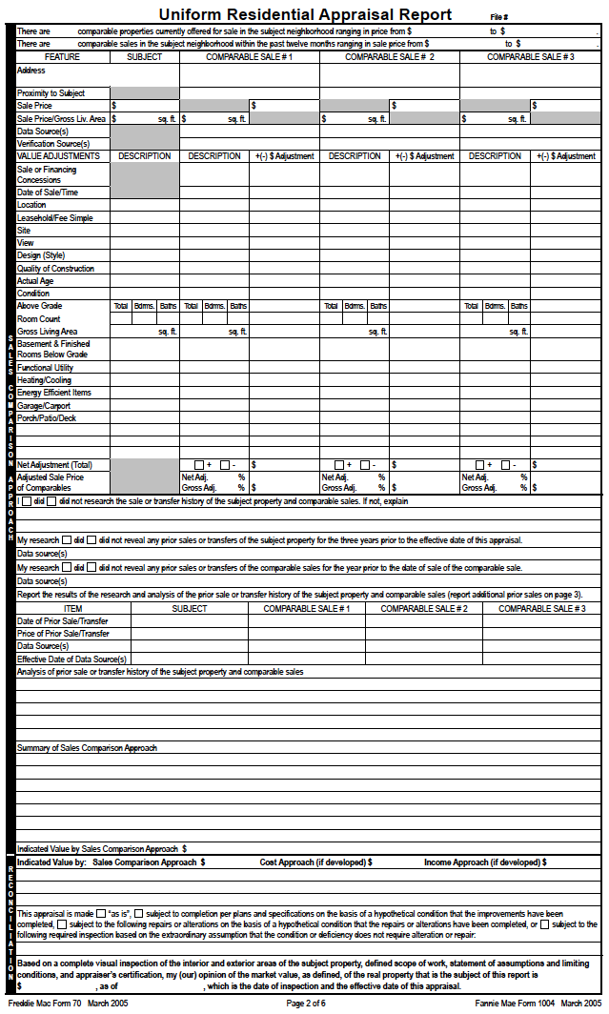
Standardized
URAR
(Uniform Residential Appraisal Report)
Form
Pg. 185

Slide 49
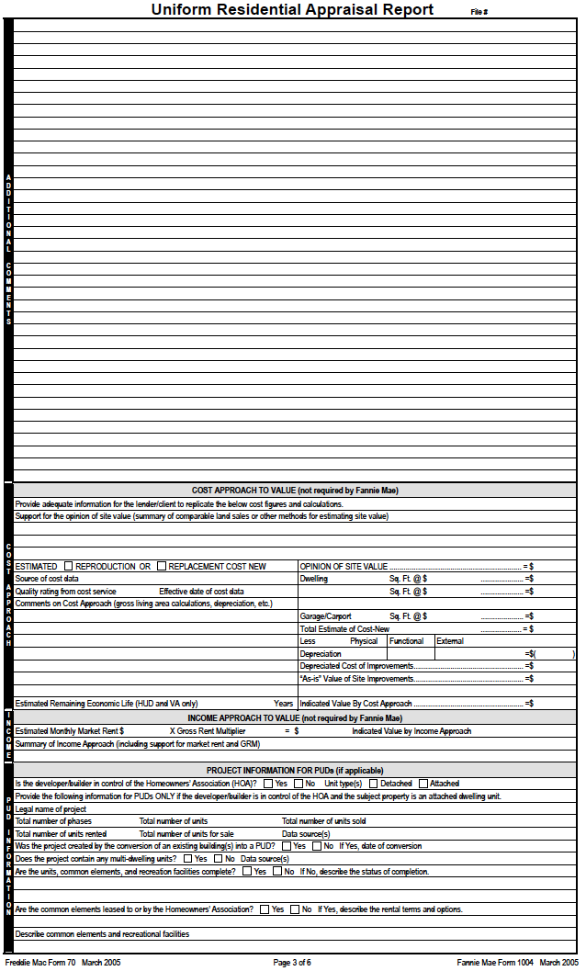
Standardized
URAR
(Uniform Residential Appraisal Report)
Form
Pg. 186

Slide 50
Valuation and Market Analysis – Appraisals
Competitive / Comparable Market Analysis &
Broker Price Opinion
Very similar to the Market Data / Sales Comparison approach.
Uses an analysis of recent solds, available for sale, under contract,
withdrawn and expired properties.
Information compiled usually results in a price range for a seller or
buyer to see the potential market value of a property.
Usually, adjustments to comparable properties are not as detailed as
an appraiser would perform.
Pg. 187

Slide 51
Valuation and Market Analysis – Appraisals
Competitive / Comparable Market Analysis &
Broker Price Opinion
Broker Price Opinion (BPO) – requested by a bank or lender to determine the value of a property.
BPO’s or CMA’s cannot be utilized as an appraisal for property being financed through a loan that may be sold on the secondary market. (FNMA, FHLMC, etc.)
Pg. 187

Slide 52
Market Price is the most probable price a property will sell for.
1) True
2) False

Slide 53
Market Price is the most probable price a property will sell for.
1) True
2) False

Slide 54
A notable weakness of the sales comparison approach to value is that
1) There may be no recent sales price data in the market.
2) The approach is not based on the principle of substitution.
3) The approach is only accurate with unique, special purpose properties.
4) Sales prices cannot be compared, since all real estate is different.

Slide 55
A notable weakness of the sales comparison approach to value is that
1) There may be no recent sales price data in the market.
2) The approach is not based on the principle of substitution.
3) The approach is only accurate with unique, special purpose properties.
4) Sales prices cannot be compared, since all real estate is different.

Slide 56
In making dollar adjustments in the sales comparison approach, the appraiser
1) Adds value to a comparable that is inferior to the subject property.
2) Adds value to the subject property if it is inferior to a comparable.
3) Subtracts value from a comparable that is inferior to the subject property.
4) Subtracts value from the subject property if it is inferior to a comparable.

Slide 57
In making dollar adjustments in the sales comparison approach, the appraiser
1) Adds value to a comparable that is inferior to the subject property.
2) Adds value to the subject property if it is inferior to a comparable.
3) Subtracts value from a comparable that is inferior to the subject property.
4) Subtracts value from the subject property if it is inferior to a comparable.

Slide 58
If commercial real estate rental prices are falling in a market, it is likely that
1) Demand has outstripped supply of space.
2) The market is in equilibrium.
3) The market is over-supplied.
4) Employment is increasing.

Slide 59
If commercial real estate rental prices are falling in a market, it is likely that
1) Demand has outstripped supply of space.
2) The market is in equilibrium.
3) The market is over-supplied.
4) Employment is increasing.

Slide 60
All of the following factors can affect supply of real estate EXCEPT
1) demographics.
2) Labor force.
3) Construction costs.
4) Government controls.

Slide 61
All of the following factors can affect supply of real estate EXCEPT
1) demographics.
2) Labor force.
3) Construction costs.
4) Government controls.

Slide 62
Adjustments made in using the market data approach are made to:
1) The subject property.
2) Comparable properties.
3) The property to be appraised.
4) The income of the property being appraised.

Slide 63
Adjustments made in using the market data approach are made to:
1) The subject property.
2) Comparable properties.
3) The property to be appraised.
4) The income of the property being appraised.

Slide 64
The net income on an apartment complex is $14,400. An investor wants an overall cap rate of 12%. What is the most she would pay for this property?
1) $1,120,000
2) $120,000
3) $83,000
4) $172,800

Slide 65
The net income on an apartment complex is $14,400. An investor wants an overall cap rate of 12%. What is the most she would pay for this property?
1) $1,120,000
2) $120,000 $14,400 ÷ 0.12 = $120,000
3) $83,000
4) $172,800

Slide 66
When three adjacent properties are combined into one to create a higher value (plottage) than the individual sum of the three properties’ values, the process is called Assemblage.
1) True
2) False

Slide 67
When three adjacent properties are combined into one to create a higher value (plottage) than the individual sum of the three properties’ values, the process is called Assemblage.
1) True
2) False

Slide 68
You own land worth $40,000 and your building has a replacement cost of $160,000. What would be the value if the appraiser used a depreciation rate of 30 percent?
1) $148,000
2) $152,000
3) $188,000
4) None of the above

Slide 69
You own land worth $40,000 and your building has a replacement cost of $160,000. What would be the value if the appraiser used a depreciation rate of 30 percent?
1) $148,000
2) $152,000 $160,000 x .70 (1.00 - .30) + $40,000
3) $188,000
4) None of the above

Slide 70
In appraising a special-purpose building such as a post office, the most reliable approach to an indication of its value would generally be the
1) Cost approach.
2) Market data approach.
3) Income approach.
4) Sales comparison approach.

Slide 71
In appraising a special-purpose building such as a post office, the most reliable approach to an indication of its value would generally be the
1) Cost approach.
2) Market data approach.
3) Income approach.
4) Sales comparison approach.

Slide 72
An airport routing was changed, with the result that airplanes flew over a residential area. The subsequent loss in value caused by the airplane noise would be BEST described as
1) Physical depreciation.
2) Functional obsolescence.
3) External or economic obsolescence.
4) Eminent domain.

Slide 73
An airport routing was changed, with the result that airplanes flew over a residential area. The subsequent loss in value caused by the airplane noise would be BEST described as
1) Physical depreciation.
2) Functional obsolescence.
3) External or economic obsolescence.
4) Eminent domain.

Slide 74
A woman buys a small house in a desirable neighborhood and pays $390,000. A man buys a nearly identical house but in a neighborhood of similar homes and pays $290,000. What economic principle BEST describes the reason why the woman paid more than the man?
1) Plottage
2) Substitution
3) Regression
4) Progression

Slide 75
A woman buys a small house in a desirable neighborhood and pays $390,000. A man buys a nearly identical house but in a neighborhood of similar homes and pays $290,000. What economic principle BEST describes the reason why the woman paid more than the man?
1) Plottage
2) Substitution
3) Regression
4) Progression

