Slide 1


Slide 2
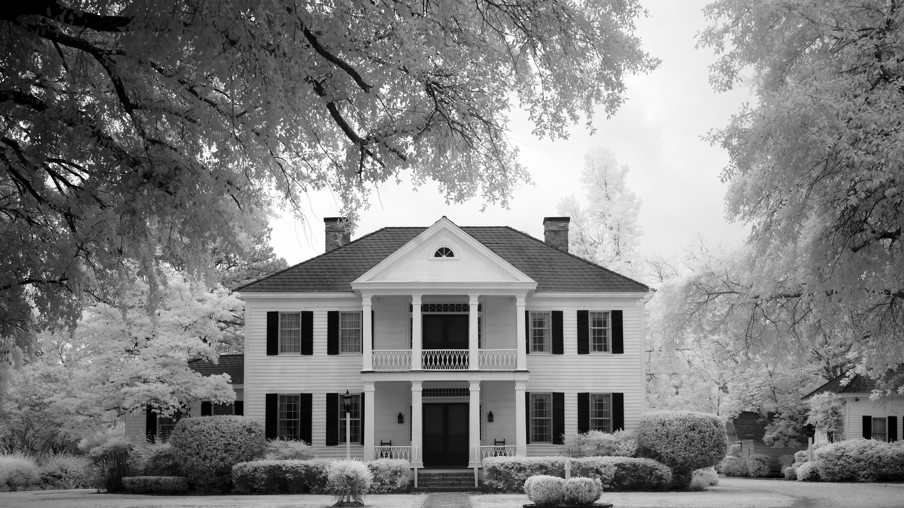
Colorado Closings and Settlement
Chapter 26
Settlement with an Assumed Loan

Slide 3

Seller: John R. and Mary L. Winter?
Address: 7373 West Flamingo Rd.
?Settlement Date: May 10, 20XX
Buyer: Harold R. and A. Jean Blue
Legal: Lots 6 and 7, Block 14, Graham Heights
Proration Date: May 9, 20XX

Slide 4
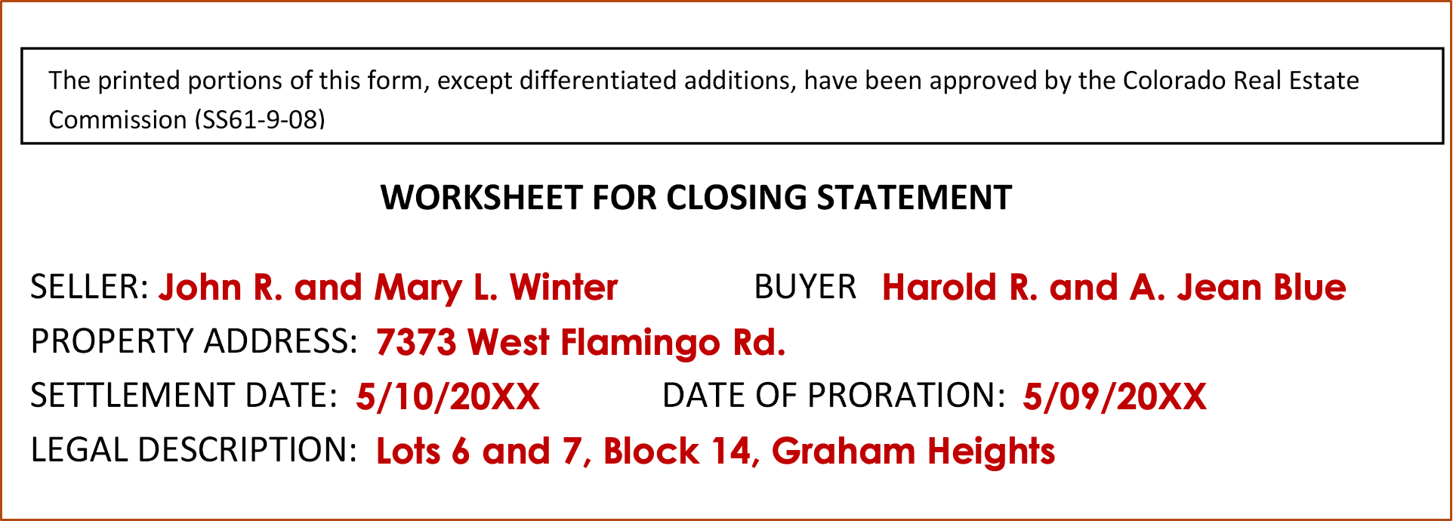

Slide 5

Selling Price
$250,000

Slide 6
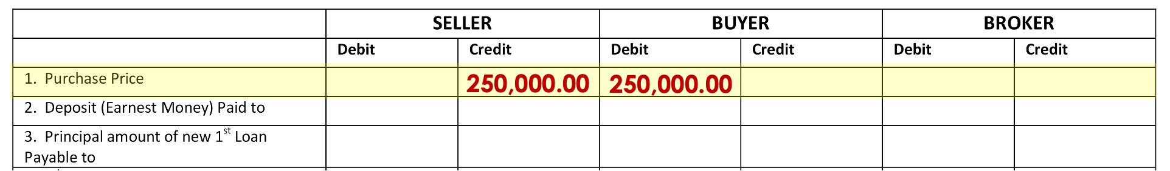
Line 1
Credit Seller / Debit Buyer
$250,000.00

Slide 7
Earnest Money
$5,000

Slide 8
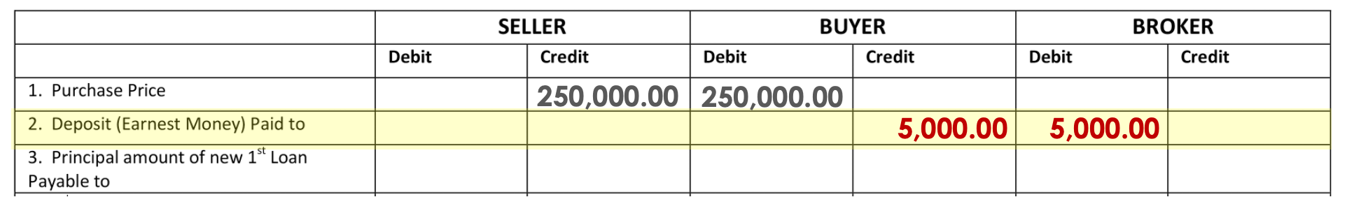
Line 2
Credit Buyer/ Debit Broker
$5,000.00

Slide 9
Seller Loan to Buyer
$200,000

Slide 10
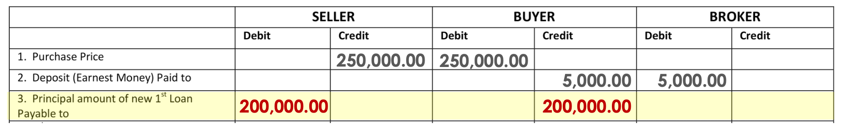
Line 3
Debit Seller/ Credit Buyer
$200,000.00

Slide 11
Last Year’s Taxes
$2,051.30
(PAID)

Slide 12
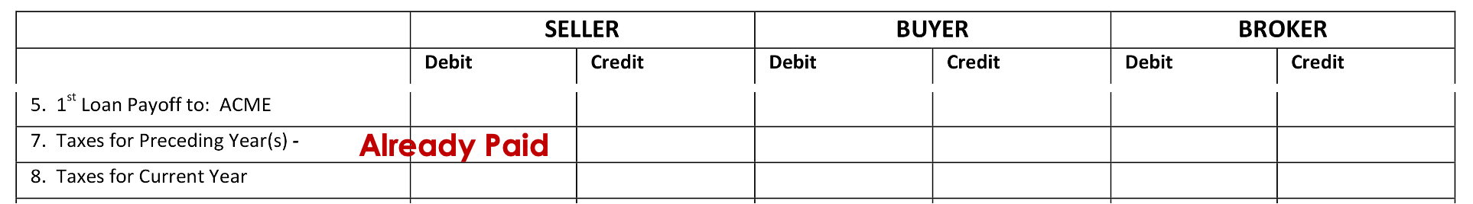
Line 7
ALREADY PAID

Slide 13
Current Year’s
Taxes
$ ???

Slide 14
What’s the Date of Closing?
May 10
Who are we going to Debit?
Seller
Jan – 31
Feb – 28
Mar – 31
Apr – 30
May – 9
129
How many days has
Seller owned:
129

Slide 15
What’s the Date of Closing?
May 10
Who are we going to Debit?
Seller
How many days has
Seller owned:
129
$2,051.30 ÷ 365 x 129 =
$724.98

Slide 16
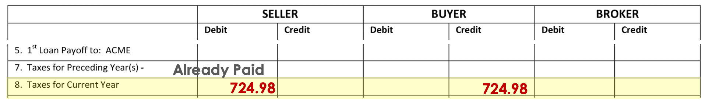
Line 8
Debit Seller/ Credit Buyer
$724.98

Slide 17
Interest on Assumed Loan
$ ???

Slide 18
The statement shows the interest rate is 7.5%, paid in arrears. The next payment is due on May 1, the Seller will make the payment on May 1 and the payment will pay for April’s interest. The Seller will owe the Buyer interest on the loan for the portion of May the Seller was in the property.

Slide 19
$200,000 x 7.5% ÷ 12 months = $1,250 per month
$1,250 ÷ 31 days (in May) = $40.3226 per day
$40.3226 x 9 days (May 1 – 9) owned by Seller =
$362.90

Slide 20
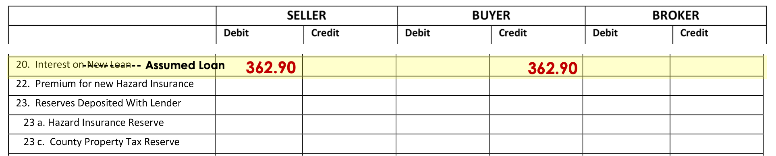
Line 20
Debit Seller/ Credit Buyer
$362.90

Slide 21
Hazard Insurance Premium
$675

Slide 22
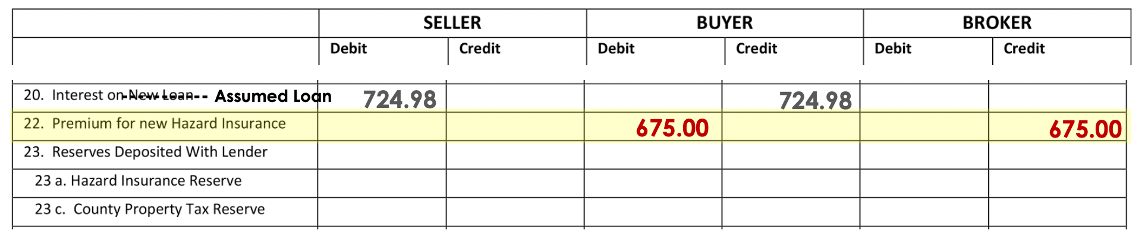
Line 22
Debit Buyer/ Credit Broker
$675.00

Slide 23
Hazard Insurance Reserve
$112.50

Slide 24
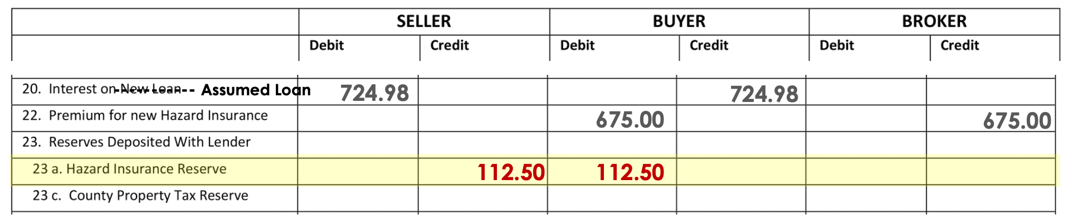
Line 23a
Credit Seller/ Debit Buyer
$112.50

Slide 25
Tax Reserve
$854.65

Slide 26
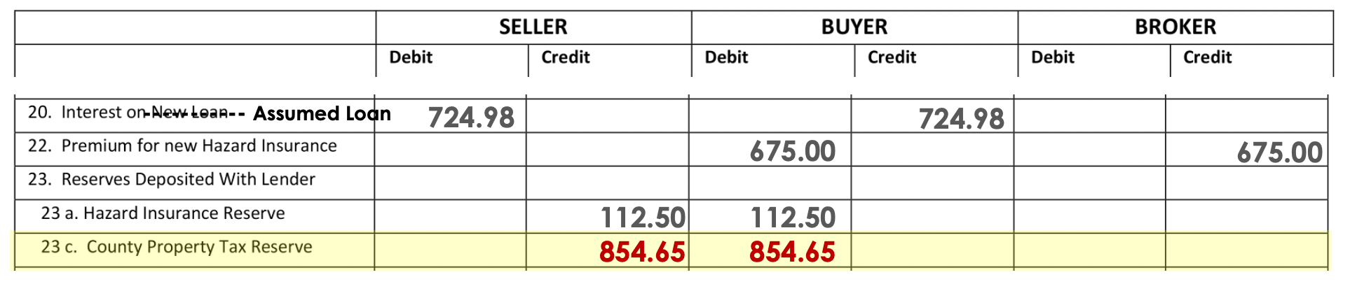
Line 23c
Credit Seller/ Debit Buyer
$854.65

Slide 27
Closing Fee
$200

Slide 28
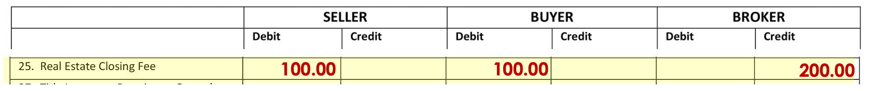
Line 25
Debit Seller/ Debit Buyer/ Credit Broker
$100.00 / $100.00 / $200.00

Slide 29
Certificate of Taxes Due
$15

Slide 30
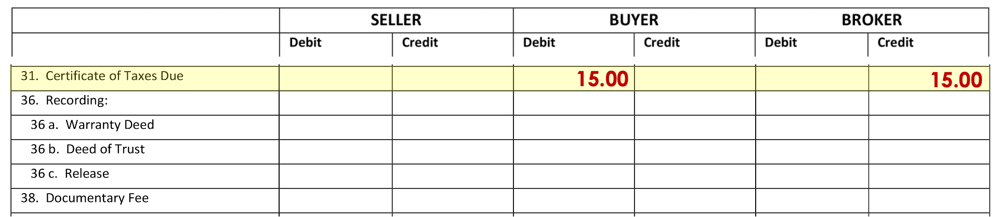
Line 31
Debit Buyer/ Credit Broker
$15.00

Slide 31
Warranty Deed
$10

Slide 32
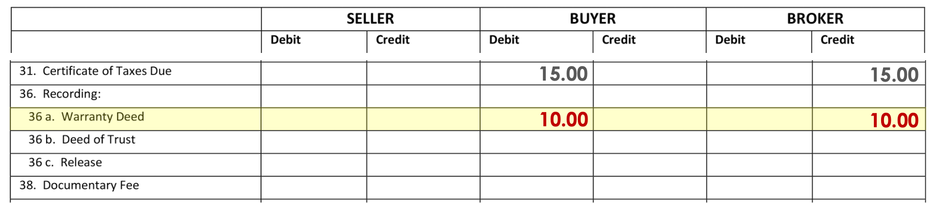
Line 36a
Debit Buyer/ Credit Broker
$10.00

Slide 33
Deeds of Trust
$31

Slide 34
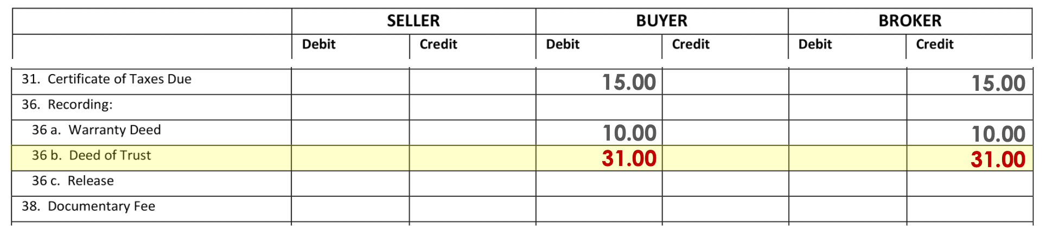
Line 36b
Debit Buyer/ Credit Broker
$31.00

Slide 35
Doc Fee
$25

Slide 36
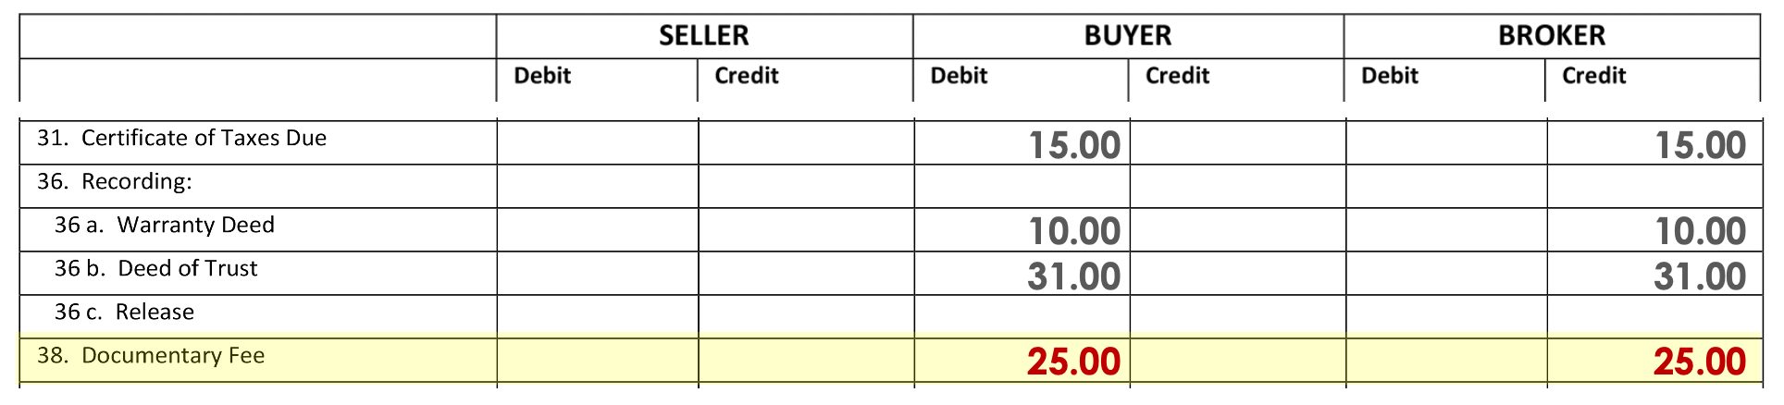
Line 38
Debit Buyer/ Credit Broker
$25.00

Slide 37
Transfer Fee
$2,000

Slide 38
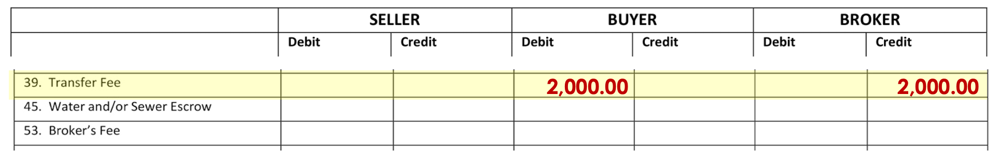
Line 39
Debit Buyer/ Credit Broker
$2,000.00

Slide 39
Water/Sewer Bill
$ ???

Slide 40
What’s the Date of Closing?
May 10
Who are we going to Debit?
Buyer - Paid in advance
How many days in the period:
April – 30
May – 31
June – 30
91

Slide 41
What’s the Date of Closing?
May 10
Who are we going to Debit?
Buyer – Paid in Advance
How many days in the period:
91
How many days are we collecting for:
April – 30
May – 31
June – 30
91

Slide 42
What’s the Date of Closing?
May 10
Who are we going to Debit?
Buyer – Paid in Advance
How many days in the period:
92
How many days are we collecting for:
52
$96.40 ÷ 91 x 52 =
$55.09

Slide 43
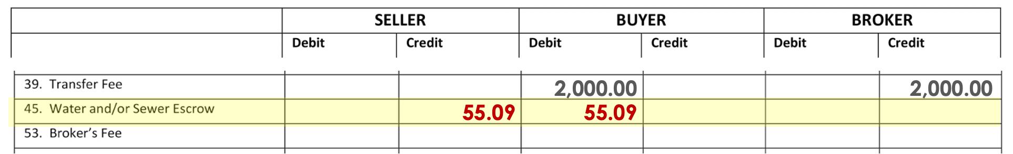
Line 45
Credit Seller/ Debit Buyer
$55.09

Slide 44
Broker’s Fee
$12,500

Slide 45
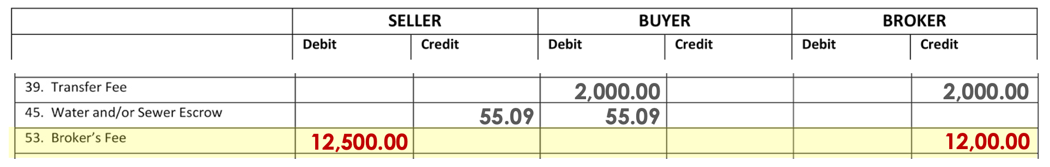
Line 53
Debit Seller/ Credit Broker
$12,500.00

Slide 46
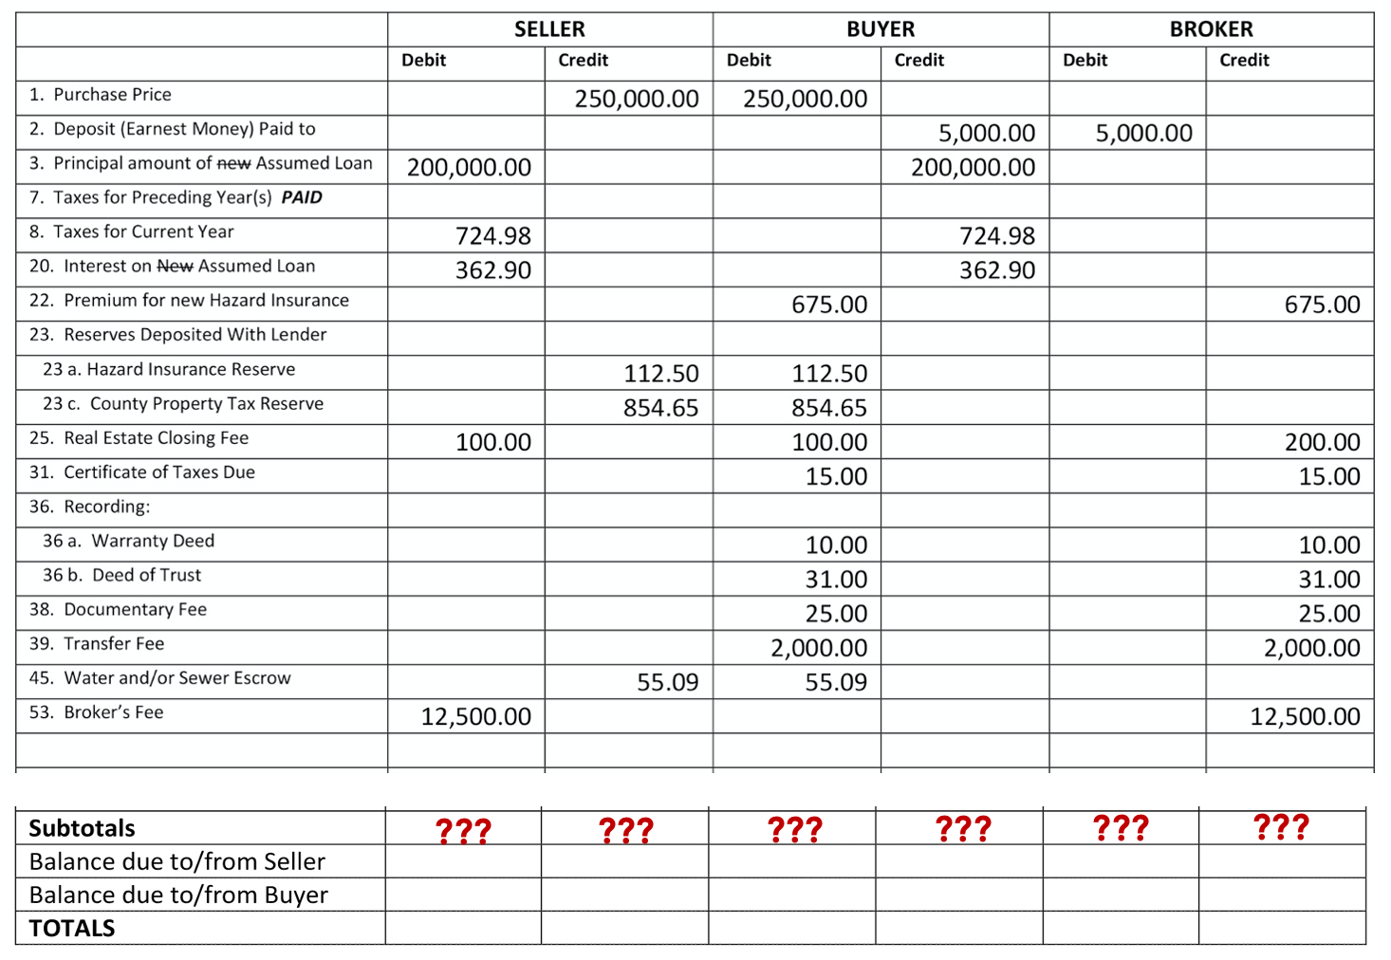

Slide 47
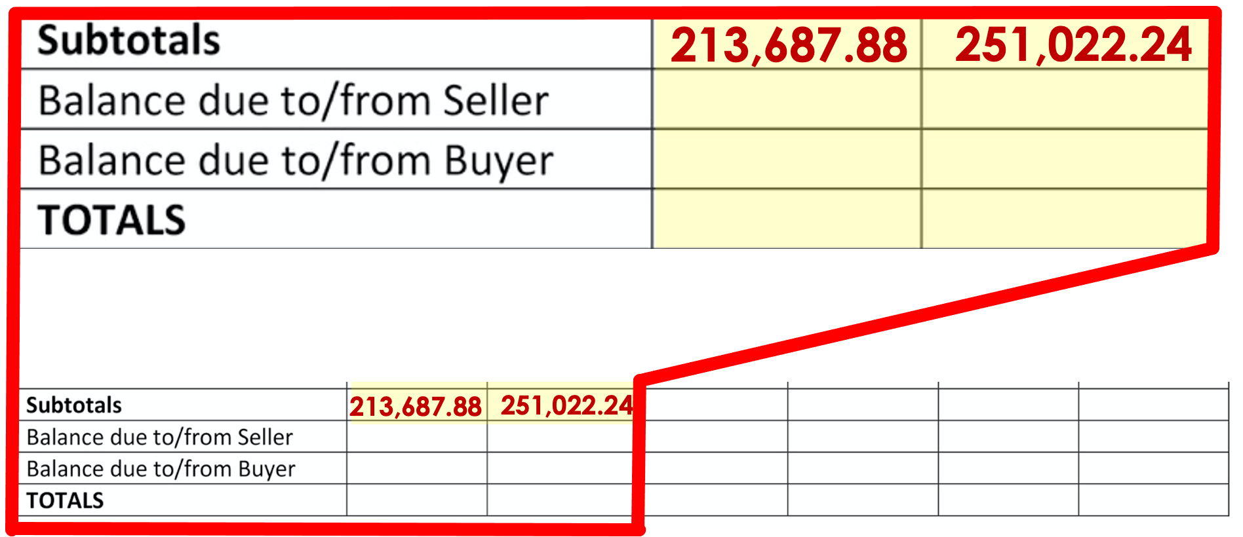

Slide 48
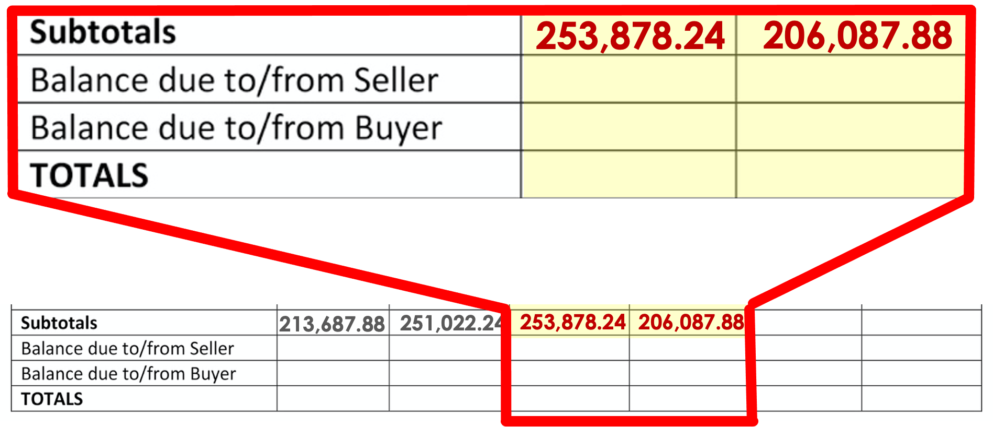

Slide 49
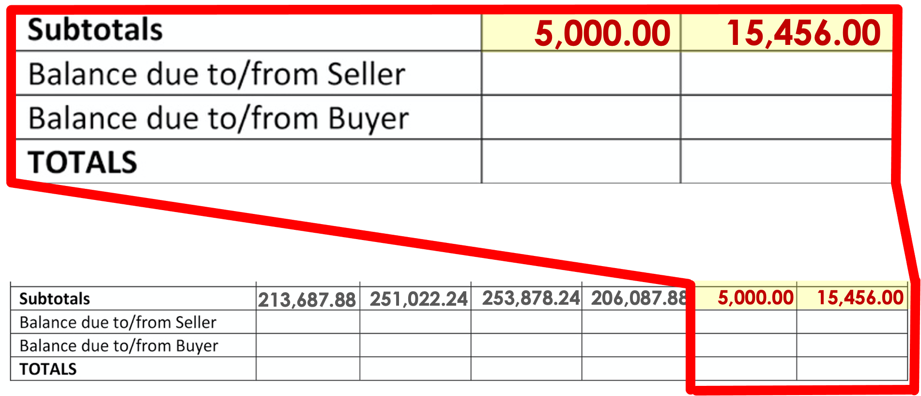

Slide 50
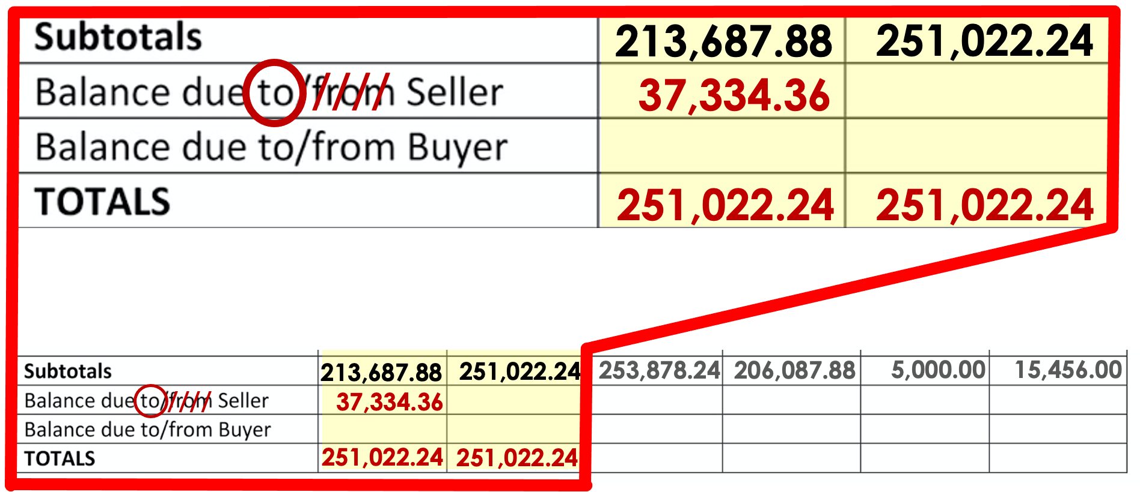

Slide 51
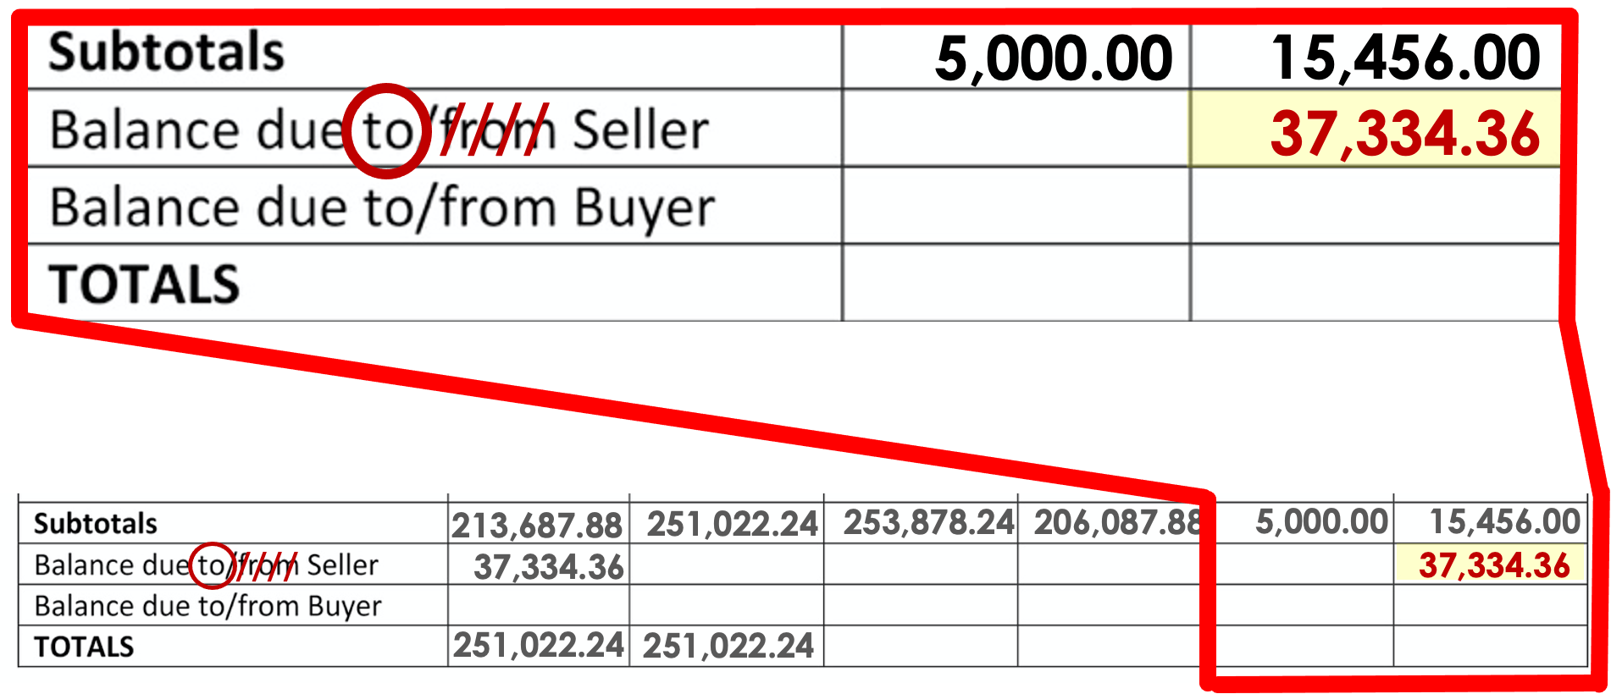

Slide 52
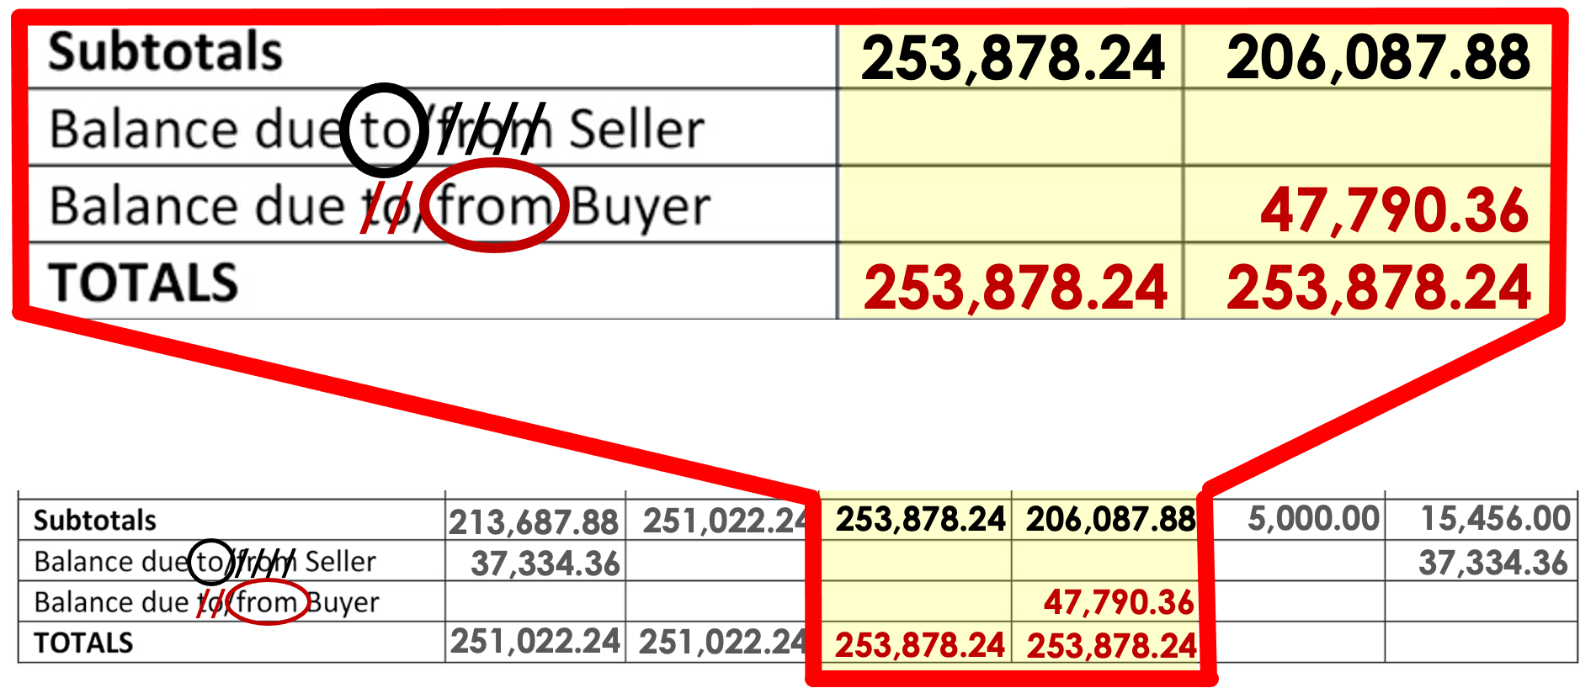

Slide 53
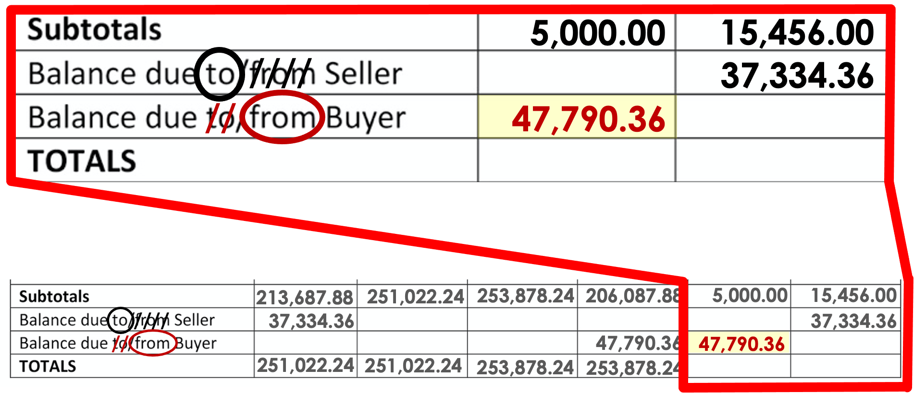

Slide 54
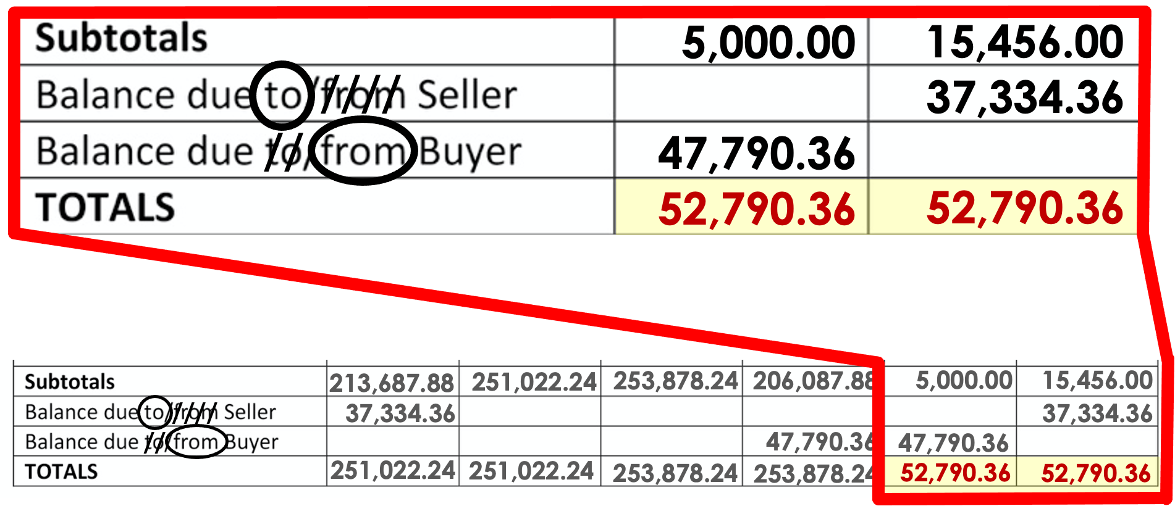

Slide 55
