Slide 1


National Law and practice
Chapter 2 – Working With The Public

Slide 2
Working with the public – common law of agency
Common Law of Agency
Exists in every state.
Sets up fiduciary obligations for all agents.
With regard to real estate, refers to the nature of the relationship between the licensee and the parties to whom brokerage services are provided.
Pg. 26

Slide 3
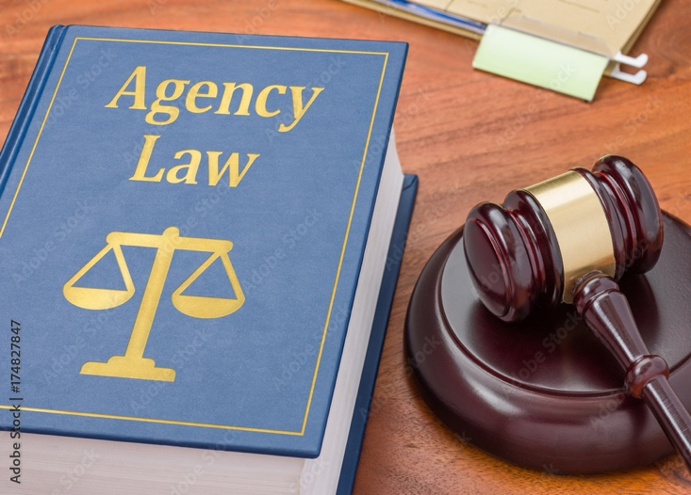
Working with the public – common law of agency
Common Law of Agency
Principal (Client) – the client for whom the agent is providing a service.
Agent – the party hired to provide a service.
Customer – a person not under an agency agreement. The other party in a transaction.
Pg. 26

Slide 4
Working with the public – common law of agency
Types of Agency:
Special (Limited) Agent – authorized to represent one principal but cannot contract on the client’s behalf.
Real Estate Brokers are usually Special Agents.
Pg. 27

Slide 5
Working with the public – common law of agency
Types of Agency:
General Agent – authorized to represent a party’s interest in a specific matter.
General Agents have limited ability to bind their Principal.
Pg. 27

Slide 6
Working with the public – common law of agency
Types of Agency:
General Agent – authorized to represent a party’s interest in a specific matter.
Property Managers are usually General Agents.
Salespeople are General Agents with the Employing Broker.
Pg. 27

Slide 7
Working with the public – common law of agency
Types of Agency:
Universal Agent – authorized to represent the Principal with virtually unlimited authority. Can act as the Principal.
Power of Attorney – written specific authority to sign documents and act as someone else.
Attorney in Fact – the person who is given the rights in a Power of Attorney.
Pg. 27

Slide 8
Working with the public – common law of agency
Power of Attorney – usually must be recorded. (Equal Dignities Rule).
Real Estate Agents should not act in the capacity of a Universal Agent in transactions for their clients.
Pg. 27

Slide 9

Working with the public – Creation of Agency
Agency Relationships can be:
Express Agency – created verbally or in writing.
Statute of Frauds would require in writing.
Implied Agency – an agency relationship created when, intentionally or inadvertently, actions indicate that the parties have consented to an agency relationship.
Not an express agreement.
Pg. 28

Slide 10
Working with the public – Agent’s Duties to Principals
Fiduciary Duties – a relationship of trust and confidence between a Principal and an agent.
Fiduciary obligations involve putting the client’s interests about the agent.
Pg. 29

Slide 11

Working with the public –
Primary Forms of Agency Relationships
Duties of an Agent (O.L.D.C.A.R.)
Obedience – Agent must comply with the client’s directions and instructions if they are legal.
An Agent who cannot obey a legal
directive, must withdraw from the
relationship.
Pg. 29

Slide 12
Working with the public –
Primary Forms of Agency Relationships
Duties of an Agent (O.L.D.C.A.R.)
Loyalty – The needs of the client must be placed above everyone else’s, including the agent.
Pg. 29

Slide 13
Working with the public –
Primary Forms of Agency Relationships
Duties of an Agent (O.L.D.C.A.R.)
Disclosure – The agent must inform the client of all material facts, reports and rumors that might affect the client’s interests in the property transaction.
Pg. 30

Slide 14
Working with the public –
Primary Forms of Agency Relationships
Duties of an Agent (O.L.D.C.A.R.)
Confidentiality – An agent must hold in confidence any personal or business information received from the client.
Confidentiality extends beyond the termination of an
agency agreement.
Pg. 30

Slide 15
Working with the public –
Primary Forms of Agency Relationships
Duties of an Agent (O.L.D.C.A.R.)
Accounting – An agent must safeguard and account for all personal property of their client (money, documents, etc.)
Pg. 30

Slide 16
Working with the public –
Primary Forms of Agency Relationships
Duties of an Agent (O.L.D.C.A.R.)
Reasonable Skill and Care – An agent is expected to do their job with diligence and care.
Pg. 30

Slide 17
Working with the public – Agent’s Duties to Principals
Fiduciary Duties of Conflicts of Interests
Needed when agents buy or sell real estate as a Principal to the transaction (i.e. for themselves).
Also required when agents recommend companies in which they have an ownership interest in.
Pg. 31

Slide 18
Working with the public –
Primary Forms of Agency Relationships
Single Agency – The agent represents only one party in a transaction.
Advocates specifically for their client.
Acts like a “coach.”
Pg. 31

Slide 19
Working with the public –
Primary Forms of Agency Relationships
Dual Agency – Where an agent represents both the buyer and seller in the same transaction.
Requires disclosure in states where it is allowed.
Pg. 31

Slide 20
Working With the Public– subagency and designated agent
A subagent is an agent of an agent
- Salesperson may represent their Broker as a subagent.
- Salesperson owes fiduciary duties to the broker and the
clients of the broker.
Designated Agent
- Broker is the agent to the seller or buyer.
- Salesperson has been designated by Broker to provide
duties to a principal on the broker’s behalf.
Pg. 32

Slide 21
Working with the public –
Responsibilities of Agent to Customers and Third Parties
Duties to Customers (D.A.H.)
Disclosure – Agents must disclose their brokerage relationships with other parties in the transaction, as well as material disclosure of the property.
Pg. 33

Slide 22
Working with the public –
Responsibilities of Agent to Customers and Third Parties
Duties to Customers (D.A.H.)
Accounting – An agent must safeguard and account for all personal property of their customer (money, documents, etc.)
Pg. 34

Slide 23
Working with the public –
Responsibilities of Agent to Customers and Third Parties
Duties to Customers (D.A.H.)
Honesty – Agents must deal honestly with customers and not misrepresent material facts.
Pg. 34

Slide 24
Working with the public –
Termination of Agency
Certain events will terminate an agency relationship:
Full performance – The completion of the reason the agency relationship was created will terminate the relationship (i.e. the sale of the house.)
Mutual Agreement – The parties can mutually agree to terminate the agency relationship.
Expiration Date – The agency relationship automatically terminates on the expiration date of the agency agreement, whether the obligations were performed or not.
Pg. 35

Slide 25
Working with the public –
Termination of Agency
Certain events will terminate an agency relationship:
Death or incapacity of either the principal or broker
Abandonment by the agent.
Condemnation or destruction of the property.
Bankruptcy or termination by force of law. (i.e foreclosure)
Breach of Agreement – If one of the parties to the agreement defaults on their obligations, the damaged party may have a potential financial claim against the defaulting party.
Pg. 35

Slide 26
Working with the public –
Non-Agency
Non-Agency / Transaction-Broker / Facilitator – A facilitator doesn’t represent any party in the transaction.
Is expected to act with neutrality towards all.
Acts like a “referee.”
Pg. 35

Slide 27

Working with the public –
Non-Agency
Duties of a Transaction-Broker (C.A.R.D.)
Confidentiality – A transaction-Broker must hold in confidence any personal or business information received from the client.
Confidentiality extends beyond the
termination of an agency
agreement.
Pg. 36

Slide 28
Working with the public –
Non-Agency
Duties of a Transaction-Broker (C.A.R.D.)
Accounting – An agent must safeguard and account for all personal property of their customer (money, documents, etc.)
Pg. 36

Slide 29
Working with the public –
Non-Agency
Duties of a Transaction-Broker (C.A.R.D.)
Reasonable Skill and Care – A transaction-broker is expected to do it their job with diligence and care.
Pg. 36

Slide 30
Working with the public –
Non-Agency
Duties of a Transaction-Broker (C.A.R.D.)
Disclosure – The transaction-broker must inform the client of all material facts concerning the property transaction.
Pg. 36

Slide 31
An agent is a fiduciary in a relationship of trust and confidence with a principal who hired him/her to represent the principal in the transaction.
1) True
2) False

Slide 32
An agent is a fiduciary in a relationship of trust and confidence with a principal who hired him/her to represent the principal in the transaction.
1) True
2) False

Slide 33
You are a broker who has listed a home for a neighbor. Which of the following terms describes your relationship with the seller?
1) You are the subagent of the seller.
2) The seller is your client.
3) The seller is your customer.
4) The seller is your agent.

Slide 34
You are a broker who has listed a home for a neighbor. Which of the following terms describes your relationship with the seller?
1) You are the subagent of the seller.
2) The seller is your client.
3) The seller is your customer.
4) The seller is your agent.

Slide 35
A special agent is BEST described as someone who
1) Has power of attorney.
2) Has authority to sell a property.
3) Has authority to represent a principal in a specific transaction.
4) Has authority to represent a principal in all matters concerning
an area of the principal’s interest.

Slide 36
A special agent is BEST described as someone who
1) Has power of attorney.
2) Has authority to sell a property.
3) Has authority to represent a principal in a specific transaction.
4) Has authority to represent a principal in all matters concerning
an area of the principal’s interest.

Slide 37
The seller of an unlisted property (FSBO) that is being sold to a buyer represented by a buyer’s agent is classified as a(n)
1) Client
2) Dual Agent
3) Customer
4) Undisclosed dual agent

Slide 38
The seller of an unlisted property (FSBO) that is being sold to a buyer represented by a buyer’s agent is classified as a(n)
1) Client
2) Dual Agent
3) Customer
4) Undisclosed dual agent

Slide 39
An agent only owes disclosure of material fact as a fiduciary duty to their client.
1) True
2) False

Slide 40
An agent only owes disclosure of material fact as a fiduciary duty to their client.
1) True
2) False

Slide 41
An agent would be violating their fiduciary duty of obedience if he discloses the leaking roof to a prospective buyer when the seller asked the agent not to disclose this information.
1) True
2) False

Slide 42
An agent would be violating their fiduciary duty of obedience if he discloses the leaking roof to a prospective buyer when the seller asked the agent not to disclose this information.
1) True
2) False

Slide 43
The agent’s obligation to use his or her skill and expertise on behalf of the principal arises under which of the common-law duties?
1) Care
2) Obedience
3) Loyalty
4) Disclosure

Slide 44
The agent’s obligation to use his or her skill and expertise on behalf of the principal arises under which of the common-law duties?
1) Care
2) Obedience
3) Loyalty
4) Disclosure

Slide 45
One of the agent’s fiduciary duties that continues even after a listing agreement expires is
1) Obedience
2) Diligence
3) Confidentiality
4) Disclosure

Slide 46
One of the agent’s fiduciary duties that continues even after a listing agreement expires is
1) Obedience
2) Diligence
3) Confidentiality
4) Disclosure

Slide 47
A principal discloses that she would sell a property for $150,000. During the listing period, the house is marketed for $180,000. NO offers come in, and the listing expires. Two weeks later, the agent grumbles to a customer that the seller would have sold for less than the listed price. Which of the following is true?
1) The agent has violated the duty of confidentiality.
2) The agent has fulfilled all fiduciary duties, including confidentiality, since the listing had expired.
3) The agent is violating the duties owed this customer.
4) The agent has created a dual agency situation with the customer.

Slide 48
A principal discloses that she would sell a property for $150,000. During the listing period, the house is marketed for $180,000. NO offers come in, and the listing expires. Two weeks later, the agent grumbles to a customer that the seller would have sold for less than the listed price. Which of the following is true?
1) The agent has violated the duty of confidentiality.
2) The agent has fulfilled all fiduciary duties, including confidentiality, since the listing had expired.
3) The agent is violating the duties owed this customer.
4) The agent has created a dual agency situation with the customer.

Slide 49
A single agent can represent two principals equally in the same transaction.
1) True
2) False

Slide 50
A single agent can represent two principals equally in the same transaction.
1) True
2) False

