Slide 1


Slide 2

Colorado Closings and Settlement
Chapter 20
Broker's Responsibility Related to Closing

Slide 3

An Introduction to Closings and Settlement
  The real estate closing, or settlement, occurs when the seller delivers title to the buyer in exchange for payment by the buyer of the purchase price.
  Title passes from the seller to the buyer and a final accounting is given for all funds received or paid.
pg. 523

Slide 4
An Introduction to Closings and Settlement
  Colorado closings are normally conducted by title companies.
  Real estate brokers, attorneys or independent closing agents also may conduct closings.
  Real estate closers are not regulated; however, Colorado Insurance Regulations require that title companies close real estate transactions only pursuant to written instructions.
pg. 523

Slide 5
An Introduction to Closings and Settlement
  The closing is created through the Contract to Buy and Sell, with the majority of the closing terms determined from the negotiations between the buyer and seller.
  The contract, along with title documents, a tax certificate, and lender loan documents make up the pieces the closing entity will use to create the “Closing Statement” for each party.
pg. 524

Slide 6
Broker and Broker Associate Responsibility
  The question of who conducts the closing is a contractual matter between the buyer, seller and closing entity.
  Colorado Division of Insurance Regulation 3-5-1 requires that title companies close real estate transactions only pursuant to written instructions.
pg. 524

Slide 7
Broker and Broker Associate Responsibility
  The Regulation requires title companies to execute closing instructions approved by the Real Estate Commission.
  Listing brokers and brokerage firms using title companies to hold earnest money are required to have a completed Closing Instructions form signed by the buyer and seller prior to depositing the funds with the title company.
pg. 524

Slide 8
Broker and Broker Associate Responsibility
  Brokers using title companies to perform closings should have the completed Closing Instructions form, signed before title deadline, in the closed file regardless of who is holding the earnest money.
pg. 524

Slide 9
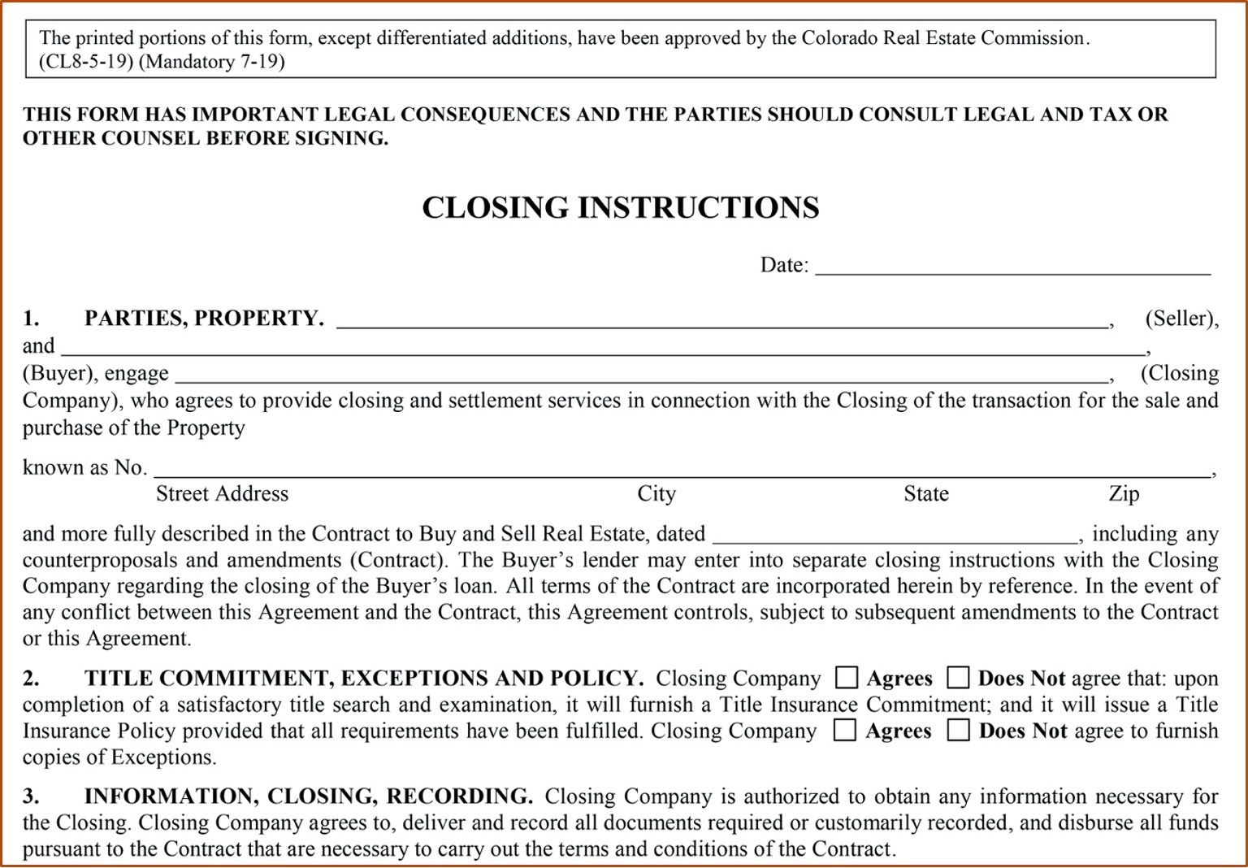

Slide 10
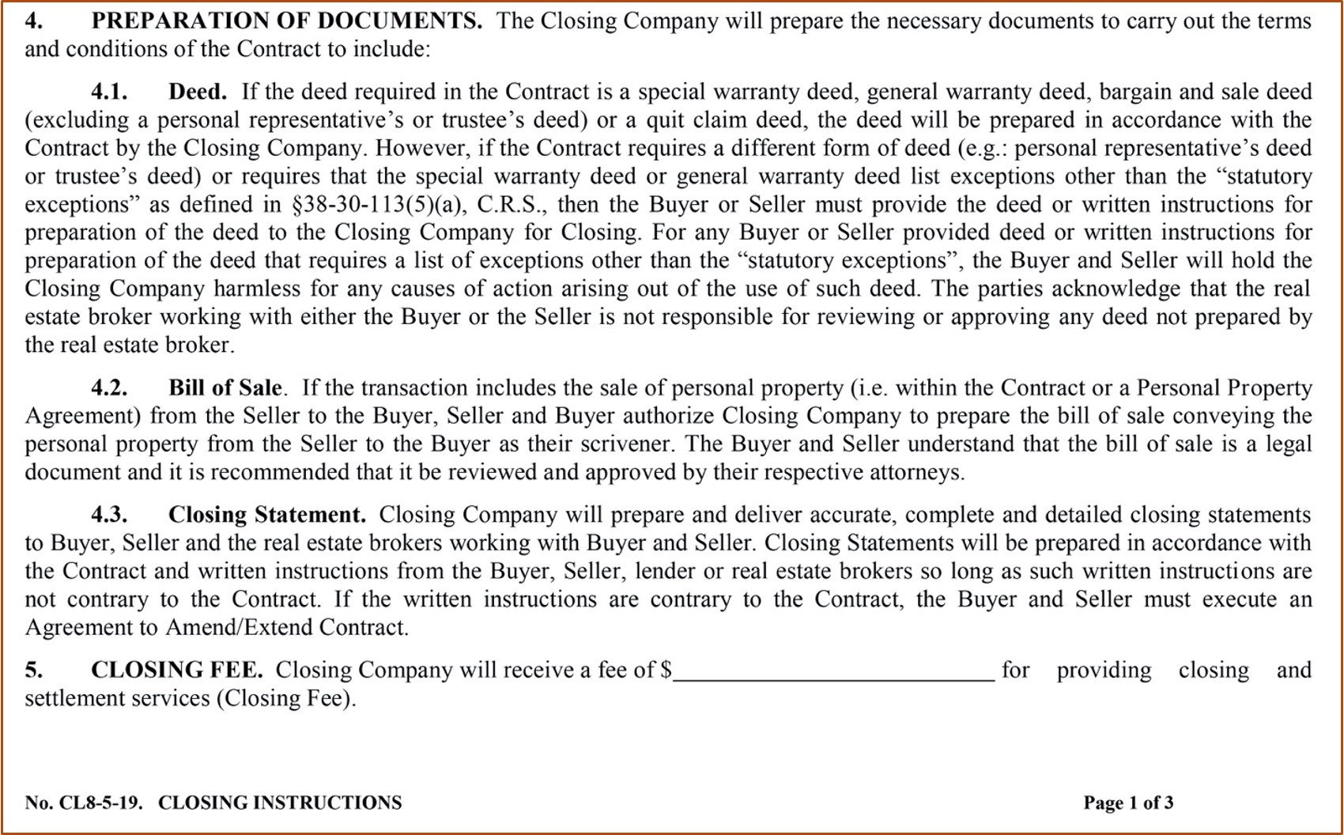

Slide 11
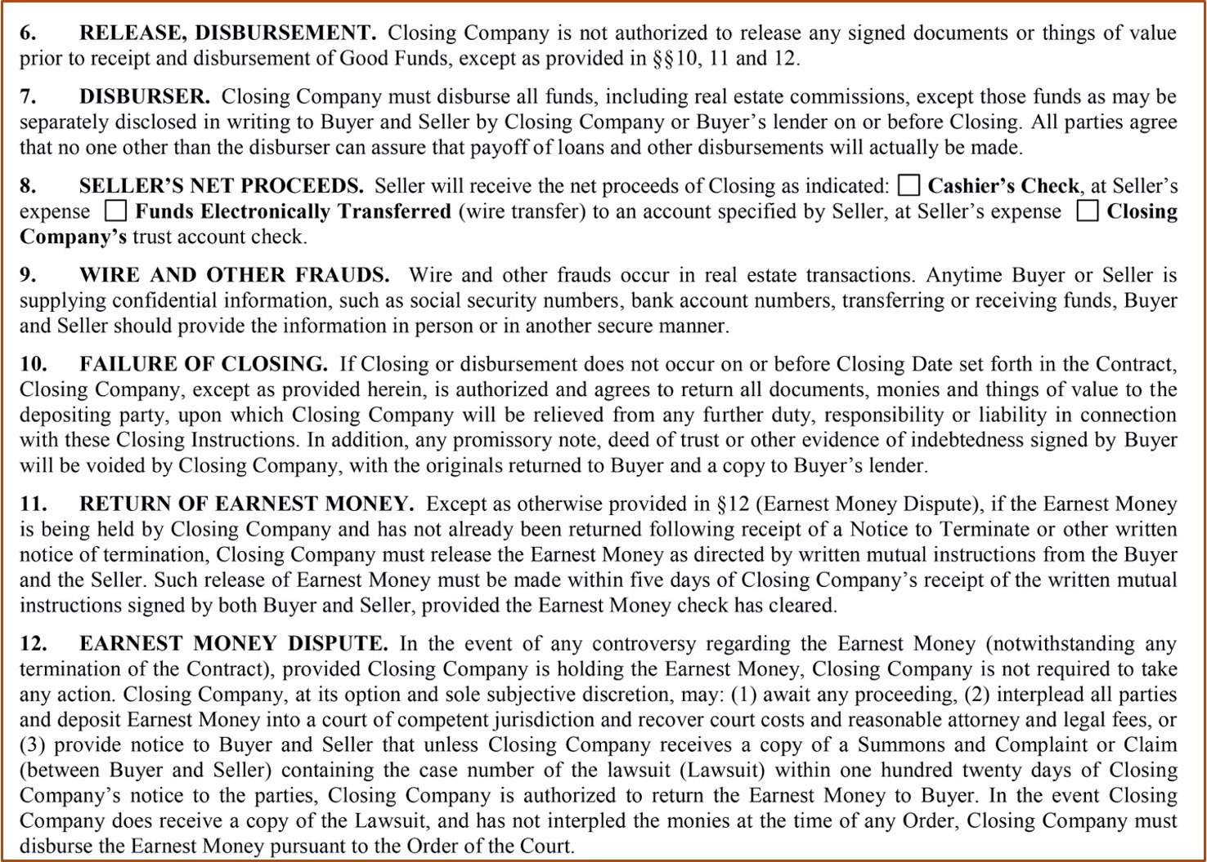

Slide 12
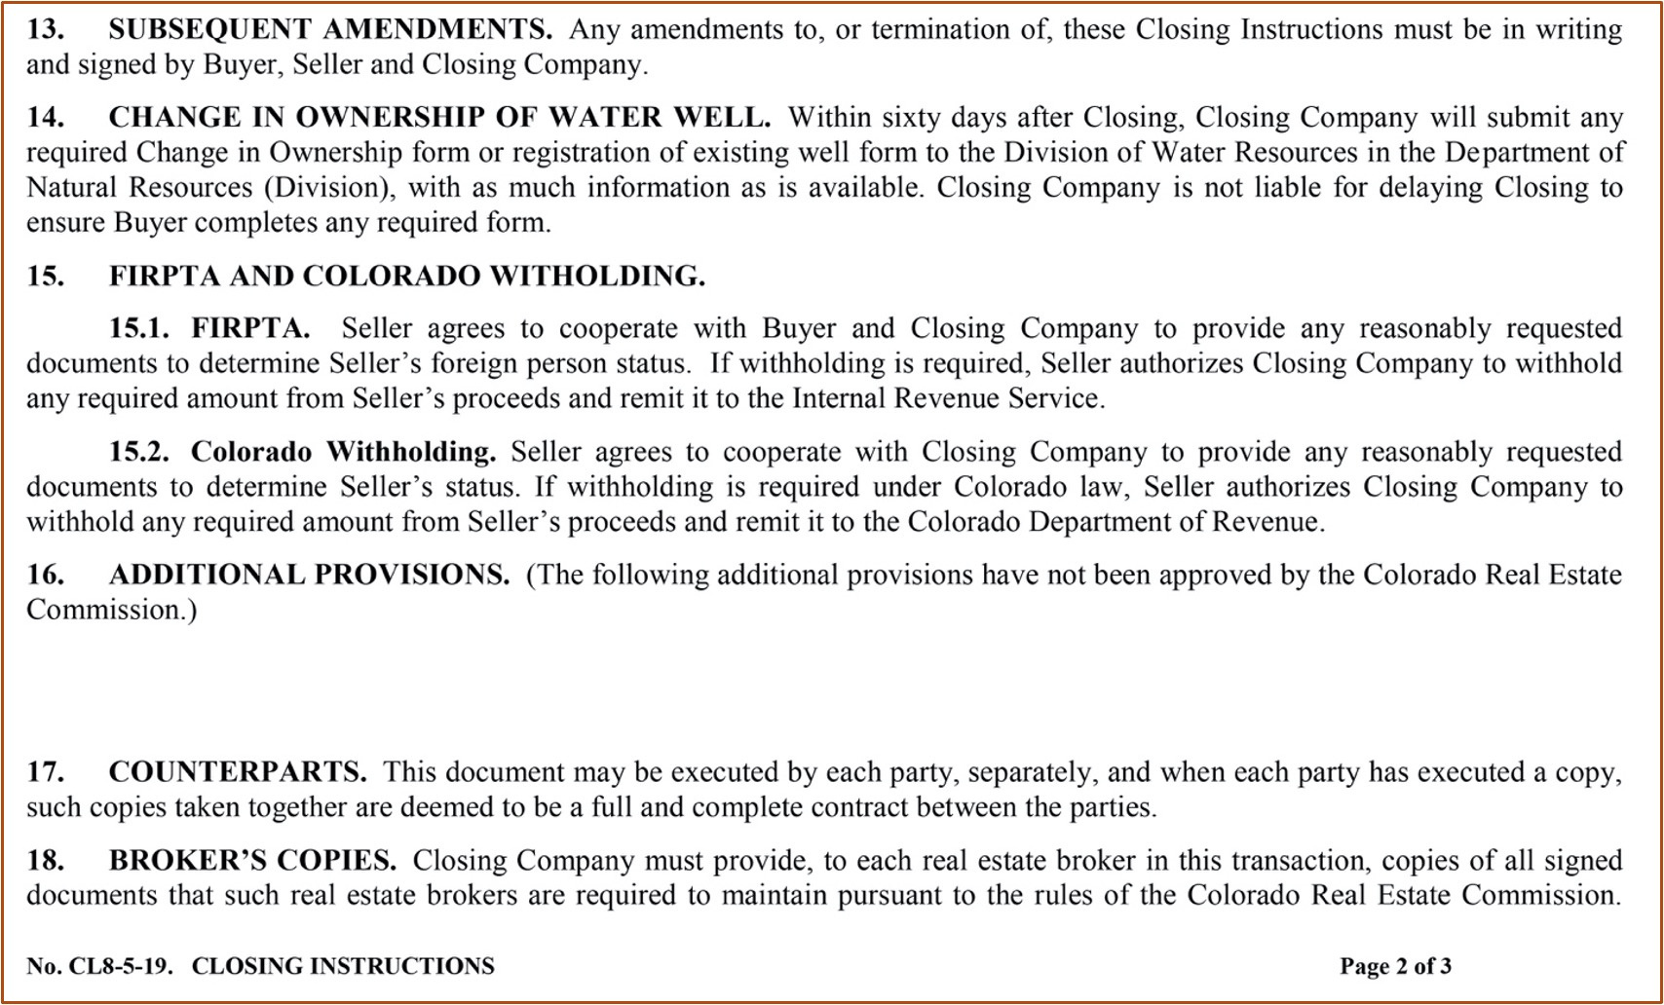

Slide 13
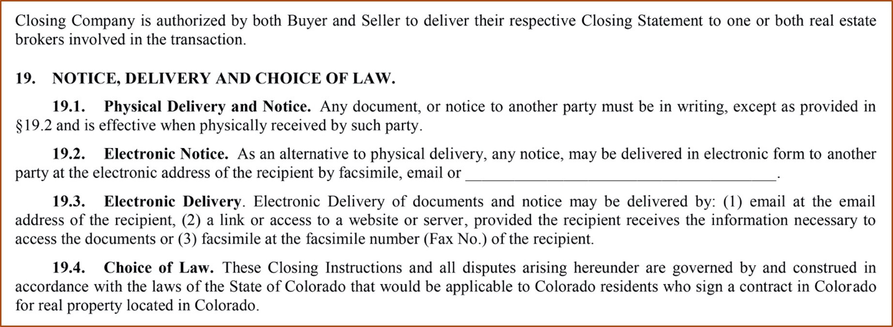

Slide 14
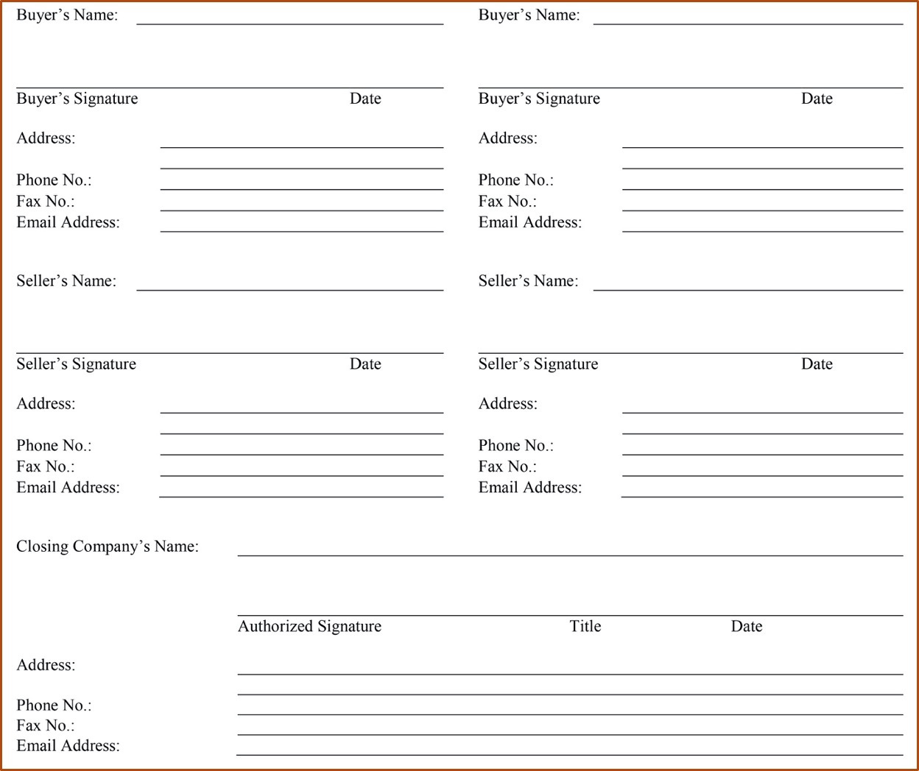

Slide 15
Broker and Broker Associate Responsibility
  Commission Rules 6.14 and 6.19 require real estate brokers to provide copies of complete and accurate closing statements to buyers and sellers for any transaction in which the broker has a relationship with the member(s) of the public.
pg. 528

Slide 16
Broker and Broker Associate Responsibility
  While the majority of closings are completed by a title company’s closing department, this does not relieve the employed designated broker and their employing broker of the responsibility to verify that the closing statement is accurate.
pg. 528

Slide 17
Broker and Broker Associate Responsibility
  The listing broker and any cooperating licensee must carefully review their respective closing statements for accuracy even if they will not conduct the actual closing.
  The listing brokerage firm and the listing broker has overall responsibility for the closing. The designated broker (for either the seller or the buyer) is responsible for the closing figures for their principal.
pg. 528

Slide 18
Broker and Broker Associate Responsibility
  The licensee who attends the closing must sign the settlement statement and is primarily responsible for providing a proper closing statement to the party they represent.
  An associate must deliver a copy of the statement to the employing broker immediately after the closing.
pg. 528

Slide 19
Broker and Broker Associate Responsibility
  If the designated broker is unable to attend a closing, the employing broker may designate another broker to attend; in which case all brokers assume joint responsibility for the accuracy of the closing statements.
  The employing broker is responsible for the supervision of both brokers, which gives all three brokers responsibility for an accurate closing.
pg. 528

Slide 20
Broker and Broker Associate Responsibility
  The required Closing Statements provided to the Seller and Buyer reflects only that party’s credits and debits.
  The broker(s) attending the closing must sign and secure the signed approval and acceptance of the Buyer and Seller on a copy of their respective closing statements.
pg. 530

Slide 21
Broker and Broker Associate Responsibility
  Original signatures are not required on the copies that are retained in the office transaction file.
  Copies must be retained in the broker’s file for four years.
pg. 530

Slide 22
The Truth in Lending Act and RESPA
  For more than 30 years, Federal law has required lenders to provide two different disclosure forms to consumers applying for a loan.
- The Good Faith Estimate and the HUD-1.
  Consumers often found the forms confusing, and lenders and settlement agents found the forms burdensome to provide and explain.
pg. 530

Slide 23
The Truth in Lending Act and RESPA
  The Good Faith Estimate (GFE) and the initial Truth-in-Lending disclosure (initial TIL) have been combined into a new form, the Loan Estimate.
- Designed to provide disclosures that will be helpful to
consumers in understanding the key features, costs,
and risks of the mortgage loan for which they are
applying, and must be delivered or mailed to consumers
no later than the third business day after they submit
a loan application.
pg. 530

Slide 24
The Truth in Lending Act and RESPA
  The old HUD-1 and final Truth-in-Lending disclosure have been combined into another new form, the Closing Disclosure.
- Designed to provide disclosures that will be
helpful to consumers in understanding all of the
costs of the transaction. This form must be
provided to consumers at least three business
days before closing.
pg. 531

Slide 25
The Truth in Lending Act and RESPA
  The Loan Estimate must contain the actual terms and costs of the transaction.
  Creditors may estimate disclosures using the best information reasonably available when the actual term or cost is not reasonably available to the creditor at the time the disclosure is made.
pg. 531

Slide 26
The Truth in Lending Act and RESPA
  The creditor normally may rely on the representations of other parties in obtaining the information, including, for example, the settlement agent.
  The creditor is required to provide corrected disclosures containing the actual terms of the transaction at or before closing.
pg. 531

Slide 27
The Truth in Lending Act and RESPA
  The Closing Disclosure must be in writing.
  If the actual terms or costs of the transaction change prior to closing, the creditor must provide a corrected Closing Disclosure that contains the actual terms of the transaction.
pg. 531

Slide 28
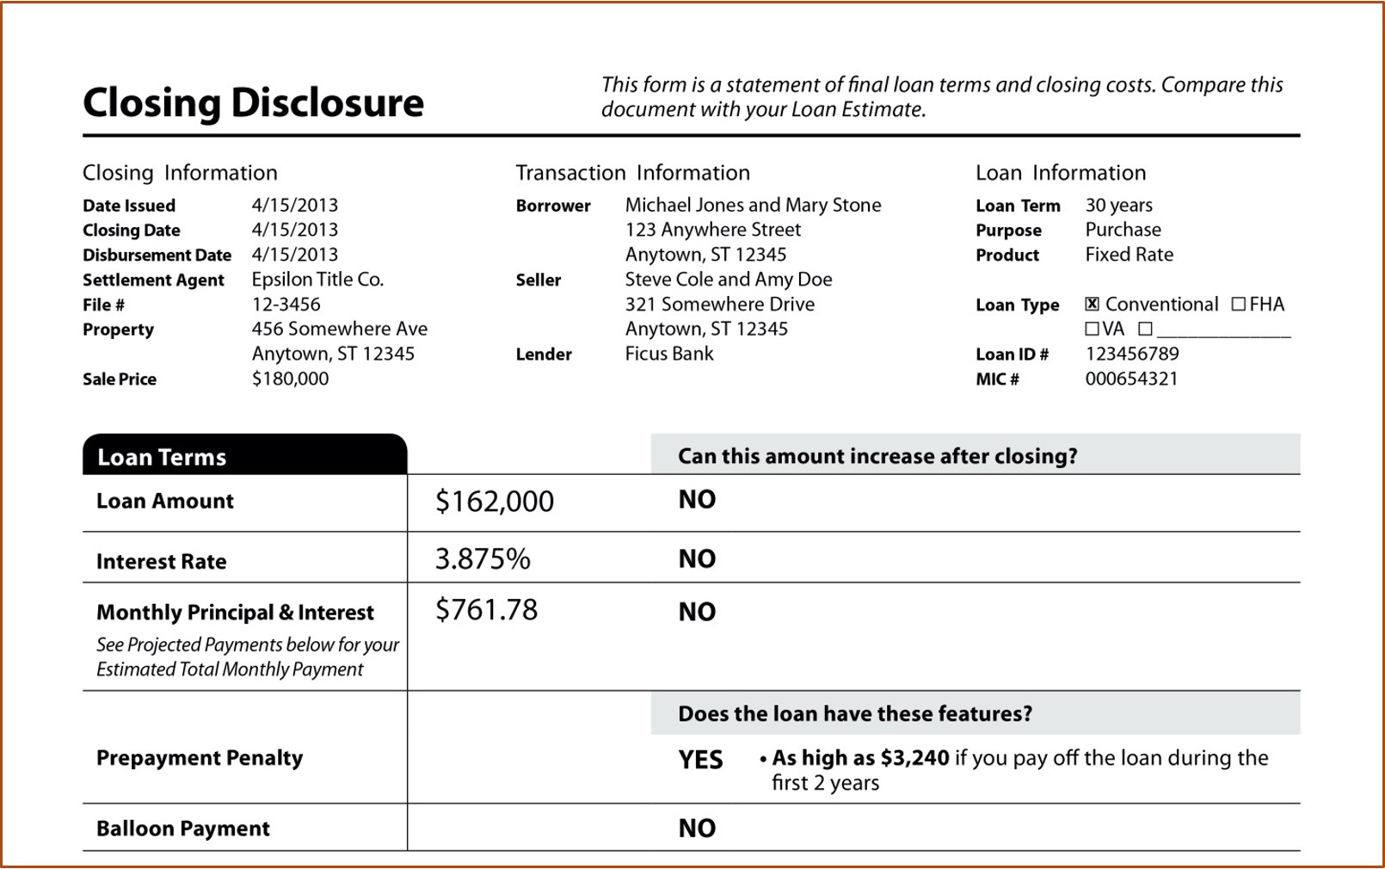

Slide 29
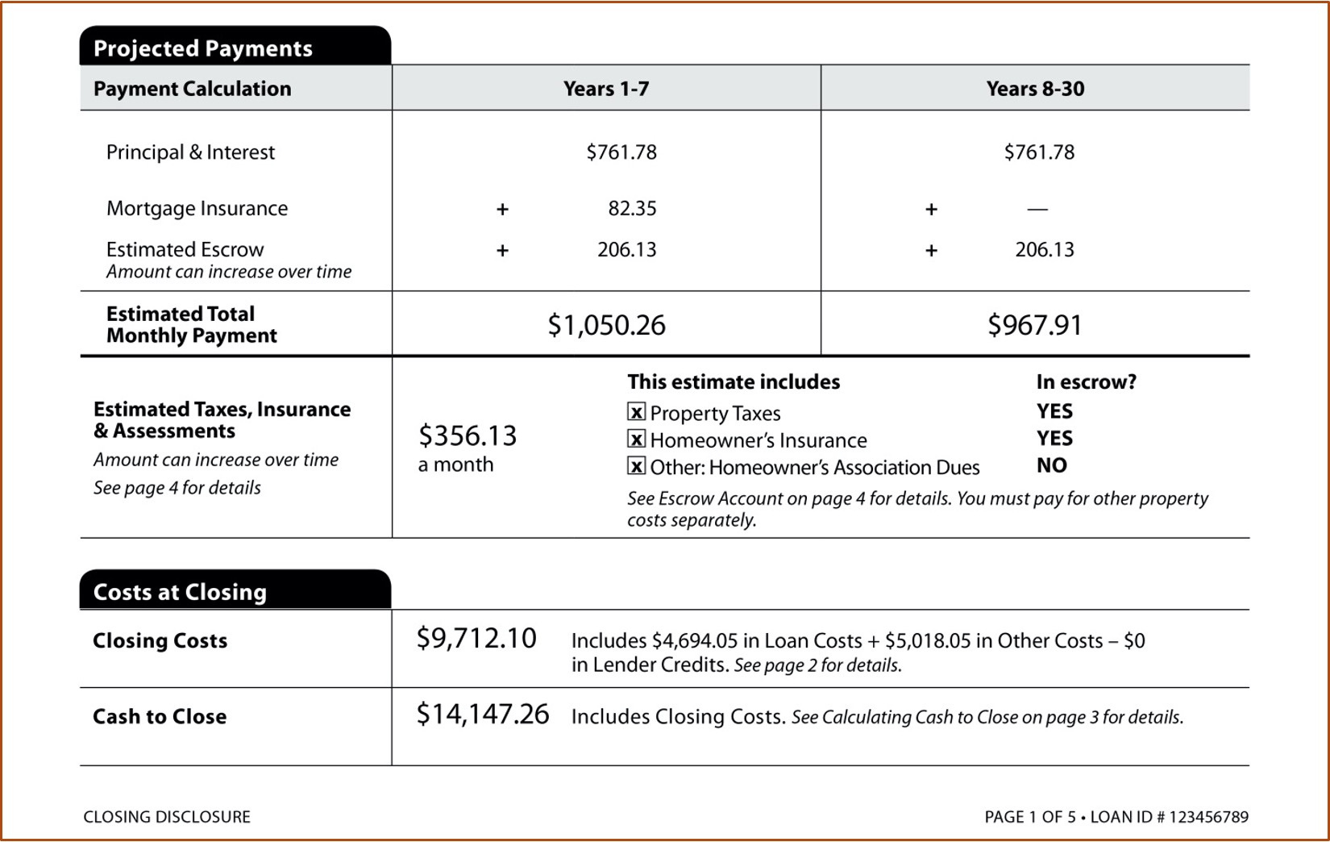

Slide 30
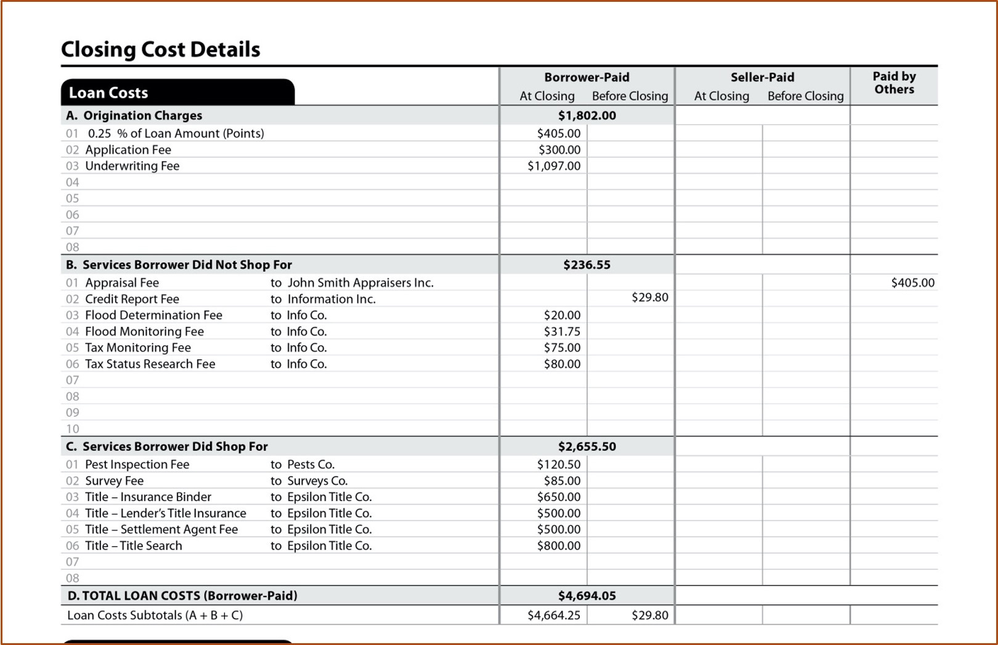

Slide 31
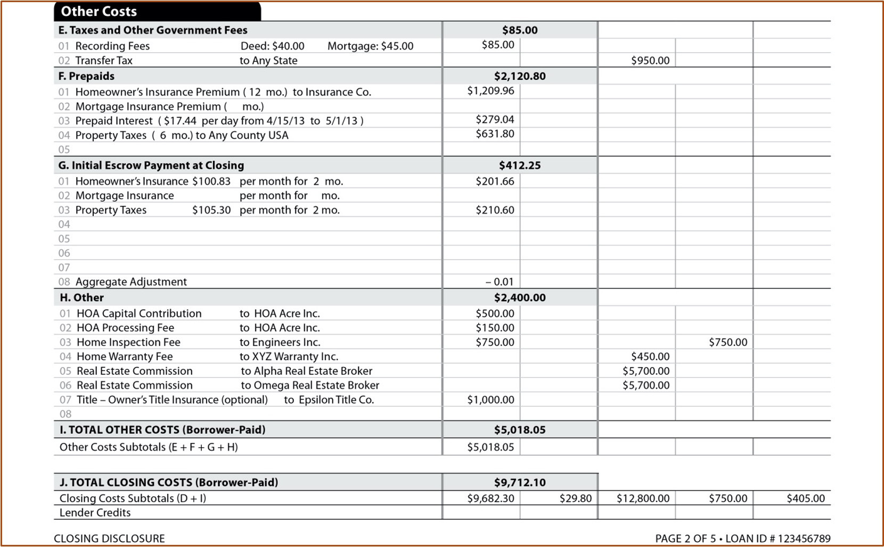

Slide 32
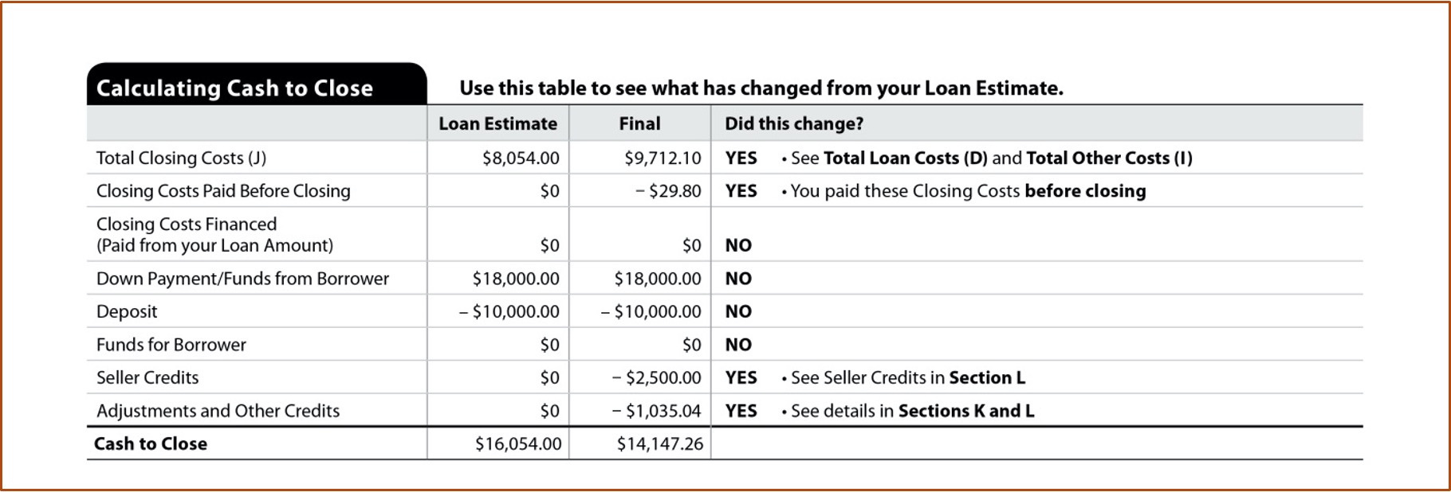

Slide 33
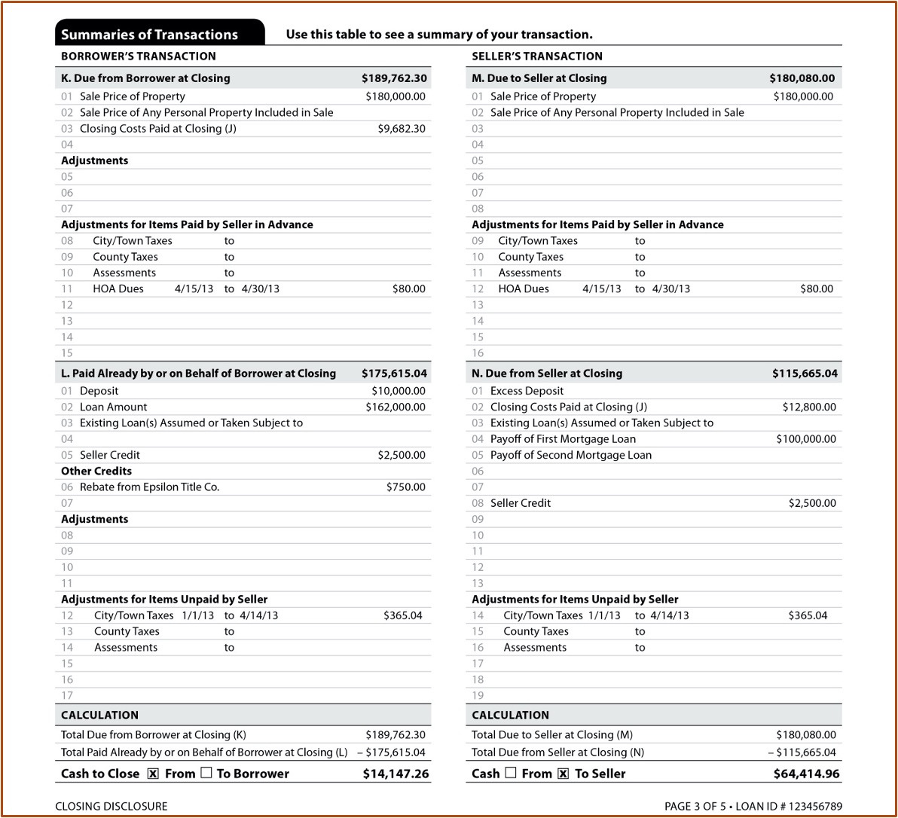

Slide 34
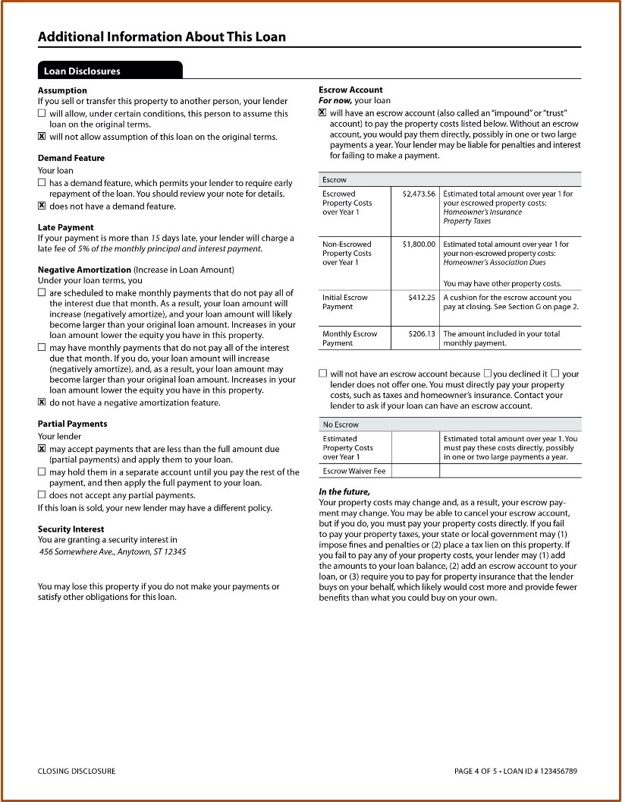

Slide 35
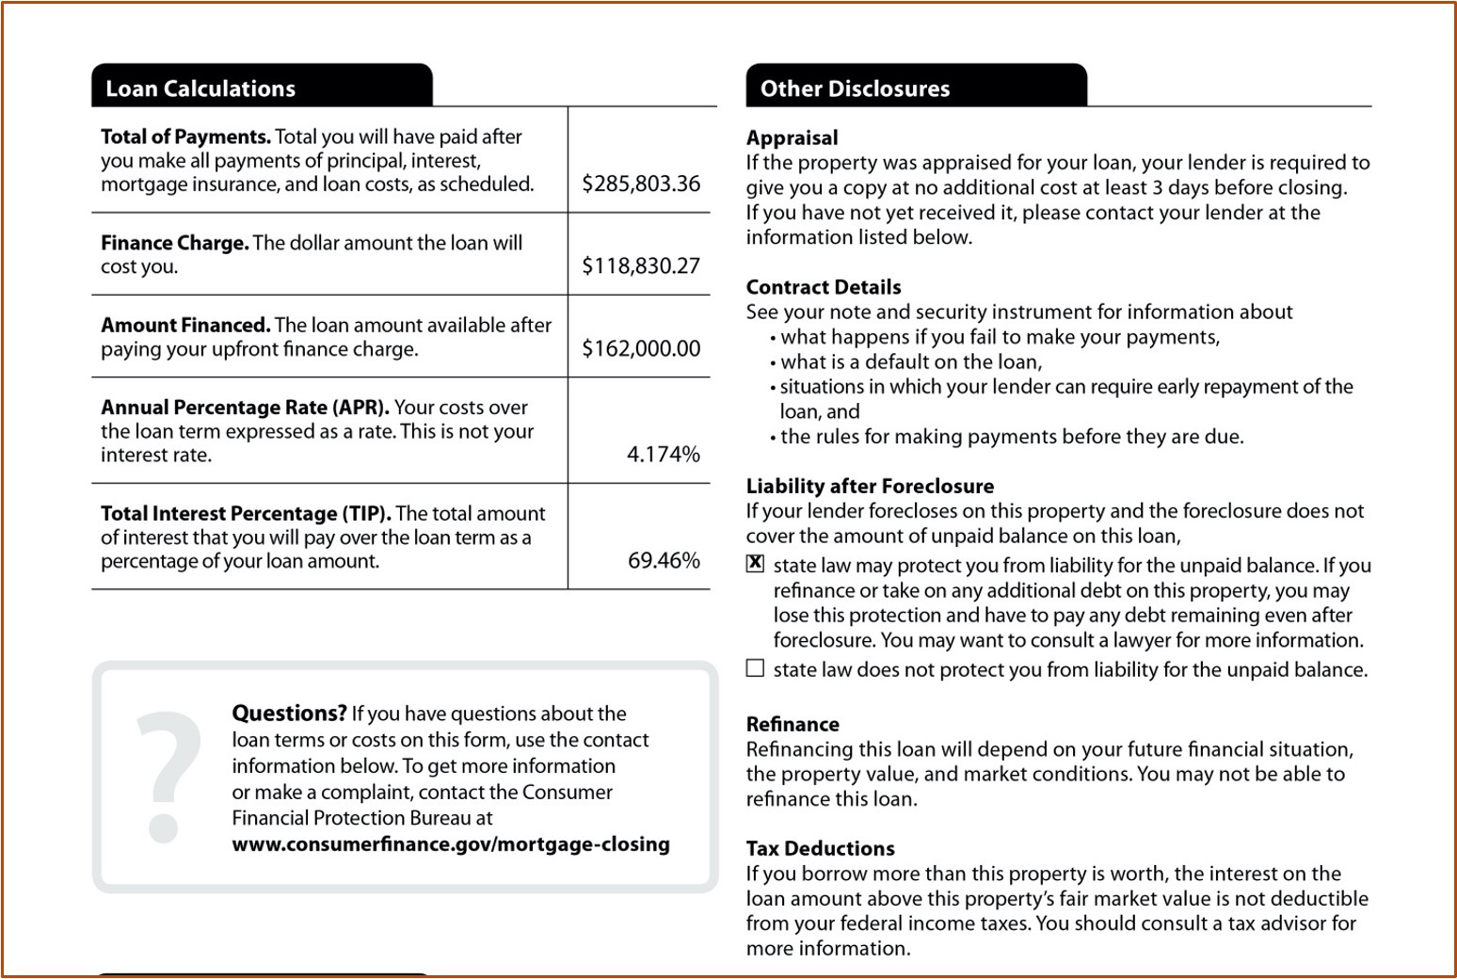

Slide 36
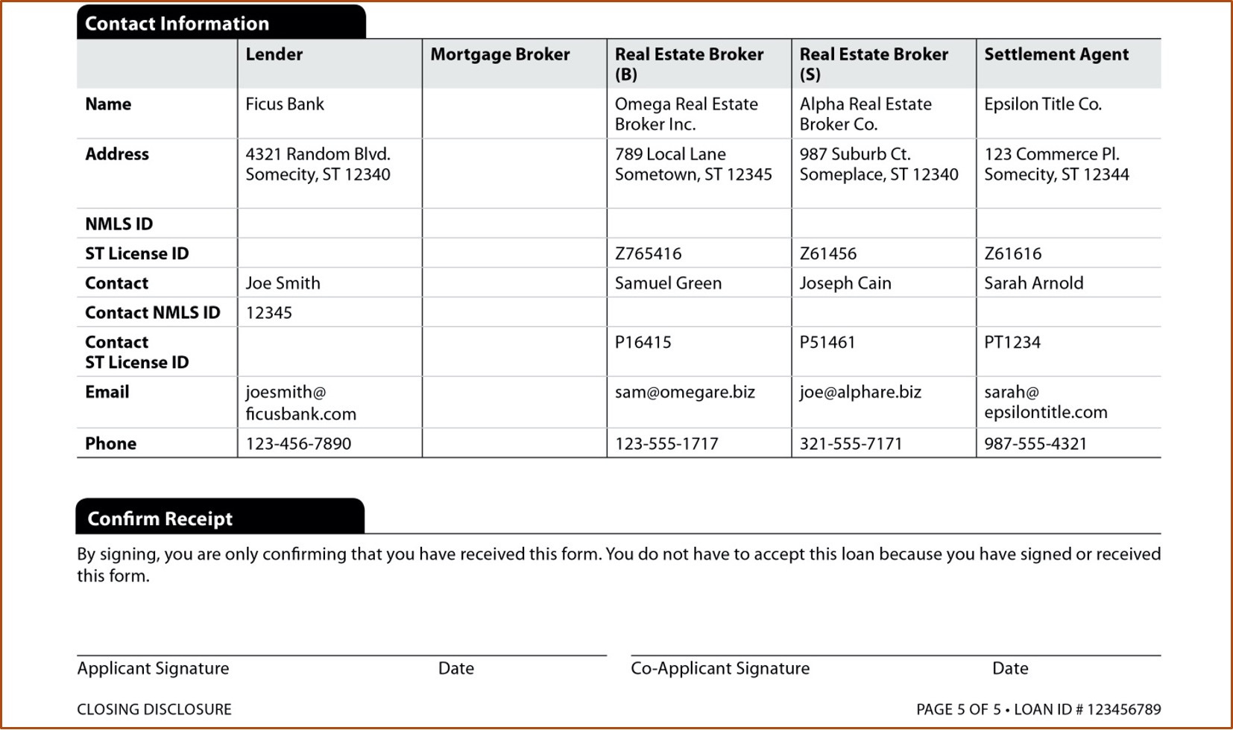

Slide 37
The Truth in Lending Act and RESPA
  Under RESPA, no seller of property may require, as a condition of selling the property, that title insurance be purchased by the Buyer from any particular title insurance company.
  In a traditional Colorado transaction, the seller agrees to pay for the title insurance policy and may therefore select the title company.
pg. 537

Slide 38
The Truth in Lending Act and RESPA
  The purchase of a mortgagee’s title policy does not involve the seller, but rather, the lender imposes this requirement on the borrower.
  A buyer normally purchases a mortgagee’s title policy from the same title company used by the seller because it costs less than buying it from another title company.
pg. 537

Slide 39
The Truth in Lending Act and RESPA
  A buyer cannot be forced to acquire the mortgagee’s policy from the same title company that is providing the owner’s policy.
pg. 537

Slide 40
Withholding
  I.R.S. Reporting - Generally, a transaction that consists in whole or in part of a sale or exchange for money, indebtedness, property, or services, or any present or future ownership interest must be reported to the IRS on Form 1099S.
pg. 537

Slide 41
Withholding
  Nonresident Seller Withholding - When the seller is not a resident of Colorado, state law requires that income tax be withheld for sales in excess of $100,000. The withholding is 2% of the sales price or the entire “net proceeds,” whichever is less.
pg. 538

Slide 42
Withholding
  Foreign Investor Real Property Tax Act (FIRPTA) - Requires that if the seller is a foreign person, the closer must deduct and withhold a tax equal to 15% of the amount realized on the disposition. The amount withheld must be 15% of the amount realized or the seller’s maximum tax liability, whichever is less.
pg. 538

Slide 43
Good Funds
  In Colorado, on the settlement date all parties, including the broker, buyer, lender, and sometimes the seller, must furnish good funds for all amounts due by the responsible party.
  No disbursements may be made until all funds are available for immediate withdrawal as “good funds.”
pg. 539

Slide 44
Good Funds
  Disbursements from closing may be made only after the closing entity has received good funds.
  Good funds are considered to be electronic wire; certified, cashier’s, or teller’s checks; and other funds that are either received in sufficient time prior to closing to be eligible for immediate withdrawal or are guaranteed by the depository on which they are drawn.
pg. 539

Slide 45
A title insurance company closing a transaction is solely responsible for the accuracy of the figures on the Closing Statement for the closing.
1) True
2) False

Slide 46
A title insurance company closing a transaction is solely responsible for the accuracy of the figures on the Closing Statement for the closing.
1) True
2) False

Slide 47
Who is primarily responsible for the seller’s statement of settlement?
1) The title insurance company closing the transaction.
2) The designated Buyer’s Broker.
3) The designated Listing Broker.
4) The new lender closing department.

Slide 48
Who is primarily responsible for the seller’s statement of settlement?
1) The title insurance company closing the transaction.
2) The designated Buyer’s Broker.
3) The designated Listing Broker.
4) The new lender closing department.

Slide 49
A title company or brokerage firm check would be considered good funds.
1) True
2) False

Slide 50
A title company or brokerage firm check would be considered good funds.
1) True
2) False

Slide 51
If a listing broker cannot attend closing and sends another broker in her place, only the broker who attends the closing has responsibility.
1) True
2) False

Slide 52
If a listing broker cannot attend closing and sends another broker in her place, only the broker who attends the closing has responsibility.
1) True
2) False

Slide 53
A property sold for $200,000 but was heavily encumbered. The left the seller with only $4,500 cash proceeds at the closing. The Seller is an out-of-state investor and is subject to the Colorado Department of Revenue income tax withholding. How much should the closing company withhold?
1) $90
2) $4,000
3) $4,500
4) $6,000

Slide 54
A property sold for $200,000 but was heavily encumbered. The left the seller with only $4,500 cash proceeds at the closing. The Seller is an out-of-state investor and is subject to the Colorado Department of Revenue income tax withholding. How much should the closing company withhold?
1) $90
2) $4,000
3) $4,500
4) $6,000

Slide 55
The Closing Instructions form can be completed as part of the offer.
1) True
2) False

Slide 56
The Closing Instructions form can be completed as part of the offer.
1) True
2) False

Slide 57
Good funds could be a certificate of deposit or money market check.
1) True
2) False

Slide 58
Good funds could be a certificate of deposit or money market check.
1) True
2) False

Slide 59
The Statement of Settlement prepared for the closing must be signed by
1) Only the Seller or Buyer.
2) The Buyers and/or the Sellers and the brokers
associated with the transaction.
3) Both Employing Brokers.
4) The buyer, seller, closing company and listing broker
on each form.

Slide 60
The Statement of Settlement prepared for the closing must be signed by
1) Only the Seller or Buyer.
2) The Buyers and/or the Sellers and the brokers
associated with the transaction.
3) Both Employing Brokers.
4) The buyer, seller, closing company and listing broker
on each form.

