Slide 1


Slide 2

National Law and practice
Chapter 9 – Contract Law

Slide 3
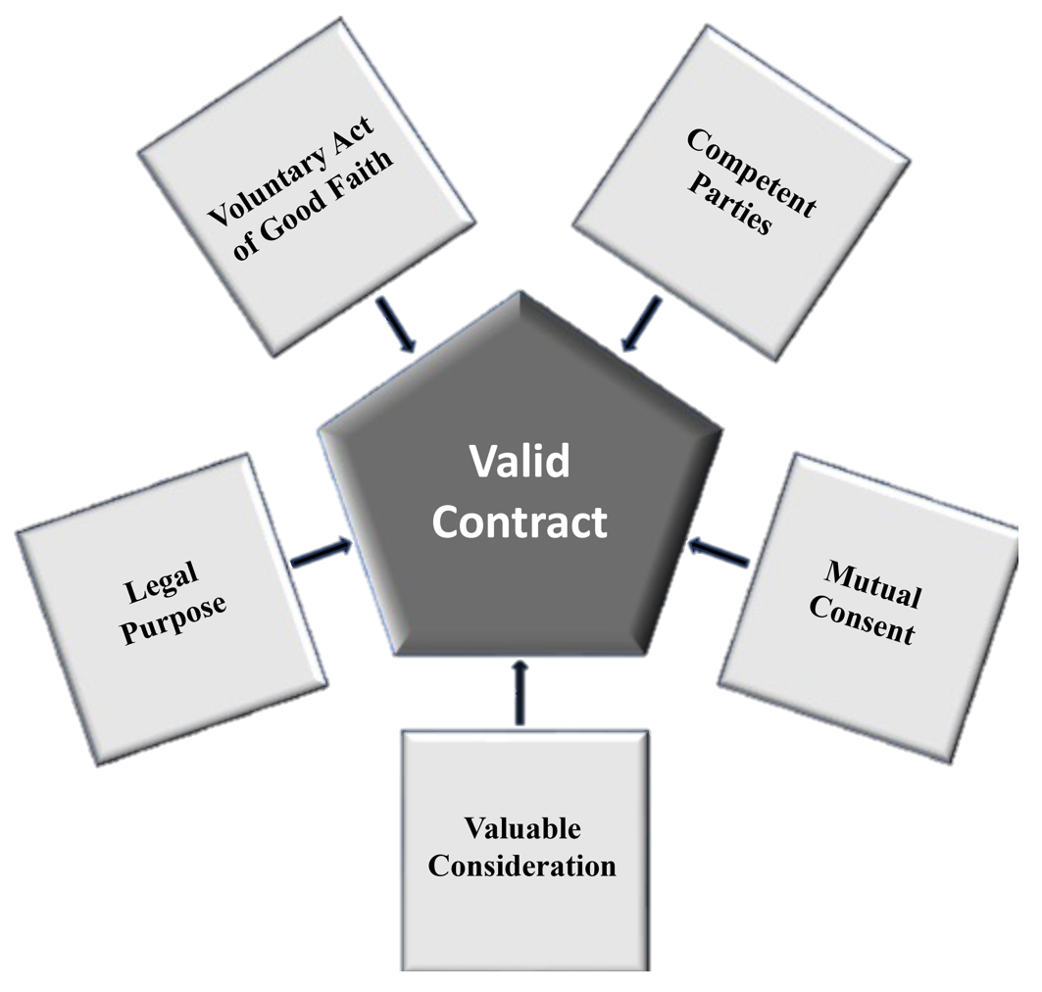
Contract Law – General Contract Law Concepts
Requirements for Contract Validity (Valid Contract)
Competent Parties
Must have capacity to contract
Legal Age
Mental Capacity
Legitimate Authority
Must be at least two parties
Pg. 245

Slide 4
Contract Law – General Contract Law Concepts
Requirements for Contract Validity (Valid Contract)
Mutual Consent
Also known as Offer and Acceptance,
Meeting of the Minds, & Mutual Agreement.
Requires a contract to have a clear and
definite offer and an unqualified acceptance
of the offer.
A court may nullify a contract where the
acceptance of terms was vague.
Pg. 245

Slide 5
Contract Law – General Contract Law Concepts
Requirements for Contract Validity (Valid Contract)
Valuable Consideration – “The Promise”
A contract must contain a two-way exchange
which is used as compensation for the
performance of the other party.
Valuable Consideration – something of
tangible value.
Good Consideration – something of intangible
value. (i.e. Love and Affection) – Not for real
estate transactions.
Pg. 245

Slide 6
Contract Law – General Contract Law Concepts
Requirements for Contract Validity (Valid Contract)
Legal Purpose / Lawful Objective
The content, promise, or intent of a contract
must be lawful.
A contract that proposes an illegal purpose is
void.
Pg. 246

Slide 7
Contract Law – General Contract Law Concepts
Requirements for Contract Validity (Valid Contract)
Voluntary Act of Good Faith
Parties must create the contract in good faith
as a free and voluntary act.
A contract may be voidable if a party to the
contract acted under duress, coercion, fraud
or misrepresentation.
Pg. 246

Slide 8
Contract Law – General Contract Law Concepts
Void, Voidable, and Unenforceable Contracts
Void Contract
A void contract is an agreement that does not meet the standards
for validity (Valid Contract)
There is no contract.
Neither party, nor the court can enforce the contract.
Pg. 246

Slide 9
Contract Law – General Contract Law Concepts
Void, Voidable, and Unenforceable Contracts
Voidable Contract
A voidable contract is one which initially appears to be valid.
Subject to recession of one of the parties to the contract who is
deemed to have acted under some kind of disability. Only the party who claims the disability may rescind the legal effect of the contract.
* Minor (limited contractual capacity * Duress
* Misrepresentation * Fraud
Pg. 246

Slide 10
Contract Law – General Contract Law Concepts
Void, Voidable, and Unenforceable Contracts
Voidable Contract
The rescission must occur within a legal time frame for the recission
to be valid. (Statute of Limitations)
If the party who could disaffirm the contract chooses to perform the
contract, the contract is no longer voidable but valid.
Pg. 247

Slide 11
Contract Law – General Contract Law Concepts
Void, Voidable, and Unenforceable Contracts
Unenforceable Contract
An unenforceable contract is a contract which cannot be
enforced in a court of law.
Unenforceable does not mean void. (As a void contract was
NEVER A CONTRACT.)
An unenforceable contract appears to be valid, but neither party
may sue the other to force performance.
Pg. 247

Slide 12
Contract Law – General Contract Law Concepts
In order to be enforceable a contract must be in writing according to the Statute of Frauds.
Contracts should contain a valid legal description of the property.
Pg. 246

Slide 13
Contract Law – General Contract Law Concepts
Factors Affecting Enforceability of Contracts
Most state laws declare that some contracts are enforceable only if they are in writing.
While an oral contract may meet the test for validity the court would not be able to enforce the performance of the contract by the parties.
Statute of Frauds – requires that certain contracts must be in writing to be enforceable.
Real estate contracts that convey real property.
Pg. 247

Slide 14
Contract Law – General Contract Law Concepts
Rights and Obligations to Parties to a Contract
Contract obligations are those duties that each party is legally responsible for in a contract agreement.
In a real estate contract, the buyer receives an Equitable Title interest in the contracted property.
- This equitable title interest prohibits the seller from selling the
property to another purchaser while the contract remains in effect.
Pg. 247

Slide 15
Contract Law – General Contract Law Concepts
Rights and Obligations to Parties to a Contract
All parties to a contract agree to act in good faith performing the terms of the contract.
Buyer agrees to purchase the property.
Seller agrees to sell the property to the buyer.
Lack of adherence to contract terms can create financial penalties for non-performance.
Pg. 247

Slide 16
Contract Law – General Contract Law Concepts
Bilateral vs. Unilateral Contracts (Option Agreements)
Bilateral Contract - Both parties promise to do something.
One promise is given in exchange for another.
Unilateral Contract - Only one party makes a promise. If the second party complies, the first party is obligated to keep the promise.
Examples: Open Listing Agreement, Option Agreement
Pg. 248

Slide 17
Contract Law – General Contract Law Concepts
Bilateral vs. Unilateral Contracts (Option Agreements)
Options
Unilateral contract by which the optionor (owner) give the optionee (prospective buyer) the right to buy at a fixed price within a stated period of time.
The optionee pays the fee for the option rights and assumes no obligation to make any other payment until the optionee decides, within a specified time, to either exercise the option right or allow it to expire.
Pg. 248

Slide 18
Contract Law – General Contract Law Concepts
Expressed and Implied, Executory and Executed
Expressed Contract - parties state terms and show intentions in words.
May be either oral or written.
Real estate contracts are typically express written agreements.
Implied Contract - agreement is demonstrated by acts and conduct.
Pg. 248

Slide 19
Contract Law – General Contract Law Concepts
Expressed and Implied, Executory and Executed
Executory Contract - A contract in which something remains to be done by one or both parties.
The period from when the offer is accepted until the contract closes.
Executed Contract - both parties have fulfilled their promises and thus performed the contract.
Pg. 249

Slide 20
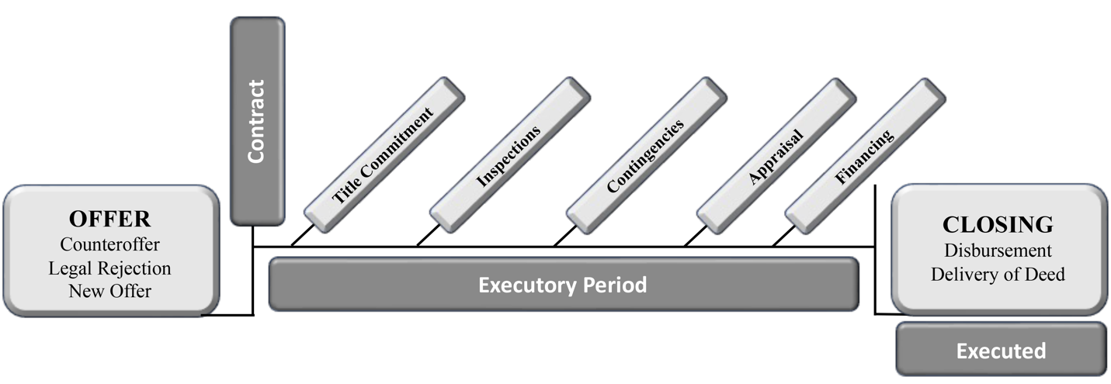
Contract Law – Purchase Agreement Offers and Counteroffers
Notice, Delivery and Acceptance of Contracts
The offer proposes contract terms in an offer to the offeree.
If the offeree accepts all terms without amendment, the offer becomes a contract.
The exact point at which the offer becomes a contract is when the offeree gives the offeror notice of the acceptance.
Pg. 249

Slide 21
Contract Law – Purchase Agreement Offers and Counteroffers
Notice, Delivery and Acceptance of Contracts
Offer – An offer expresses the offeror’s intention to enter into a contract with an offeree to perform the terms of the agreement.
If an offer contains an expiration date and the phrase “time is of the essence,” the offer expires at exactly the time specified.
In the absence of a stated time period the offeree has a “reasonable” time to accept an offer.
Pg. 249

Slide 22
Contract Law – Purchase Agreement Offers and Counteroffers
Notice, Delivery and Acceptance of Contracts
Acceptance – For an acceptance to be valid, the offeree must unequivocally accept the terms of the offer without change and indicate that by signing the offer.
The acceptance must be communicated to the offeror.
Any changes made to the offer would constitute a counteroffer.
A counteroffer terminates the original offer.
Pg. 249

Slide 23
Contract Law – Purchase Agreement Offers and Counteroffers
Notice, Delivery and Acceptance of Contracts
Revocation of an Offer
An offer may be revoked, or withdrawn, at any time before the offeree has communicated acceptance.
The revocation extinguishes the offer and offeree’s right to accept.
Pg. 250

Slide 24
Contract Law – Purchase Agreement Offers and Counteroffers
Notice, Delivery and Acceptance of Contracts
Termination of an Offer
The offer may be terminated by any of the following actions or circumstances:
Acceptance The offer expires
Rejection Counteroffer
Revocation Death or Insanity of either party
Pg. 250

Slide 25
Contract Law – Purchase Agreement Offers and Counteroffers
Notice, Delivery and Acceptance of Contracts
Electronic Signature and Paperless Transaction
The E-Sign Act is a federal law that passed in 2000.
Grants legal recognition to electronic signatures and records if all parties to the contract choose to use electronic documents and to sign them electronically.
Parties to the agreement would have to agree to utilize electronic signatures or electronic transmission of documents. Usually agreed to by all the parties in the sales contract.
Pg. 251

Slide 26
Contract Law – Sales Contracts
Earnest Money
A deposit collected from the buyer at time of contracting.
Held in a separate trust or escrow account.
Provides compensation for damages to the seller if the buyer defaults.
Can be utilized for closing costs or down payment, but is NOT considered “Consideration”
Pg. 252

Slide 27
Contract Law – Sales Contracts
Clauses or Contingencies
Conditions in a contract that require a certain event or events to happen before the contract is complete.
Contingency clauses have three distinguishing features:
Actions needed to satisfy the contingency
Time frame within which the actions must be performed
Statement identifying who will be responsible for costs, etc.
Pg. 252

Slide 28
Contract Law – Sales Contracts
Addenda
Become binding components of the overall agreement.
If something is added to the contract as an addendum it must always remain with the sales contract and be provided to any party who receives a copy of the contract.
Pg. 252

Slide 29
Contract Law – Sales Contracts
Amendments
Changes the terms or conditions of the original agreed upon contract and must be completed in writing and agreed to by all parties (via their signatures).
All parties (buyer, seller, lender, attorneys, title companies, etc.) who are utilizing the contract for completion of the closing must receive a copy of any amendments to the contract.
Pg. 252

Slide 30
Contract Law – Sales Contracts
Breach of Contract (and remedies for breach)
Breach of contract – the failure, without legal excuse, of one of the parties to a contract to perform according to the contract.
Remedies for breach if the seller defaults:
1. Rescind or terminate the contract and recover the earnest money.
2. Sue the seller for damages.
3. Sue the seller for Specific Performance.
Pg. 253

Slide 31
Contract Law – Sales Contracts
Breach of Contract (and remedies for breach)
Breach of contract – the failure, without legal excuse, of one of the parties to a contract to perform according to the contract.
Remedies for breach if the buyer defaults:
1. Declare the contract forfeited.
2. Rescind the contract and keep all or part of the deposit as Liquidated Damages.
3. Sue the buyer for Specific Performance (if the contract allows for it).
4. Sue the buyer for damages.
Pg. 253

Slide 32
Contract Law – Sales Contracts
Assignment
The transfer of the rights (but not the liability) in a real estate contract from an original party to another party.
(In National Only) Sales contracts are considered assignable unless the assignment is specifically prohibited in the contract.
The process of assignment may also require a novation.
NOVATION – replacing someone or something in a contract with someone or something else. It transfers the right AND liability in a real estate contract from the original party to another party.
Pg. 253

Slide 33
Contract Law – Sales Contracts
Termination, Rescission and Cancellation of Contracts
Termination of a contract (also called cancellation or discharge) may occur for any of the following causes:
  Performance – a contract terminates when fully performed by the parties.
  Infeasibility - a contract may be cancelled if it is not possible to perform.
  Mutual Agreement – parties to a contract can agree to terminate a contract.
  Rescission – the act of cancelling or nullifying a contract.
    - A damaged party may be able to rescind a contract.
    - A rescission returns the parties to their pre-contract condition including
    the refunding of any monies that have already be transferred.
Pg. 253

Slide 34
Contract Law – Sales Contracts
Termination, Rescission and Cancellation of Contracts
Termination of a contract (also called cancellation or discharge) may occur for any of the following causes:
  Revocation – cancellation of the contract by one party without the consent of
  the other. In the absence of justifiable grounds, a revocation may not relieve
  the revoking party of contract obligations.
  Abandonment – occurs when parties fail to perform contract obligations. This could allow the parties to cancel the contract.
  Lapse of Time – If a contract contains an expiration provision and date, the contract automatically expires on the deadline
Pg. 254

Slide 35
Contract Law – Other Real Estate Contracts
Option to Buy
Unilateral agreement
Seller (optionor) give the buyer (optionee) the right to purchase property at a given price and terms for a set period. Optionee pays a price for the option (option fee).
The Optionee is under no obligation to buy.
The Optionor must sell if the optionee exercises their option.
The Optionee enjoys an equitable title interest.
Pg. 254

Slide 36
Contract Law – Other Real Estate Contracts
Installment/Land Contracts, Contracts for Deed
Bilateral agreement
Buyer (Vendee) gives the seller (Vendor) a nominal down payment for the contract.
Seller retains legal title / buyer receives equitable title.
Buyer makes payments with interest to seller over the life of the contract.
Seller delivers the deed (legal title) to buyer once all payments have been made.
Pg. 255

Slide 37
Contract Law – Listing / Buyer Representation contracts
Listing Contract – a contract between an owner (principal) and a licensed real estate brokerage by which the brokerage is employed to list and sell real estate on the owner’s terms within a given time, for which the owner agrees to pay a fee (commission).
General requirements of a valid listing contract:
1. Be in writing and enforceable.
2. State the exact amount of commission to be earned by the broker.
3. Specify a termination date for the agreement.
4. State the price of the real estate and terms of the sale.
5. Include a legal description of the property.
6. List the name of the Broker/Brokerage Firm.
7. Have (at least) the principal’s signature authorizing the agency and the payment of
the commission when earned.
Pg. 256

Slide 38
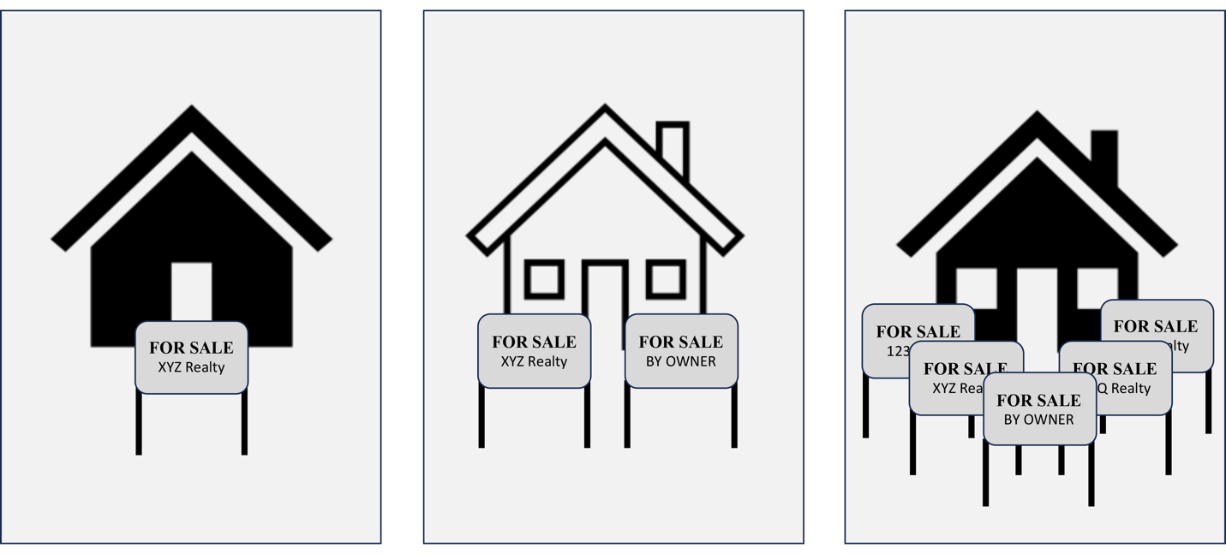
Contract Law – Listing / Buyer Representation contracts
Exclusive Listings
Exclusive Right-to-Sell – one brokerage is given the exclusive right to sell the property.
The seller gives up the right to sell the property without paying the broker’s commission.
The brokerage receives the commission regardless of who sells the property.
Pg. 256

Slide 39
Contract Law – Listing / Buyer Representation contracts
Exclusive Listings
Exclusive Agency – Only one brokerage is authorized to act as the exclusive agent of the principal.
However, the seller retains the right to sell the property without any obligation to the brokerage.
The brokerage receives a commission only if its firm is the procuring cause or caused the sale to happen.
Pg. 256

Slide 40
Contract Law – Listing / Buyer Representation contracts
Non-Exclusive Listings
Open Listing – The Seller may employ any number of brokerage firms.
The seller is obligated to pay a commission only to the brokerage who produces a buyer (procuring cause.)
If the seller personally sells the property, without the aid of any broker, the seller is not obligated to pay a commission.
Pg. 257

Slide 41
Contract Law – Listing / Buyer Representation contracts
Non-Exclusive Listings
Net Listing – A listing which states a minimum sale or lease price the owner will accept, with any excess going to the broker as a commission.
Illegal in many states and/or professionally discouraged.
Pg. 257

Slide 42
Contract Law – Listing / Buyer Representation contracts
Buyer Brokerage / Tenant Representation Contracts
Unless agreed that the seller pays the commission, the buyer or tenant must compensate their representative whenever purchasing or renting a property.
Agreement entered into which describes the type of property sought, and the term of the representation agreement. Very much like a listing contract with a seller.
Pg. 258

Slide 43
Contract Law – Listing / Buyer Representation contracts
Buyer Brokerage / Tenant Representation Contracts
Buyer Broker can be compensated in many ways:
Retainer fee – gives buyer or tenant incentive to perform the contract.
The fee may be refundable or nonrefundable.
Flat or Fixed Fee – the fee can be paid by the buyer or tenant or as a co-op fee by the
seller or landlord.
Hourly Fee
Percentage Fee - can be a percent of sales or rent price or an MLS co-op fee.
Pg. 258

Slide 44
Contract Law – Listing / Buyer Representation contracts
Termination of Listing Agreements
Listing agreements can terminate for:
1. Completion of the agreement (Sale of the property)
2. Mutual agreement to terminate the relationship between the parties.
3. Death, incapacity, bankruptcy of Broker/Brokerage or Principal.
4. Expiration of the agreement.
5. Abandonment by the Broker.
6. Condemnation (Eminent Domain) of the Property.
7. Destruction of the Property
8. Foreclosure
Pg. 258

Slide 45
A valid contract must have mutual consent, also known as meeting of minds, mutual agreement, or offer, acceptance and communication of acceptance.
1) True
2) False

Slide 46
A valid contract must have mutual consent, also known as meeting of minds, mutual agreement, or offer, acceptance and communication of acceptance.
1) True
2) False

Slide 47
A buyer agrees to all terms of a seller’s counteroffer except price. The buyer lowers the price by $1,000, signs the form, and mails it back to the seller. At this point, the seller’s offer
1) Is void.
2) Becomes an executory contract.
3) Becomes a counteroffer.
4) Has been accepted.

Slide 48
A buyer agrees to all terms of a seller’s counteroffer except price. The buyer lowers the price by $1,000, signs the form, and mails it back to the seller. At this point, the seller’s offer
1) Is void.
2) Becomes an executory contract.
3) Becomes a counteroffer.
4) Has been accepted.

Slide 49
According to contract law, every valid contract is also
1) void.
2) enforceable.
3) Enforceable or unenforceable.
4) voidable.

Slide 50
According to contract law, every valid contract is also
1) void.
2) enforceable.
3) Enforceable or unenforceable.
4) voidable.

Slide 51
A buyer signs an earnest money agreement and gives it to the broker who showed her the property she is buying. After leaving the broker’s office, she reconsiders and decides she prefers a different property. How long does she have to take back her offer?
1) Until the seller communicates acceptance of the offer.
2) Twenty-four hours.
3) She can take it back at any time but must forfeit the earnest
money.
4) She cannot take it back until after the expiration date of the
offer.

Slide 52
A buyer signs an earnest money agreement and gives it to the broker who showed her the property she is buying. After leaving the broker’s office, she reconsiders and decides she prefers a different property. How long does she have to take back her offer?
1) Until the seller communicates acceptance of the offer.
2) Twenty-four hours.
3) She can take it back at any time but must forfeit the earnest
money.
4) She cannot take it back until after the expiration date of the
offer.

Slide 53
A contract to buy land is voidable if:
1) The purchaser is a minor.
2) The purchase has been adjudicated insane.
3) The contract was signed by an attorney-in-fact.
4) The purchaser and seller are related parties.

Slide 54
A contract to buy land is voidable if:
1) The purchaser is a minor.
2) The purchase has been adjudicated insane.
3) The contract was signed by an attorney-in-fact.
4) The purchaser and seller are related parties.

Slide 55
During the period of time after a real estate sales contract is signed, but before title actually passes, the status of the contract is
1) voidable.
2) executory.
3) unilateral.
4) implied.

Slide 56
During the period of time after a real estate sales contract is signed, but before title actually passes, the status of the contract is
1) voidable.
2) executory.
3) unilateral.
4) implied.

Slide 57
A contract in which the intentions of the parties are shown by their actions is
1) An expressed contract.
2) An implied contract.
3) An executory contract.
4) A bilateral contract.

Slide 58
A contract in which the intentions of the parties are shown by their actions is
1) An expressed contract.
2) An implied contract.
3) An executory contract.
4) A bilateral contract.

Slide 59
If a party to an offer dies, the offer remains in place.
1) True
2) False

Slide 60
If a party to an offer dies, the offer remains in place.
1) True
2) False

Slide 61
An important legal characteristic of an option-to-buy agreement is that
1) The potential buyer, the optionee, is obligated to buy the property once the option agreement is completed.
2) The optionor must perform if the optionee takes the option, but the optionee is under no obligation to do so.
3) The contract can be executed at no cost to the optionee.
4) It is a bilateral agreement.

Slide 62
An important legal characteristic of an option-to-buy agreement is that
1) The potential buyer, the optionee, is obligated to buy the property once the option agreement is completed.
2) The optionor must perform if the optionee takes the option, but the optionee is under no obligation to do so.
3) The contract can be executed at no cost to the optionee.
4) It is a bilateral agreement.

Slide 63
A buyer makes an offer on a seller’s house and the seller accepts. Both parties sign the sales contract. At this point, the buyer has what type of title to the property?
1) Voidable.
2) Escrow.
3) Equitable.
4) Contract.

Slide 64
A buyer makes an offer on a seller’s house and the seller accepts. Both parties sign the sales contract. At this point, the buyer has what type of title to the property?
1) Voidable.
2) Escrow.
3) Equitable.
4) Contract.

Slide 65
An important distinction between a contract for deed and a contract for sale is
1) A contract for deed requires no action on the part of the seller.
2) A contract for deed requires no action on the part of the buyer.
3) The Seller retains legal title in a contract for deed transaction
until fully executed.
4) The buyer acquires legal title in a contract for deed transaction.

Slide 66
An important distinction between a contract for deed and a contract for sale is
1) A contract for deed requires no action on the part of the seller.
2) A contract for deed requires no action on the part of the buyer.
3) The Seller retains legal title in a contract for deed transaction
until fully executed.
4) The buyer acquires legal title in a contract for deed transaction.

Slide 67
All the following are essential to a valid real estate sales contract EXCEPT
1) An adequate description of the property.
2) Consideration.
3) An earnest money deposit, held in an escrow account.
4) Legally competent parties.

Slide 68
All the following are essential to a valid real estate sales contract EXCEPT
1) An adequate description of the property.
2) Consideration.
3) An earnest money deposit, held in an escrow account.
4) Legally competent parties.

