Slide 1


Slide 2

National Law and practice
Chapter 8 – Financing

Slide 3
Financing – Basic Concepts and Terminology
Purchase Price – the amount a property is purchased for.
Down Payment – the amount paid that is the difference
between the purchase price and the
loan amount.
Loan Amount – the amount financed.
Interest – the charge for financing. A percentage of the
loan amount.
Pg. 200

Slide 4
Financing – Basic Concepts and Terminology
Loan to Value (LTV) – the amount of the loan divided by the value of the property. [Leveraging]
Equity – the difference between the value of the property and all of its liens.
Appreciation – the property increasing in value through market changes.
Hypothecation – pledging property as security for the loan without losing ownership/possession of the property.
Pg. 201

Slide 5
Financing – The Paperwork
Mortgage or Deed of Trust – documents that pledges the property as collateral for the debt.
Both contain a Promissory Note
and agreements that collateralize the property.
Pg. 201

Slide 6
Financing – The Paperwork
Promissory Note:
- Signed by the borrower (mortgagor/trustor).
- States the debt amount, loan term, method and timing of
repayment, interest rate, and a promise to pay.
- Assignable
Pg. 202

Slide 7
Financing – The Paperwork
Clauses:
- Defines payment of principal and interest, prepayment, late charges, escrows for taxes and insurance, liens, insurance requirements, occupancy, lender’s rights, private mortgage, etc.
Pg. 202

Slide 8
Financing – The Paperwork
Clauses:
- Release of Indebtedness
1. Defeasance Clause – States that when the mortgage is
satisfied, the mortgagee executes a satisfaction or
release of mortgage.
2. Release Deed or Reconveyance Deed – document utilized in a Deed of Trust
Pg. 203

Slide 9
Financing – The Paperwork
Clauses:
- Alienation (Due on Sale) Clause
If the borrower sells the property, the lender has the choice
of either declaring the entire debt due and payable or
allowing the buyer to assume the loan.
- Acceleration Clause
Allows the lender to call the note due before the
scheduled end of the term. (Judicial Foreclosure pg. 221)
Pg. 204

Slide 10
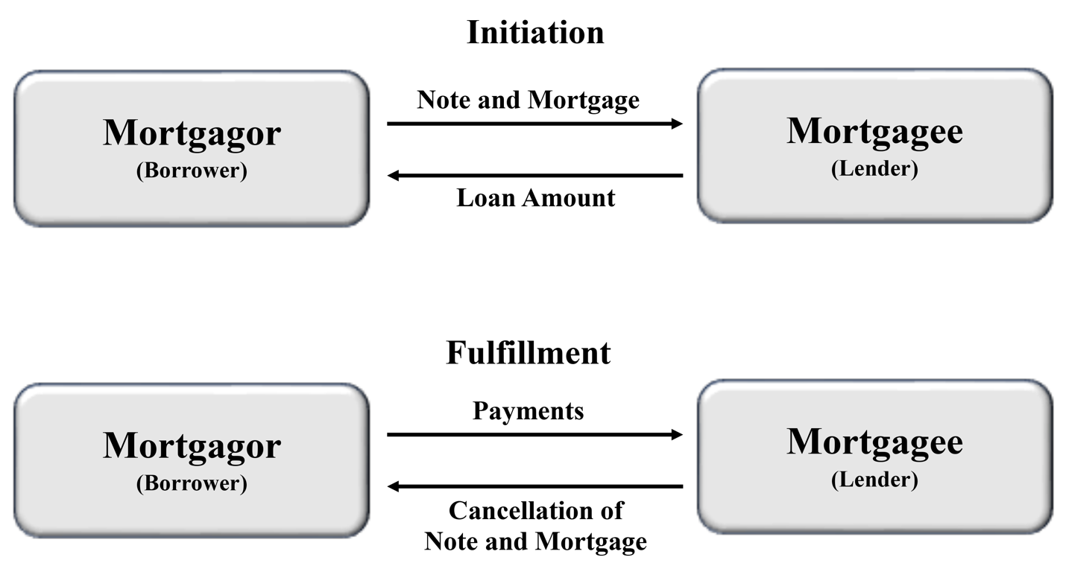
Financing – The Paperwork
A Mortgage is a two-party document between the mortgagor (borrower) and the mortgagee (lender).
Pg. 202

Slide 11
Financing – The Paperwork
A Deed of Trust is a three-party document.
- Conveys title from the trustor (borrower) to a third-party Trustee who
holds title on behalf of the beneficiary (lender.)
- Public Trustee – either an elected or appointed county government
position.
- Private Trustee - could be an attorney
- Trustor signs a deed of trust, which is given to the public or private
trustee.
Pg. 203

Slide 12
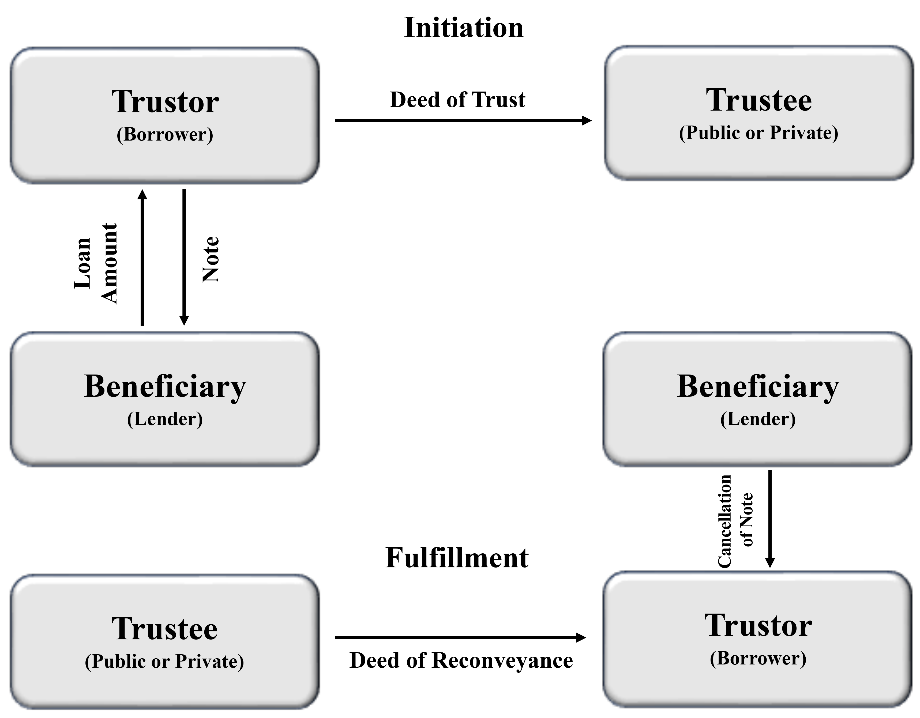
Financing – The Paperwork
Pg. 203

Slide 13
Financing – Understanding monthly mortgage payments
Principal – the amount of the loan.
Interest Rate – percentage of the loan amount that must
be repaid.
- Usually calculated on an annual basis.
- Rates float with the open market and are negotiable
with the lender originating the loan.
- Charging an interest in excess of the maximum rate
allowed by state law is called usury and is illegal.
Pg. 204

Slide 14
Financing – math
(Interest Calculations)
Formula:
IRP
I = Annual Interest Dollars
R = Rate of Interest
P = Principal
I
Unless a Problem states otherwise always use:
  Simple Interest (Not compound)
  30 days in every month
  360 days in a year
R
P
Pg. 205

Slide 15
Financing – math
(Interest Calculations) – Problem #1
Formula:
IRP
Mark owes $120,000 at 7% interest to First national bank. How much money will he pay in interest in one year?
Step 1 – Place the known information into the circle formula.
I
???
R (Rate) = .07
P (Principal) = $120,000
R
P
7% (.07)
$120,000
120,000 x .07 = $8,400 (Annual Interest)
Pg. 205

Slide 16
Financing – math
(Interest Calculations) – Problem #2
Formula:
IRP
A $325,000 mortgage has quarterly interest payments of $5,281.25. What is the interest rate?
Step 1 – Determine the annual interest by multiplying $5,281.25 x 4 = $21,125 (annual)
I
21,125
Step 2 – Place the known information into the circle formula
R
P
I (Interest) = 21,125
P (Principal) = $325,000
????
$325,000
21,125 ÷ 325,000 = .065 or 6.5% (interest rate)
Pg. 206

Slide 17
Financing – Understanding monthly mortgage payments
P & I (Principal and Interest)Payment – monthly payment to the lender that includes both principal and interest.
Amortized Loans – a loan which has been configured so that at the end of the loan’s term all interest and the full amount of principal due have been paid.
- Monthly payments don’t change over the life of an
amortized loan.
- A portion of each payment is applied to interest and then
the remainder to principal.
Pg. 206

Slide 18
Financing – math
(Interest Calculations) – Problem #3
Formula:
IRP
Mark owes $120,000 at 7% interest to First National Bank. Mark’s monthly P & I payment is $850. What will be his principal balance after his second monthly payment?
Step 1 – Place the known information into the formula
I
R (Rate) = .07
P (Principal) = $120,000
????
120,000 x .07 = $8,400 (Annual Interest)
R
P
8,400 ÷ 12 = $700 (monthly interest)
.07
$120,000
Step 2 – Marks monthly payment is $850
Marks monthly interest is $700 therefore $150 is applied to Principal in the first payment
$120,000 - $150 = $119,850 (Remaining Principal)
Pg. 207

Slide 19
Financing – math
(Interest Calculations) – Problem #3
Formula:
IRP
Mark owes $120,000 at 7% interest to First National Bank. Mark’s monthly P & I payment is $850. What will be his principal balance after his second monthly payment?
Step 3 – Draw the formula again and place the updated Principal amount in the Principal section of the formula. The interest rate does not change
I
R (Rate) = .07
P (Principal) = $119,850
????
R
P
119,850 x .07 = $8,389.50 (Annual Interest)
.07
$119,850
8,389.50 ÷ 12 = $699.13 (monthly interest)
Step 4 – Marks monthly payment is $850
Marks monthly interest is $699.13 therefore $150.87 is applied to Principal in the first payment
$119,850 - $150.87 = $119,699.13
Pg. 207

Slide 20
Financing
(USING A Mortgage Factor Chart)
MONTHLY PAYMENT FACTORS (PER $1,000)
Rate | 15 Years | 30 Years
7.00% | $8.99 | $6.65
7.25% | 9.13 | 6.82
7.50% | 9.27 | 6.99
7.75% | 9.41 | 7.16
8.00% | 9.56 | 7.34
8.25% | 9.70 | 7.51
8.50% | 9.85 | 7.69
8.75% | 10.00 | 7.87
9.00% | 10.15 | 8.05
9.25% | 10.30 | 8.23
9.50% | 10.45 | 8.41
9.75% | 10.60 | 8.60
10.00% | 10.75 | 8.78
10.25% | 10.90 | 8.97
10.50% | 11.06 | 9.15
10.75% | 11.21 | 9.34
11.00% | 11.37 | 9.53
11.25% | 11.53 | 9.72
11.50% | 11.69 | 9.91
11.75% | 11.85 | 10.10
12.00% | 12.01 | 10.29
12.25% | 12.17 | 10.48
12.50% | 12.33 | 10.68
What is the monthly payment on a $60,000 loan at 9% for 30 years?
60 x 8.05 = $483
Pg. 208

Slide 21
Financing – Understanding monthly mortgage payments
PITI (Principal, Interest, Taxes, Insurance) – payment that includes the amount for principal, interest, and a monthly portion of the tax and insurance requirement.
Pg. 209

Slide 22
Financing – Understanding monthly mortgage payments
PMI (Private Mortgage Insurance) – protects enders against loss of a portion of a mortgage that exceeds the acceptable loan to value ratio.
- usually required on Conventional loans when less than 20% is
placed as a down payment.
- made part of the borrower’s monthly payment.
- As property values rise and the loan-to-value ratio becomes 80%
or less, the borrower can request the PMI be dropped.
Pg. 209

Slide 23
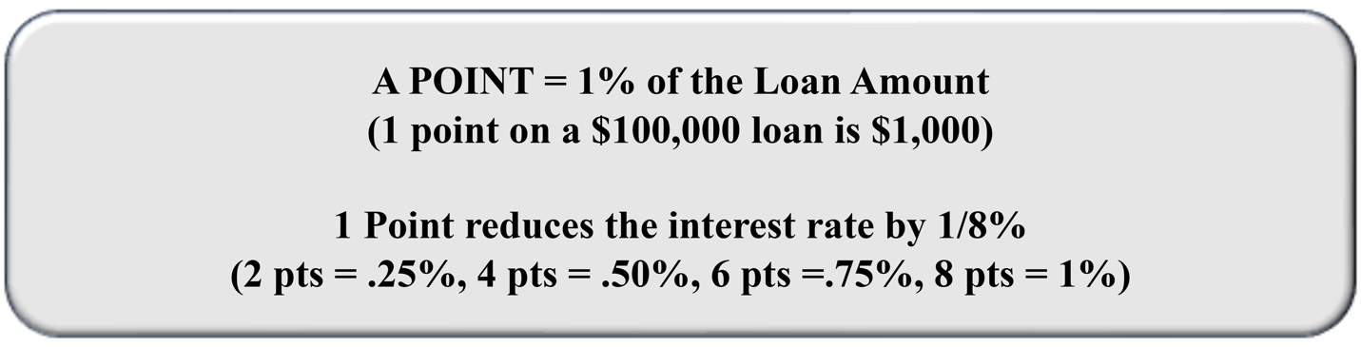
Financing – Understanding monthly mortgage payments
Points – an upfront payment utilized to buy down or lower interest rates.
Pg. 209

Slide 24
Financing – Types of Loans
Conventional – permanent loans that are not FHA or VA.
- Market rates determine loan’s interest rate.
- Qualification based on buyer’s ability to pay.
- Lender may require PMI (Private Mortgage Insurance) as
well as escrows for taxes and insurance.
- Usually requires an appraisal to determine value.
- Rarely assumable.
Pg. 210

Slide 25
Financing – Types of Loans
FHA (Federal Housing Authority) – INSURES lenders against loss on loans.
For new or existing one-to-four unit family housing.
Borrower must meet FHA standards.
Minimum 3.5% down payment.
Has a MIP (Mortgage Insurance Premium) – paid up front, which can be rolled into the loan, and a monthly amount, which cannot be financed. (Does not go away when the property has over 20% equity.)
Pg. 211

Slide 26
Financing – Types of Loans
FHA (Federal Housing Authority) – INSURES lenders against loss on loans.
Property must be appraised by an FHA appraiser.
No prepayment penalties.
Assumable with qualification.
Lender may charge discount points and a 1% loan origination fee.
Pg. 211

Slide 27
Financing – Types of Loans
VA (Veterans Affairs) – GUARANTEES home loans to lenders.
For entitled veterans or an un-remarried surviving spouse. (National Guard members and reservists with at least six years of service are also eligible for VA-guaranteed loans.)
Interest rate is set by the lender.
VA does not originate these loans.
VA guarantees a portion of the loan value to the lender.
Pg. 211

Slide 28
Financing – Types of Loans
VA (Veterans Affairs) – GUARANTEES home loans to lenders.
Loans can be 100% loan-to-value, requiring no down payment.
No limits on what can be borrowed by the veteran, but they will only guarantee a maximum of 25% of the county loan limit for loans over $144,000. (If the loan is above that limit, a down payment may be required.)
Pg. 211

Slide 29
Financing – Types of Loans
VA (Veterans Affairs) – GUARANTEES home loans to lenders.
VA funding fee may be required.
The property must be appraised by a VA approved appraiser.
  Completes a CRV (Certificate of Reasonable Value)
  VA’s guarantee is based on either the amount of the CRV or the selling price of the property, whichever is less.
Pg. 211

Slide 30
Financing – Types of Loans
VA (Veterans Affairs) – GUARANTEES home loans to lenders.
May be assumed by a veteran, qualified non-veteran, or by a qualified un-remarried surviving spouse.
No prepayment penalties.
Pg. 212

Slide 31
Financing – Types of Loans
USDA (United States Department of Agriculture) – offers loans, grants and guarantees.
For single and multi-family housing.
For low- and moderate-income rural Americans.
Loans and grants are also offered to make health and safety repairs to homes.
Some rental assistance is also offered through the program.
Pg. 212

Slide 32
Financing – Types of Loans
Partially Amortized Loan – payments are not enough to repay the entire debt. Results in a remaining balance at the end of the loan term.
Negative Amortized Loan – causes the loan balance to increase over the loan term.
Pg. 213

Slide 33
Financing – Types of Loans
Adjustable Rate Mortgage (ARM) – a variable interest rate loan. The lender is allowed to change the interest rate at determined intervals and be a specific amount. Federal regulations limit the amount of change that is allowed.
Interest Only Loans – payments only apply to the interest owed and not to principal. Full balance must be paid off at the end of the loan term (Balloon Payment).
Pg. 213

Slide 34
Financing – Types of Loans
Buydown Loan – Prepayment of interest on a loan, reducing the interest rate and the borrower’s periodic payments.
Wraparound – Seller receives a junior mortgage from the buyer and uses the buyer’s payments to make the original first mortgage’s payments. Only possible if the senior mortgage allows it and does not have an Alienation/Due on Sale Clause.
Pg. 213

Slide 35
Financing – Types of Loans
Home Equity Loan / Home Equity Line of Credit – a loan utilized to borrow against the accrued equity in a home.
Package Loan – finances the purchase of real estate and personal property.
Construction Loan – finances construction of improvements. Considered short-term, high risk, expensive financing.
Pg. 214

Slide 36
Financing – Types of Loans
Bridge Loan – used to cover the gap between construction financing and long-term financing. Considered short term financing.
Permanent (take out) Loan – a loan that “takes out” a construction or short-term lender.
Reverse Annuity – a homeowner pledges the equity in their home as security for a loan that is paid out in regular monthly amounts over its term to the homeowner.
Pg. 214

Slide 37
Financing – Types of Loans
Seller Financing (Purchase Money Mortgage) – a loan made by the seller to the buyer for all or part of the purchase price.
Contract for Deed / Land Contract / Installment Contract – an Installment sale where the seller finances the buyer and retains legal title until the contract terms are fully performed. Buyer receives the right to possess the property but does not receive the deed to the property until all the payments have been made.
Pg. 214

Slide 38
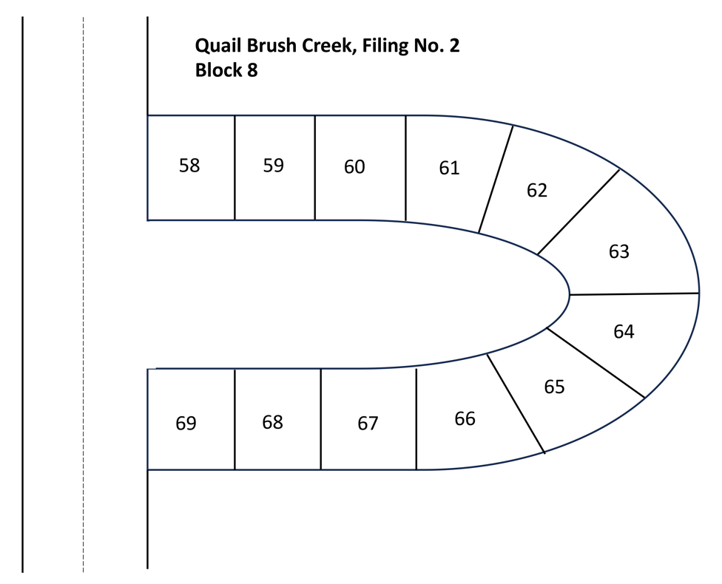

Financing – Types of Loans
Blanket Mortgage – a loan that covers more than one property or lot. Includes a partial release clause which allows sold lots to be removed from the indebtedness.
Pg. 215

Slide 39
Financing – The Lending Process
Borrower completes a loan application and submits for review.
Usually completed on the Uniform Residential Loan Application required for properties that would be sold to FNMA/FHLMC on the secondary market.
Borrower provides information on their age, employment history, assets, monthly income and expenses, and a credit report.
If an application is denied the lender must provide specific reasons for its denial.
Pg. 215

Slide 40
Financing – The Lending Process
Lender must rely on eight types of information to determine if the borrower can repay the loan (Qualified Borrower).
Current income or assets.
Current employment status.
Credit history.
Monthly payment for the mortgage.
Monthly payments being made on other loans on the same property.
Monthly payments for other mortgage related expenses.
Other debts.
Monthly debt payments compared to monthly income (Debt-To-Income ratio.)
Pg. 215

Slide 41
Financing – The Lending Process
Income Ratio – limits the percent of gross income a borrower may spend on housing costs (PITI and possible HOA fees, utilities, PMI)
Monthly housing expenses ÷ monthly gross income.
Most lenders require the ratio be no greater than 25% - 28%
FHA has a ratio of 31%
VA does not utilize this qualifying ratio.
Pg. 216

Slide 42
Financing – The Lending Process
Debt Ratio – considers all of the monthly obligations of the income ratio plus any additional payments the borrower must make for other debts.
Borrowers monthly housing expense plus monthly debt obligations ÷ monthly gross income.
Most conventional lenders require this ratio be no greater than 36%.
FHA have a ratio of no greater than 43%
VA loans utilize 41% and a variable “residual income” calculation.
Pg. 216

Slide 43
Financing – The Lending Process
Lenders also evaluate:
How long the applicant has been employed.
How frequently the applicant has changed jobs in the past.
How likely secondary income (bonuses, overtime) will continue.
How education level, training and skills, age and type of occupation may affect the income stream in the future.
Cash resources needed to make the down payment.
Gifts may require a gift letter attesting that the money does not need
to be repaid.
Pg. 217

Slide 44
Financing – The Lending Process
Lenders also evaluate:
A written credit report detailing:
Outstanding Debts
Payment behavior.
Legal information of public record.
Bankruptcies, divorces, foreclosures, short sales, repossessions.
Problems with payment behavior.
If a lender denies a loan based on a credit report, the lender must disclose in writing that the applicant is entitled to a statement of reason for any creditor responsible for the negative credit report.
Pg. 217

Slide 45
Financing – The Lending Process
Consumer Financial Protection Bureau (CFPB) requirements:
Loan Estimate – must be provided within three days of receiving the loan application.
Closing Disclosure – must be provided at least three days before loan consummation.
Documents include settlement charges, title charges, recording and transfer fees, required reserve deposits, tax and homeowner’s insurance impound deposits and other closing costs.
Costs in the Closing Disclosure must match those in the Loan Estimate within certain tolerances.
Pg. 217

Slide 46
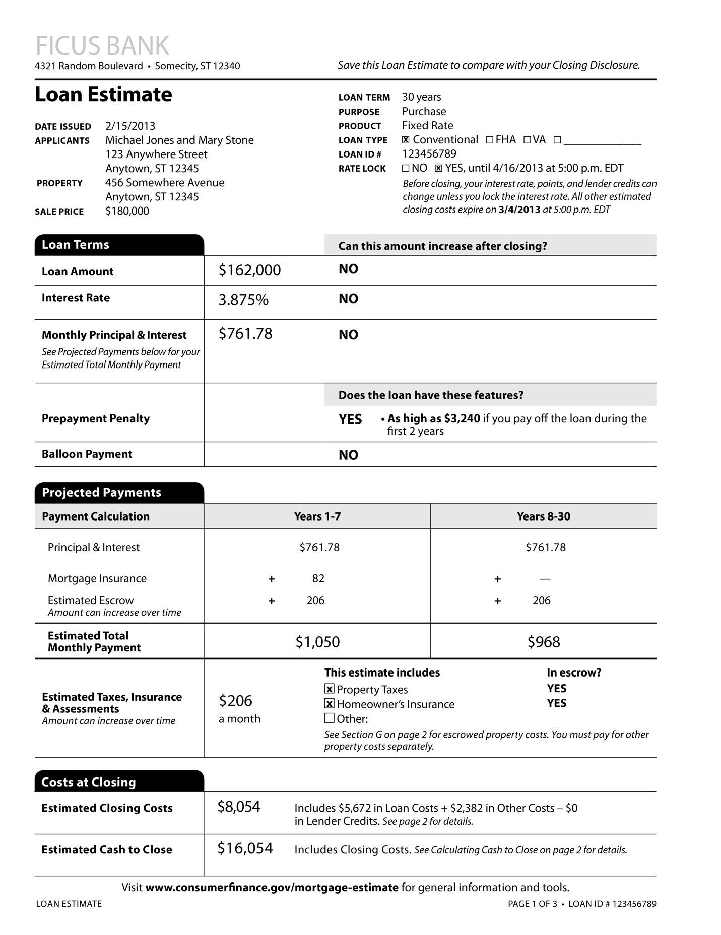
Pg. 218

Slide 47
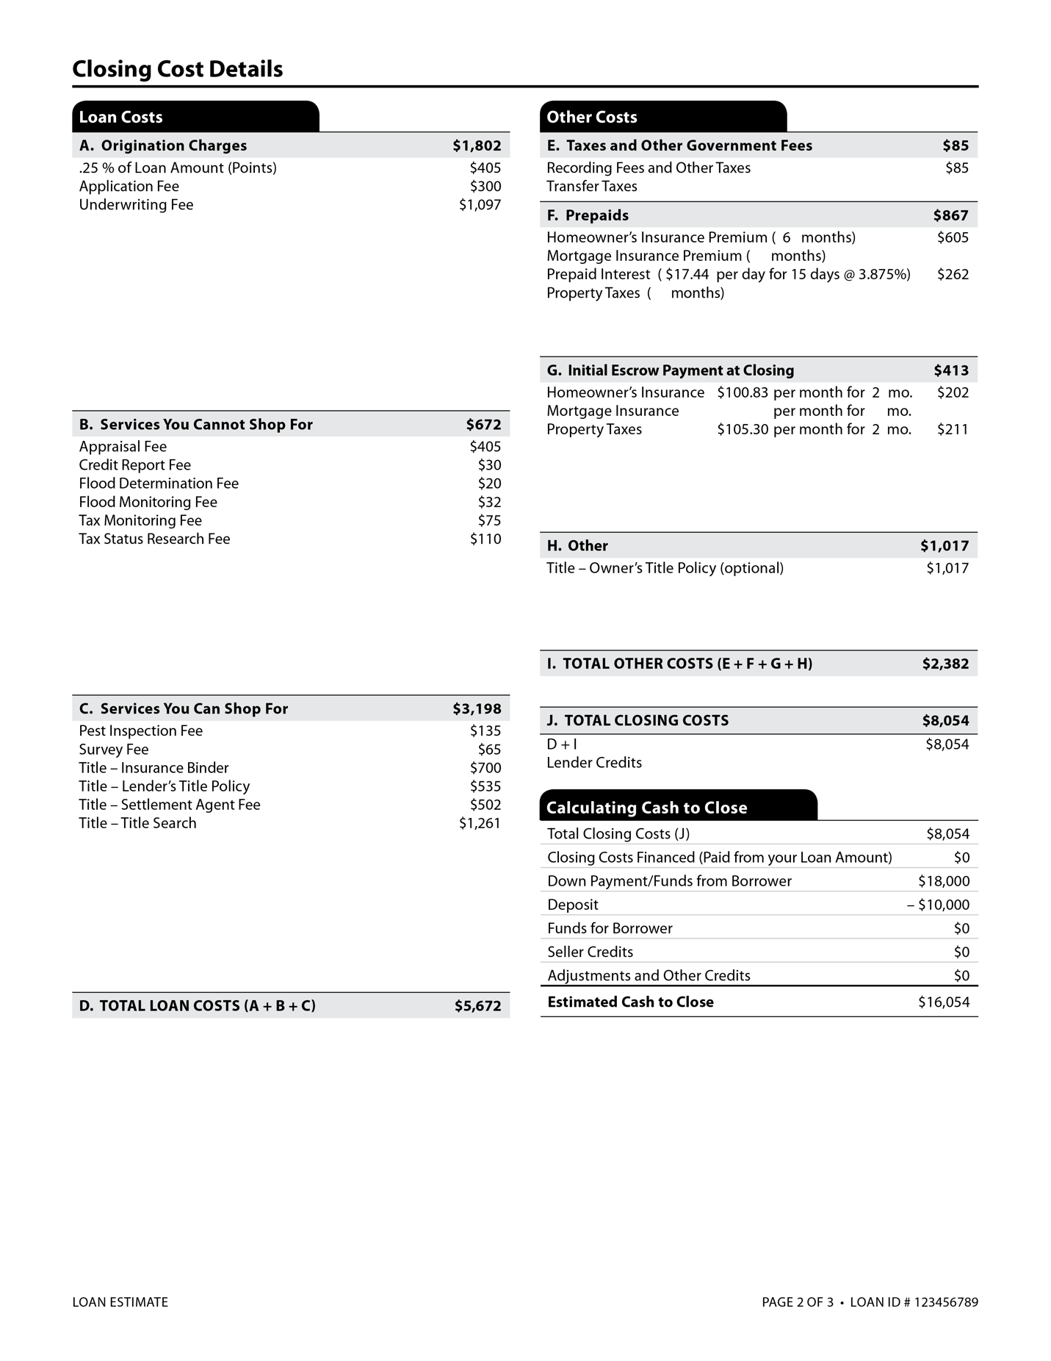
Pg. 219

Slide 48
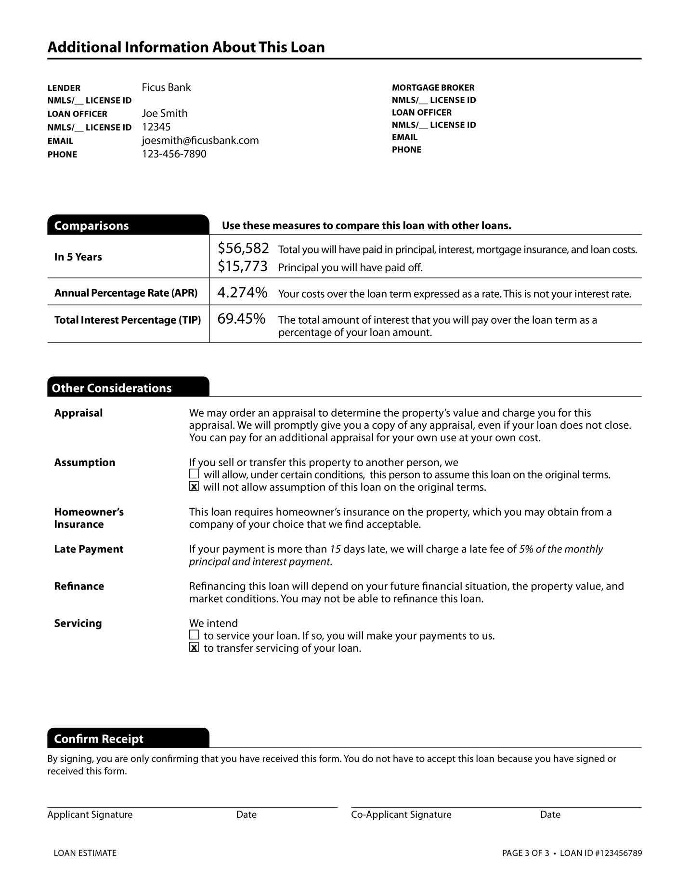
Pg. 220

Slide 49
Financing – Foreclosure and Short Sales
Judicial Foreclosure
Used with properties with a Mortgage or a Deed of Trust with a private trustee.
Lender sues the borrower in a court and obtains a judgment and a court order to sell the property.
Property is sold at public sale to the highest bidder.
Acceleration Clause allows the lender to call the note due before the scheduled end of the term due to default.
Pg. 221

Slide 50
Financing – Foreclosure and Short Sales
Non-Judicial Foreclosure
Used with properties that utilize a Deed of Trust with a public trustee.
Third party trustee is called to foreclose and sell the property for the lender.
Notice of default must be recorded and a public sale advertised in the newspaper.
Property is sold at a public sale to the highest bidder.
Strict Foreclosure – The court awards title to the lender.
Pg. 222

Slide 51
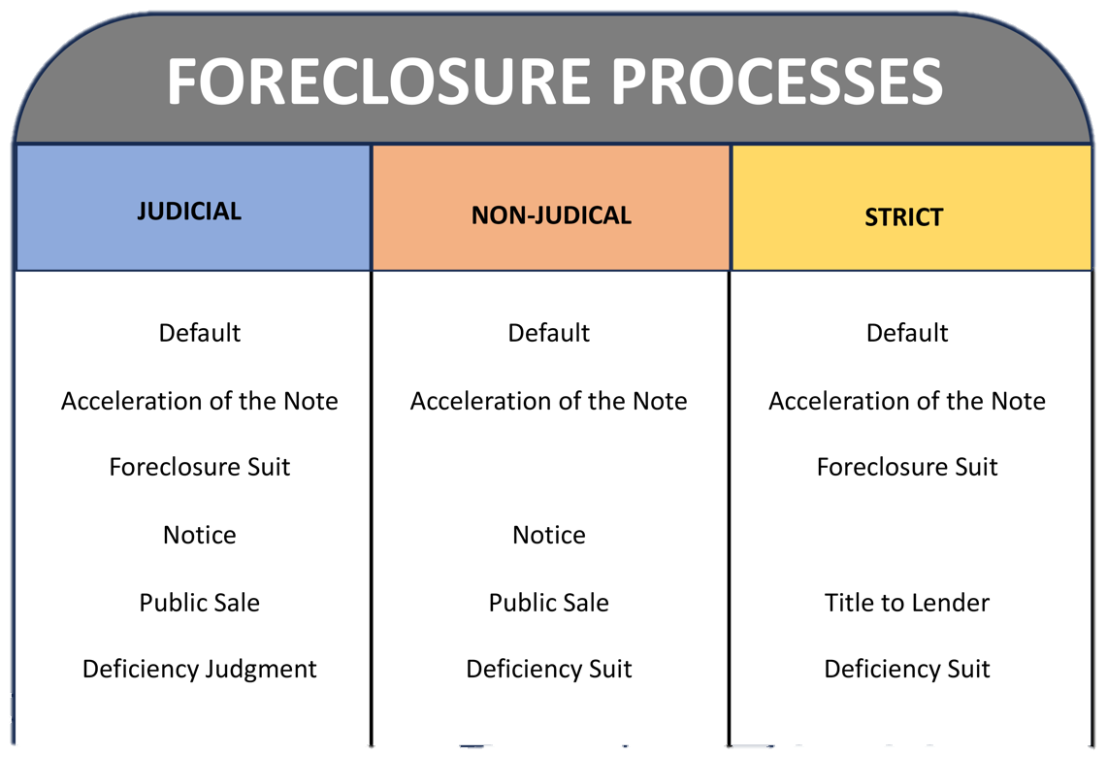
Financing – Foreclosure and Short Sales
Pg. 222

Slide 52
Financing – Foreclosure and Short Sales
Equitable Redemption – process prior to the public sale where the borrower can pay the back payments plus fees and penalties to reinstate the mortgage.
Statutory Redemption – process that allows the borrower an opportunity to pay off the entire loan balance plus fees and penalties and then keep the property.
Pg. 222

Slide 53
Financing – Foreclosure and Short Sales
Deed in Lieu of Foreclosure – borrower gives the lender a deed to the property of instead of foreclosing on it.
Deficiency Judgement – if a property is sold and the proceeds are insufficient to pay the loan and foreclosure costs, the lender can sue the borrower for the difference.
Pg. 222

Slide 54
Financing – Foreclosure and Short Sales
Short Sale – When a borrower needs to sell the property and owes more on the property than it’s worth.
- Contract is contingent on lender’s approval.
- Lienholder is not relieved of their entire monetary
obligation unless forgiven by the lender.
- Lender could still sue for a deficiency judgment.
Pg. 223

Slide 55
Financing – The Money Supply
Primary Mortgage Market – financial institutions that make loans directly to consumers.
Savings and loans, commercial banks, mutual savings banks, life insurance companies, mortgage bankers, credit unions.
Mortgage Banker – loan officer who presents his or her bank’s loan products.
Mortgage Broker – helps borrowers understand and choose a loan produce from various offerings of numerous lenders/investors.
Pg. 223

Slide 56
Financing – The Money Supply
Primary Mortgage Market – financial institutions that make loans directly to consumers.
Primary lenders assume the initial risk of the mortgage loan.
Portfolio Loans – loans originated by lenders (Portfolio Lenders) for retaining the investments in their own portfolios.
Loan Servicing – holding loans and collecting payments.
Pg. 224

Slide 57
Financing – The Money Supply
Secondary Mortgage Market – Lenders investors and government agencies that buy loans originated by someone else.
FNMA, FHLMC, GNMA, Investment Firms, Life Insurance Companies, pension funds, etc.
Organizations by pools of mortgages from primary lenders and sell securities backed by these pooled mortgages to investors.
Secondary market only buys loans that meet established requirements for quality of collateral, quality of the borrower and specific requirements for documentation.
Pg. 224

Slide 58

Financing – The Money Supply
Secondary Mortgage Market – Lenders investors and government agencies that buy loans originated by someone else.
Pg. 224

Slide 59
Financing – The Money Supply
Federal National Mortgage Associations (FNMA / Fannie Mae)
Government sponsored.
Originally a privately owned corporation.
Buys Conventional, FHA and VA loans.
Gives banks mortgage-backed securities and guarantees payment of interest and principal on mortgage-backed securities.
Pg. 225

Slide 60
Financing – The Money Supply
Government National Mortgage Associations (GNMA / Ginnie Mae)
Division of Housing and Urban Development
Guarantees payment on FNMA high-risk, low-yield mortgages.
Absorbs the difference in yield between the mortgages and market rates.
Guarantees privately generated securities backed by pools of VA and FHA-guaranteed loans.
Pg. 225

Slide 61
Financing – The Money Supply
Federal Home Loan Mortgage Corp. (FHLMC / Freddie Mac)
Government sponsored enterprise that buys mortgages and pools them, selling bonds backed by the mortgages on the open market.
Guarantees performance on FHLMC mortgages.
Pg. 225

Slide 62
Financing – Financing Laws and Rules
Truth In Lending Act (TILA/Regulation Z)
Requires costs in credit transactions to be disclosed to borrowers.
Requires that all finance charges as well as the true APR (Annual Percentage Rate) be disclosed to the consumer before the transaction is completed.
A “cooling off” period is required when liens such as a refinance or home equity loan will be placed on a principal residence.
Recission right up to three business days.
Does not apply to residential purchase loans.
Pg. 225

Slide 63
Financing – Financing Laws and Rules
Truth In Lending Act (TILA/Regulation Z)
Pertains to advertising requirements.
Specific credit terms may not be advertised unless the ad includes full disclosure of:
- The down payment
- The full purchase price
- Repayment terms
- The Annual Percentage Rate (APR)
- Whether the rate can be increased after the consummation of the loan.
Penalties for non-compliance include imprisonment of up to a year and a fine of $5,000.
Pg. 226

Slide 64
Financing – Financing Laws and Rules
Real Estate Settlement Procedures Act (RESPA)
Created to ensure buyers understand settlement costs.
Applies to purchases of residential real estate (one-to-four family homes) financed by “federally related” first mortgage loans.
Prohibits lenders from paying kickbacks and unearned fees.
Requires that lenders provide a loan applicant with a loan information booklet and the Loan Estimate and Closing Disclosure forms.
Pg. 226

Slide 65
Financing – Financing Laws and Rules
Equal Credit Opportunity Act (ECOA)
Prohibits discrimination against credit applicants on the basis of race, color, religion, national origin, sex, marital status, AGE, or dependency on public assistance.
Pg. 227

Slide 66
Financing – Financing Laws and Rules
Mortgage Fraud
Acts such as identity theft, false documentation, occupancy fraud.
Predatory Lending
Any practice in which lenders try to coerce borrowers into agreeing to loans that are unaffordable and violate industry standards.
Pg. 227

Slide 67
The difference between the property’s current loan balance and its current value is known as equity.
1) True
2) False

Slide 68
The difference between the property’s current loan balance and its current value is known as equity.
1) True
2) False

Slide 69
A conventional mortgage loan is one that is
1) Backed by the Federal National Mortgage Association.
2) Insured under Section 203(b) of the Federal Housing Mortgage Administration loan program.
3) Guaranteed by the Government National Mortgage Association.
4) Not FHA-insured or VA-guaranteed.

Slide 70
A conventional mortgage loan is one that is
1) Backed by the Federal National Mortgage Association.
2) Insured under Section 203(b) of the Federal Housing Mortgage Administration loan program.
3) Guaranteed by the Government National Mortgage Association.
4) Not FHA-insured or VA-guaranteed.

Slide 71
A borrower obtains a 30-year, fully amortizing mortgage loan of $30,000 at 8%. What is the principal balance at the end of the loan term?
1) $1,000
2) $30,000
3) $220
4) Zero

Slide 72
A borrower obtains a 30-year, fully amortizing mortgage loan of $30,000 at 8%. What is the principal balance at the end of the loan term?
1) $1,000
2) $30,000
3) $220
4) Zero

Slide 73
A lender who charges a rate of interest in excess of legal limits is guilty of
1) redlining.
2) usury.
3) profit-taking.
4) Nothing; there are no legal limits to interest rates.

Slide 74
A lender who charges a rate of interest in excess of legal limits is guilty of
1) redlining.
2) usury.
3) profit-taking.
4) Nothing; there are no legal limits to interest rates.

Slide 75
If a lender agrees to make a loan at 95% loan to value, what is the amount of the loan if the sale price is $187,000 and the property appraises for $183,000.
1) $173,850
2) $177,650
3) $168,300
4) $164,700

Slide 76
If a lender agrees to make a loan at 95% loan to value, what is the amount of the loan if the sale price is $187,000 and the property appraises for $183,000.
1) $173,850 $183,000 x 0.95
2) $177,650
3) $168,300
4) $164,700

Slide 77
Which clause would give a lender the right to have all future installments become due upon default.
1) Escalation
2) Defeasance
3) Alienation
4) Acceleration

Slide 78
Which clause would give a lender the right to have all future installments become due upon default.
1) Escalation
2) Defeasance
3) Alienation
4) Acceleration

Slide 79
A promissory note is NOT
1) A negotiable instrument.
2) Evidence of debt.
3) A document in which the debtor agrees to repay the stated loan.
4) Evidence of title.

Slide 80
A promissory note is NOT
1) A negotiable instrument.
2) Evidence of debt.
3) A document in which the debtor agrees to repay the stated loan.
4) Evidence of title.

Slide 81
RESPA allows lenders to pay kickbacks to parties that helped the lender obtain a borrower’s business.
1) True
2) False

Slide 82
RESPA allows lenders to pay kickbacks to parties that helped the lender obtain a borrower’s business.
1) True
2) False

Slide 83
What is the kind of real estate loan in which the interest rate is tied to the movement of an objective economic indicator?
1) Buydown
2) Graduated mortgage payment
3) Adjustable-rate mortgage
4) Straight loan

Slide 84
What is the kind of real estate loan in which the interest rate is tied to the movement of an objective economic indicator?
1) Buydown
2) Graduated mortgage payment
3) Adjustable-rate mortgage
4) Straight loan

Slide 85
What helps lenders reduce the risk on a conventional mortgage loan with a high LTV?
1) Private mortgage insurance
2) Flood insurance
3) Sale and leaseback arrangement
4) Home equity

Slide 86
What helps lenders reduce the risk on a conventional mortgage loan with a high LTV?
1) Private mortgage insurance
2) Flood insurance
3) Sale and leaseback arrangement
4) Home equity

Slide 87
If the lender will accept the amount that the Martins will receive from the sale of their property even though it is not adequate to cover that actual balance due on their loan this is called a
1) Foreclosure presale.
2) Deed in lieu.
3) Short sale.
4) forbearance.

Slide 88
If the lender will accept the amount that the Martins will receive from the sale of their property even though it is not adequate to cover that actual balance due on their loan this is called a
1) Foreclosure presale.
2) Deed in lieu.
3) Short sale.
4) forbearance.

Slide 89
A defaulting borrower may avoid foreclosure by giving the mortgagee
1) A redemption notice.
2) A deed in lieu of foreclosure.
3) A promissory note.
4) A lis pendens.

Slide 90
A defaulting borrower may avoid foreclosure by giving the mortgagee
1) A redemption notice.
2) A deed in lieu of foreclosure.
3) A promissory note.
4) A lis pendens.

