Slide 1


Slide 2

Colorado Closings and Settlement
Chapter 31
Settlement with a New Loan

Slide 3

Settlement with a New Loan
  When a new loan is secured, the lending institution may make some of the payouts in order to protect itself.
  The Lender provides a New Loan Statement showing the amount of the loan and the payouts it has or will make.
pg. 665

Slide 4
Settlement with a New Loan
  When preparing the Settlement Worksheet for a new loan closing the double entry system is still utilized except for those items charges against the lender’s New Loan Statement.
pg. 665

Slide 5

pg. 665

Slide 6
Settlement with a New Loan
  When the Buyer gets a new loan, the lender will withhold funds from the new loan gross amount to pay some of the fees they want to handle on behalf of the responsible party (Buyer/Seller).
pg. 665

Slide 7
Settlement with a New Loan
  Anything on the New Loan Statement will be handled by the LENDER, NOT the Broker.
  These items will appear as a single entry, not double entries or off-setting entries.
  Items will only show as a debit or as a credit for a Buyer or Seller as needed.
pg. 665

Slide 8
Settlement with a New Loan
  Just what are Net Proceeds?
- To arrive at a Net Proceeds figure the lender
deducts all of the payouts from the amount of the
loan. The balance is called the Net Proceeds.
- Figuratively, the lender gives a check for this
amount to the Buyer who then authorizes the
broker (closing entity) to complete the rest of the
closing.
additional

Slide 9
Settlement with a New Loan
  Just what are Net Proceeds? (cont.)
- On the Settlement Worksheet, the Net Proceeds
figure is entered as a debit (money deposited into
the trust account) to the broker as a single entry
item.
additional

Slide 10
Settlement with a New Loan
  Because the closing is utilizing the Lender’s New Loan Statement, the Broker must use the Lender’s exact figures.
  If an error is found on the settlement sheets prior to the closing, the closing entity should correct or adjust the error.
pg. 666

Slide 11
Settlement with a New Loan
  If a minor error is found at closing, the parties (Buyer/Seller) may agree to adjust the error with a check or a small amount of cash. Adjustments may delay the closing as it may require time to adjust the settlement statements so they reflect accurately.
  If the minor error involves the Lender, the Lender can adjust the error with the party (Buyer an/or Seller) after closing.
pg. 666

Slide 12
Settlement with a New Loan
  A MAJOR ERROR MAY REQUIRE THE CLOSING TO BE DELAYED.
  THERE IS NO SUCH THING AS AN INSIGNIFICANT ERROR.
pg. 666

Slide 13
Settlement with a New Loan - Recommended
  Complete the New Loan Closing utilizing the following steps:
- Step 1 – Enter all single entry items from the New
Loan Statement first.
- Step 2 – Enter all of the double entry items
resulting in equal dollar values of debits and
credits on each applicable line.
pg. 666

Slide 14
Settlement with a New Loan - Recommended
  Complete the New Loan Closing utilizing the following steps (cont.):
- Step 3 – Add the Net Proceeds to the Broker
Debit Column. The Net Proceeds amount will be
provided by the Lender on the New Loan
Statement.
pg. 666

Slide 15
Settlement with a New Loan - Recommended
  Complete the New Loan Closing utilizing the following steps (cont.):
- Step 4 – Add up each column of debits and credits
to find the subtotals.
- Step 5 – Calculate amount to/from Seller and
Buyer.
pg. 666

Slide 16
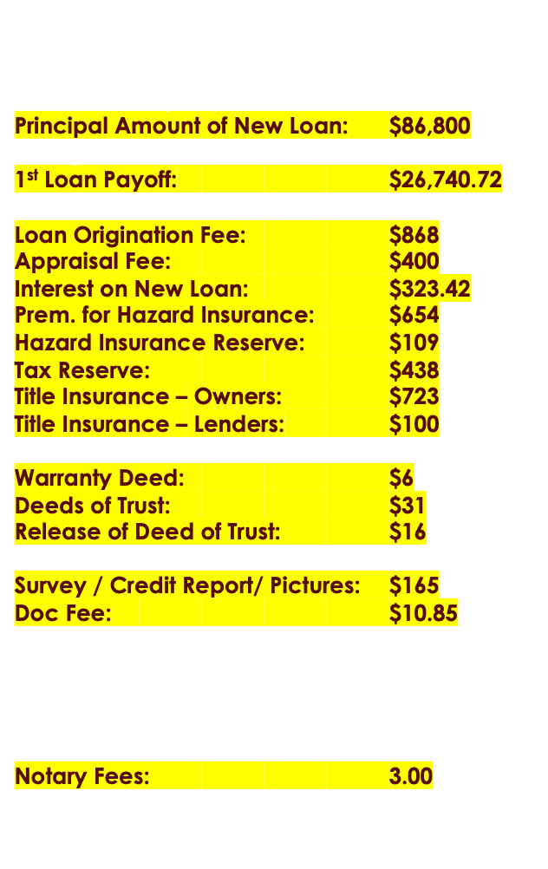
Items highlighted in Yellow are Items found on the
New Loan Statement
We will enter these first.

Slide 17
New Loan
$86,800

Slide 18
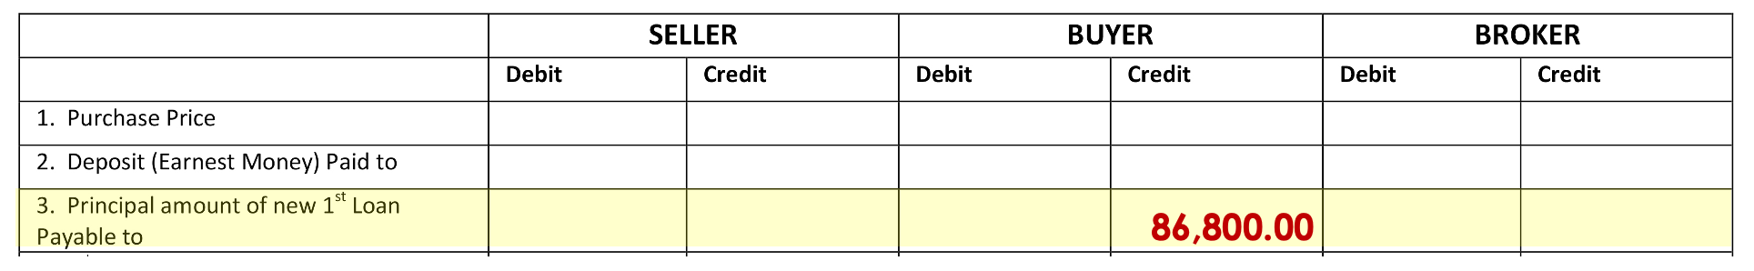
Line 3
Credit Buyer
$86,800.00

Slide 19
1st Loan Payoff
$26,740.72

Slide 20
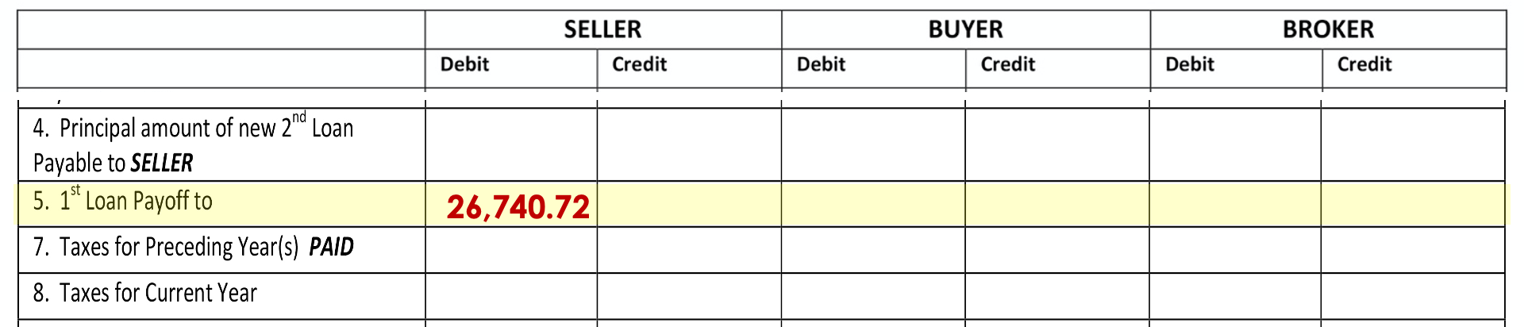
Line 5
Debit Seller
$26,740.72

Slide 21
Loan Origination Fee
$868

Slide 22
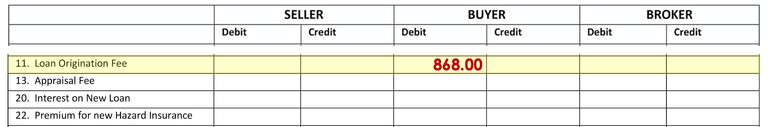
Line 11
Debit Buyer
$868.00

Slide 23
Appraisal Fee
$400

Slide 24
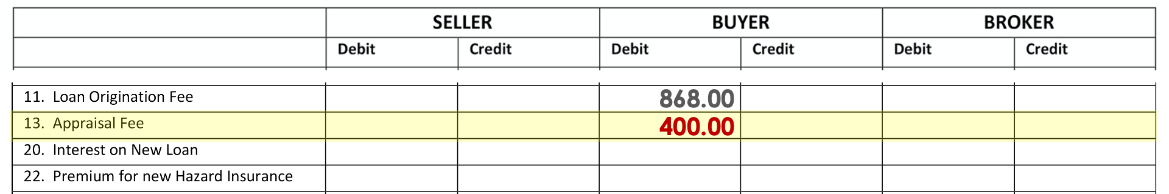
Line 13
Debit Buyer
$400.00

Slide 25
Interest on New Loan
$323.42

Slide 26
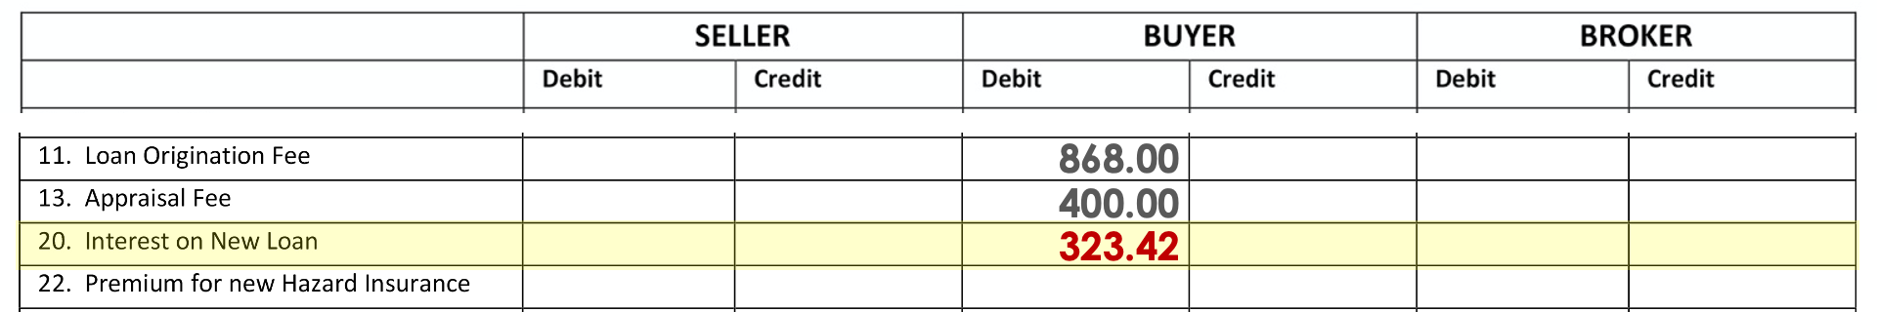
Line 20
Debit Buyer
$323.42

Slide 27
Hazard Insurance Premium
$654

Slide 28
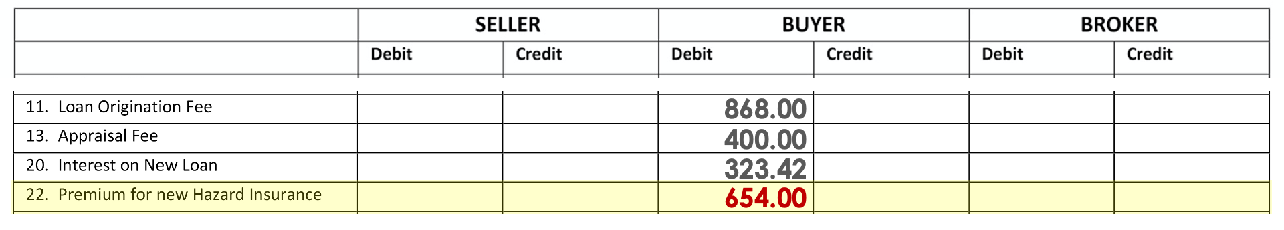
Line 22
Debit Buyer
$654.00

Slide 29
Hazard Insurance Reserve
$109

Slide 30
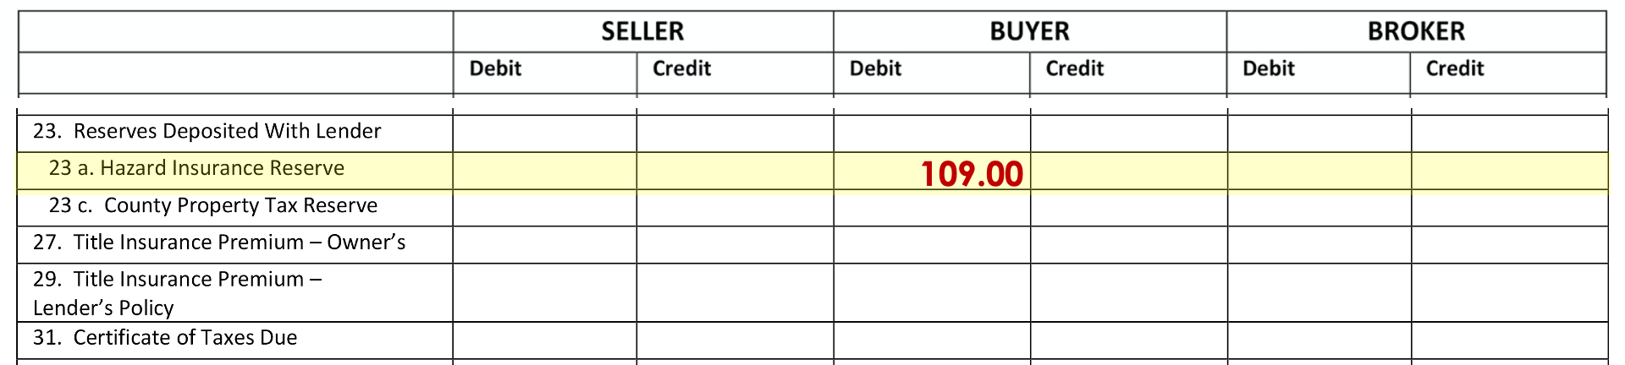
Line 23a
Debit Buyer
$109.00

Slide 31
Tax Reserve
$438

Slide 32
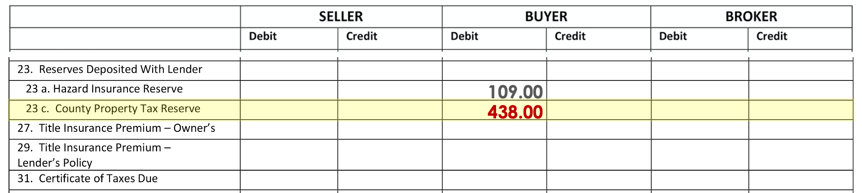
Line 23c
Debit Buyer
$438.00

Slide 33
Title Insurance Owners
$723

Slide 34
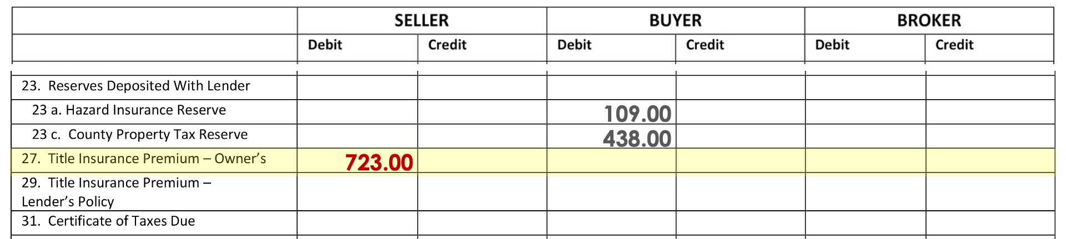
Line 27
Debit Seller
$723.00

Slide 35
Title Insurance Lenders
$100

Slide 36
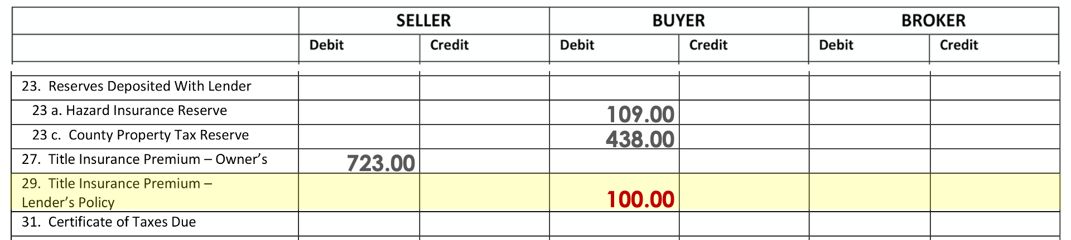
Line 29
Debit Buyer
$100.00

Slide 37
Warranty Deed
$6

Slide 38
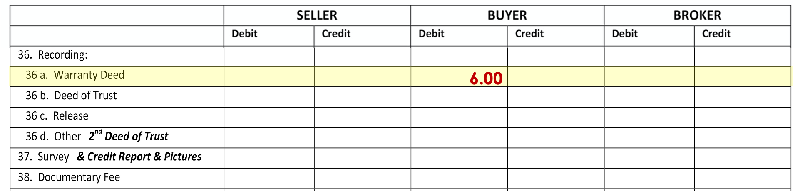
Line 36a
Debit Buyer
$6.00

Slide 39
Deeds of Trust
$31

Slide 40
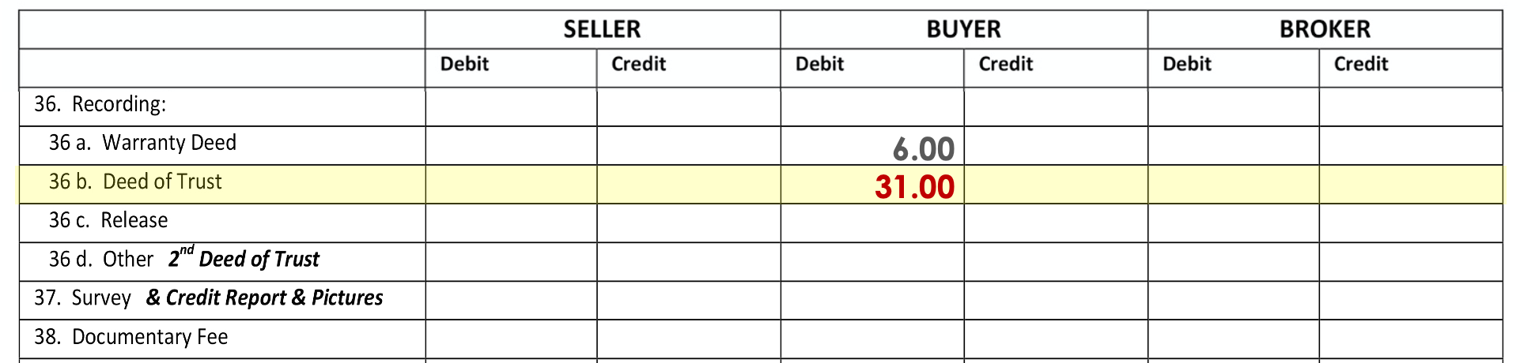
Line 36b
Debit Buyer
$31.00

Slide 41
Release of Deeds of Trust
$16

Slide 42
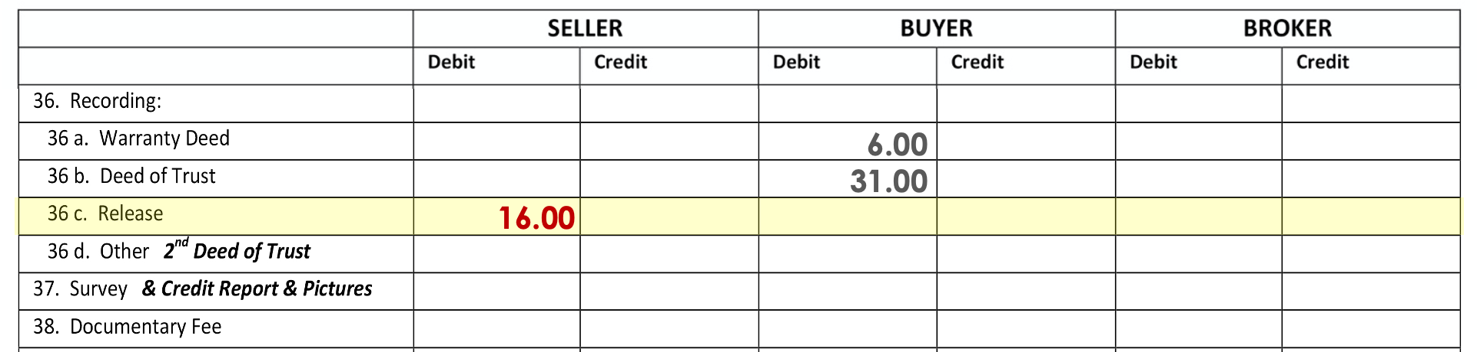
Line 36c
Debit Seller
$16.00

Slide 43
Survey/ Credit Report/ Pictures
$165

Slide 44
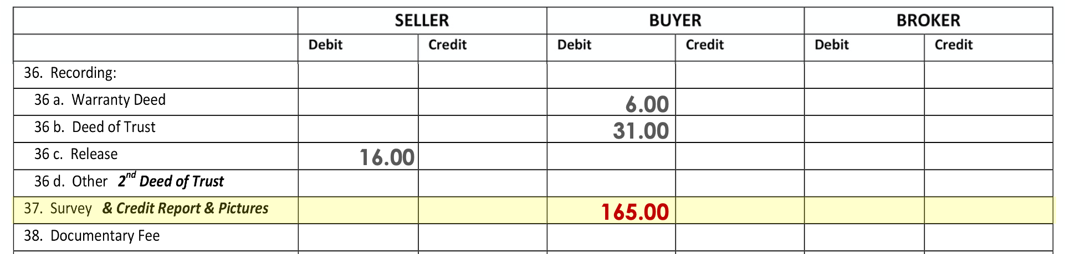
Line 37
Debit Buyer
$165.00

Slide 45
Doc Fee
$10.85

Slide 46
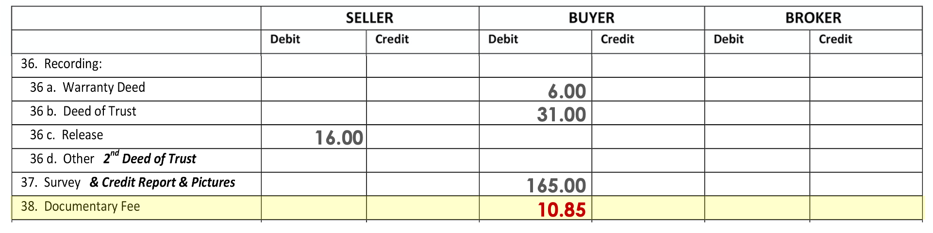
Line 38
Debit Buyer
$10.85

Slide 47
Notary Fees
$3.00

Slide 48
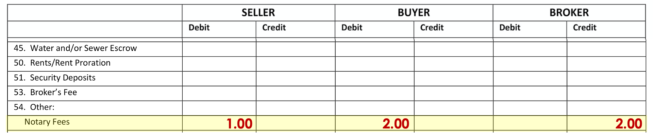
Line 54
Debit Seller/ Debit Buyer/ Credit Broker
$1.00 / $2.00 / $2.00

Slide 49
Notary Fee Explanation
  The Lender’s Loan Closing Statement only references one Notary fee, but our instructions indicate that there will be three fees:
    Warranty Deed (paid by Seller),
    Seller’s Trust Deed (paid by the Buyer) and
    the 1st Trust Deed (Referenced on the Lender’s Loan Closing Statement – and paid by the Buyer).

Slide 50
For Seller
Debit $1.00 and Credit Broker $1.00
For Buyer
Debit $1.00 and Credit Broker $1.00
plus
Debit $1.00 (Single Entry item)
Broker only needs to write a check for $2.00 the other $1.00 is part of the New Loan

Slide 51
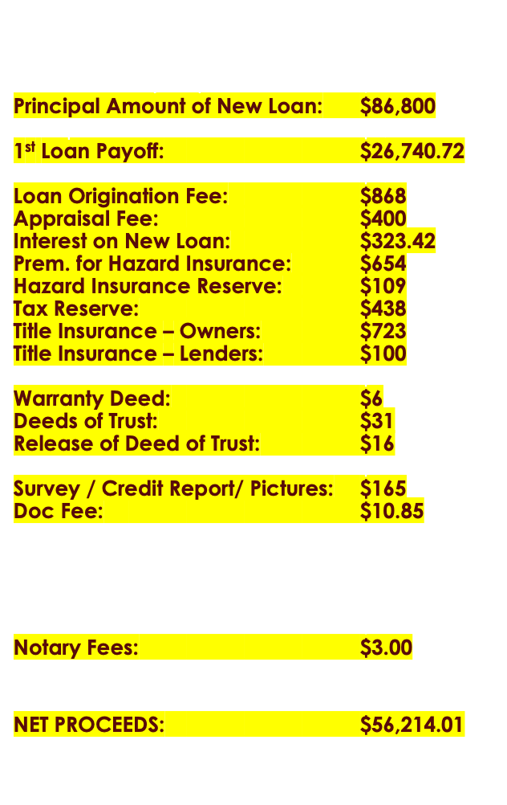
Net Proceeds
$56,214.01

Slide 52
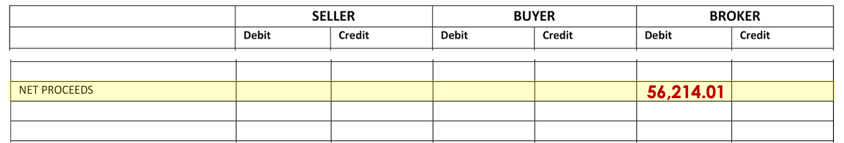
NET PROCEEDS
Debit Broker
$56,214.01

Slide 53
Now we will move on to all the double-entry items

Slide 54

Selling Price
$108,500

Slide 55
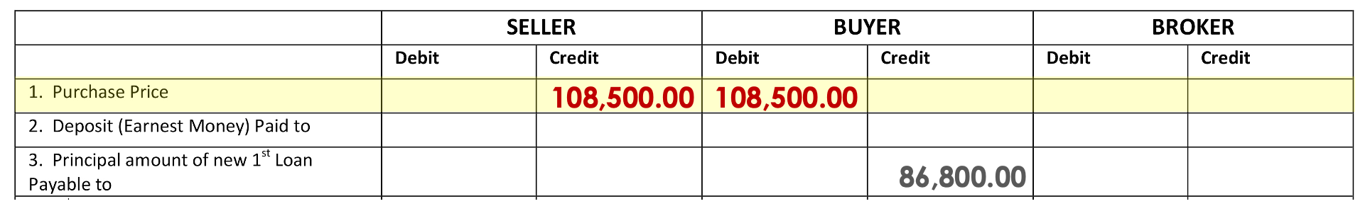
Line 1
Credit Seller/ Debit Buyer
$108,500.00

Slide 56
Earnest Money
$5,000

Slide 57
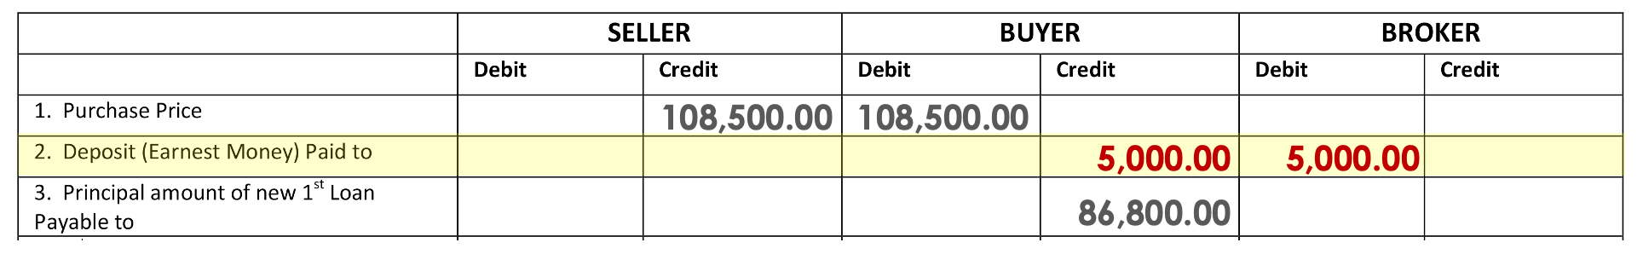
Line 2
Credit Buyer/ Debit Broker
$5,000.00

Slide 58
2nd Loan Amount
$1,500

Slide 59
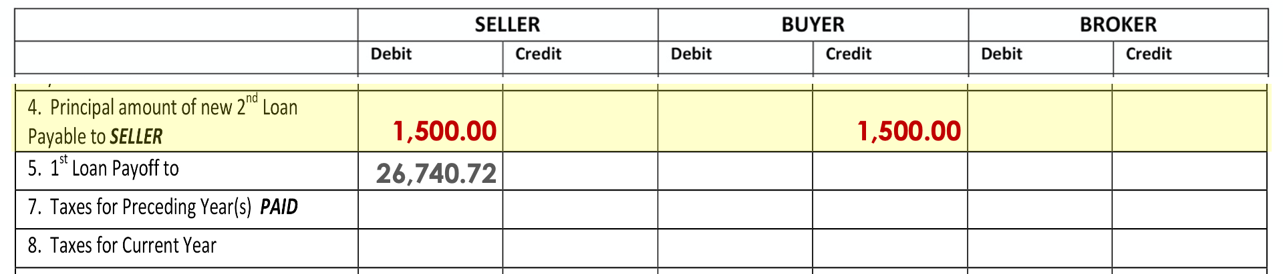
Line 4
Debit Seller/ Credit Buyer
$1,500.00

Slide 60
Last Year’s Taxes
$1,051.20
(PAID)

Slide 61
Taxes for Current Year
$ ???

Slide 62
What’s the Date of Closing?
July 15
Who are we going to Debit?
Seller
Jan. – 31
Feb – 28
Mar. – 31
April – 30
May – 31
June – 30
July – 14
195
How many days has
Seller owned:
195

Slide 63
What’s the Date of Closing?
July 15
Who are we going to Debit?
Seller
How many days has
Seller owned:
195
$1,051.20 ÷ 365 x 195 =
$561.60

Slide 64
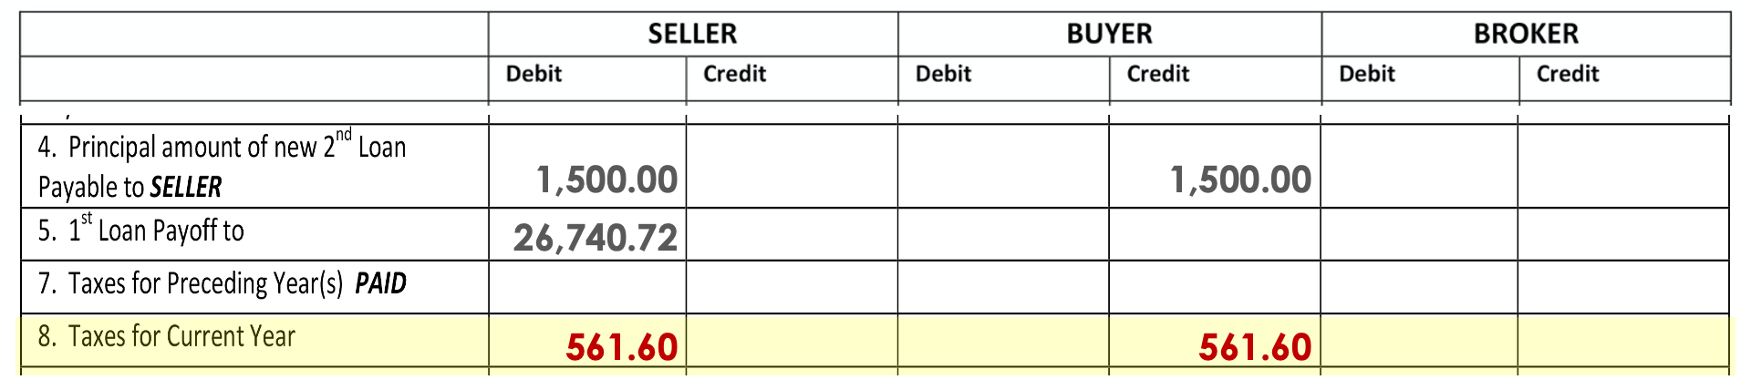
Line 8
Debit Seller/ Credit Buyer
$561.60

Slide 65
Certificate of Taxes Due
$15

Slide 66
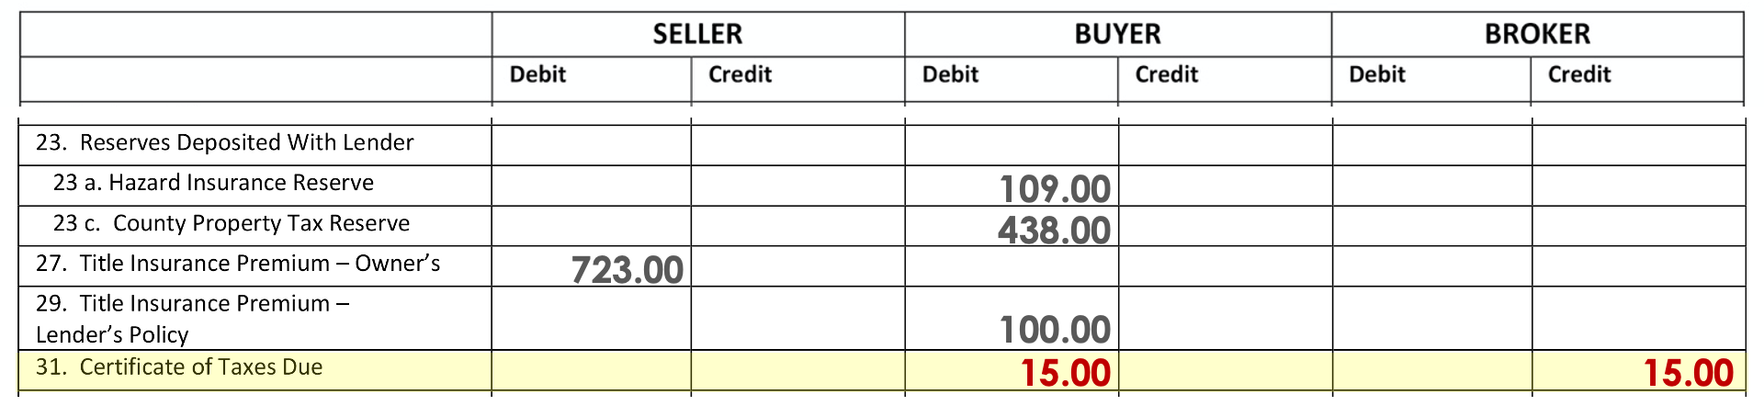
Line 31
Debit Buyer/ Credit Broker
$15.00

Slide 67
2nd Deed of Trust
$21

Slide 68
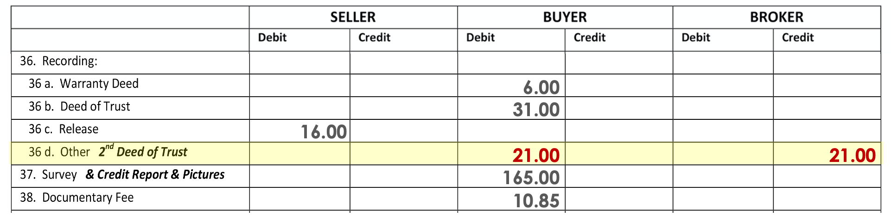
Line 36d
Debit Buyer/ Credit Broker
$21

Slide 69
Water/Sewer Bill
$ ???

Slide 70
Water and sewer is paid quarterly in advance June 1 through August 31 at $27.60.

Slide 71
What’s the Date of Closing?
July 15
Who are we going to Debit?
Buyer - Paid in advance
How many days in the period:
June – 30
July – 31
Aug – 31
92

Slide 72
What’s the Date of Closing?
July 15
Who are we going to Debit?
Buyer – Paid in Advance
How many days in the period:
92
How many days are we collecting for:
July – 17
Aug – 31
48

Slide 73
What’s the Date of Closing?
July 15
Who are we going to Debit?
Buyer – Paid in Advance
How many days in the period:
92
How many days are we collecting for:
48
$27.60 ÷ 92 x 48 =
$14.40

Slide 74
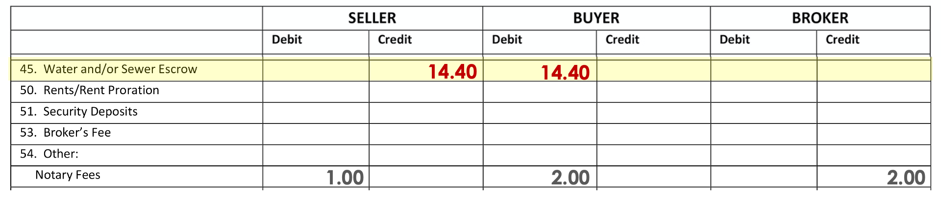
Line 45
Credit Seller/ Debit Buyer
$14.40

Slide 75
Prorated Rents
$ ???

Slide 76
Seller occupies one unit of this three-unit building. Rent for Unit Two is $550.00 per month and rent for unit three is $640.00 per month. Both are due and paid on the 1st of this month. Each tenant has given to Seller a $200 security deposit.

Slide 77
What’s the Date of Closing?
July 15
Who are we going to Credit?
Buyer
(Seller already received)
How many days in the period:
31

Slide 78
What’s the Date of Closing?
July 15
Who are we going to Credit?
Buyer
(Seller already received)
How many days in the period:
31
How many days are we collecting for:
17
Unit 2: $550 ÷ 31 x 17 = $301.61
Unit 3: $640 ÷ 31 x 17 = $350.97
$201.61 + $350.97 = $652.58

Slide 79
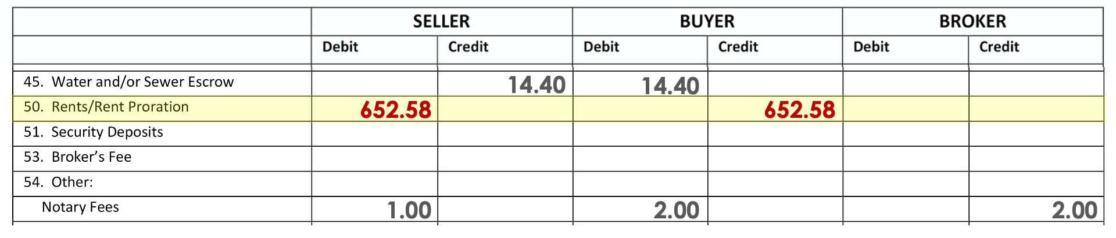
Line 50
Debit Seller/ Credit Buyer
$652.58

Slide 80
Security Deposits
$400
($200 / tenant)

Slide 81
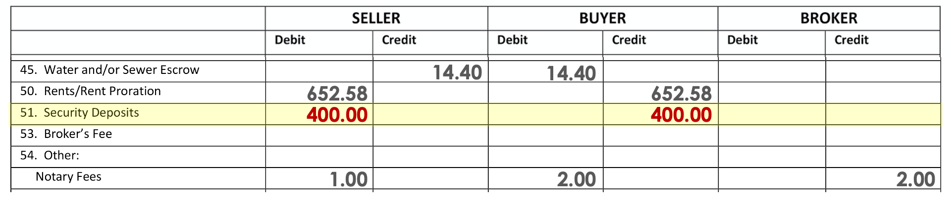
Line 51
Debit Seller/ Credit Buyer
$400.00

Slide 82
Broker's Fee
$5,425

Slide 83
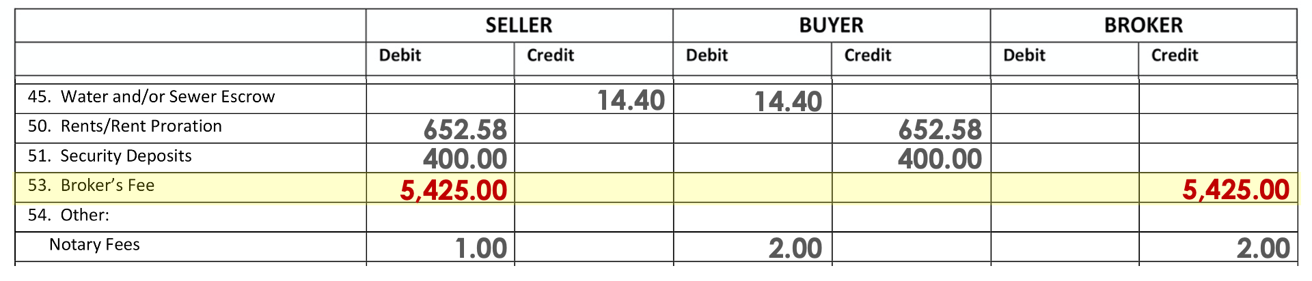
Line 53
Debit Seller/ Credit Broker
$5,425.00

Slide 84
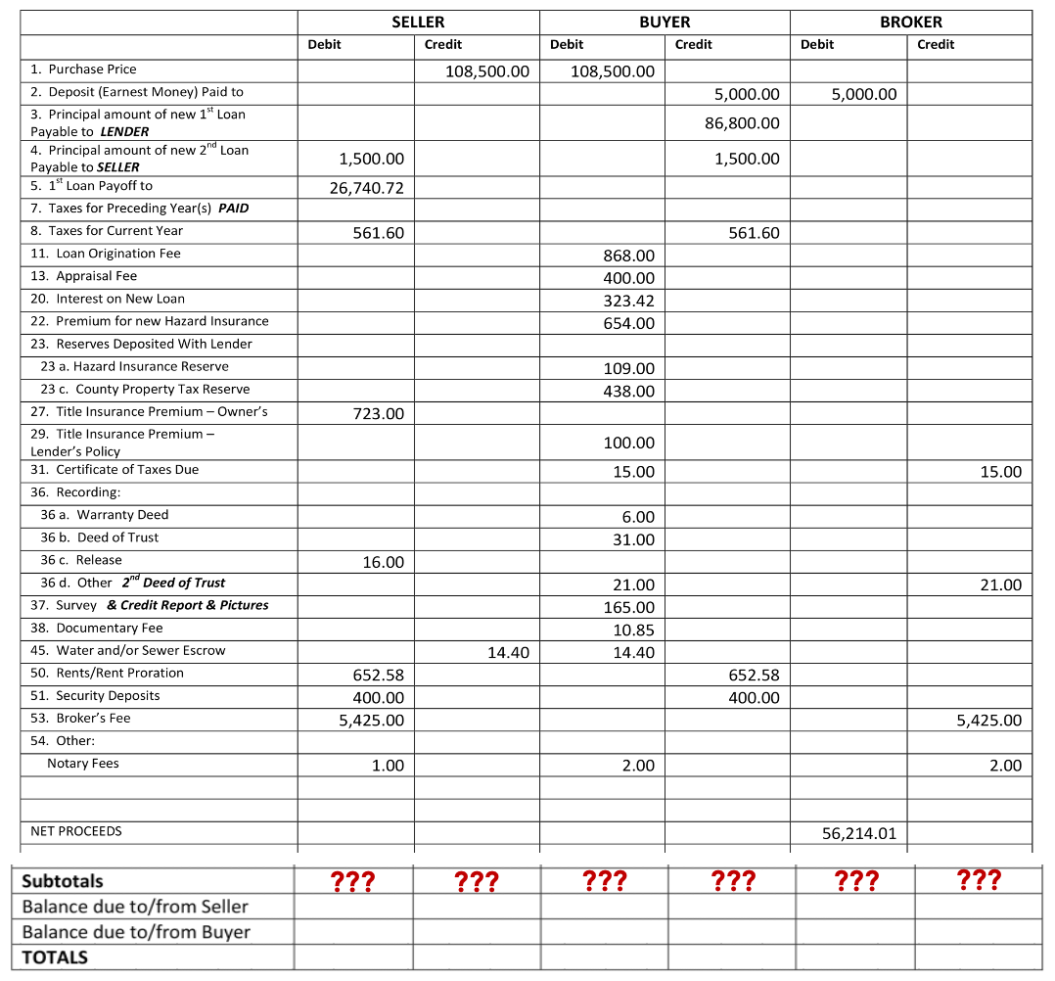

Slide 85
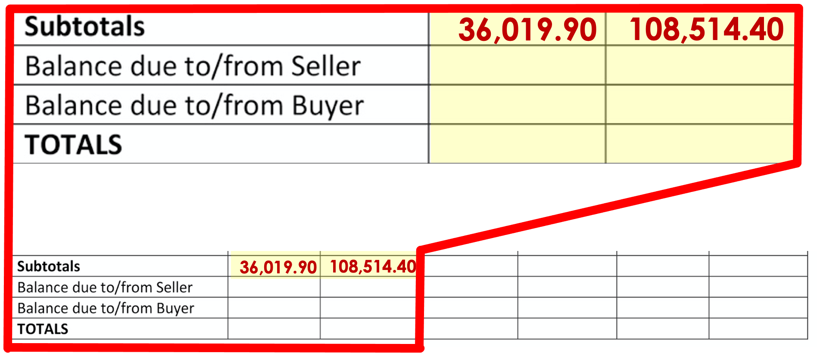

Slide 86
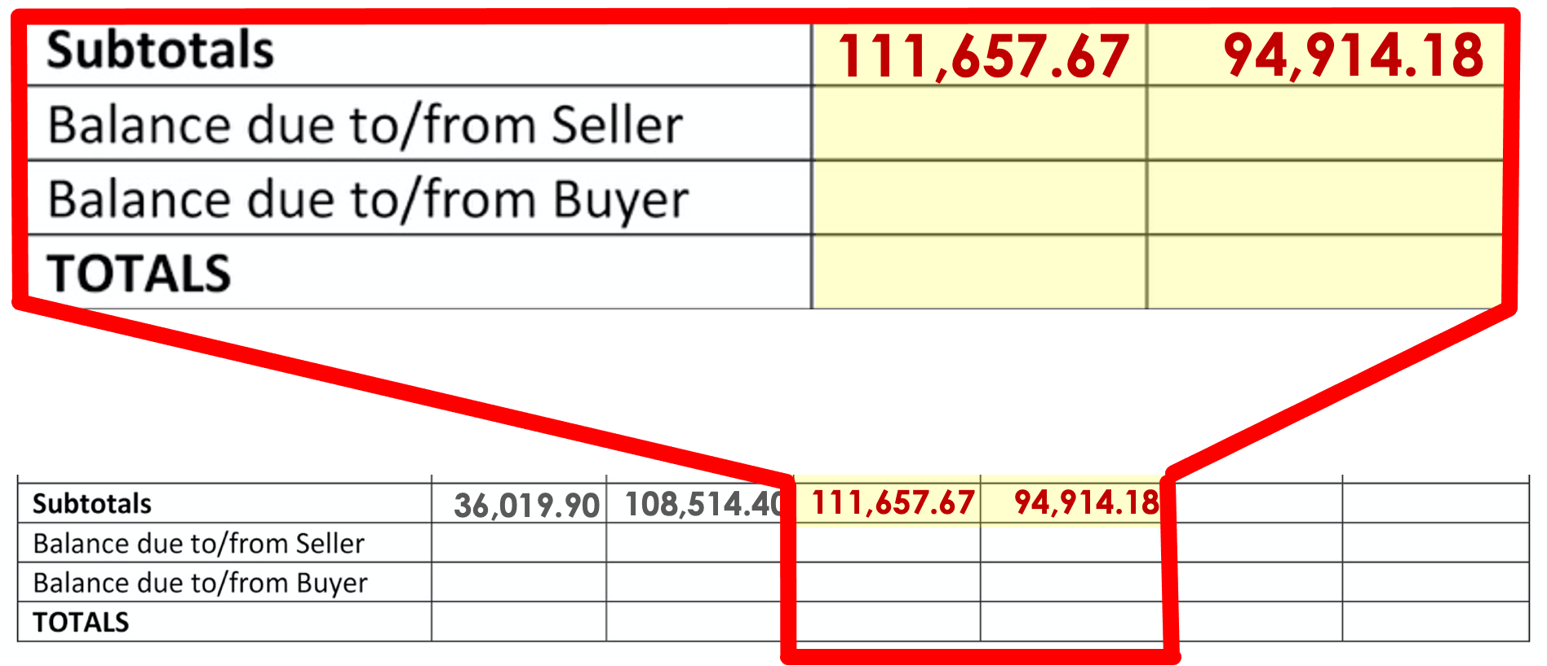

Slide 87
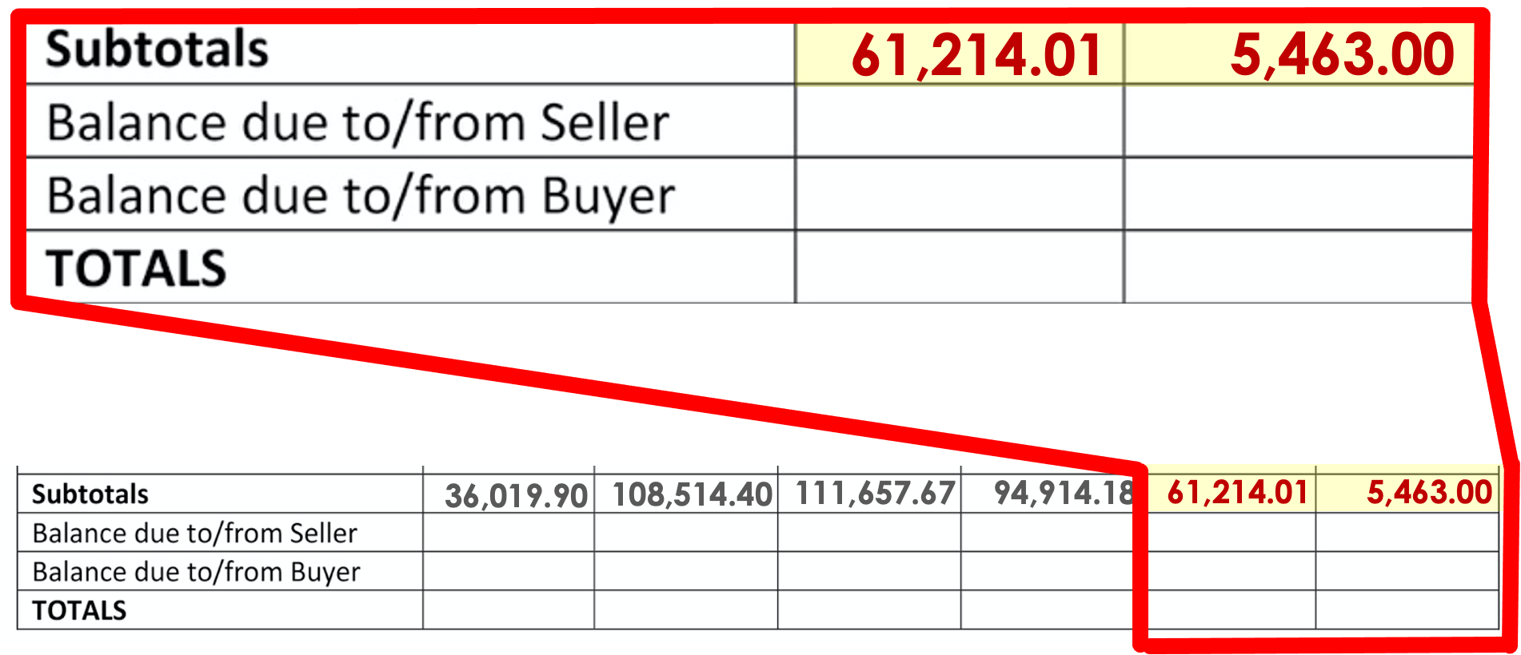

Slide 88
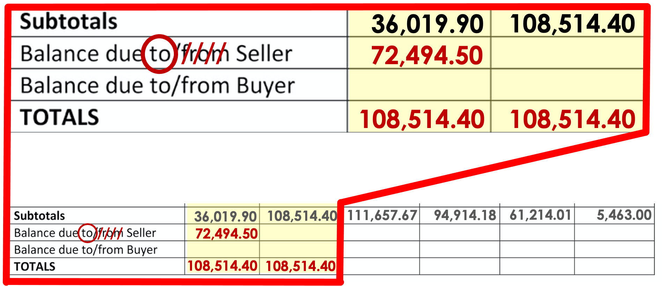

Slide 89
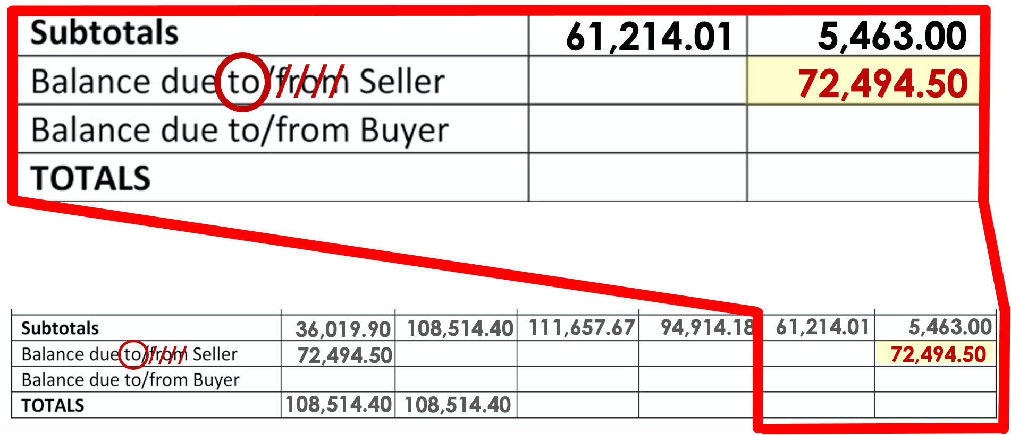

Slide 90
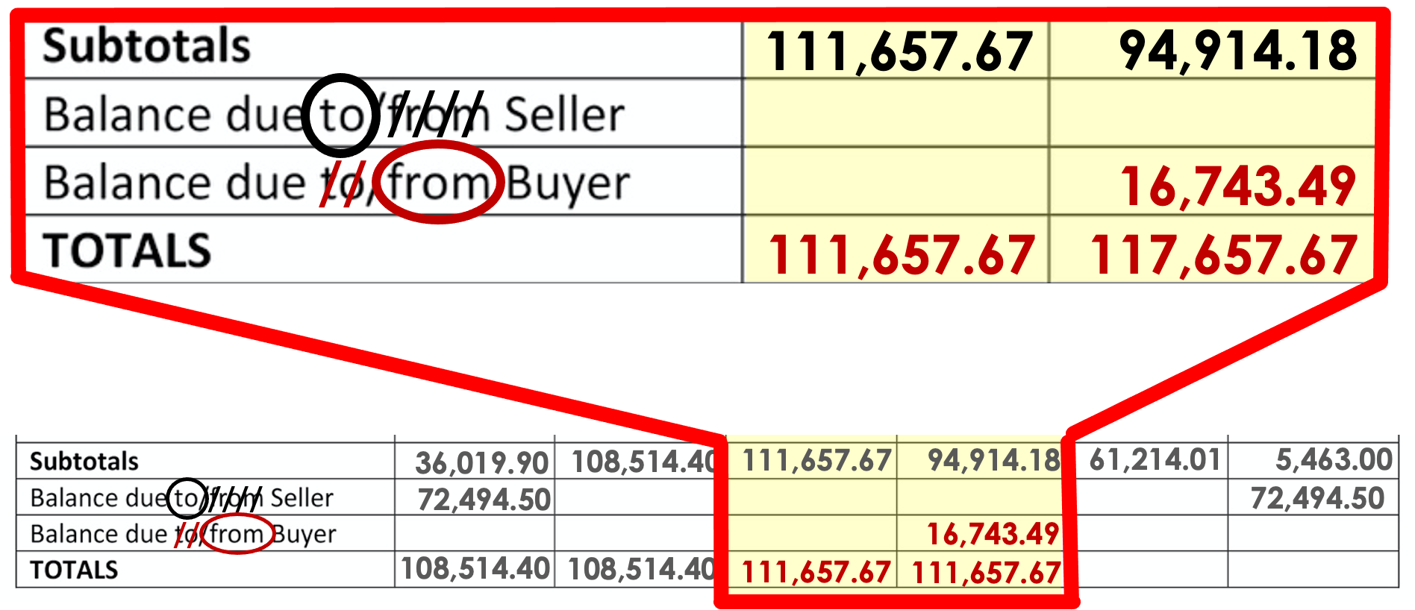

Slide 91
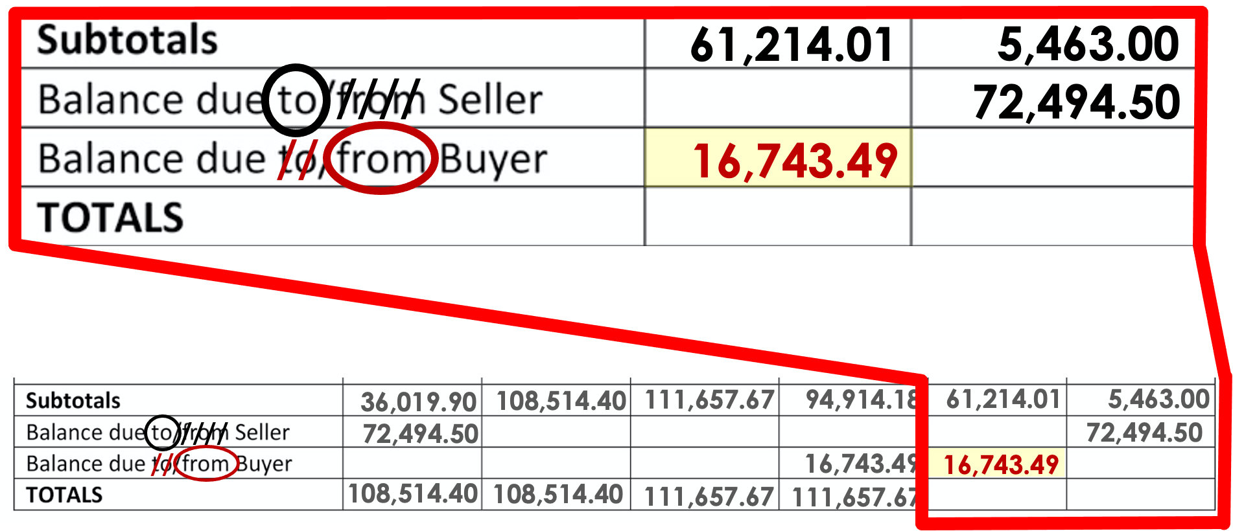

Slide 92
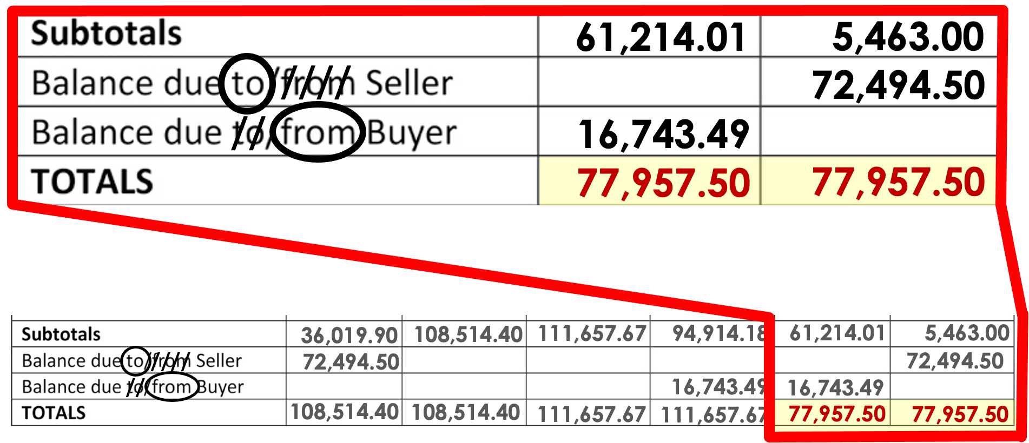

Slide 93
